Slide 1
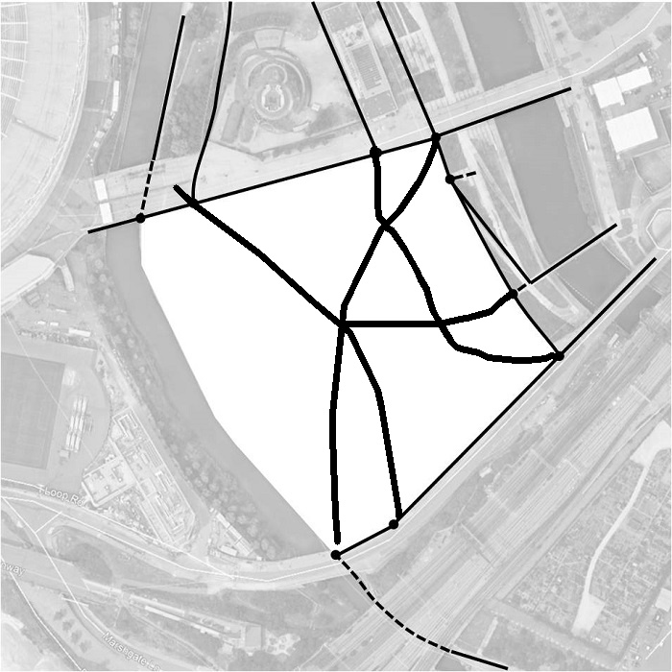
Start drawing simple pedestrian routes connecting different access points…

Slide 2
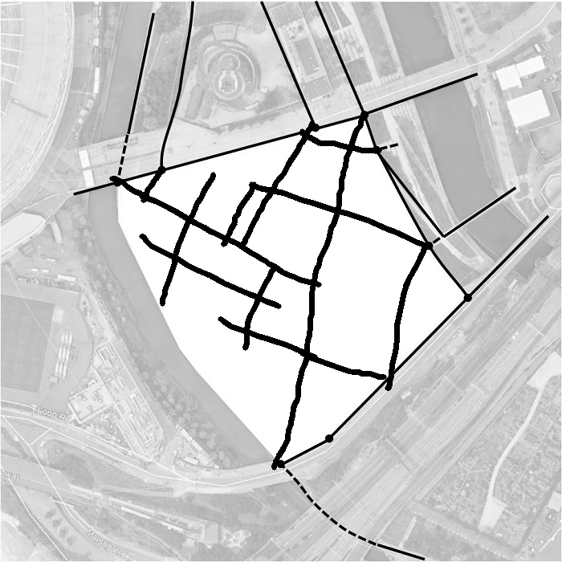
Start drawing simple pedestrian routes connecting different access points…

Slide 3
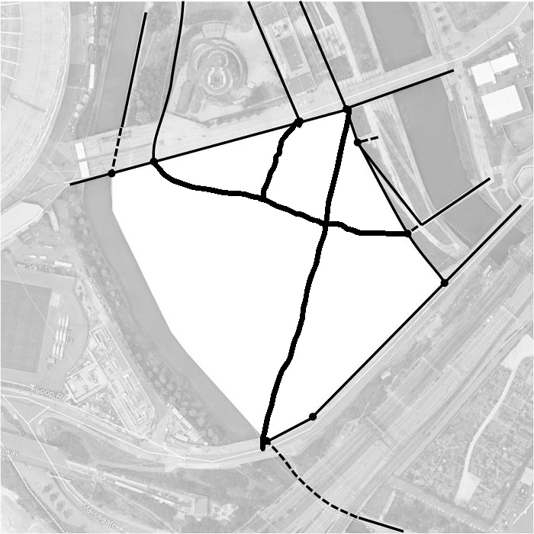
Start drawing simple pedestrian routes connecting different access points…

Slide 4
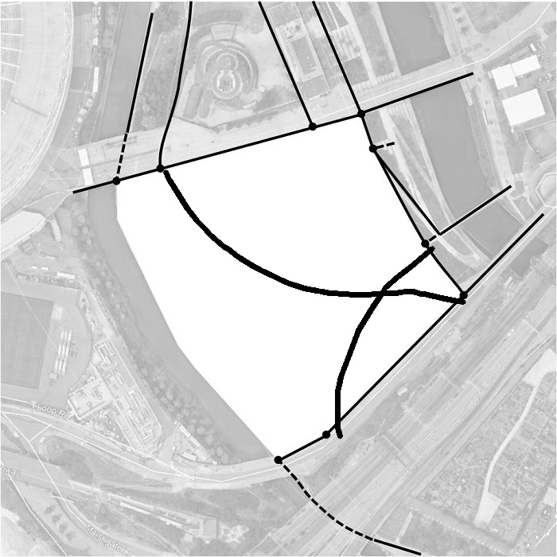
Start drawing simple pedestrian routes connecting different access points…

Slide 5
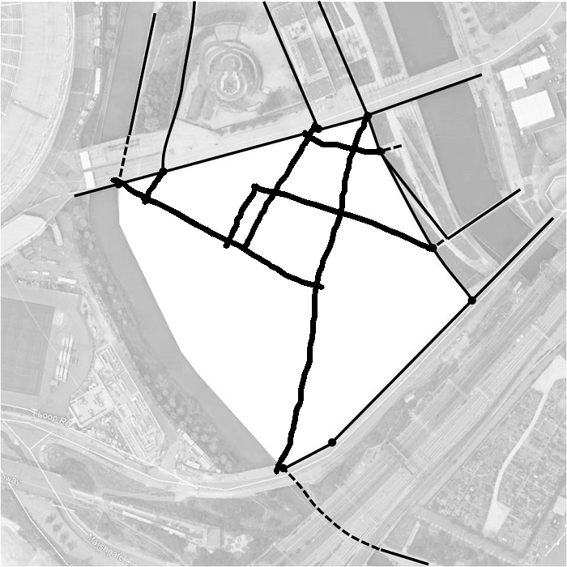
Start drawing simple pedestrian routes connecting different access points…

Slide 6
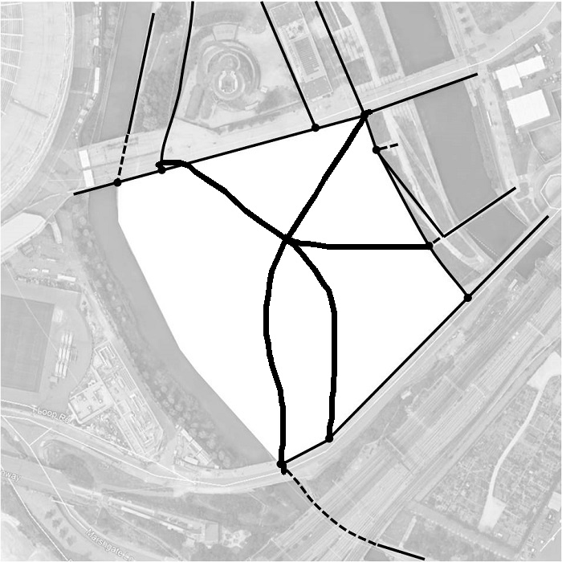
Start drawing simple pedestrian routes connecting different access points…

