Slide 1
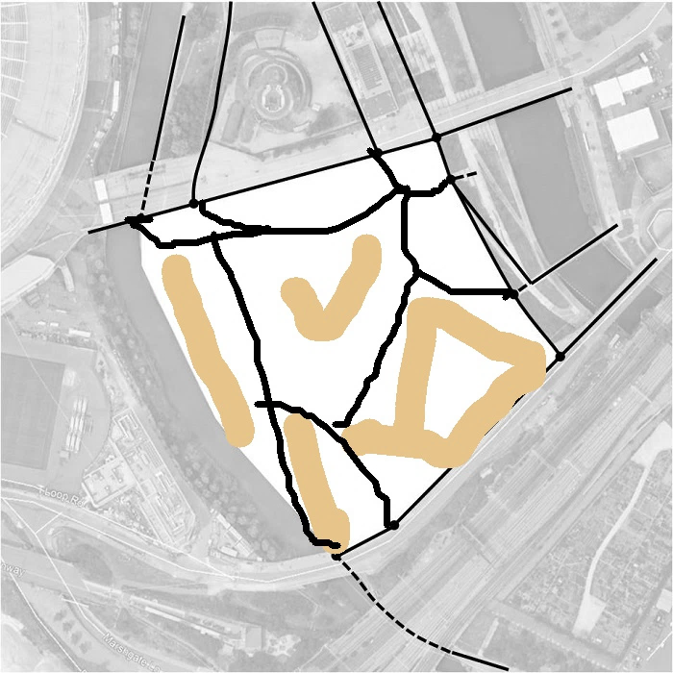
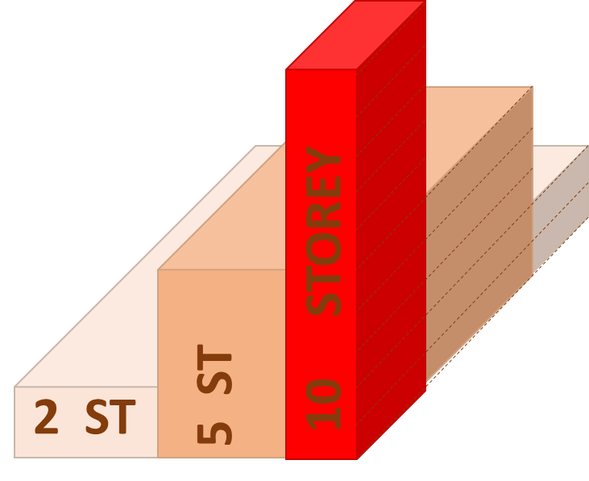
Then draw buildings with a thicker pen

Slide 2
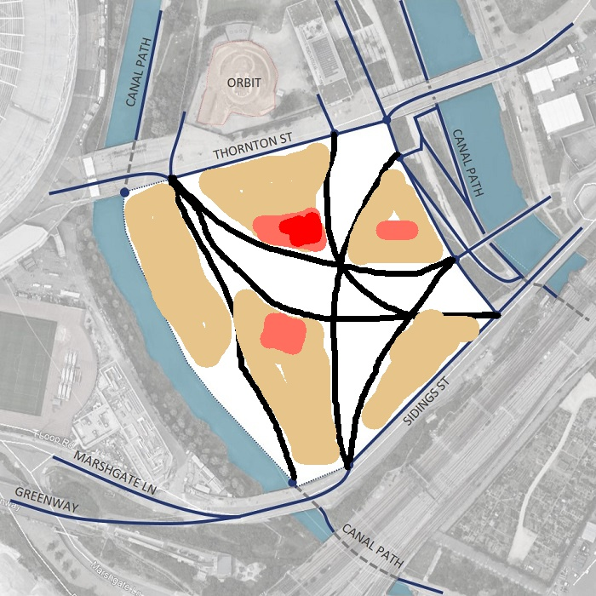
Then draw buildings with a thicker pen

Slide 3
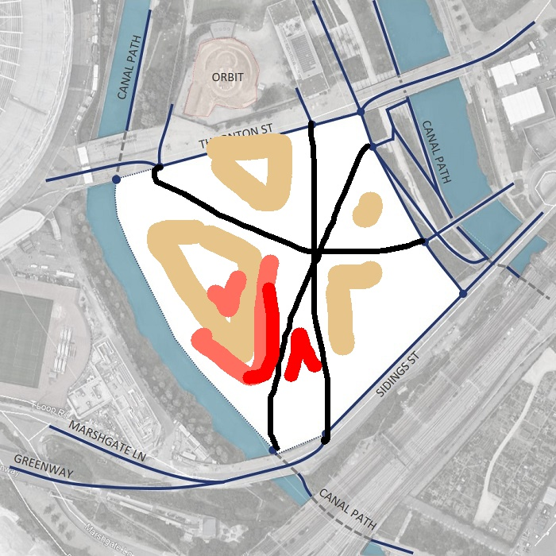
Then draw buildings with a thicker pen

Slide 4
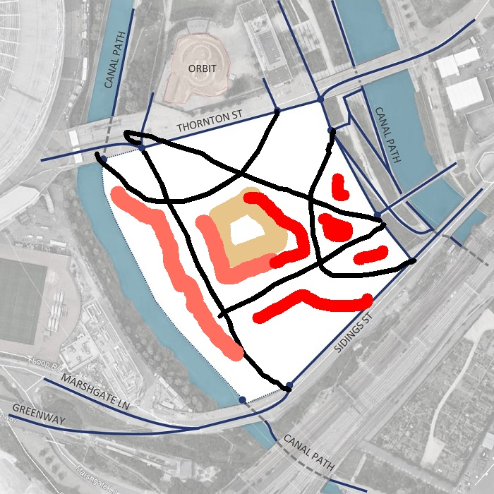
Then draw buildings with a thicker pen

Slide 5
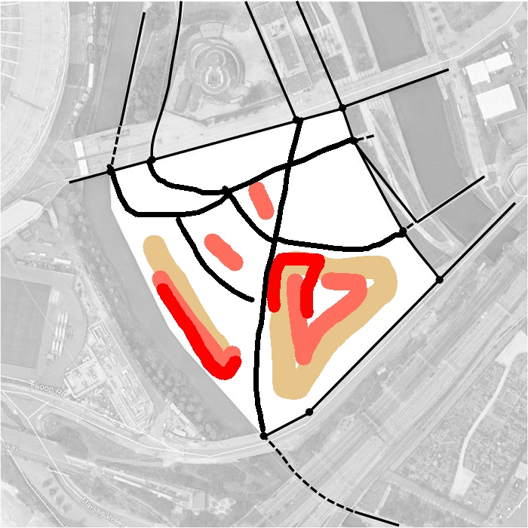
Then draw buildings with a thicker pen

Slide 6
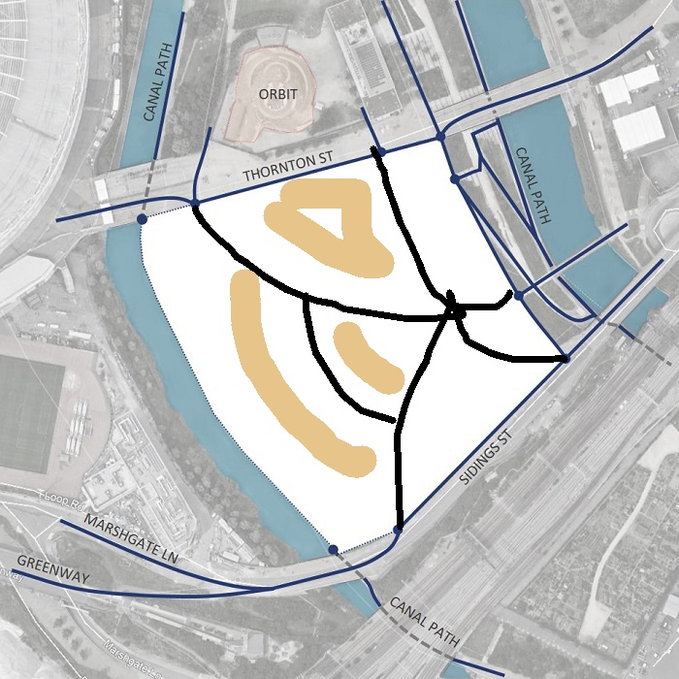
Then draw buildings with a thicker pen

