Slide 1
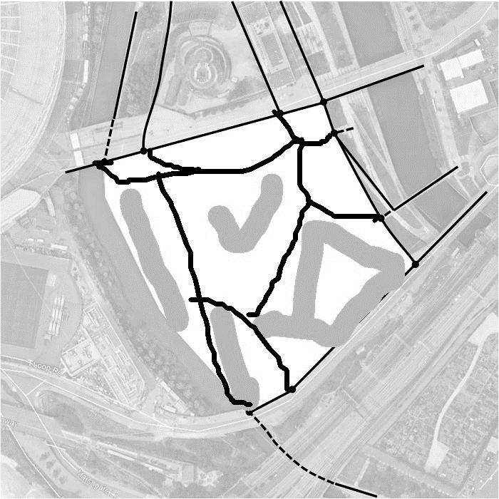








And finally other land uses pen

Slide 2
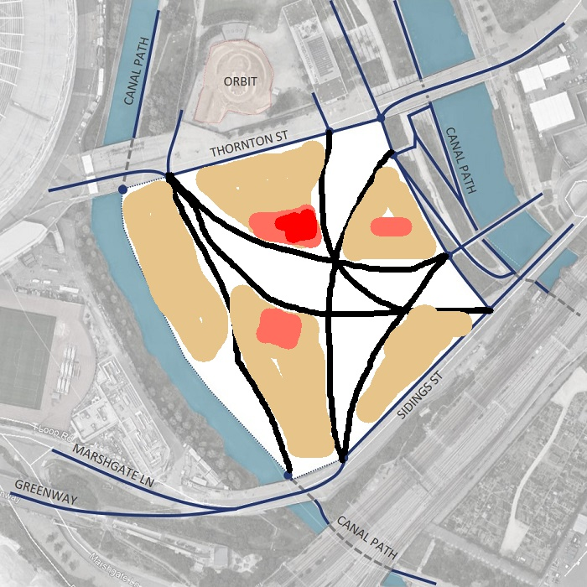
And finally other land uses pen

Slide 3
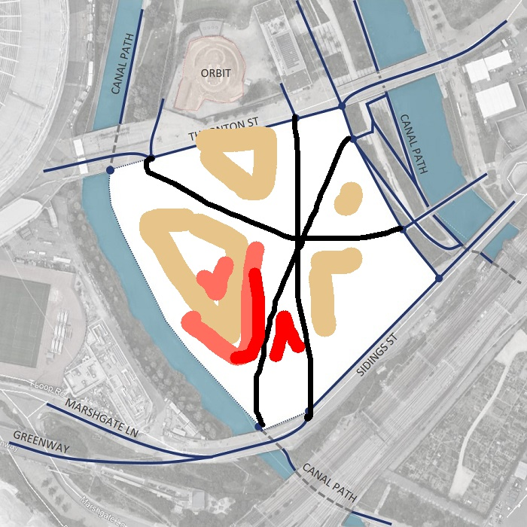
And finally other land uses pen

Slide 4
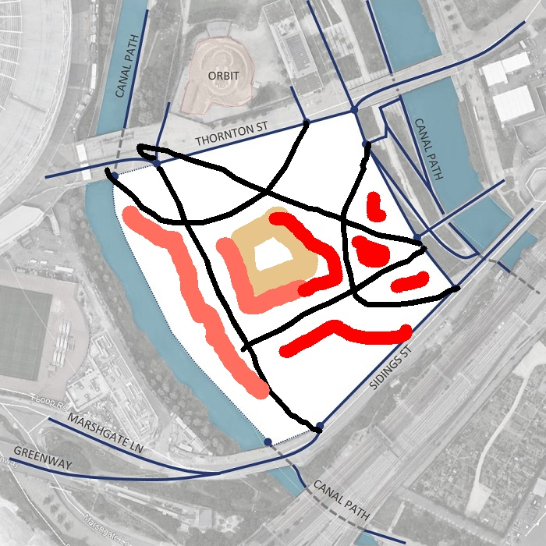
And finally other land uses pen

Slide 5
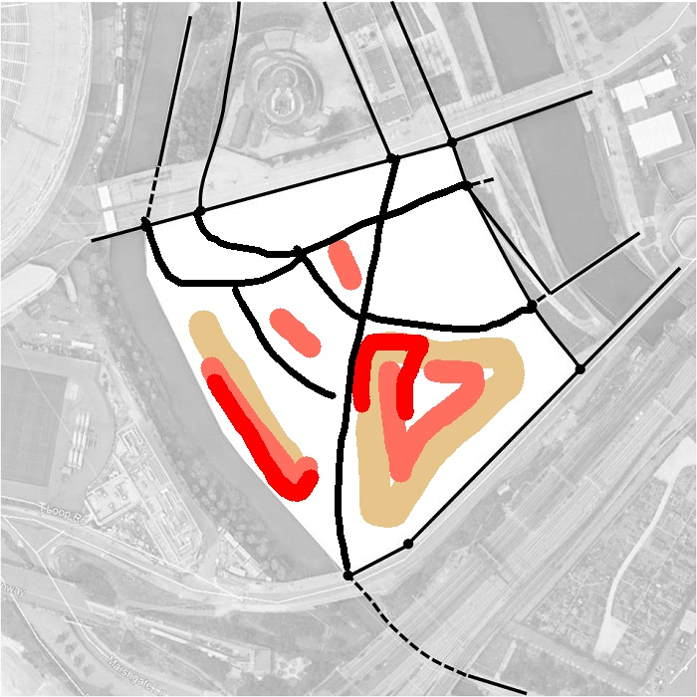
And finally other land uses pen

Slide 6
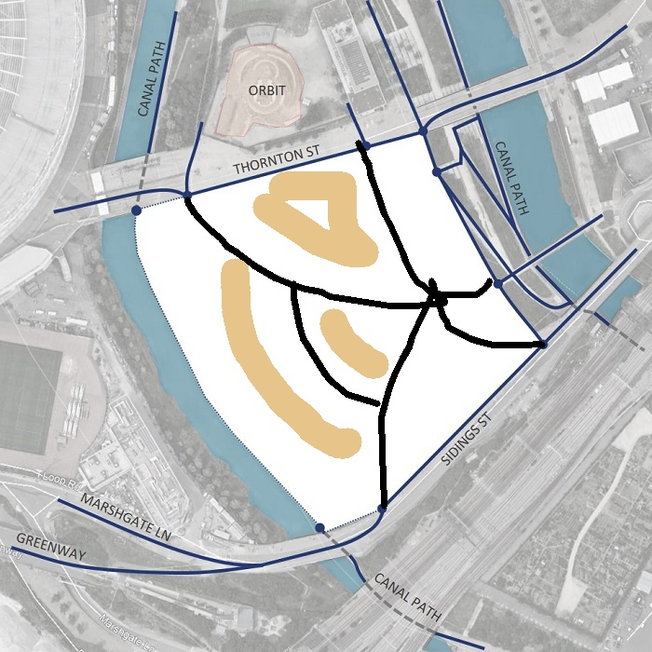
And finally other land uses pen

