Slide 1

Adidas case study
By Nicolas Rodriguez

Slide 2
Business Task: Executive Sales Performance
OBJECTIVE​
Analyze Adidas US sales performance to uncover growth drivers and profit leaks.
GOAL
Deliver data-driven recommendations for product categories, sales channels, and regional strategy.

Slide 3
Core Business Questions
Product Strategy: Which product categories generate the highest revenue and profit?
Partner Performance: Who are our most valuable retail partners?
Channel Efficiency: Is In-store sales volume more profitable than Online channels?
Geographic Focus: Which regions drive US sales growth?

Slide 4
Data Source & Integrity
Dataset: Adidas US Sales Dataset .
Volume: 9,600+ transaction records spanning 2020–2021.
Scope: Sales method, region, state, city, product category, unit price, units sold, total sales, operating profit, and operating margin.

Slide 5



Tech Stack & Workflow
Excel / CSV: Initial data inspection, formatting validation, and structural checks.
PostgreSQL (VS Code): Advanced SQL queries, data aggregation, and analytical logic.
Tableau Public (macOS): Executive dashboard architecture, data visualization, and interactive reporting.

Slide 6
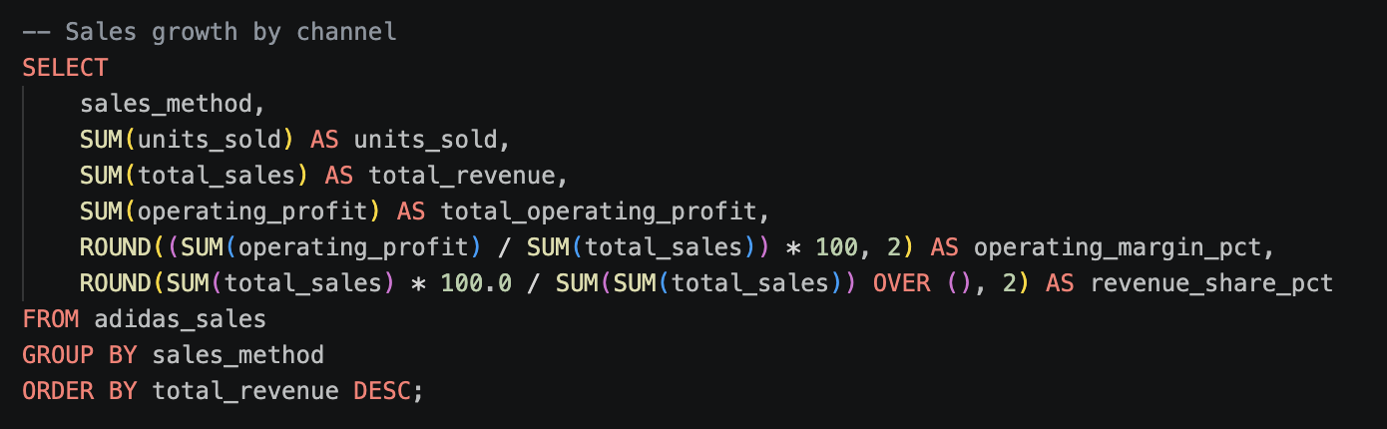
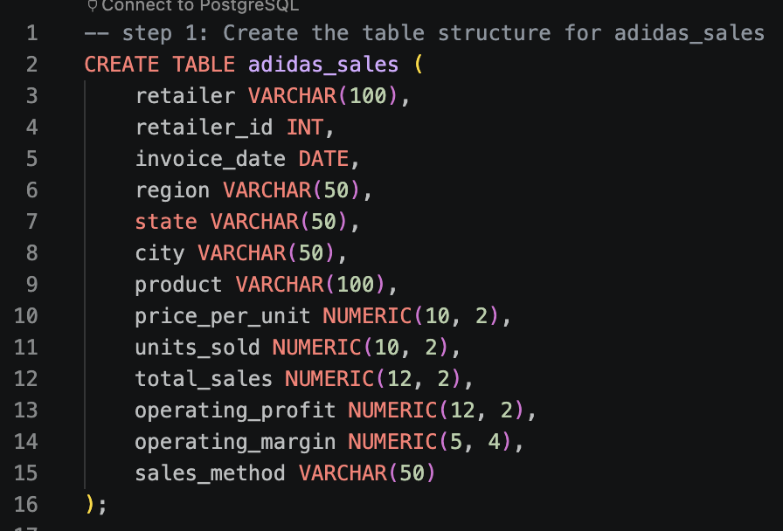
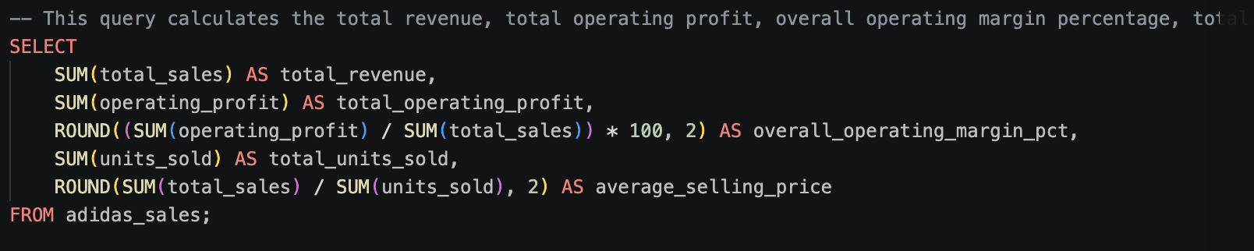

Slide 7
Financial Overview (2020–2021)
Total Revenue: $899.90M generated across all channels.
Operating Profit: $332.14M with an overall operating margin of 36.91%.
Volume & Pricing: 2.48M units sold at an Average Selling Price of $363.03.

Slide 8
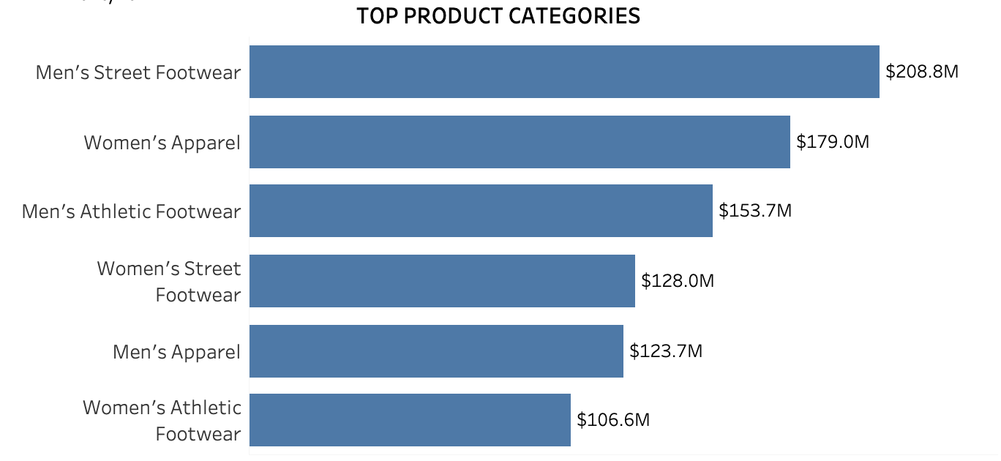
Product Performance
Top Driver: Men's Street Footwear leads with $208.8M in total revenue.
Apparel Strength: Women's Apparel ranks 2nd with $179.0M.
Insight: Footwear drives overall volume, while apparel shows high potential for bundle strategies.

Slide 9
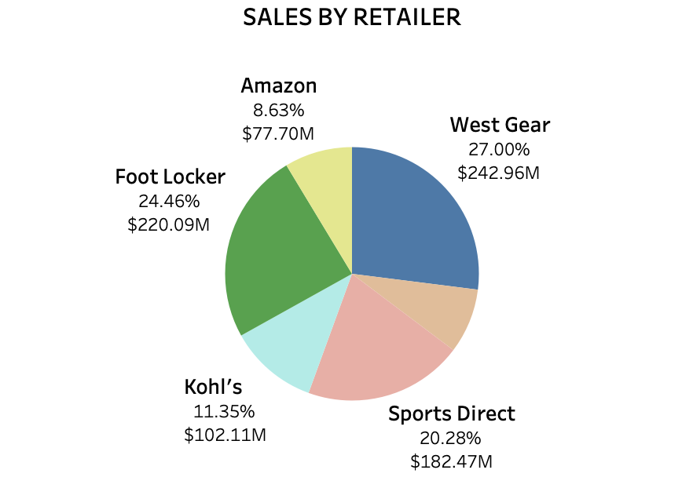
Retailer Contribution
Duopoly Dominance: West Gear (27.00%) and Foot Locker (24.46%) generate >51% of total revenue ($463M+).
Secondary Tier: Sports Direct contributes 20.28% ($182.47M).
Insight: High dependency on top 2 retail partners; key account management is critical.

Slide 10
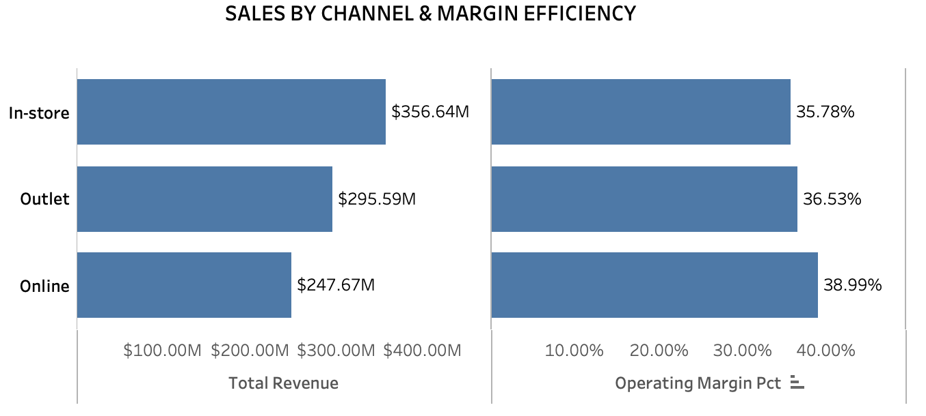
Channel Efficiency
Volume Leader: In-store drives highest gross revenue ($356.64M).
Profit Leader: Online achieves highest operating margin (38.99%) vs. In-store (35.78%).
Insight: E-commerce offers higher profitability per transaction due to lower overhead costs.

Slide 11
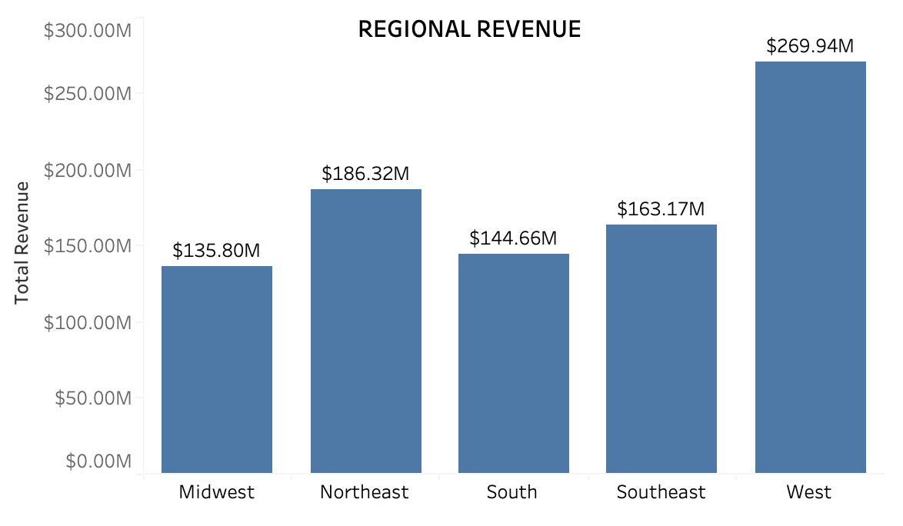
Geographic Distribution
Top Region: West leads US sales with $269.94M.
Strong Runner-Up: Northeast generates $186.32M.
Expansion Target: Midwest ($135.80M) presents an untapped growth opportunity.

Slide 12
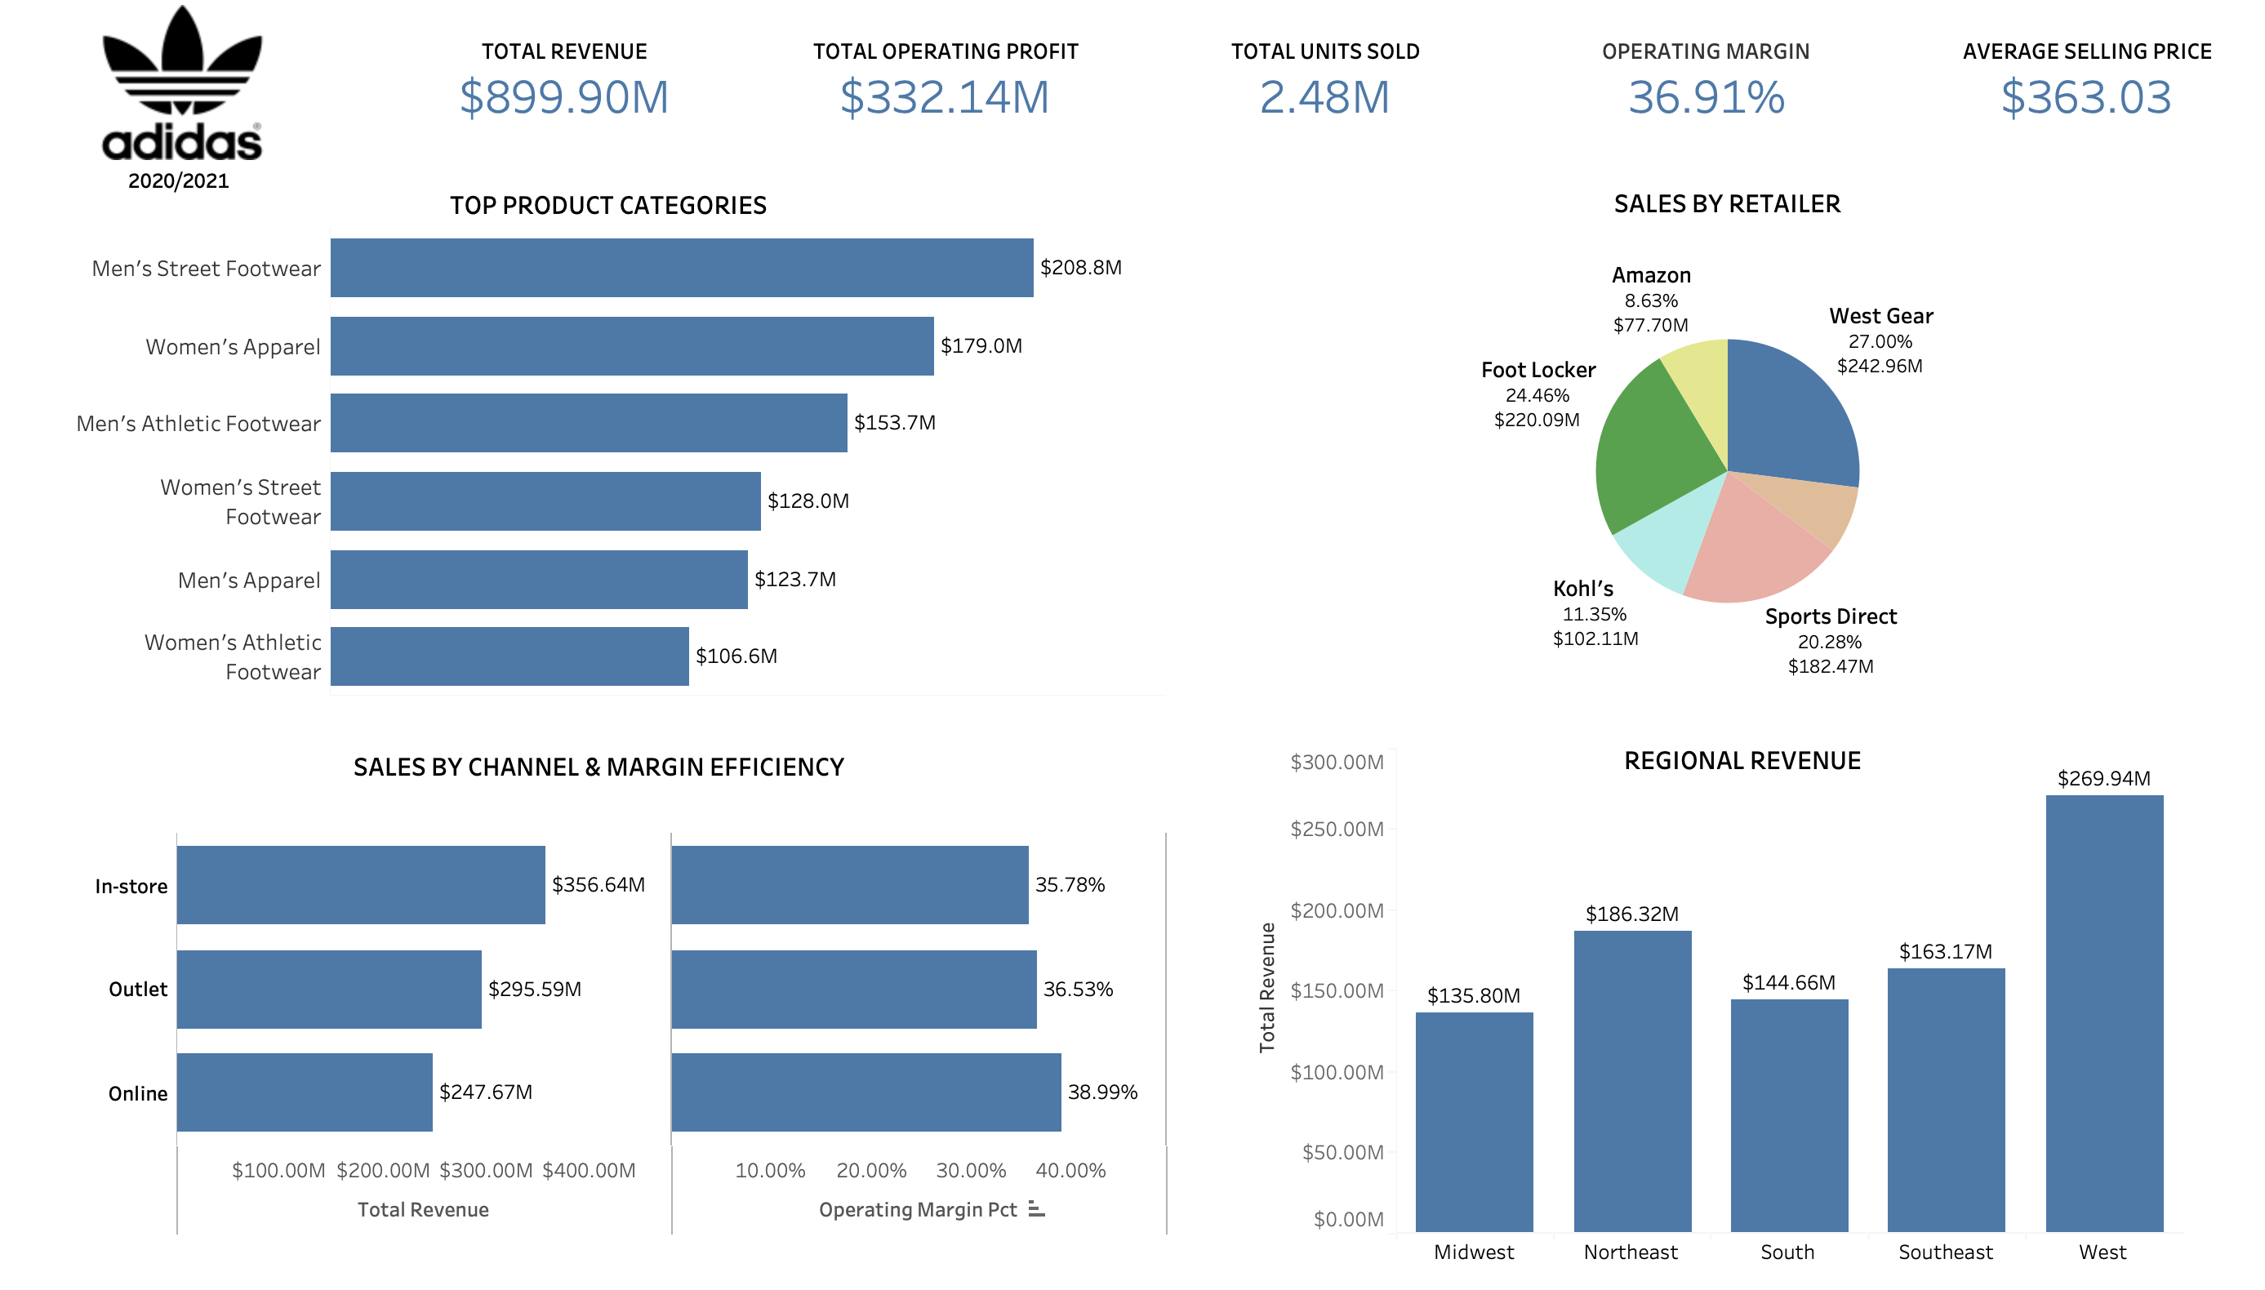
Actionable Business Recommendations
Double Down on Digital: Expand Online channel operations to capitalize on the 38.99% operating margin.
Partner Optimization: Strengthen key account ties with West Gear & Foot Locker while boosting direct-to-consumer (D2C) presence.
Midwest Expansion: Implement targeted regional marketing campaigns in the Midwest to close the revenue gap.

