Slide 1


Stock Volatility Forecasting
Jan 2023

Slide 2

Volatility Forecasting
Volatility?
What it is
How to measure
Traditional model – GARCH
Machine learning model – XGBoost
Code example
Improve model

Slide 3
Volatility Forecasting | Volatility
What is volatility
Volatility is the range of price changes a security experiences over a given period.

Slide 4
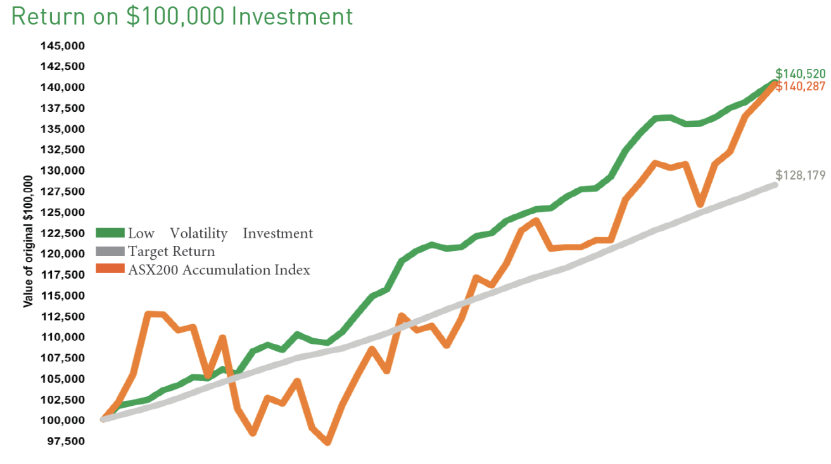
Volatility Forecasting | Volatility
What is volatility
Volatility is the range of price changes a security experiences over a given period.

Slide 5
Volatility Forecasting | Volatility
How is it measured
Standard deviation is the most common way to measure volatility
The CBOE Volatility Index (VIX) is a common metric used to measure the expected volatility of the S&P 500
Ref. https://www.investopedia.com/

Slide 6
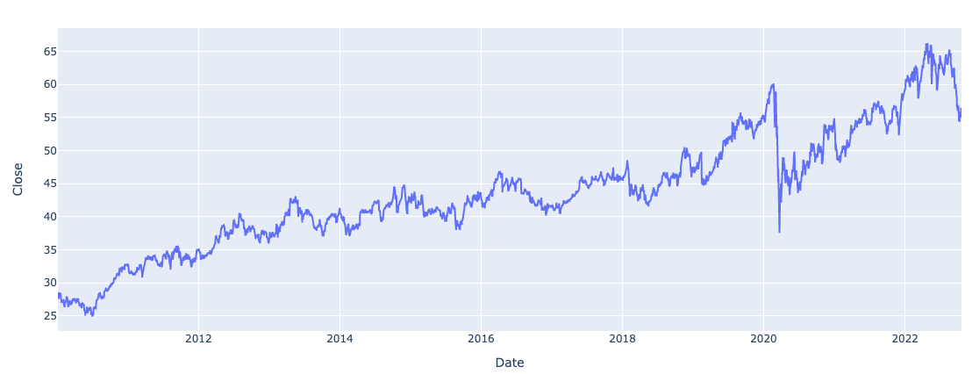
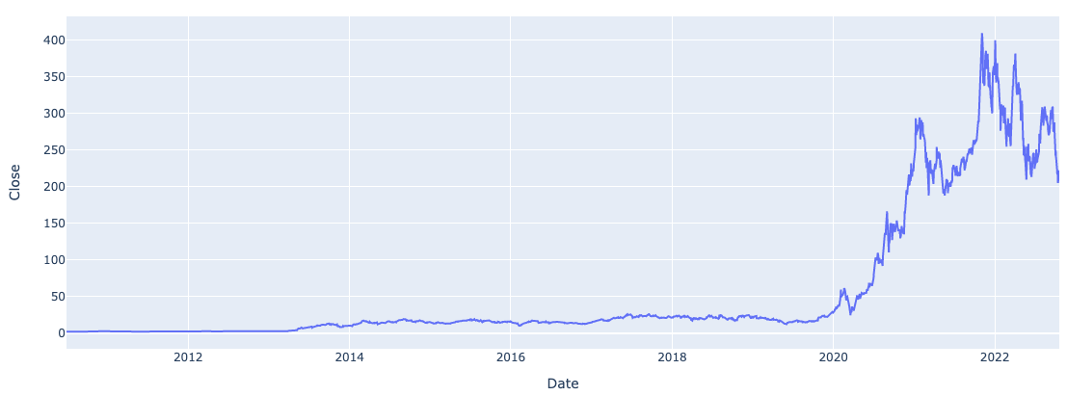
Volatility Forecasting | Volatility
How is it measured
Standard deviation is the most common way to measure volatility

Slide 7
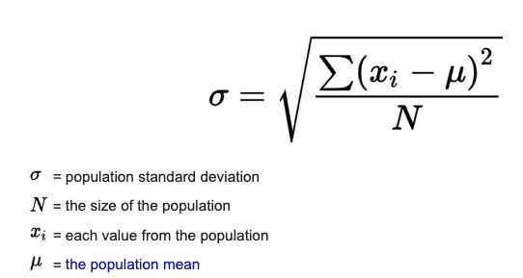


Volatility Forecasting | Volatility
How is it measured
Standard deviation is the most common way to measure volatility

Slide 8
Volatility Forecasting | Volatility
How is it measured
Standard deviation is the most common way to measure volatility
The CBOE Volatility Index (VIX) is a common metric used to measure the expected volatility of the S&P 500
Ref. https://www.investopedia.com/

Slide 9
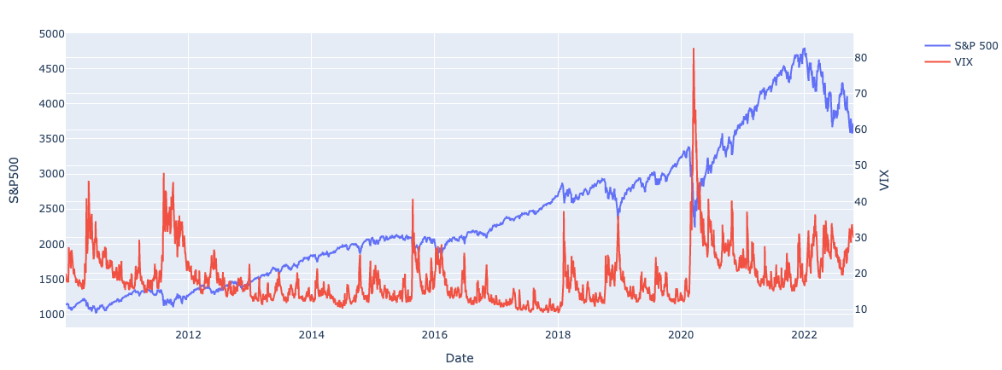
Volatility Forecasting | Volatility
How is it calculated
The CBOE Volatility Index (VIX) is a common metric used to measure the expected volatility of the S&P 500

Slide 10

Volatility Forecasting | GARCH model
GARCH (Generalized Auto Regressive Conditional Heteroskedasticity)
Developed in 1986, widely used econometric model to estimate historical volatility
Volatility today is affected by the yesterday’s value and also yesterday’s volatility

Slide 11
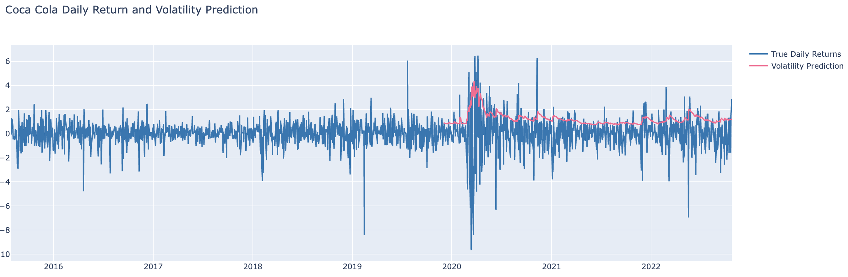
Volatility Forecasting | GARCH model
GARCH (Generalized Auto Regressive Conditional Heteroskedasticity)
Developed in 1986, widely used econometric model to estimate historical volatility
Volatility today is affected by the yesterday’s value and also yesterday’s volatility

Slide 12
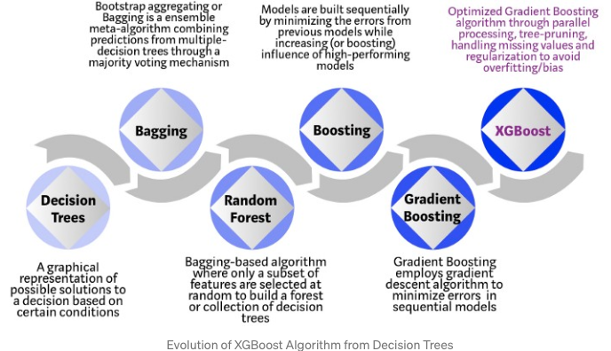
Volatility Forecasting | XGBoost model
XGBoost
Regularisation
Sparsity Awareness
Weighted Quantile Sketch
Cross-validation
Parallelisation
Tree Pruning
Hardware Optimisation
Etc..

Slide 13
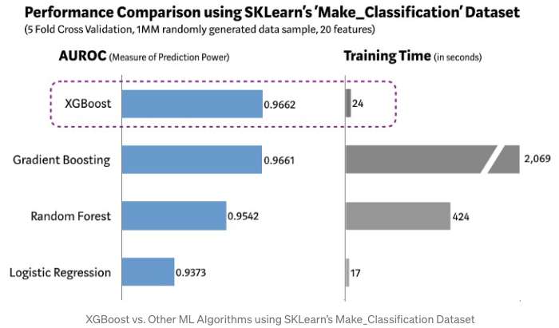
Volatility Forecasting | XGBoost model
XGBoost

Slide 14
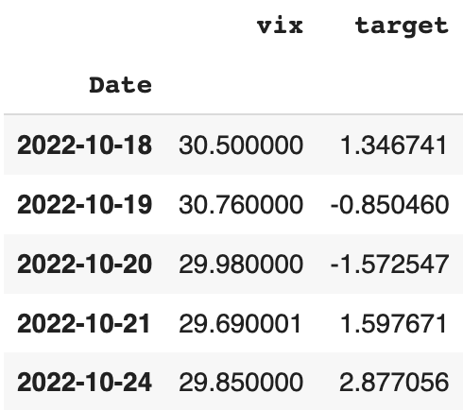
Volatility Forecasting | XGBoost model
Historical Price
(Daily Return)
XGBoost
Tomorrow’s
volatility
VIX
2022-10-25 ?

Slide 15
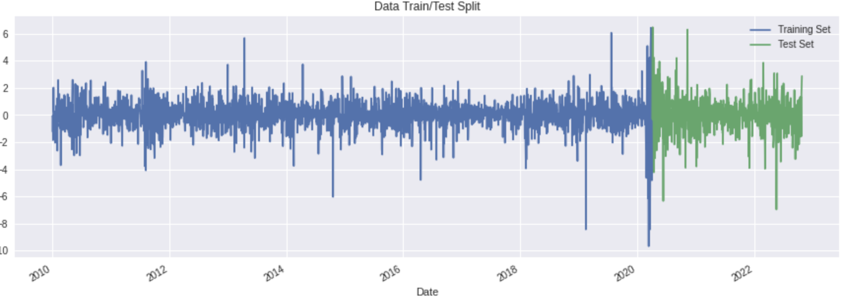
Volatility Forecasting | Validation
Validation
Root Mean squared error
GARCH : 1.63(KO), 5.54(TSLA)
XGBoost : 1.12(KO), 1.15(TSLA)

Slide 16
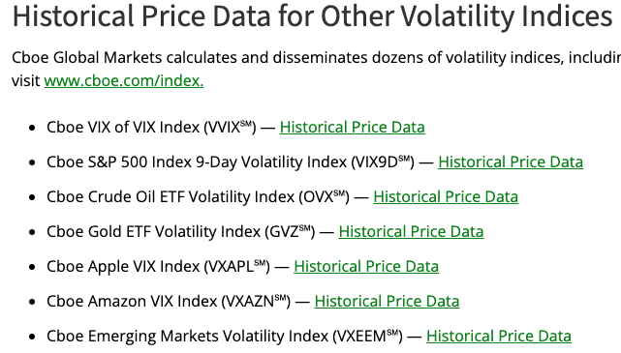
Volatility Forecasting | Improvement
Validation
Root Mean squared error
GARCH : 1.63(KO), 5.54(TSLA)
XGBoost : 1.12(KO), 1.15(TSLA)
Improve
Add other features

Slide 17
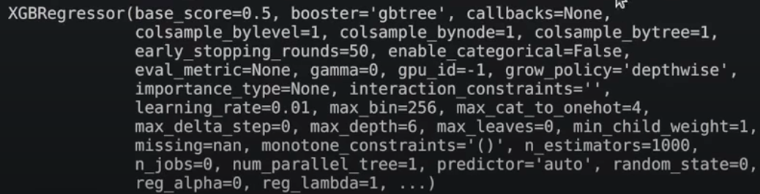
Volatility Forecasting | Improvement
Validation
Root Mean squared error
GARCH : 1.63(KO), 5.54(TSLA)
XGBoost : 1.12(KO), 1.15(TSLA)
Improve
Add other features
Parameter tuning

Slide 18
Volatility Forecasting
Reference
Volatility
https://www.investopedia.com/ask/answers/021015/what-best-measure-given-stocks-volatility.asp
https://www.cboe.com/tradable_products/vix/vix_historical_data/
VIX
https://www.learningmarkets.com/predicting-volatility-with-the-vix/
GARCH
https://goldinlocks.github.io/ARCH_GARCH-Volatility-Forecasting/
https://www.kaggle.com/code/ninetyninenewton/prediction-of-stock-market-volatility/notebook
Time Series
https://neptune.ai/blog/select-model-for-time-series-prediction-task
Ensemble/XGBoost
https://builtin.com/machine-learning/ensemble-model
https://towardsdatascience.com/https-medium-com-vishalmorde-xgboost-algorithm-long-she-may-rein-edd9f99be63d
Literature
https://arxiv.org/pdf/2110.09489.pdf

