Slide 1
GAME DEVELOPMENT PLAN
다음 분기에 출시할 게임 조사 분석

Slide 2
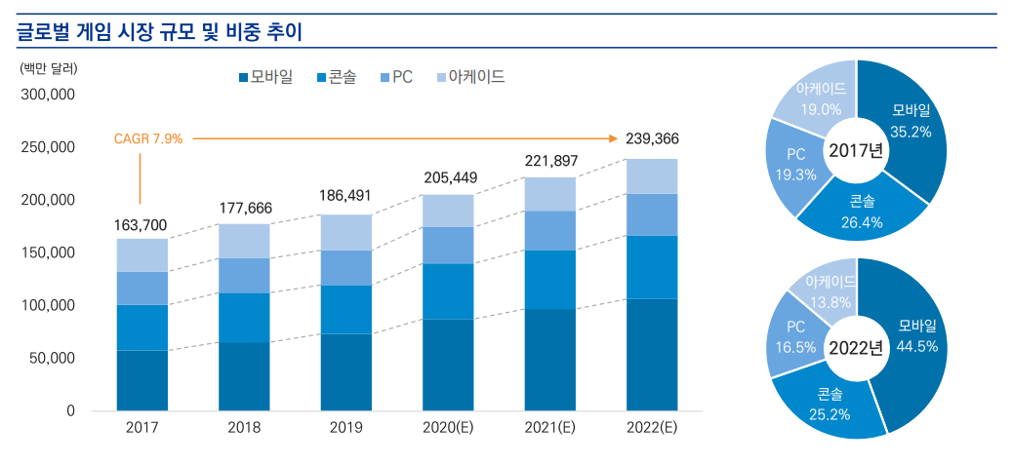
글로벌 게임 산업 동향
source: 2022 대한민국 게임백서(한국콘텐츠진흥원, 2020), 삼정KPMG 경제연구원 재구성
Notes:
글로벌 게임 시장 규모는 2019년 1865억 달러에서 2022년 2394억 달러까지 증가할 것으로 예측됩니다. 또한, 2022년에는 모바일 게임 비중이 44.5%로 높아질 것으로 전망되며, 콘솔, PC게임 비중은 소폭 감소될 것으로 예상됩니다.

Slide 3
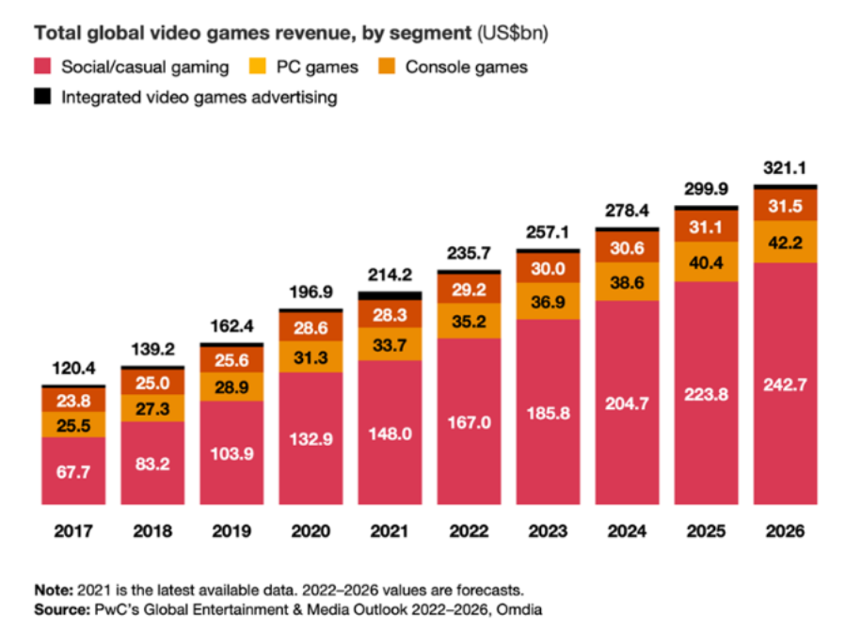
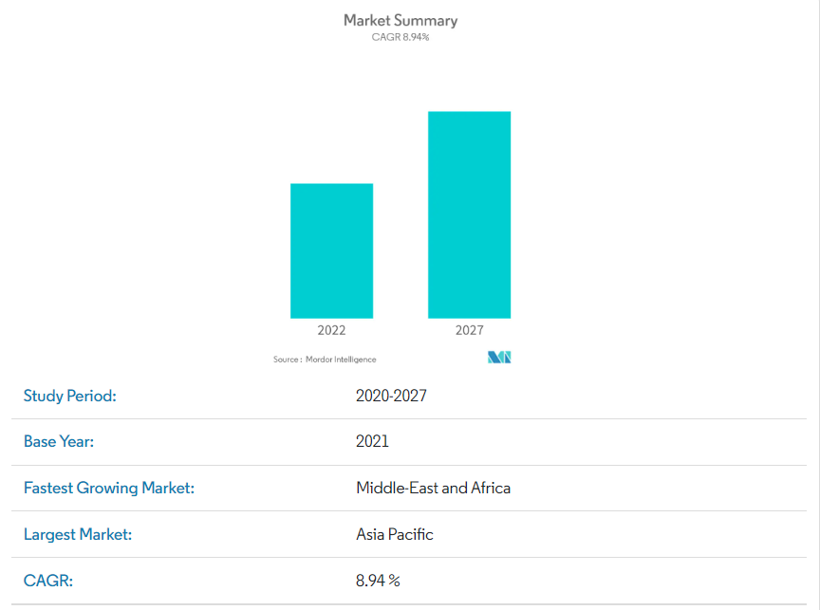
미래 글로벌 게임 산업
Notes:
expected to reach a value of USD 339.95 billion by 2027. Due to nationwide lockdowns implemented because of the COVID-19 pandemic, some people turned to game platforms to pass the time. Thus, these platforms attracted hundreds and thousands of new visitors to online traffic

Slide 4
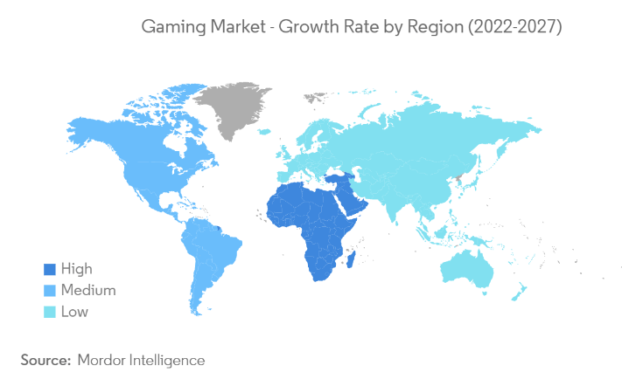
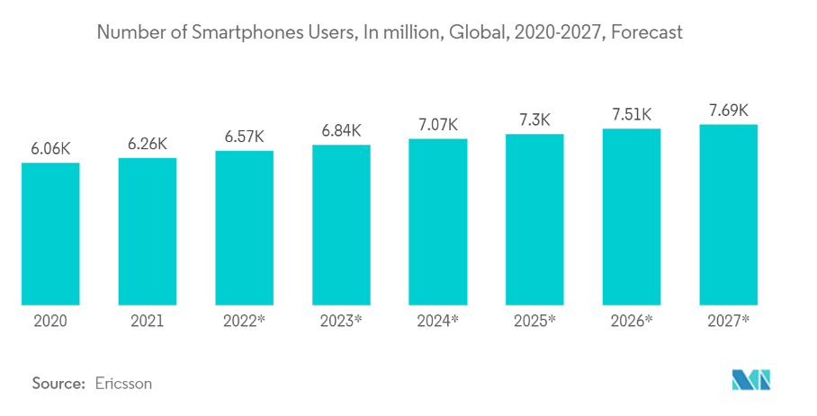
미래 글로벌 게임 산업
Notes:
China and the US dominated the market in 2021, accounting for about half of gaming and eSports revenues. But future growth could come from less wealthy countries with growing populations. The PwC report predicts that the games market will expand fastest in Turkey, with average annual growth of 24.1% between 2021 and 2026. It will be followed by Pakistan, with expansion of 21.9%, and India on 18.3%. The gaming market is growing with the increasing per capita income, growing interest, and the rising number of dual-income households, augmenting the transformation of the global market. With the increasing usage of smartphones and consoles and cloud penetration, the market shows high potential growth in the future. Mobile gaming is the most favored form of gaming globally, overtaking both console and PC gaming. One of the main reasons for mobile gaming's popularity is accessibility. Nearly everyone has a smartphone with games. The Gaming Market is Segmented by Gaming Type (Console, Tablet, Smartphone, Downloaded/Box PC, and Browser PC) and Geography.

Slide 5
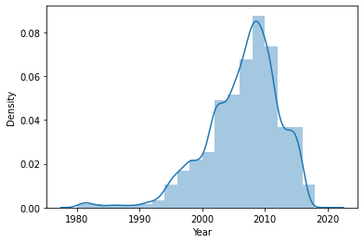
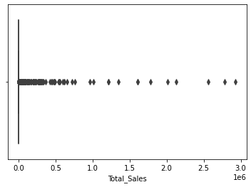
데이터 분포 확인
데이터 분포 형태

Slide 6
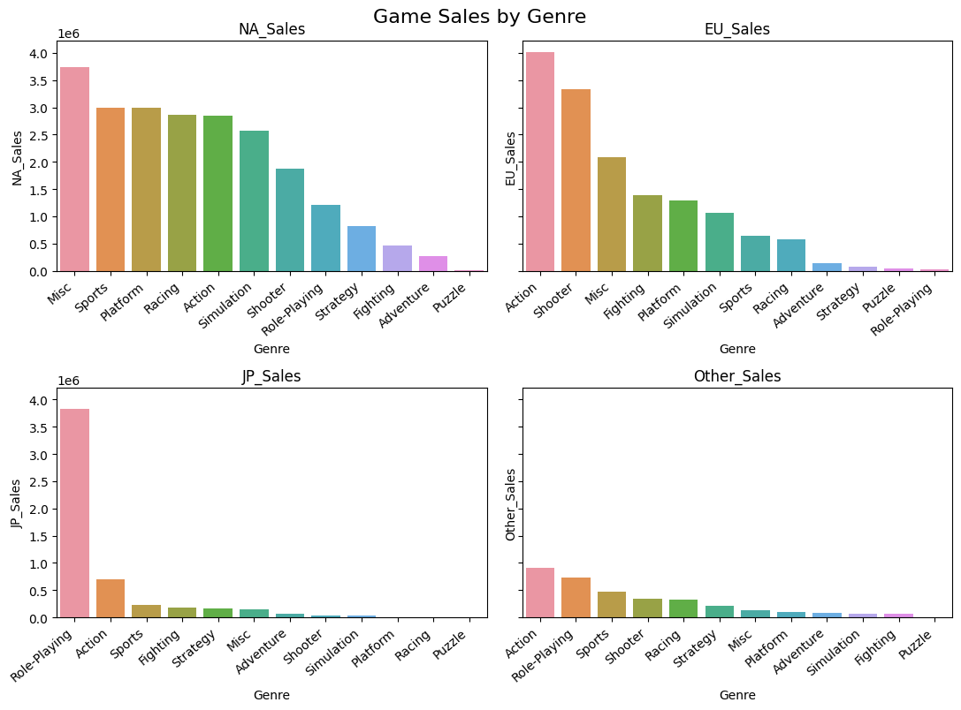
지역별 선호 장르

Slide 7
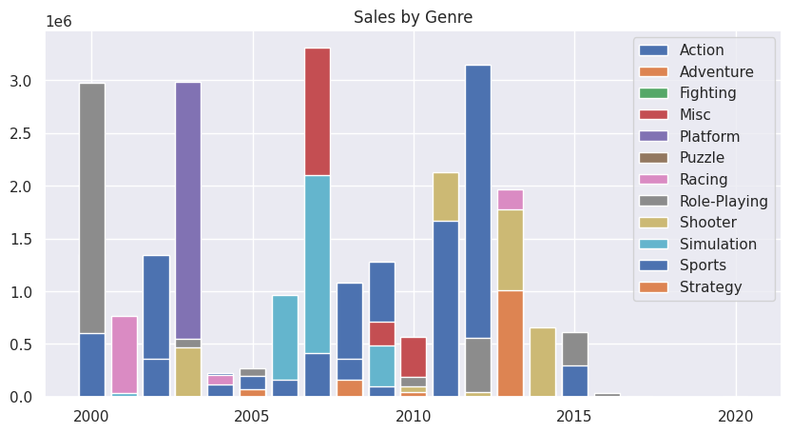
연도별 게임 트랜드
연도별 게임 출고 장르 분포

Slide 8
연도별 게임 트랜드
연도별 게임 출고 장르 분포

