Slide 1

System Analysis & Design
Lecture 02
Mustafa Hasan
Head of CSE

Slide 2
Review Last Class

Slide 3
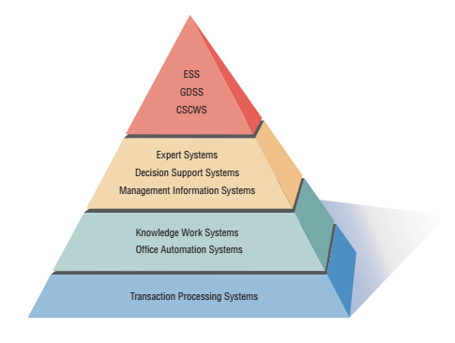
A System Analyst May Involve in any or all of the following System
Strategic Level
Higher Level
Knowledge Level
Operation Level

Slide 4
Operational Level
Transaction Processing System (TPS)
Process large amounts of data for routine business transactions
Boundary-­‐spanning
Support the day-­‐to-­‐day operations of the company
Examples: Payroll Processing, Inventory Management

Slide 5
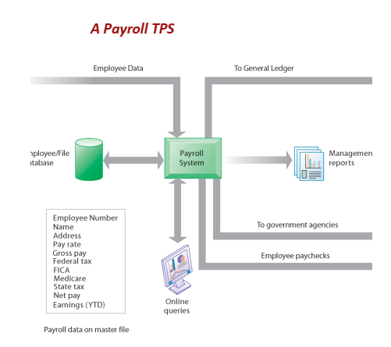

A TPS for payroll processing captures employee payment transaction data (such as a time card). System outputs include online and hard-­‐copy reports for management and employee paychecks.

Slide 6
Knowledge Level
Oﬃce Automation System (OAS)
Supports data workers who share information, but do not usually create new knowledge
Examples: Word processing, Spreadsheets, Desktop publishing, Electronic scheduling, Communication through voice mail, Email, Video conferencing
Knowledge Work System (KWS)
Supports professional workers such as scientists, engineers, and doctors
Examples: computer-­‐aided design systems, virtual reality systems, investment workstations

Slide 7
Higher Level
Management Information System (MIS)
Support a broad spectrum of organizational tasks including decision analysis and decision making
Examples: proﬁt margin by sales region, expenses vs. budgets
Decision Support System (DSS)
Aids decision makers in the making of decisions
Examples: ﬁnancial planning with what-­‐if analysis, budgeting with modeling
Expert System (ES)
Captures and uses the knowledge of an expert for solving a particular problem which leads to a conclusion or recommendation
Examples: MYCIN, XCON

Slide 8
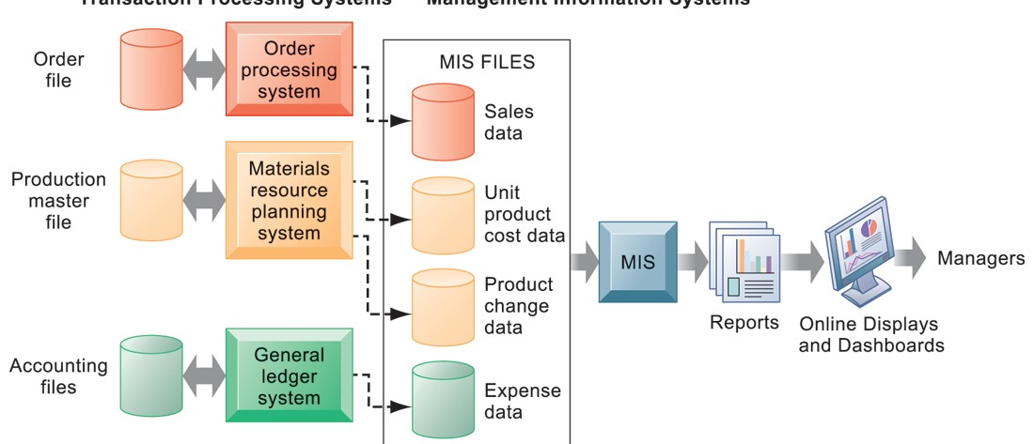
How MIS Obtain Their Data from the Organization’s TPS

Slide 9
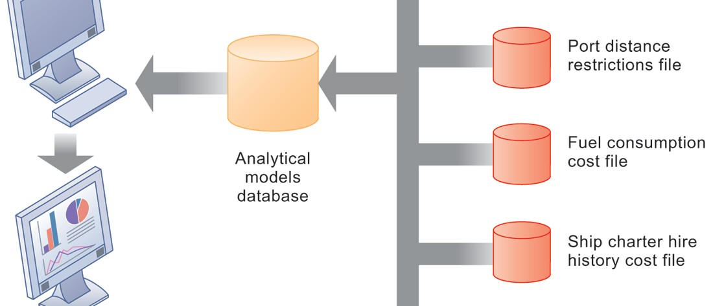
Decision Support System

Slide 10
Strategic Level
Executive Support System (ESS)
Helps executives to make unstructured strategic decisions in an informed way
Examples: drill-­‐down analysis, status access
Group Decision Support System (GDSS)
Permit group members to interact with electronic support
Examples: email,
Computer-­‐Supported Collaborative Work System (CSCWS)
CDCWS is a more general term of GDSS
May include software support called “groupware” for team collaboration via network computers
Example: video conferencing, Web survey system

Slide 11
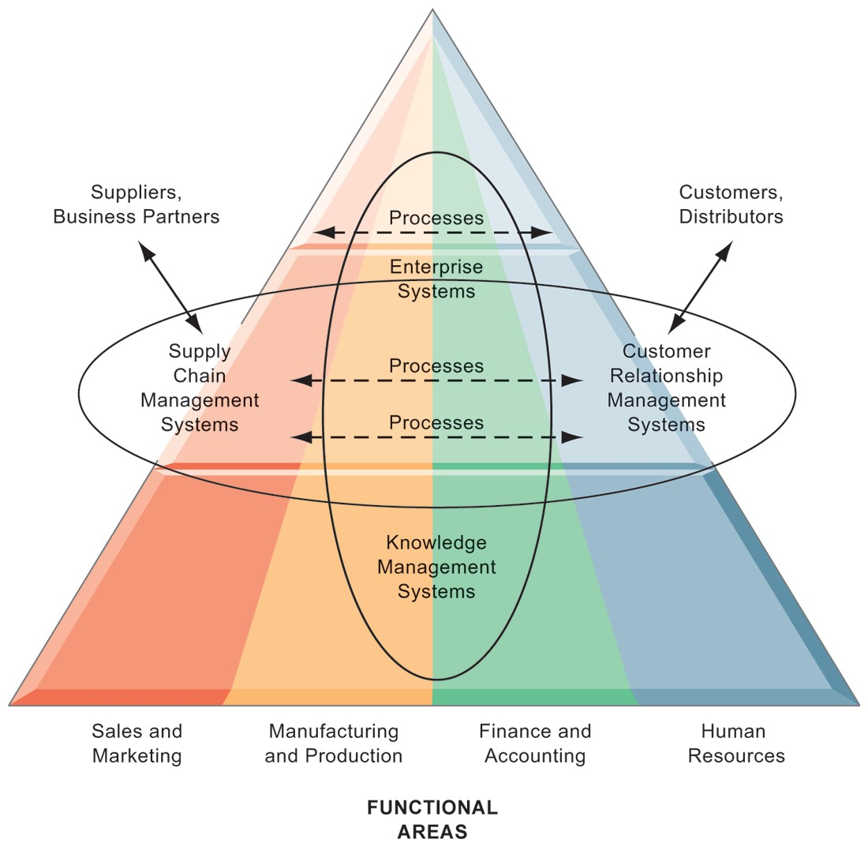
Enterprise Application Architecture

Slide 12
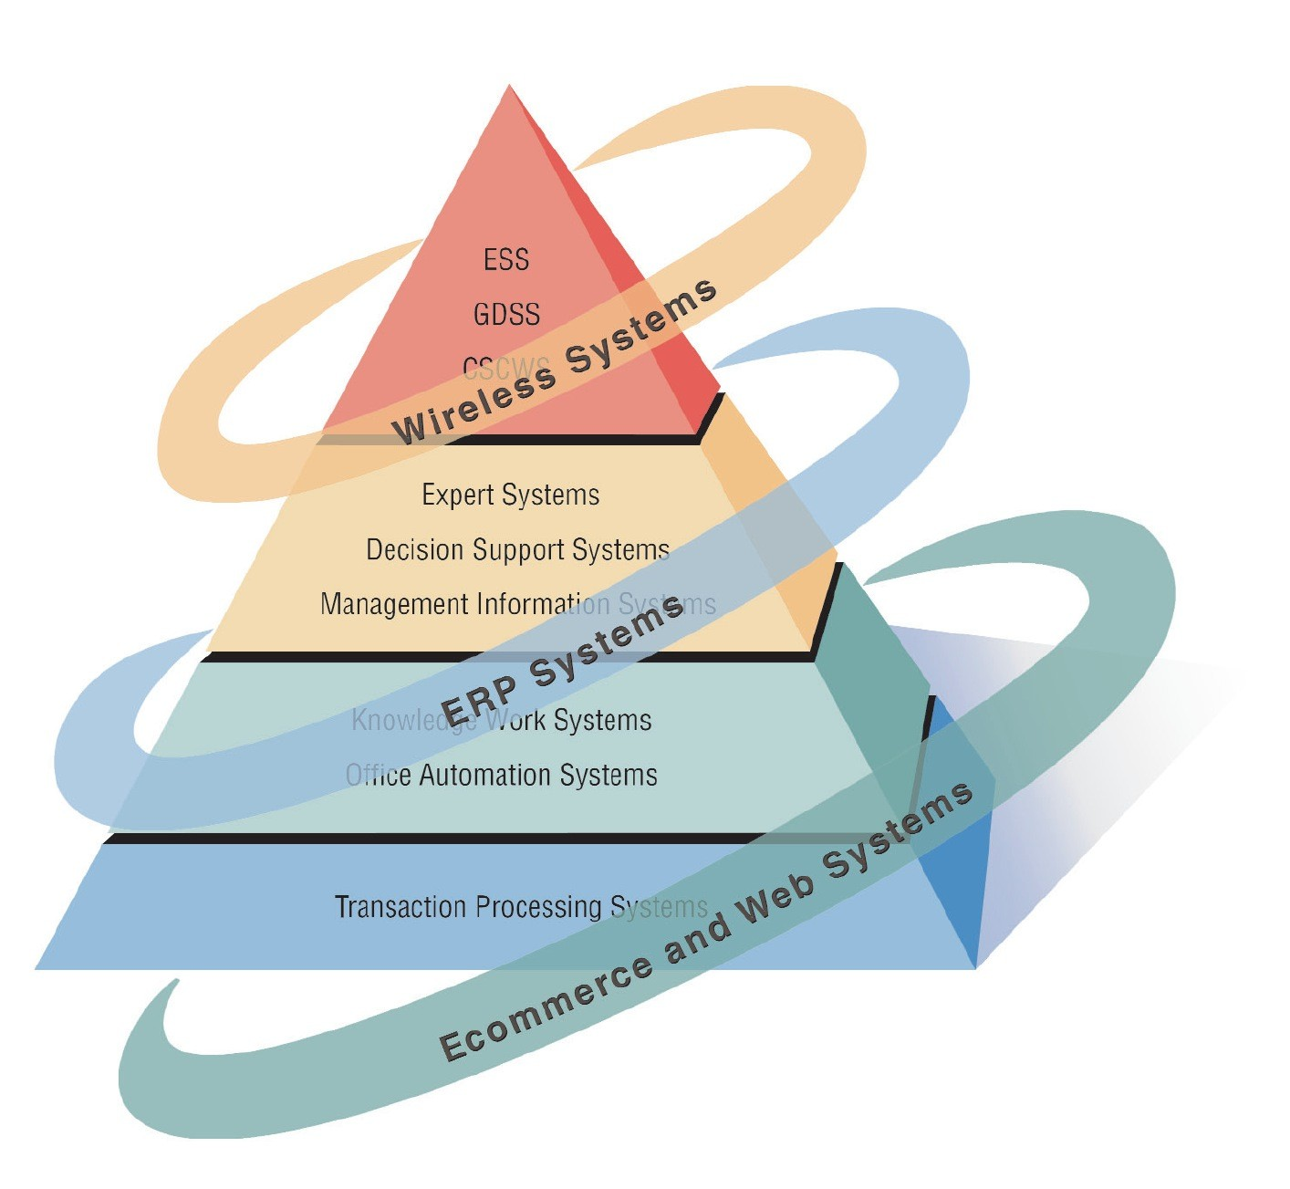
Systems analysts need to be aware that integrating technologies aﬀects all types of systems

Slide 13
Ecommerce and Web Systems
Beneﬁts
Increasing user awareness of the availability of a service, product, industry, person, or group
The possibility of 24-­‐hour access for users
Improving the usefulness and usability of interface design
Creating a system that can extend globally rather than remain local, thus reaching people in remote locations without worry of the time zone in which they are located

Slide 14
Enterprise Resource Planning Systems (ERP)
Performs integration of many information systems existing on diﬀerent management levels and within diﬀerent functions
Example: SAP, Oracle

Slide 15
Wireless Systems
System analyst may be asked to design standard or wireless communication networks that integrate voice, video and email into organizational intranets or industry extranets
System analyst may also be asked to develop intelligent agents
Example: Microsod's new sodware based on Bayesian statistics
Wireless communication is referred as m-­‐commerce (mobile commerce)

Slide 16
Open Source Software
An alternative of traditional software development where proprietary code is hidden from the users
Open source software is free to distribute, share and modify
Characterized as a philosophy rather than simply the process of creating new software
Example: Linux Operating System, Apache Web Server, Mozilla Firefox Web browser

Slide 17
Need for Systems Analysis and Design
Installing a system without proper planning leads to great user dissatisfaction and frequently causes the system to fall into disuse
Lends structure to the analysis and design of information systems
A series of processes systematically undertaken to improve a business through the use of computerized information systems

Slide 18




System Analyst>Roles & Environment
System analyst (SA) studies the problems and needs of an organization to determine how people, data, process, communications and information technology can best accomplish improvements for the business (organizations)
(Computerized) Information Systems

Slide 19
Roles of the Systems Analyst
The analyst must be able to work with people of all descriptions and be experienced in working with computers
Three primary roles:
Consultant
Supporting Expert
Agent of change

Slide 20
Qualities of the Systems Analyst
Problem solver
Communicator
Strong personal and professional ethics
Self-­‐disciplined and self-­‐motivated

Slide 21
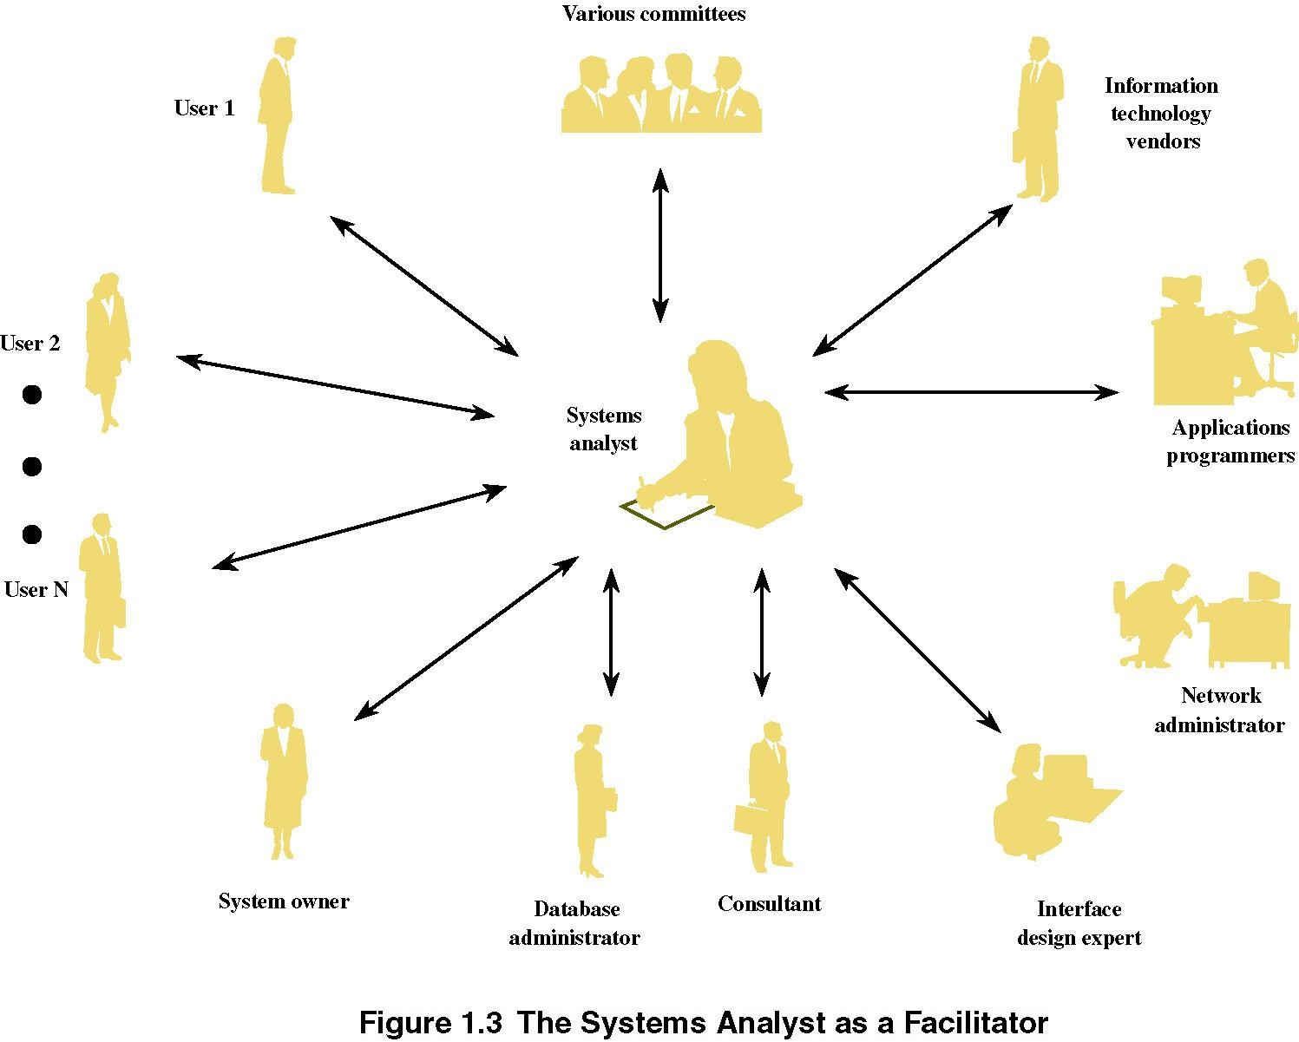

Slide 22
Systems Development Life Cycle (SDLC)
The systems development life cycle is a phased approach to solving business problems
Developed through the use of a speciﬁc cycle of analyst and user activities
Each phase has unique user activities

Slide 23
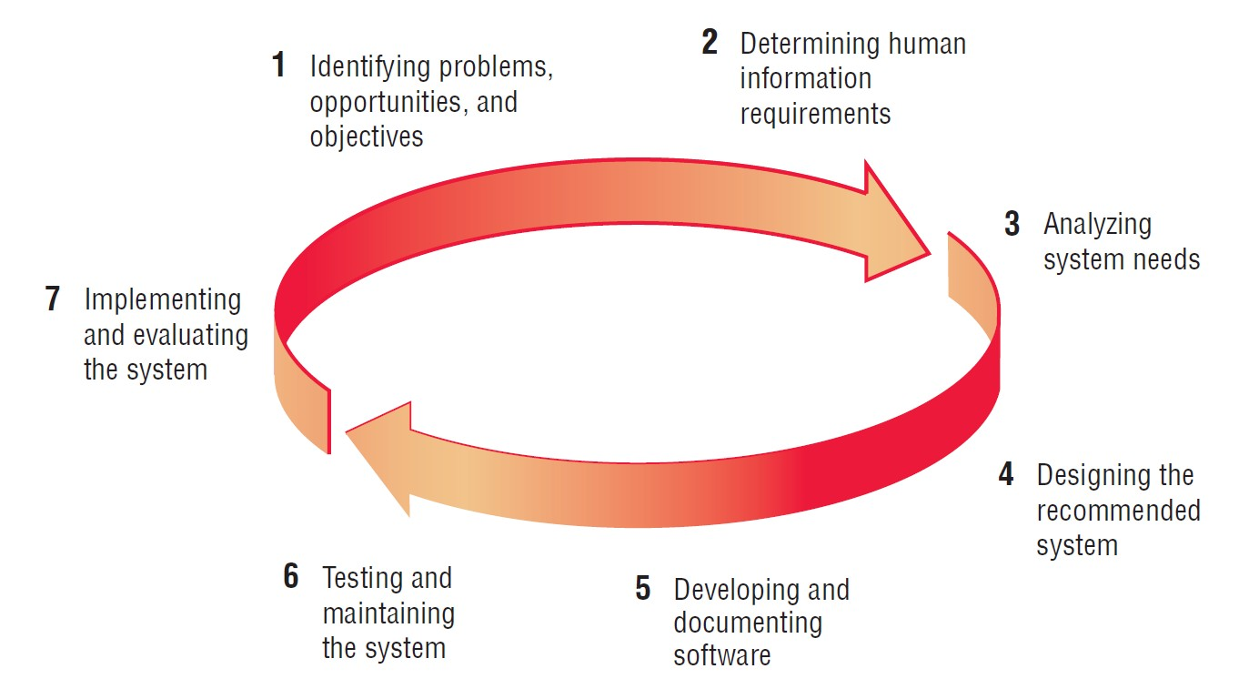
The seven phases of the systems development life cycle

Slide 24
Incorporating Human-­‐Computer Interaction (HCI) Considerations
The demand for analysts who are capable of incorporating HCI into the systems development process keeps increasing, as companies begin to realize that the quality of systems and the quality of work life can be improved by taking a human-­‐centered approach at the outset of a project

Slide 25
Identifying Problems, Opportunities, and Objectives
Activity:
Interviewing user management
Summarizing the knowledge obtained
Estimating the scope of the project
Documenting the results
Output:
Feasibility report containing problem deﬁnition and objective summaries from which management can make a decision on whether to proceed with the proposed project (come out with your system proposal)

Slide 26
Determining Human Information Requirements
Activity:
Interviewing
Sampling and investing hard data
Questionnaires
Observe the decision maker’s behavior and environment
Prototyping
Learn the who, what, where, when, how, and why of the current system
Output:
Analyst understands how users accomplish their work when interacting with a computer; and begin to know how to make the new system more useful and usable. The analyst should also know the business functions and have complete information on the people, goals, data and procedure involved

Slide 27
Analyzing System Needs
Activity:
Create data ﬂow diagrams
Complete the data dictionary
Analyze the structured decisions made
Prepare and present the system proposal
Output:
Recommendation on what, if anything, should be done

Slide 28
Designing the Recommended System
Activity:
Design procedures for data entry
Design the human-­‐computer interface
Design system controls
Design ﬁles and/or database
Design backup procedures
Output
Model of the actual system

Slide 29
Developing and Documenting Software
Activity:
System analyst works with programmers to develop any original software
Works with users to develop eﬀective documentation
Programmers design, code, and remove syntactical errors from computer programs
Document software with help ﬁles, procedure manuals, and Web sites with Frequently Asked Questions
Output:
Computer programs
System documentation

Slide 30
Testing and Maintaining the System
Activity:
Test the information system
System maintenance
Maintenance documentation
Output:
Problems, if any
Updated programs
Documentation

Slide 31
Implementing and Evaluating the System
Activity:
Train users
Analyst plans smooth conversion from old system to new system
Review and evaluate system
Output:
Trained personnel
Installed system

Slide 32
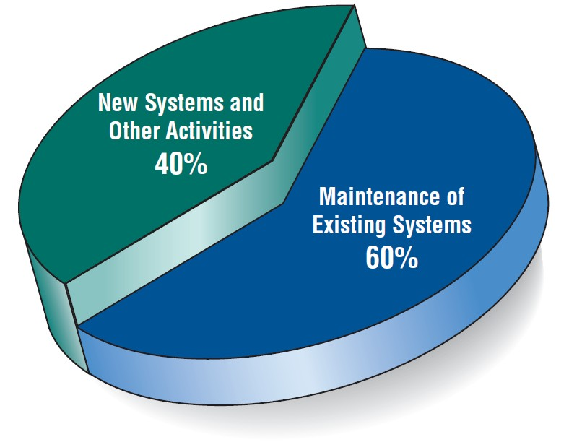
Figure 1.4 Some researchers estimate that the amount of time spent on systems maintenance may be as much as 60 percent of the total time spent on systems projects

Slide 33
The Impact of Maintenance
Maintenance is performed for two reasons
Removing software errors, and
Enhancing existing software
Over time the cost of continued maintenance will be greater than that of creating an entirely new system. At that point it becomes more feasible to perform a new systems study

Slide 34
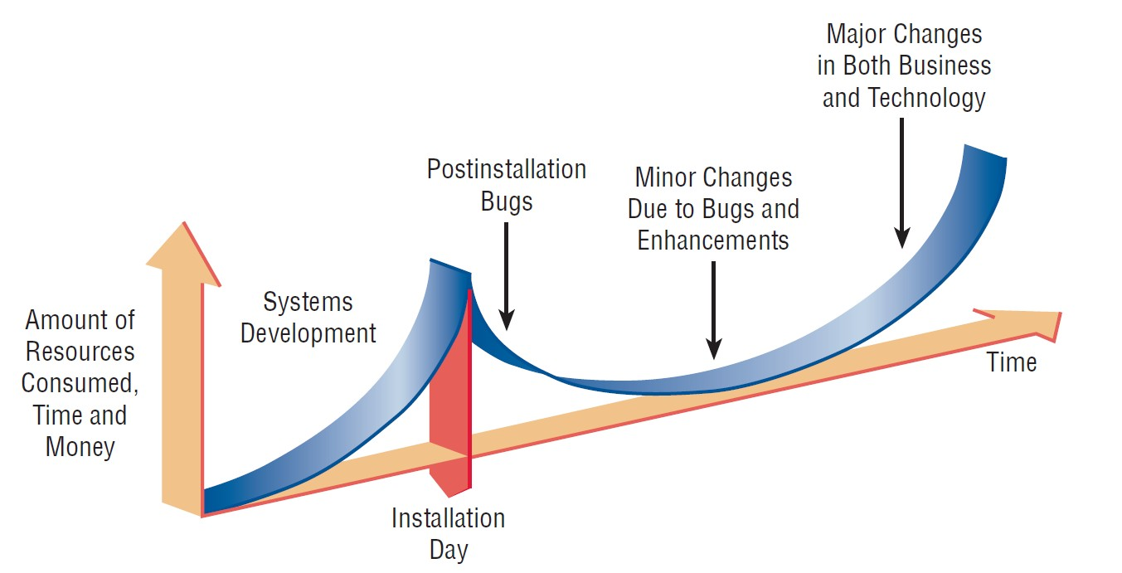
Resource consumption over the system life

Slide 35
IS Development Methodologies
“Comprehensive guidelines to follow for completing every activity in the systems development life cycle, including specific models, tools and techniques”

Slide 36
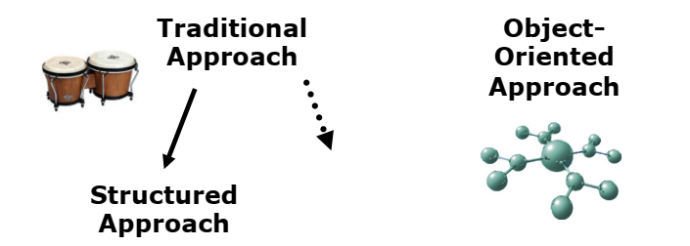
Two General Approaches to IS Development
“…All system developers should be familiar with two very general approaches (structured, OO) to system development, because they form the basis of virtually all methodologies…”

Slide 37
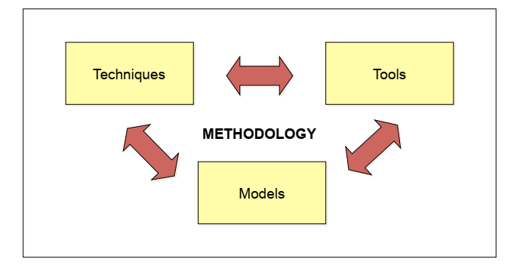
The Main Components of Methodology (MCM)

Slide 38
MCM>Techniques, Models, Tools (TMT)
Techniques is a collection of guidelines that help an analyst complete a system development.
Model is a representation of some important aspect of the real world
Tool is software tool that helps create models or other components required in the project

Slide 39
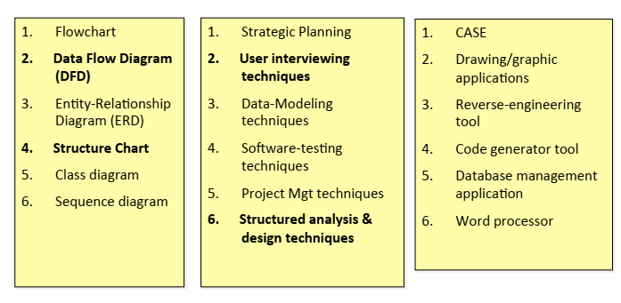
MCM>TMT>Samples

Slide 40
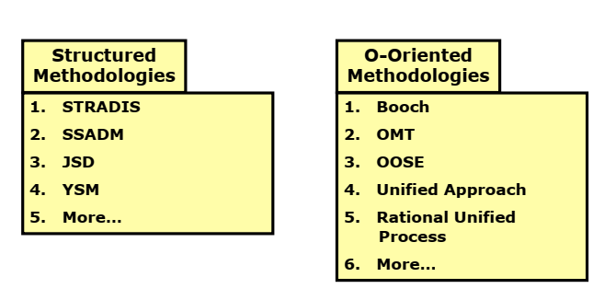
Structured & O-O Methodologies

Slide 41
Approaches to Structured Analysis and Design and to the Systems Development Life Cycle
Traditional systems development life cycle
CASE systems development life cycle
Object-­‐Oriented Systems Analysis and Design

Slide 42
Case Tools
CASE tools are productivity tools for systems analysts that have been created explicitly to improve their routine work through the use of automated support
Reasons for using CASE tools
Increasing Analyst Productivity
Improving Analyst-­‐User Communication
Integrating Life Cycle Activities
Accurately Assessing Maintenance Changes

Slide 43
Case Tool Classiﬁcations
Upper CASE tools perform analysis and design (mainly for analyst & designers)
Lower CASE tools generate programs from CASE design (use by programmers)
Integrated CASE tools perform both upper and lower CASE functions

Slide 44
Upper CASE Tools
Create and modify the system design
Help in modeling organizational requirements and deﬁning system boundaries
Can also support prototyping of screen and report designs

Slide 45
Lower CASE Tools
Lower CASE tools generate computer source code from the CASE design
Source code is usually generated in several languages

Slide 46
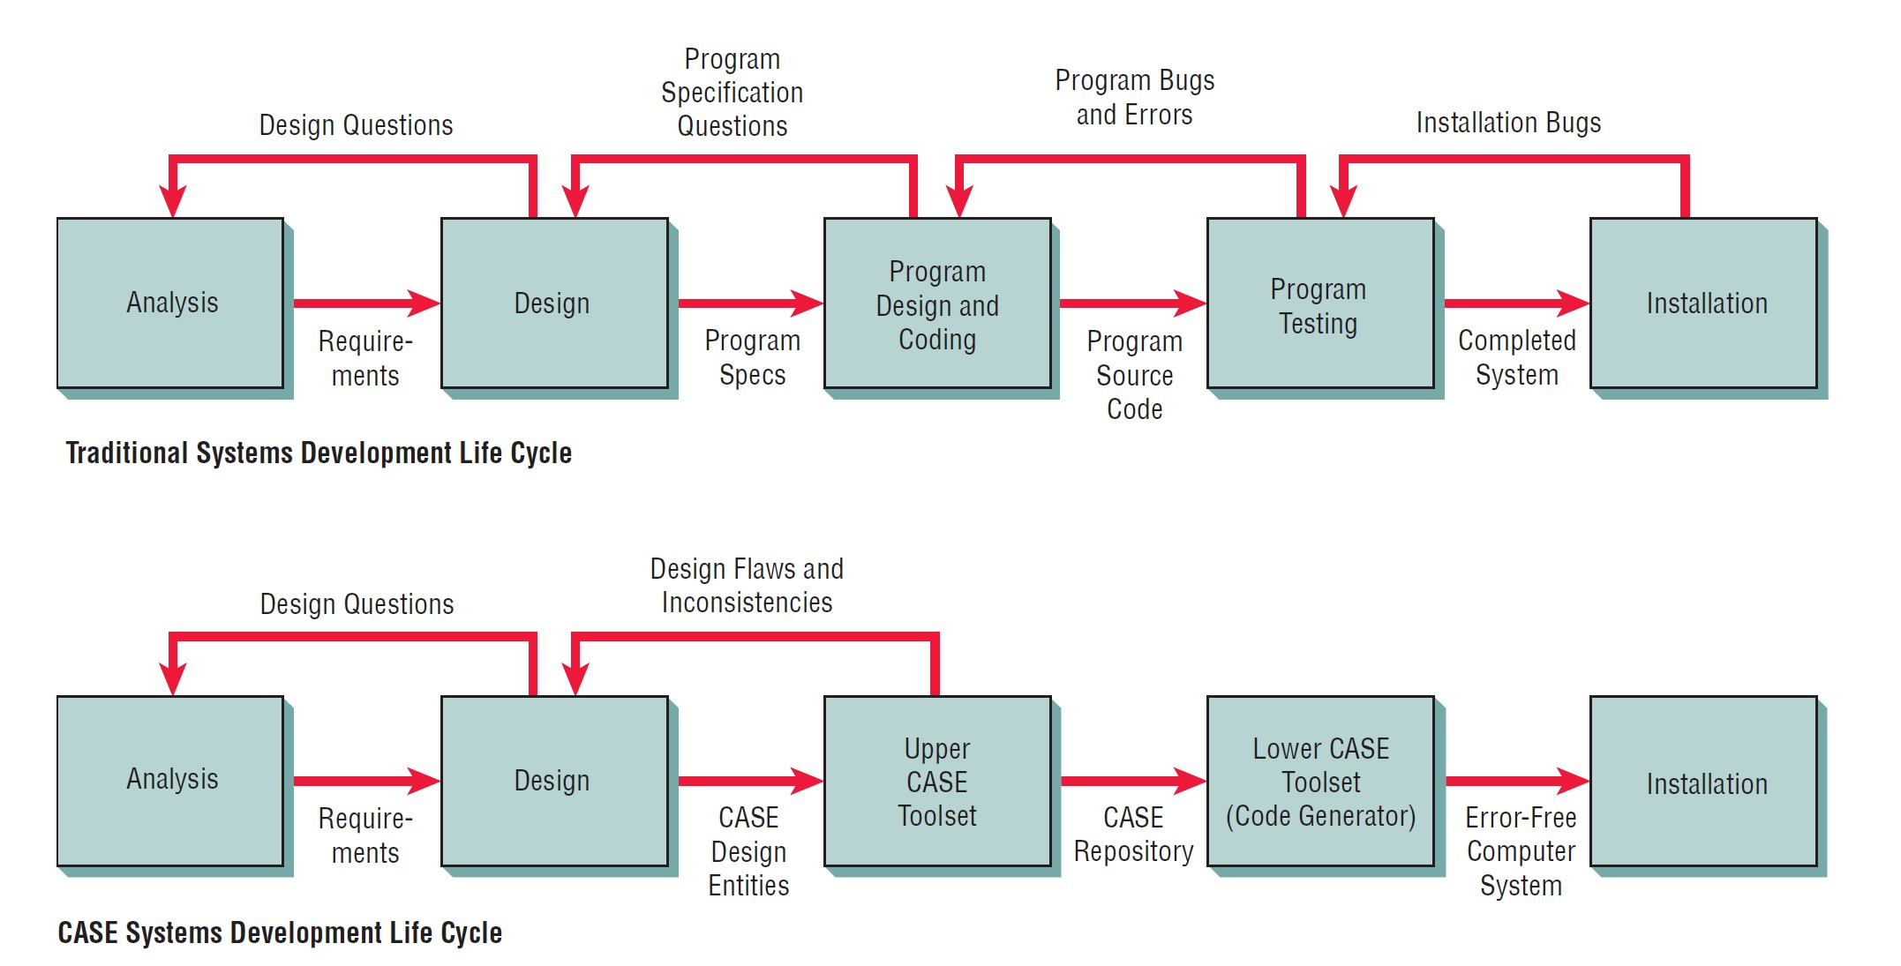
Traditional versus CASE systems development life cycle

Slide 47
Object-­‐Oriented Systems Analysis and Design
Alternate approach to the structured approach of the SDLC that is intended to facilitate the development of systems that must change rapidly in response to dynamic business environments
Analysis is performed on a small part of the system followed by design and implementation. The cycle repeats with analysis, design and implementation of the next part and this repeats until the project is complete

Slide 48
Summary
Information is a key resource
Systems analysts deal with many types of information systems
Integration of traditional systems with new technologies
Roles and qualities of the systems analyst
The systems Development Life Cycle
CASE tools
Alternatives to structured analysis and design and to the SDLC

