Slide 1


System Analysis & Design
Lecture 04
Mustafa Hasan
Head of CSE

Slide 2
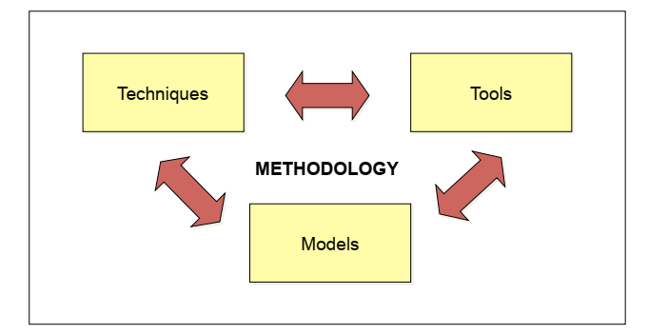
The Main Components of Methodology (MCM)

Slide 3


MCM>Techniques, Models, Tools (TMT)
Techniques is a collection of guidelines that help an analyst complete a system development.
Model is a representation of some important aspect of the real world
Tool is software tool that helps create models or other components required in the project

Slide 4
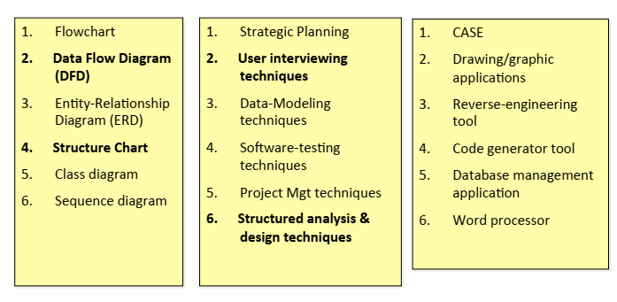
MCM>TMT>Samples

Slide 5

Approaches to Structured Analysis and Design and to the Systems Development Life Cycle
Traditional systems development life cycle
CASE systems development life cycle
Object-­‐Oriented Systems Analysis and Design

Slide 6


Case Tools
CASE tools are productivity tools for systems analysts that have been created explicitly to improve their routine work through the use of automated support
Reasons for using CASE tools
Increasing Analyst Productivity
Improving Analyst-­‐User Communication
Integrating Life Cycle Activities
Accurately Assessing Maintenance Changes

Slide 7

Case Tool Classiﬁcations
Upper CASE tools perform analysis and design (mainly for analyst & designers)
Lower CASE tools generate programs from CASE design (use by programmers)
Integrated CASE tools perform both upper - and lower-CASE functions

Slide 8

Upper CASE Tools
Create and modify the system design
Help in modeling organizational requirements and deﬁning system boundaries
Can also support prototyping of screen and report designs

Slide 9

Lower CASE Tools
Lower CASE tools generate computer source code from the CASE design
Source code is usually generated in several languages

Slide 10
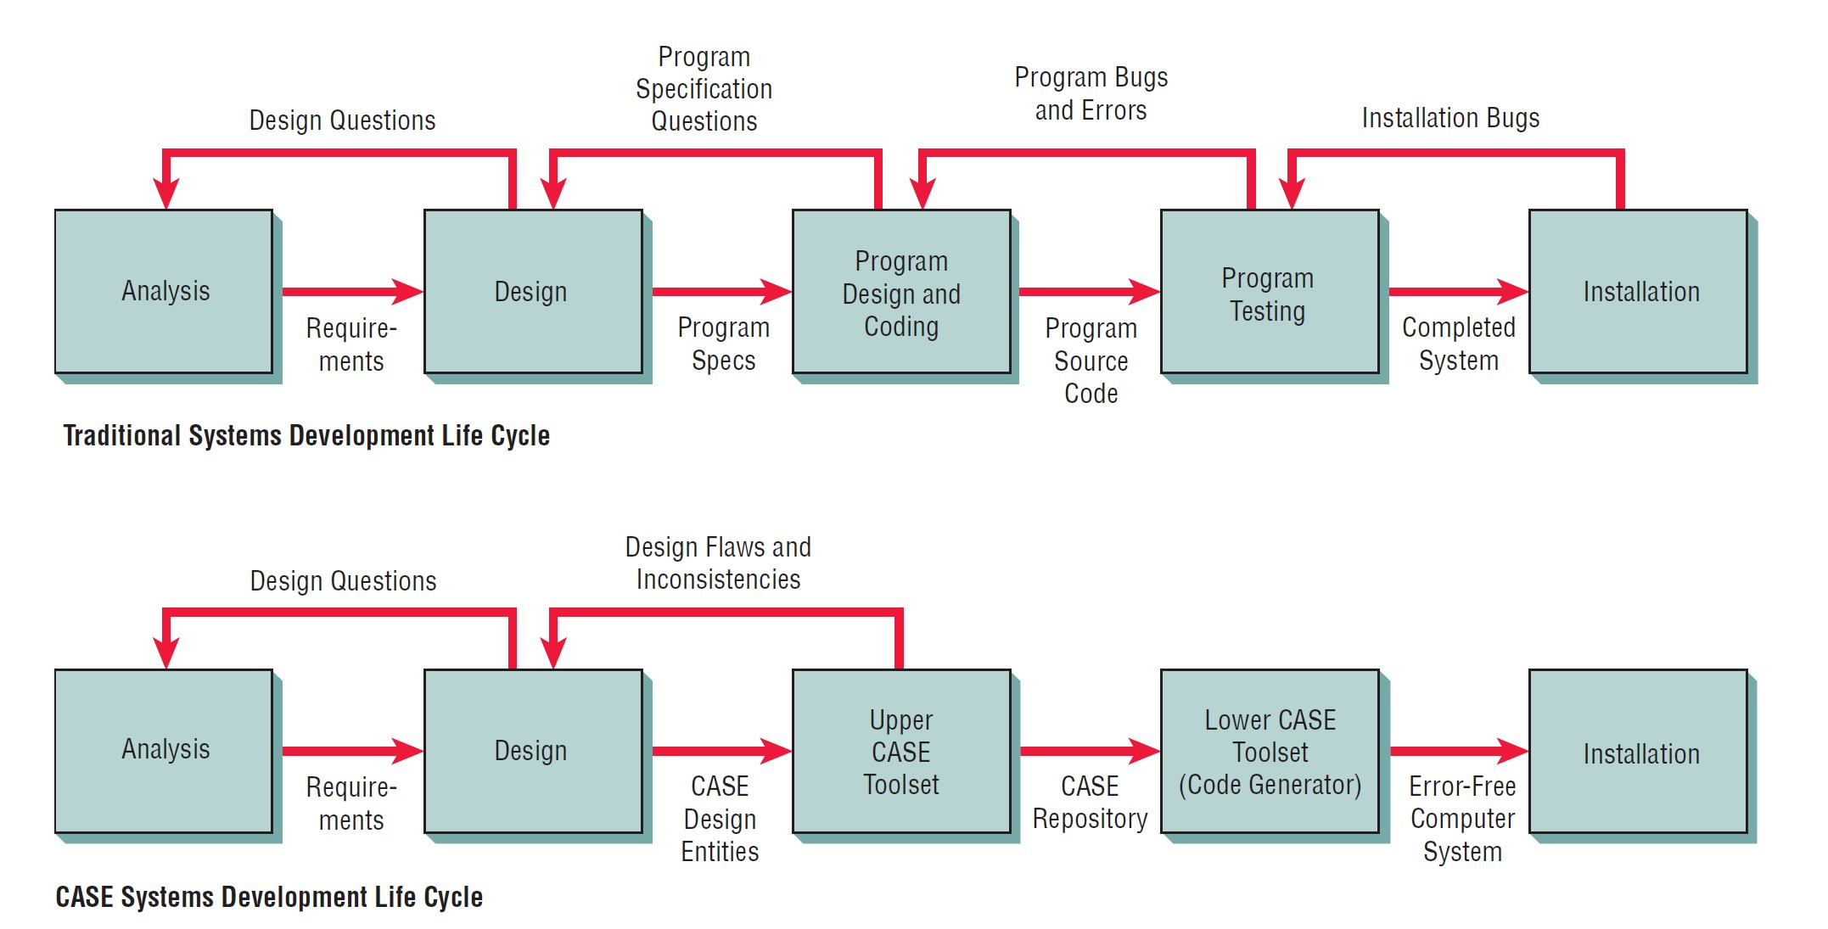
Traditional versus CASE systems development life cycle

Slide 11
Object-­‐Oriented Systems Analysis and Design
Alternate approach to the structured approach of the SDLC that is intended to facilitate the development of systems that must change rapidly in response to dynamic business environments
Analysis is performed on a small part of the system followed by design and implementation. The cycle repeats with analysis, design and implementation of the next part and this repeats until the project is complete

Slide 12

Agile approach
The agile approach is a software development approach based on values, principles, and core practices.
The four values are
communication,
simplicity,
feedback,
courage

Slide 13
Developmental Process for an Agile Project
Exploration,
Planning,
Iterations to the first release,
Productionizing,
Maintenance

Slide 14
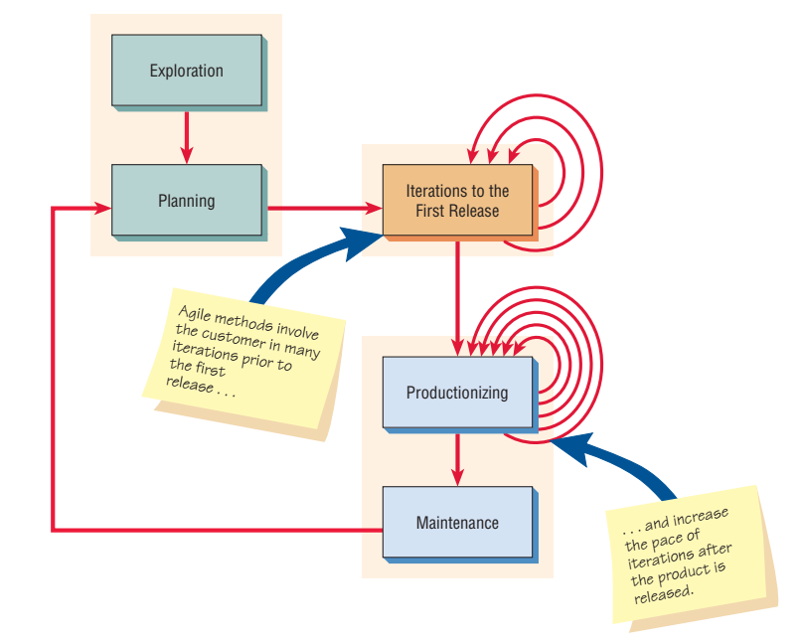
Agile Process

Slide 15

EXPLORATION
Explore your environment, asserting your conviction that the problem can and should be approached with agile development,
Assemble the team and assess team member skills.
Examining potential technologies needed to build the new system.
Estimating the time needed for a variety of tasks.
Work environment, its problems, technologies, and people

Slide 16

PLANNING
You and your customers agree on a date anywhere from two months to half a year from the current date to deliver solutions to their most pressing business problems
The entire agile planning process has been characterized using the idea of a planning game as devised by Beck.
There are two main players in the planning game: the development team and the business customer.

Slide 17
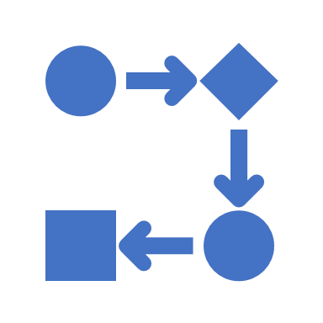
ITERATIONS TO THE FIRST RELEASE
Typically these are iterations (cycles of testing, feedback, and change) of about three weeks in duration.
You will be pushing yourself to sketch out the entire architecture of the system, even though it is just in outline or skeletal form.
One goal is to run customer-written functional tests at the end of each iteration.

Slide 18

PRODUCTIONIZING
The feedback cycle speeds up so that rather than receiving feedback for an iteration every three weeks, software revisions are being turned around in one week.
The product is released in this phase but may be improved by adding other features.

Slide 19
MAINTENANCE
New features may be added, riskier customer suggestions may be considered, and team members may be rotated on or off the team.
The developmental process is more conservative than at any other time.

Slide 20
OBJECT-ORIENTED SYSTEMS ANALYSIS AND DESIGN
O-O is Intended to facilitate the development of systems that must change rapidly in response to dynamic business environments.
Object-oriented techniques are thought to work well in situations in which complicated information systems are undergoing continuous maintenance, adaptation, and redesign.
Object oriented approaches use the industry standard for modeling object-oriented systems, called the unified modeling language (UML), to break down a system into a use case model.

Slide 21
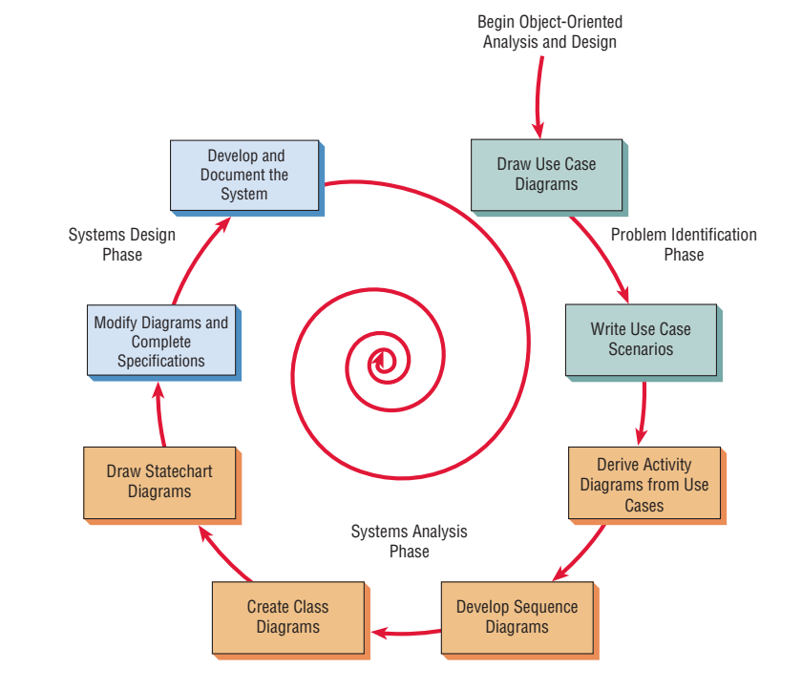
The steps in the UML development process.

Slide 22
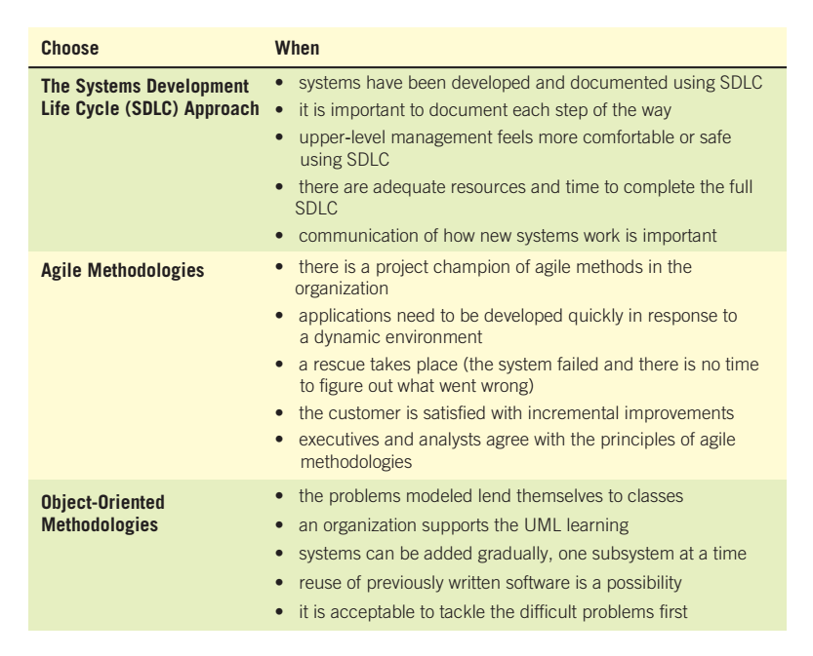
How to decide which development method to use.

