Slide 1

System Analysis and Design Part1: Fundamentals of System Analysis &Design
Mustafa Hasan
Head, CSE

Slide 2
Course Outline
System analysis fundamentals: systems, roles, and development methodologies; Understanding and modeling organizational system; Project management;
Information requirements analysis: Interactive methods; Information gathering: Unobtrusive methods; agile modeling and prototyping;
The analysis process: Using data ﬂow diagrams; Analyzing systems using data dictionaries; Process speciﬁcations and structured decisions; Object oriented systems analysis and design using UML;
The essentials of design: Designing eﬀective output, Designing eﬀectiveinput; Designing databases; Human-computer interaction;
Quality assurance and implementation: Designing accurate data entry procedures; Quality assurance and implementation.

Slide 3
Learning Objective
By the end of this lecture, you will be able to:
Recall the basic types of computer-­‐based systems that a systems analyst needs to address
Understand how users working in context with new technologies change the dynamics of a system
Realize what the many roles of the systems analyst are
Understand what CASE tools are and how they help a systems analyst
Explore other methodologies such as object-­‐oriented systems design and prototyping
Learn RPA.

Slide 4
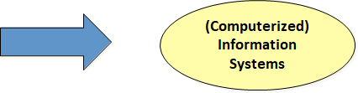
What is Information Systems (IS)?
A system which assembles, stores, processes and delivers information relevant to an organization, in such a way that the information is accessible and useful to those who wish to use it, including managers, staff, clients and citizens. An IS is human activity (social system) which may or may not involve the use of computer systems

Slide 5


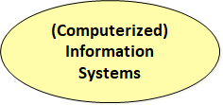
What and Why ISD ???
Systems analysis and design is a systematic approach to identifying problems, opportunities, and objectives; analyzing the information flows in organizations; and designing computerized (in this case) information systems to solve a problem

Slide 6
What and Why ISD ?
•System development needs proper planning.
•There is a cost in system development.
•It is time consuming and needs project management.
•SADM is about problem solving that needs to be creative, critical, and innovative.

Slide 7
Organization as Systems
•Organization as systems, is composed of subsystems and so on.
•It is mainly involving levels of management and culture.
•These will impact the information system development.
•The diﬀerent levels of management will produce the diﬀerent levels of decisions.
•The culture inﬂuences the way people in subsystems interrelate.

Slide 8
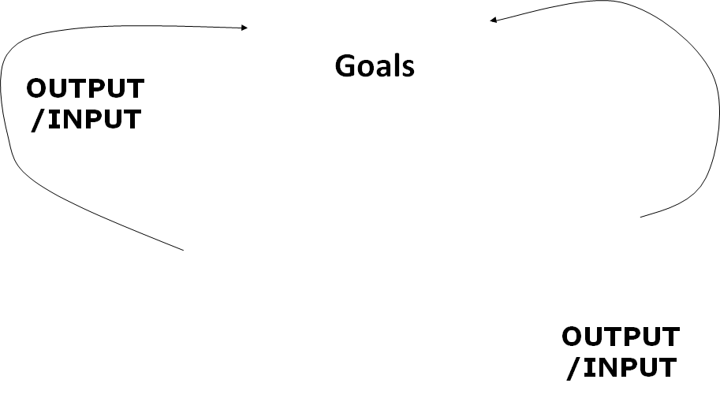
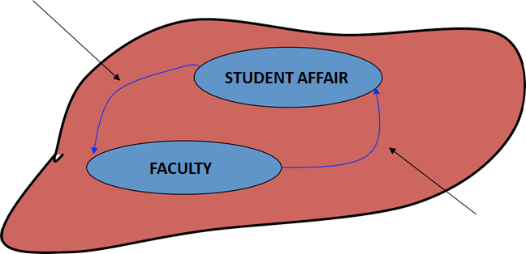
Organization as Systems

Slide 9
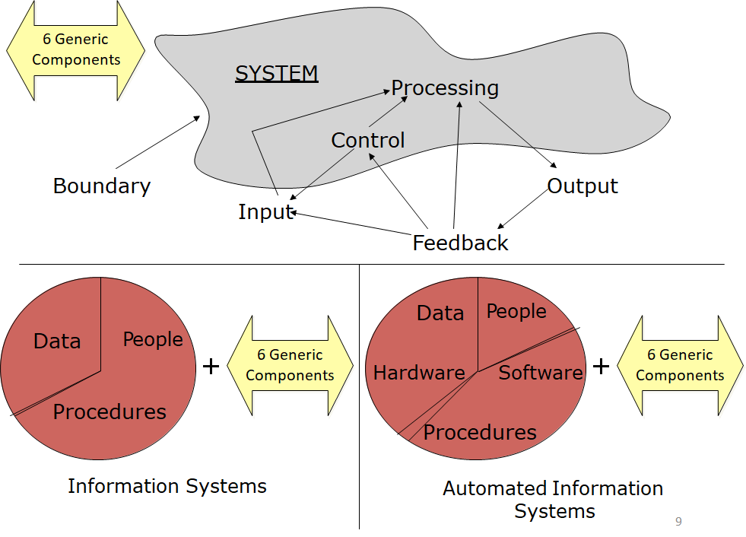

Slide 10
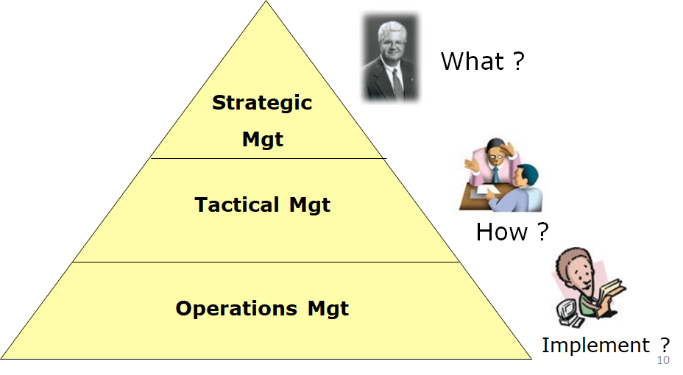
Organizations as Systems> Levels of Management

Slide 11
Business Drivers for Today’s Information Systems
•Globalization of the Economy
•Electronic Commerce and Business
•Security and Privacy
•Collaboration and Partnership
•Knowledge Asset Management
•Continuous Improvement and Total Quality Management
•Business Process Redesign

Slide 12
Business Drivers for Today’s Information Systems
•Networks and the Internet
•Mobile and Wireless Technologies
•Object Technologies
•Collaborative Technologies
•Enterprise Applications

Slide 13
Major Topics
•Fundamentals of diﬀerent kinds of information systems
•Roles of systems analysts
•Phases in the systems development life cycle as they relate to Human-­‐Computer Interaction (HCI) factors
•Computer-­‐Aided Sodware Engineering (CASE) tools

Slide 14
Systems Analysts Recommend, Design, and Maintain Many Types of Systems for Users
–Transaction Processing Systems (TPS)
–Oﬃce Automation Systems (OAS)
–Knowledge Work Systems (KWS)
–Management Information Systems (MIS)
–Decision Support Systems (DSS)
–Expert Systems (ES)
–Executive Support Systems (ESS)
–Group Decision Support Systems (GDSS)
–Computer-­‐Supported Collaborative Work Systems (CSCWS)

Slide 15
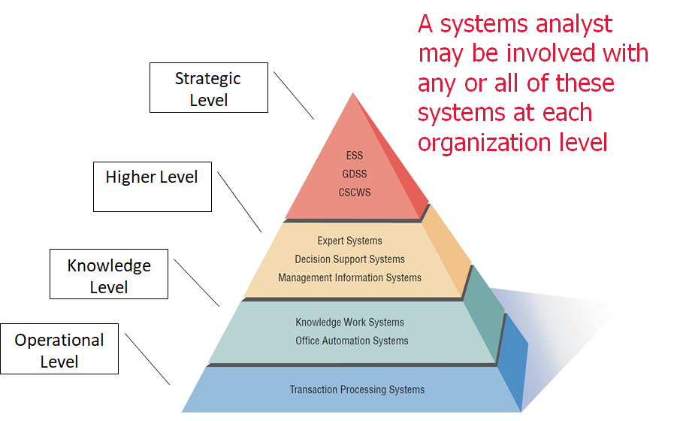
System Analyst Role

