Slide 1
Intelligent Agents
Russell & Norvig
Chapter 2

Slide 2
Today’s class
What’s an agent?
  Definition of an agent
  Rationality and autonomy
  Types of agents
  Properties of environments

Slide 3
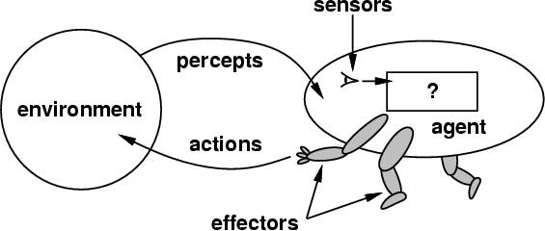
How do you design an intelligent agent?
Definition: An intelligent agent perceives its environment via sensors and acts rationally upon that environment with its effectors.
A discrete agent receives percepts one at a time, and maps this percept sequence to a sequence of discrete actions.
Properties
  Autonomous
  Reactive to the environment
  Pro-active (goal-directed)
  Interacts with other agents
  via the environment

Slide 4
What do you mean, sensors/percepts and effectors/actions?
Humans
  Sensors: Eyes (vision), ears (hearing), skin (touch), tongue (gustation), nose (olfaction), neuromuscular system (proprioception)
  Percepts:
    At the lowest level – electrical signals from these sensors
    After preprocessing – objects in the visual field (location, textures, colors, …), auditory streams (pitch, loudness, direction), …
  Effectors: limbs, digits, eyes, tongue, …
  Actions: lift a finger, turn left, walk, run, carry an object, …
The Point: percepts and actions need to be carefully defined, possibly at different levels of abstraction

Slide 5
Rational Agent → Always try to maximize performance.
No Agent is Omniscience.

Slide 6
A more specific example:
Automated taxi driving system
Performance Measure: Maintain safety, reach destination, maximize profits (fuel, tire wear), obey laws, provide passenger comfort, …
Environment: U.S. urban streets, freeways, traffic, pedestrians, weather, customers, …
Actions: Steer, accelerate, brake, horn, speak/display, …
Sensors/Percepts: Video, sonar, speedometer, odometer, engine sensors, keyboard input, microphone, GPS, …
Different aspects of driving may require different types of agent programs!

Slide 7
Rationality
An ideal rational agent should, for each possible percept sequence, do whatever actions will maximize its expected performance measure based on
    (1) the percept sequence, and
    (2) its built-in and acquired knowledge.
Rationality includes information gathering, not “rational ignorance.” (If you don’t know something, find out!)
Rationality → Need a performance measure to say how well a task has been achieved.
Types of performance measures: false alarm (false positive) and false dismissal (false negative) rates, speed, resources required, effect on environment, etc.

Slide 8
Autonomy
A system is autonomous to the extent that its own behavior is determined by its own experience.
Therefore, a system is not autonomous if it is guided by its designer according to a priori decisions.
To survive, agents must have:
  Enough built-in knowledge to survive.
  The ability to learn.

Slide 9
Some agent types
(0) Table-driven agents
  use a percept sequence/action table in memory to find the next action. They are implemented by a (large) lookup table. It is not autonomous.
(1) Simple reflex agents
  are based on condition-action rules, implemented with an appropriate production system. They are stateless devices which do not have memory of past world states. It can not save history.
(2) Agents with memory
  have internal state, which is used to keep track of past states of the world.
(3) Agents with goals
  are agents that, in addition to state information, have goal information that describes desirable situations. Agents of this kind take future events into consideration. Never thinks about cost.
(4) Utility-based agents
  base their decisions on classic axiomatic utility theory in order to act rationally. Always thinks about cost.

Slide 10
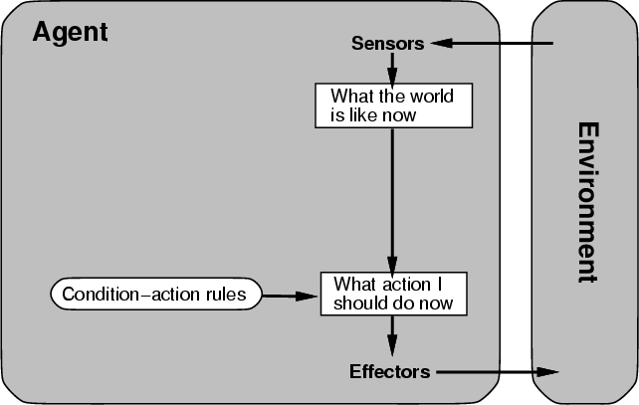
Table-driven/reflex agent architecture

Slide 11
Table-driven agents
Table lookup of percept-action pairs mapping from every possible perceived state to the optimal action for that state
Problems
  Too big to generate and to store (Chess has about 10¹²⁰ states, for example)
  No knowledge of non-perceptual parts of the current state
  Not adaptive to changes in the environment; requires entire table to be updated if changes occur
  Looping: Can’t make actions conditional on previous actions/states

Slide 12
Simple reflex agents
Rule-based reasoning to map from percepts to optimal action; each rule handles a collection of perceived states
Problems
  Still usually too big to generate and to store
  Still not adaptive to changes in the environment; requires collection of rules to be updated if changes occur
  Still can’t make actions conditional on previous state

Slide 13
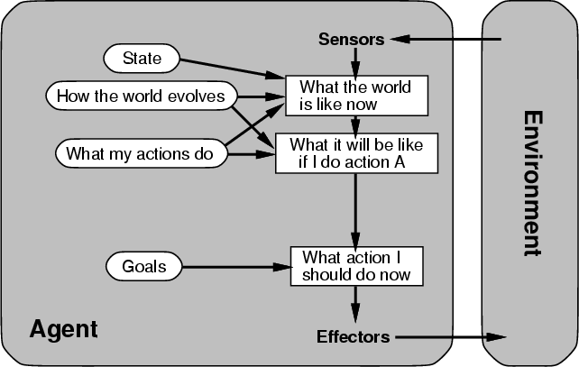
Architecture for goal-based agent

Slide 14
Goal-based agents
Choose actions so as to achieve a (given or computed) goal.
A goal is a description of a desirable situation.
Keeping track of the current state is often not enough − need to add goals to decide which situations are good
Deliberative instead of reactive.
May have to consider long sequences of possible actions before deciding if goal is achieved – involves consideration of the future, “what will happen if I do...?”

Slide 15
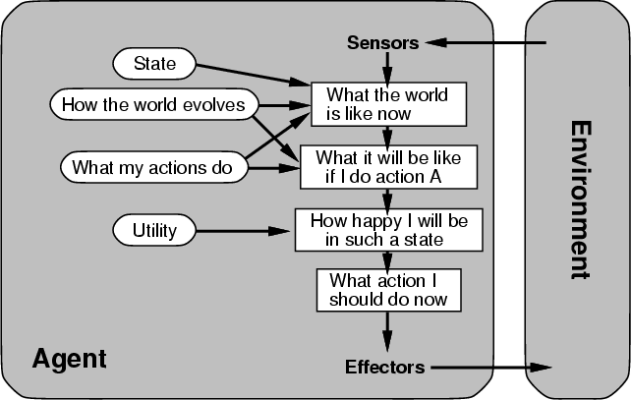
Architecture for a complete utility-based agent

Slide 16
Utility-based agents
When there are multiple possible alternatives, how to decide which one is best?
A goal specifies a crude distinction between a happy and unhappy state, but often need a more general performance measure that describes “degree of happiness.”
Utility function U: State → Reals indicating a measure of success or happiness when at a given state.

Slide 17
Properties of Environments
Fully observable/Partially observable.
  If an agent’s sensors give it access to the complete state of the environment needed to choose an action, the environment is fully observable.
Deterministic/Stochastic.
  An environment is deterministic if the next state of the environment is completely determined by the current state of the environment and the action of the agent; in a stochastic environment, there are multiple, unpredictable outcomes
  In a fully observable, deterministic environment, the agent need not deal with uncertainty. (Ideal Environment)

Slide 18
Properties of Environments II
Episodic/Sequential.
  An episodic environment means that subsequent episodes do not depend on what actions occurred in previous episodes.
  In a sequential environment, the agent engages in a series of connected episodes.
  Such environments do not require the agent to plan ahead.
Static/Dynamic.
  A static environment does not change while the agent is thinking.
  The agent doesn’t need to observe the world during deliberation.

Slide 19
Properties of Environments III
Discrete/Continuous.
  If the number of distinct percepts and actions is limited, the environment is discrete, otherwise it is continuous.
Single agent/Multi-agent.
  If the environment contains other intelligent agents, the agent needs to be concerned about strategic, game-theoretic aspects of the environment (for either cooperative or competitive agents)
  Most engineering environments don’t have multi-agent properties, whereas most social and economic systems get their complexity from the interactions of (more or less) rational agents.

Slide 20
Characteristics of environments
 | Fully observable? | Deterministic | Episodic | Static | Discrete? | Single agent?
Solitaire
Driving
Internet shopping
Medical diagnosis

Slide 21
Characteristics of environments
 | Fully observable? | Deterministic? | Episodic? | Static? | Discrete? | Single agent?
Solitaire | No | Yes | Yes | Yes | Yes | Yes
Driving | No | No | No | No | No | No
Internet shopping
Medical diagnosis

Slide 22
Characteristics of environments
 | Fully observable? | Deterministic? | Episodic? | Static? | Discrete? | Single agent?
Solitaire | No | Yes | Yes | Yes | Yes | Yes
Driving | No | No | No | No | No | No
Internet shopping | No | No | No | No | Yes | No
Medical diagnosis

Slide 23
Characteristics of environments
 | Fully observable? | Deterministic? | Episodic? | Static? | Discrete? | Single agent?
Solitaire | No | Yes | Yes | Yes | Yes | Yes
Driving | No | No | No | No | No | No
Internet shopping | No | No | No | No | Yes | No
Medical diagnosis | No | No | No | No | No | Yes
→ Lots of real-world domains fall into the hardest case!

Slide 24
Summary
An agent perceives and acts in an environment, has an architecture, and is implemented by an agent program.
An ideal agent always chooses the action which maximizes its expected performance, given its percept sequence so far.
An autonomous agent uses its own experience rather than built-in knowledge of the environment by the designer.
An agent program maps from percept to action and updates its internal state.
  Reflex agents respond immediately to percepts.
  Goal-based agents act in order to achieve their goal(s).
  Utility-based agents maximize their own utility function.
Representing knowledge is important for successful agent design.
The most challenging environments are partially observable, stochastic, sequential, dynamic, and continuous, and contain multiple intelligent agents.

