Slide 1
Simulated Annealing

Slide 2
Optimization Problems
Instead of considering the whole state space, consider only the current state
Limits necessary memory; paths not retained
Amenable to large or continuous (infinite) state spaces where exhaustive search algorithms are not possible
Local search algorithms can’t backtrack

Slide 3
Local Search Algorithms
They are useful for solving optimization problems
  Aim is to find a best state according to an objective function
Many optimization problems do not fit the standard search model outlined in chapter 3
  E.g. There is no goal test or path cost in Darwinian evolution
State space landscape

Slide 4
Optimization Problems
Given measure of goodness (of fit)
  Find optimal parameters (e.g correspondences)
  That maximize goodness measure (or minimize badness measure)
Optimization techniques
  Direct (closed-form)
  Search (generate-test)
  Heuristic search (e.g Hill Climbing)
  Genetic Algorithm

Slide 5
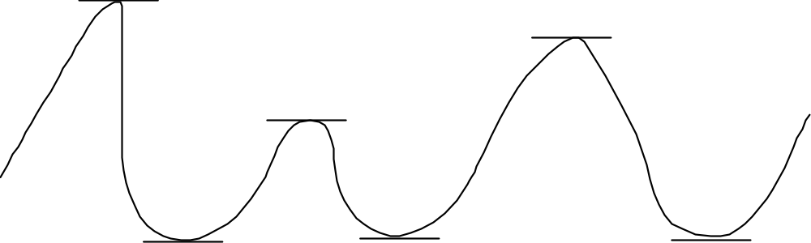
Direct Optimization
AI: Chapter 4: Informed Search and Exploration
The slope of a function at the maximum or minimum is 0
  Function is neither growing nor shrinking
  True at global, but also local extreme points
Find where the slope is zero and you find extrema!
(If you have the equation, use calculus (first derivative=0)

Slide 6
Hill Climbing
Consider all possible successors as “one step” from the current state on the landscape.
At each iteration, go to
  The best successor (steepest ascent)
  Any uphill move (first choice)
  Any uphill move but steeper is more probable (stochastic)
All variations get stuck at local maxima

Slide 7
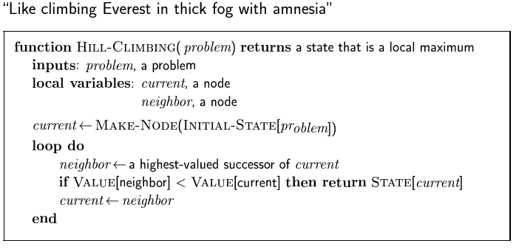
Hill Climbing

Slide 8
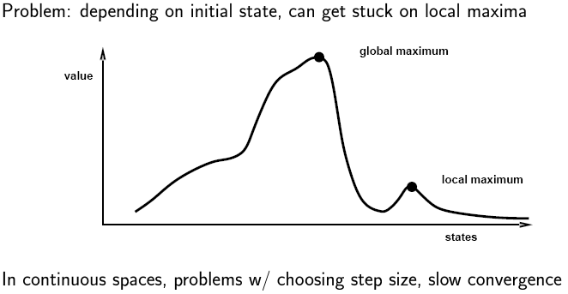
Hill Climbing

Slide 9
Hill Climbing
Local maxima = no uphill step
  Algorithms on previous slide fail (not complete)
  Allow “random restart” which is complete, but might take a very long time
Plateau = all steps equal (flat or shoulder)
  Must move to equal state to make progress, but no indication of the correct direction
Ridge = narrow path of maxima, but might have to go down to go up (e.g. diagonal ridge in 4-direction space)

Slide 10
Simulated Annealing
Idea: Escape local maxima by allowing some “bad” moves
  But gradually decreasing their frequency
Algorithm is randomized:
  Take a step if random number is less than a value based on both the objective function and the Temperature
When Temperature is high, chance of going toward a higher value of optimization function J(x) is greater
Note higher dimension: “perturb parameter vector” vs. “look at next and previous value”

Slide 11
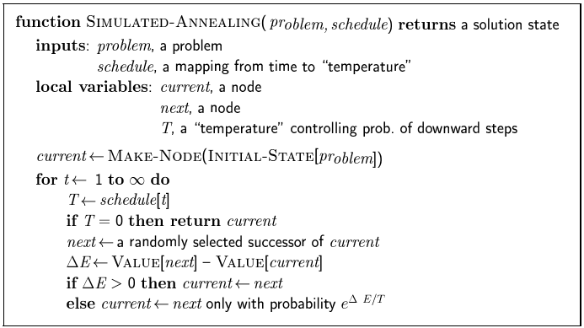
Simulated Annealing

Slide 12
Iterative Search
General method to solve combinatorial optimization problems
Principle:
Start with initial configuration
Repeatedly search neighborhood and select a neighbor as candidate
Evaluate some cost function (or fitness function) and accept candidate if "better"; if not, select another neighbor
Stop if quality is sufficiently high, if no improvement can be found or after some fixed time

Slide 13
Requirement
A method to generate initial configuration
A transition or generation function to find a neighbor as next candidate
A cost function
An Evaluation Criterion
A Stopping Criterion

Slide 14
Simple Iterative or Hill Climbing Algorithm
Procedure
Candidate is always and only accepted if cost is lower (or fitness is higher) than current configuration
Stop when no neighbor with lower cost (higher fitness) can be found
Disadvantages
Local optimum as best result
Local optimum depends on initial configuration
Generally no upper bound on iteration length

Slide 15
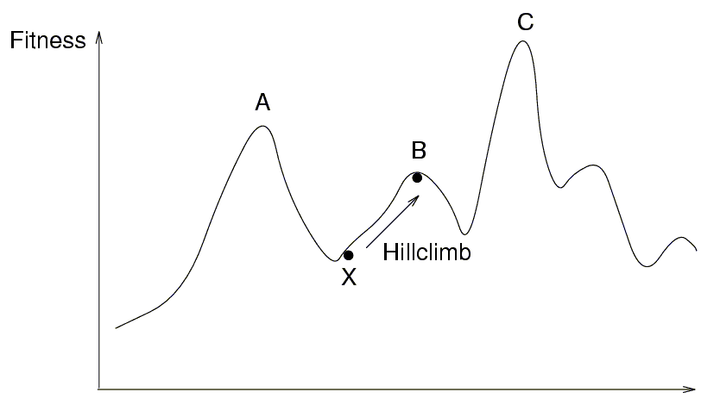
Hill climbing

Slide 16
How to cope with disadvantages
Repeat algorithm many times with different initial configurations
Use information gathered in previous runs
Use a more complex Generation Function to jump out of local optimum
Use a more complex Evaluation Criterion that accepts sometimes (randomly) also solutions away from the (local) optimum

Slide 17
Simulated Annealing
Use a more complex Evaluation Function
Sometime accept candidates with higher cost to escape from local optimum
Adapt the parameters of this Evaluation Function during execution
Based upon the analogy with the simulation of the annealing of solids

Slide 18
Other Names
Monte Carlo Annealing
Statistical Cooling
Probabilistic Hill Climbing
Stochastic Relaxation
Probabilistic Exchange Algorithm

Slide 19
Analogy
Annealing is a thermal process for obtaining low energy states of a solid in a heat bath
The process contains two steps
  Increase the temperature of the heat bath to a maximum value at which the solid melts
  Decrease carefully the temperature of the heat bath until the particles arrange themselves in the ground state of the solid. Ground state is a minimum energy state of the solid
The ground state of the solid is obtained only if the maximum temperature is high enough and the cooling is done slowly

Slide 20
Analogy
Slowly cool down a heated solid, so that all particles arrange in the ground energy state
At each temperature wait until the solid reaches its thermal equilibrium
Probability of being in a state with energy E :
Pr { E = E } = 1/Z(T) . exp (-E / k_{B}.T)
E Energy
T Temperature
k_{B} Boltzmann constant
Z(T) Normalization factor (temperature dependant)

Slide 21
Simulation of cooling (Metropolis 1953)
At a fixed temperature T :
Perturb (randomly) the current state to a new state
ΔE is the difference in energy between current and new state
If ΔE < 0 (new state is lower), accept new state as current state
If ΔE ≥ 0 , accept new state with probability
Pr (accepted) = exp (- ΔE / k_{B}.T)
Eventually the systems evolves into thermal equilibrium at temperature T ; then the formula mentioned before holds
When equilibrium is reached, temperature T can be lowered and the process can be repeated

Slide 22
Simulated Annealing
Same algorithm can be used for combinatorial optimization problems:
Energy E corresponds to the Cost function C
Temperature T corresponds to control parameter c
Pr { configuration = i } = 1/Q(c) . exp (-C(i) / c)
C Cost
c Control parameter
Q(c) Normalization factor (not important)

Slide 23
Homogeneous Algorithm
initialize;
REPEAT
REPEAT
perturb ( config.i → config.j, ΔC_{ij});
IF ΔC_{ij} < 0 THEN accept
ELSE IF exp(-ΔC_{ij}/c) > random[0,1) THEN accept;
IF accept THEN update(config.j);
UNTIL equilibrium is approached sufficient closely;
c := next_lower(c);
UNTIL system is frozen or stop criterion is reached

Slide 24
Inhomogeneous Algorithm
Previous algorithm is the homogeneous variant:
c is kept constant in the inner loop and is only decreased in the outer loop
Alternative is the inhomogeneous variant:
There is only one loop; c is decreased each time in the loop, but only very slightly

Slide 25
Parameters
Choose the start value of c so that in the beginning nearly all perturbations are accepted (exploration), but not too big to avoid long run times
The function next_lower in the homogeneous variant is generally a simple function to decrease c, e.g. a fixed part (80%) of current c
At the end c is so small that only a very small number of the perturbations is accepted (exploitation)
If possible, always try to remember explicitly the best solution found so far; the algorithm itself can leave its best solution and not find it again

Slide 26
Performance
SA is a general solution method that is easily applicable to a large number of problems
"Tuning" of the parameters (initial c, decrement of c, stop criterion) is necessary
Generally the quality of the results of SA is good, although it can take a lot of time
Results are generally not reproducible: another run can give a different result
SA can leave an optimal solution and not find it again
(so try to remember the best solution found so far)
Proven to find the optimum under certain conditions; one of these conditions is that you must run forever

Slide 27
Practical Issues with Simulated Annealing
The cost function should be fast it is going to be called “millions” of times
The best is if we just have to calculate the deltas produced by the modification instead of traversing through all the state
This is dependent on the application

Slide 28
Practical Issues with Simulated Annealing
In asymptotic convergence simulated annealing converges to globally optimal solutions
In practice, the convergence of the algorithm depends of the cooling schedule
There are some suggestion about the cooling schedule but it stills requires a lot of testing and it usually depends on the application

Slide 29
Practical Issues with Simulated Annealing
Start at a temperature where 50% of bad moves are accepted
Each cooling step reduces the temperature by 10%
The number of iterations at each temperature should attempt to move between 1-10 times each “element” of the state
The final temperature should not accept bad moves; this step is known as the quenching step

