Slide 1
Constraint Satisfaction Problems
Taksir
CSE 4107
Spring 17

Slide 2
Outline
What is a CSP ???
Inference in CSP
Backtracking for CSP
Local search for CSPs

Slide 3
CSP
a set of variables, each of which has a value. A problem is solved when each variable has a value that satisfies all the constraints on the variable. A problem described this way is called a constraint satisfaction problem, or CSP.

Slide 4
Examples
Different types of scheduling
  Airline schedules
  Scheduling your exam /class routine
  Job Shop Scheduling
Linear programming Problem
  Constraint Optimization Problem

Slide 5
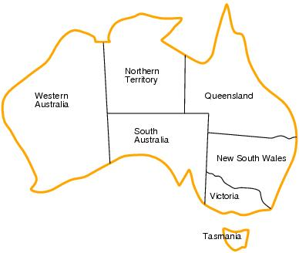
CSP example: map coloring
Adjacent regions must have different colors.

Slide 6
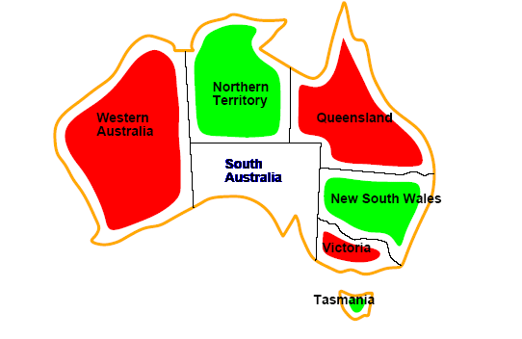
CSP example: map coloring

Slide 7
Constraint Satisfaction Problems
A CSP consists of three components – X, D and C.
A set of variables, X = { X₁, X₂, …, X_{n} }
A set of domain of possible values for each variable D = {D₁, D₂, … D_{n} }
Finite set of constraints C = {C₁, C₂, …, C_{m} }
    Each constraint C_{i} limits the values that variables can take,
      e.g., X₁ ≠ X₂
A state is defined as an assignment of values
to some or all variables.

Slide 8
Some terminology
Partial Assignment
  An assignment is partial when only some of the variables are assigned to some value.
Complete Assignment
  An assignment is complete when every variable is assigned to some value.
Consistent assignment
  assignment does not violate the constraints
  Can be partial or complete
A solution to a CSP is a complete assignment that satisfies all constraints.

Slide 9
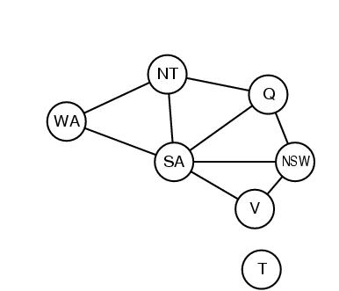
Constraint graphs
Constraint graph:
  each node is a variable
  arcs are binary constraints
Graph can be used to simplify search
e.g. Tasmania is an independent subproblem
(will return to graph structure later)

Slide 10
Varieties of CSPs
Discrete variables
  Finite domains; size d ⇒O(d^{n}) complete assignments.
    E.g. Boolean CSPs: Boolean satisfiability (NP-complete).
  Infinite domains (integers, strings, etc.)
    E.g. job scheduling, variables are start/end days for each job
    Need a constraint language e.g StartJob₁ +5 ≤ StartJob₃.
    Infinitely many solutions
    Linear constraints: solvable
    Nonlinear: no general algorithm
Continuous variables
  e.g. building an airline schedule or class schedule.
  Linear constraints solvable in polynomial time by LP methods.

Slide 11
Varieties of constraints
Unary constraints involve a single variable.
  e.g. SA ≠ green
Binary constraints involve pairs of variables.
  e.g. SA ≠ WA
Global constraints involve 3 or more variables.
  Professors A, B, and C cannot be on a committee together
  Can always be represented by multiple binary constraints
Preference (soft constraints)
  e.g. red is better than green often can be represented by a cost for each variable assignment
  combination of optimization with CSPs

Slide 12
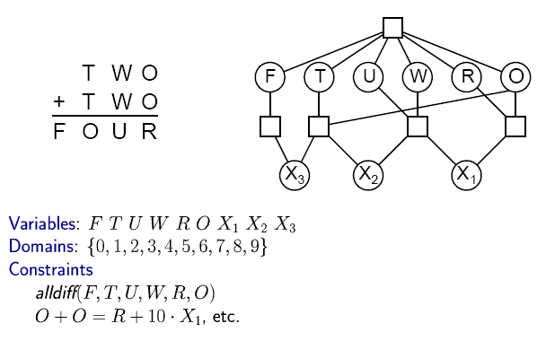


CSP Example: Cryptharithmetic puzzle

Slide 13
CSP Example: Cryptharithmetic puzzle

Slide 14
CSP Example: Cryptharithmetic puzzle

Slide 15
CSP Example: Cryptharithmetic puzzle- Constraint HyperGraph

Slide 16
CSP as a standard search problem
A CSP can easily be expressed as a standard search problem.
Incremental formulation
  Initial State: the empty assignment {}
  Successor function: Assign a value to any unassigned variable provided that it does not violate a constraint
  Goal test: the current assignment is complete
(by construction its consistent)
  Path cost: constant cost for every step (not really relevant)
Can also use complete-state formulation
  Local search techniques (Chapter 4) tend to work well

Slide 17
CSP as a standard search problem
Solution is found at depth n (if there are n variables).
Consider using BFS
  Branching factor b at the top level is nd
  At next level is (n-1)d
  ….
end up with n!d^{n} leaves even though there are only d^{n} complete assignments!

Slide 18
Commutativity
CSPs are commutative.
  The order of any given set of actions has no effect on the outcome.
  Example: choose colors for Australian territories one at a time
    [WA=red then NT=green] same as [NT=green then WA=red]
All CSP search algorithms can generate successors by considering assignments for only a single variable at each node in the search tree
⇒ there are d^{n} leaves
(will need to figure out later which variable to assign a value to at each node)

Slide 19
Backtracking search
Similar to Depth-first search
Chooses values for one variable at a time and backtracks when a variable has no legal values left to assign.

Slide 20
Backtracking search (without inference)
function BACKTRACKING-SEARCH(csp) return a solution or failure
return RECURSIVE-BACKTRACKING({} , csp)
function BACKTRACKING(assignment, csp) return a solution or failure
if assignment is complete then return assignment
var ← SELECT-UNASSIGNED-VARIABLE(VARIABLES[csp],assignment,csp)
for each value in ORDER-DOMAIN-VALUES(var, assignment, csp) do
if value is consistent with assignment then
add {var=value} to assignment
result ← RECURSIVE-BACTRACKING(assignment, csp)
if result ≠ failure then return result
remove {var=value} from assignment
return failure

Slide 21
Backtracking example

Slide 22
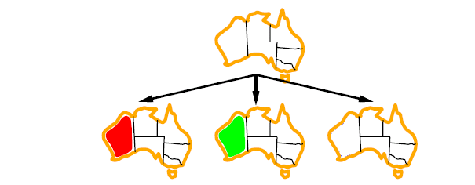
Backtracking example

Slide 23
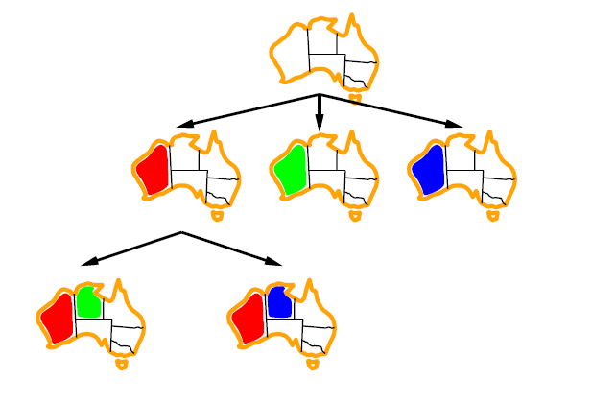
Backtracking example

Slide 24
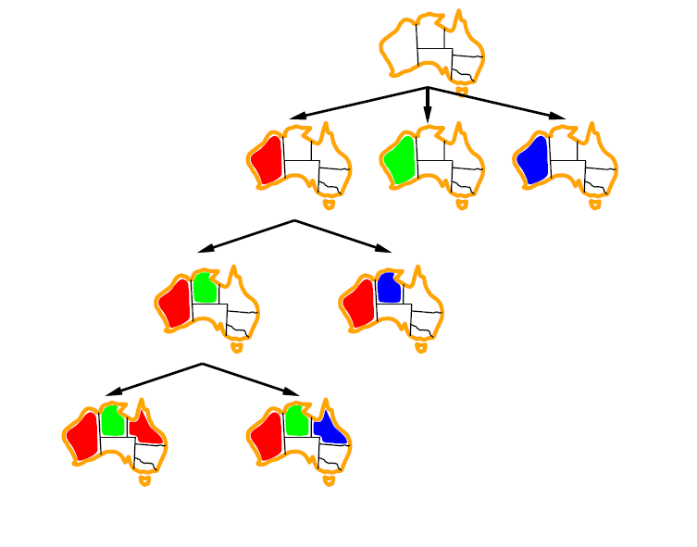
Backtracking example

Slide 25
Some Issues to Inspect
In which order should we assign the variables with different values ??
In which order different values should be tried?

Slide 26
Improving CSP efficiency
Previous improvements on uninformed search
→ introduce heuristics
For CSPs, general-purpose methods can give large gains in speed, e.g.,
  Which variable should be assigned next?
  In what order should its values be tried?
  Can we detect inevitable failure early?
  Can we take advantage of problem structure?
Note: CSPs are somewhat generic in their formulation, and so the heuristics are more general compared to methods in Chapter 4

Slide 27
Backtracking search (without inference)
function BACKTRACKING-SEARCH(csp) return a solution or failure
return RECURSIVE-BACKTRACKING({} , csp)
function RECURSIVE-BACKTRACKING(assignment, csp) return a solution or failure
if assignment is complete then return assignment
var ← SELECT-UNASSIGNED-VARIABLE(VARIABLES[csp],assignment,csp)
for each value in ORDER-DOMAIN-VALUES(var, assignment, csp) do
if value is consistent with assignment according to CONSTRAINTS[csp] then
add {var=value} to assignment
result ← RRECURSIVE-BACTRACKING(assignment, csp)
if result ≠ failure then return result
remove {var=value} from assignment
return failure

Slide 28
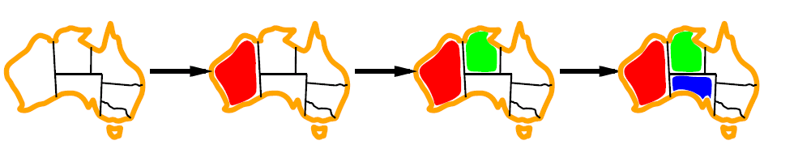
Minimum remaining values (MRV)
var ← SELECT-UNASSIGNED-VARIABLE(VARIABLES[csp],assignment,csp)
A.k.a. most constrained variable heuristic
Heuristic Rule: choose variable with the fewest legal moves
  e.g., will immediately detect failure if X has no legal values

Slide 29

Degree heuristic for the initial variable
Heuristic Rule: select variable that is involved in the largest number of constraints on other unassigned variables.
Degree heuristic can be useful as a tie breaker.
In what order should a variable’s values be tried?

Slide 30
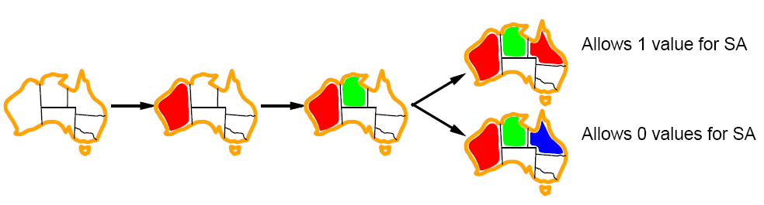
Least constraining value for value-ordering
Least constraining value heuristic
Heuristic Rule: given a variable choose the least constraining value
  leaves the maximum flexibility for subsequent variable assignments

Slide 31

Variable Ordering is fail-first
Value Ordering is fail-last
WHY ???

Slide 32
Variable ordering is fail-first
Minimizes the number of nodes in the search tree
Value ordering is fail-last
We need only one solution, look the most likely values first. If all consistent solutions are needed, value ordering is irrelevant

Slide 33
Inference – Constraint Propagation
Reduce the numbers of legal moves for a variable
As a preprocessing step of search
Can also solve the whole problem sometimes
The key idea is “LOCAL CONSISTENCY”

Slide 34
Node consistency
A node is Node-Consistent if no values in its domain violate any of its unary constraints
By running node consistency all the unary constraints can be eliminated
Say we add a new constraint that SA does not like Red color, we can remove Red from its domain.
  w

Slide 35
Arc consistency
A variable is arc-consistent if doesn’t violate any of its binary constraints
An Arc X → Y is consistent if
for every value x of X there is some value y consistent with x
(note that this is a directed property)
Say, one constraint is X = Y^2
Domain of X, Y: {0,1,2, …, 9}
So we know that X can only have a value from {0,1,2,3}
Similarly, Y can have only {0,1,4,9}

Slide 36
Arc consistency
A network is arc consistent, if every variable is arc consistent

Slide 37
Arc consistency algorithm (AC-3)
function AC-3(csp) return false if inconsistent
inputs: csp, a binary csp with components (X,D,C)
local variables: queue, a set of arcs; initially all the arcs in csp
while queue is not empty do
(X_{i}, X_{j}) ← REMOVE-FIRST(queue)
if REVISE(X_{i}(X_{i}, X_{j}) then
if DOMAIN[X_{i}] = 0 return flase
for each X_{k} in NEIGHBORS[X_{i}] – {Xj} do
add (X_{k}, X_{i}) to queue
return true
function REVISE(X_{i}, X_{j}) return true iff we revise the domain of X_{i}
revised ← false
for each x in DOMAIN[X_{i}] do
if no value y in DOMAIN[X_{i}] allows (x,y) to satisfy the constraints between X_{i} and X_{j}
then delete x from DOMAIN[X_{i}]; revised ← true
return revised

Slide 38

Simple Example
Simplified Map Coloring, only with red and Blue
Will AC-3 help ???

Slide 39
Any luck for Australian map coloring ?

Slide 40
Another problem to try
[R,B,G]
[R,B,G]
[R]
[R,B,G]
[R,B,G]

Slide 41
Arc consistency
We can know, if the problem is insolvable early.
  Reducing all domain size to 0
Sometimes we can even solve the problem
  Reducing all domain size to 1
By AC-3 we find a equivalent CSP, but in a reduced form
Can faster the search
  Reducing domain size
Sometimes, we don’t get much from AC-3
  Australian map coloring example – no reduction at all

Slide 42
Path Consistency
Generalizing arc consistency
Xi and Xj are path consistent with Xm if, for every pair of values (a,b) that satisfies the binary constraint between Xi and Xj , there exists a value c of Xm such that (a,c) and (b,c) satisfy the constraints
We again go to the reduced problem of only 2 colors
There are 2 consistent assignments for WA and SA
WA= red, SA = blue
WA =blue, SA = red
Now no choice for NT
Path consistency of {WA,SA} w.r.to NT

Slide 43
K-consistency
Arc consistency does not detect all inconsistencies:
Stronger forms of propagation can be defined using the notion of k-consistency.
A CSP is k-consistent if for any set of k-1 variables and for any consistent assignment to those variables, a consistent value can always be assigned to any kth variable.
  E.g. 1-consistency = node-consistency
  E.g. 2-consistency = arc-consistency
  E.g. 3-consistency = path-consistency

Slide 44

K-consistency
Strongly k-consistent:
  k-consistent for all values {k, k-1, …2, 1}
What happens if we make a CSP with n variables, strongly n – consistent???

Slide 45

K-consistency
What happens if we make a CSP with n variables, strongly n – consistent???
We can solve the problem very easily!!!!!

Slide 46

To make a graph n-consistent we need exponential time and space

Slide 47
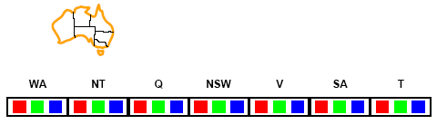
Interleaving Search and inference - Forward checking
Can we detect inevitable failure early?
  And avoid it later?
Forward checking idea: keep track of remaining legal values for unassigned variables.
Terminate search when any variable has no legal values.

Slide 48
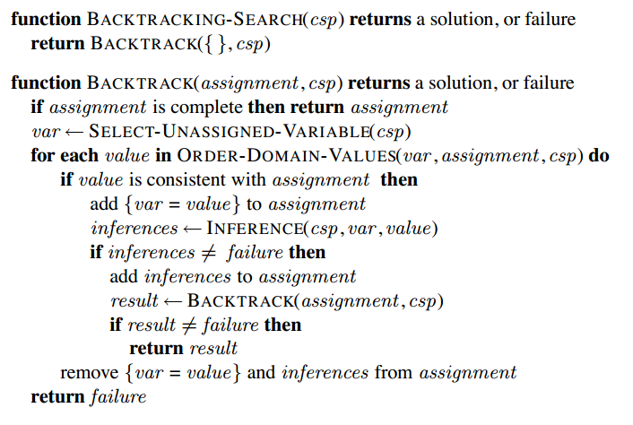
Backtracking Search

Slide 49
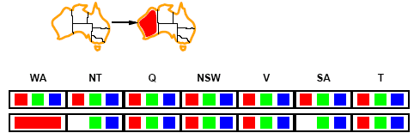
Forward checking
In backtracking., whenever a variable X is assigned, process its arc-consistency
Assign {WA=red}
Effects on other variables connected by constraints to WA
  NT can no longer be red
  SA can no longer be red

Slide 50
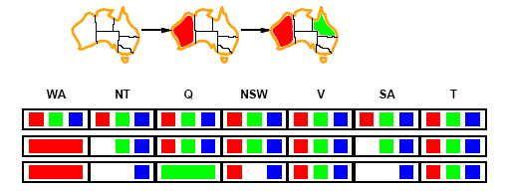
Forward checking
Assign {Q=green}
Effects on other variables connected by constraints with WA
  NT can no longer be green
  NSW can no longer be green
  SA can no longer be green

Slide 51
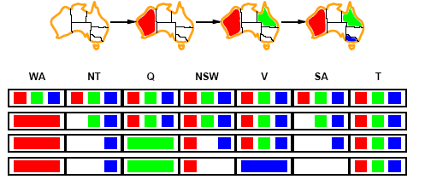
Forward checking
If V is assigned blue
Effects on other variables connected by constraints with WA
  NSW can no longer be blue
  SA is empty
FC has detected that partial assignment is inconsistent with the constraints and backtracking can occur.

Slide 52
Forward checking
MRV heuristic can come handy
- after WA = red, MRV would automatically select NT or SA next

Slide 53
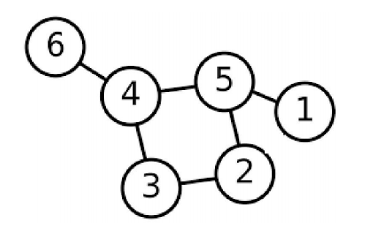
Forward Checking - Practice
Each node can be colored either with red or blue (except node 4).
Node 4 can only be colored with red.
Node ordering : 1, 2, 5, 4, 6, and 3.
Value order: first blue and then red.

Slide 54
MAC(Maintaining arc consistency)
Arc consistency does not see much
When WA = red, and Q = green was assigned, both NT and SA was forced to choose blue, which is a inconsistency
We can improve with MAC
Call AC-3 each time a variable is assigned to a value

Slide 55
Local search for CSPs
Use complete-state representation
  Initial state = all variables assigned values
  Successor states = change 1 (or more) values
For CSPs
  allow states with unsatisfied constraints (unlike backtracking)
  operators reassign variable values
  hill-climbing with n-queens is an example
Variable selection: randomly select any conflicted variable
Value selection: min-conflicts heuristic
  Select new value that results in a minimum number of conflicts with the other variables

Slide 56
Local search for CSP
function MIN-CONFLICTS(csp, max_steps) return solution or failure
inputs: csp, a constraint satisfaction problem
max_steps, the number of steps allowed before giving up
current ← an initial complete assignment for csp
for i = 1 to max_steps do
if current is a solution for csp then return current
var ← a randomly chosen, conflicted variable from VARIABLES[csp]
value ← the value v for var that minimize CONFLICTS(var,v,current,csp)
set var = value in current
return failure

Slide 57
4 Queens Problem
Q
 | Q
 |  | Q
 | Q

Slide 58
Local search for CSP
Plateau Search
  Allow sideways moves to escape plateau
Constraint weighting
  Initially each problem have same weight, e.g., 1
  Choose variable-value pair the minimizes the sum of all weights
  Increase weights of the hard constraints
  One can simply increase the weights of the constraints that are violated by current assignment
  Reduces plateau problems
Solving problems online

Slide 59
Utilizing the Structure of the problems
Divide into independent subproblems
  Find connected components
Search space can reduce significantly

Slide 60
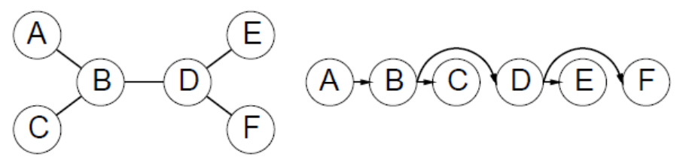
Tree-structured CSP
Any tree-structured CSP can be solved in O(n)
Directed Arc Consistency
  Under an ordering of variables X1,X2,X3,…Xn, A CSP is DAC, iff every Xi is arc consistent with each Xj, j>i

Slide 61
Tree-structured CSP
Sort topologically to get the ordering
For j = n to 2
  Make arc consistent parent (Xj) -> Xj
Assign values to Xi, i=1, 2, …n
O(n*d^2)

Slide 62
Difference between the other search techniques
The search techniques that we have seen before considered each state as a black box.
CSP search techniques considers a factored representation
CSP search techniques take advantage of the structure of the states
CSP search techniques use general-purpose techniques
  Does not use problem-specific heuristics
  Standard representation pattern
  Generic goal and successor functions
Many natural problems can be formulated as a CSP, and by a generic CSP solving system solutions can be found
Can be faster than state-space search, as it reduce search space quickly

Slide 63
☺

