Slide 1
What is Unix?
A multi-task and multi-user Operating System
Developed in 1969 at AT&T’s Bell Labs by
Ken Thompson (Unix)
Dennis Ritchie (C)
Douglas Mcllroy (Pipes - Do one thing, do it well)
Some other variants: System V, Solaris, SCO Unix, SunOS, 4.4BSD, FreeBSD, NetBSD, OpenBSD, BSDI

Slide 2
What is Linux?
A clone of Unix
Developed in 1991 by Linus Torvalds, a Finnish graduate student
Inspired by and replacement of Minix
Linus' Minix became Linux
Consist of
Linux Kernel
GNU (GNU is Not Unix) Software
Software Package management
Others

Slide 3


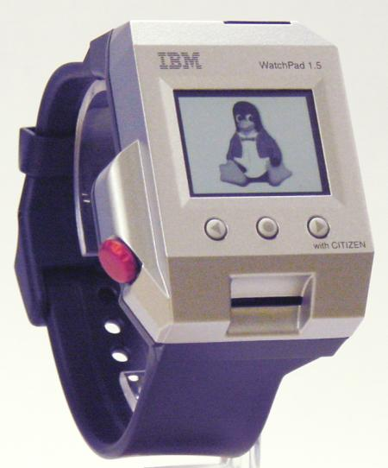

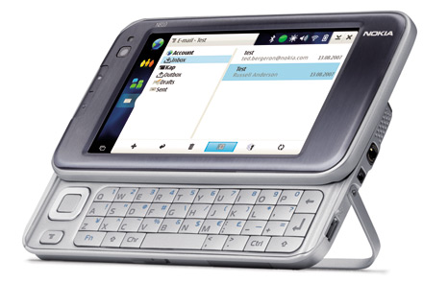




What is Linux?
Originally developed for 32-bit x86-based PC
Ported to other architectures, eg.
Alpha, VAX, PowerPC, IBM S/390, MIPS, IA-64
PS2, TiVo, cellphones, watches, Nokia N810, NDS, routers, NAS, GPS, …

Slide 4
Which Linux Distribution is better?
> 300 Linux Distributions
Slackware Redhat
RHEL (commercially support)
Fedora (free)
CentOS (free RHEL, based in England)
SuSe ( based in German)
Gentoo (Source code based)
Debian (one of the few called GNU/Linux)
Ubuntu (based in South Africa)
Knoppix (first LiveCD distro.)
…

Slide 5
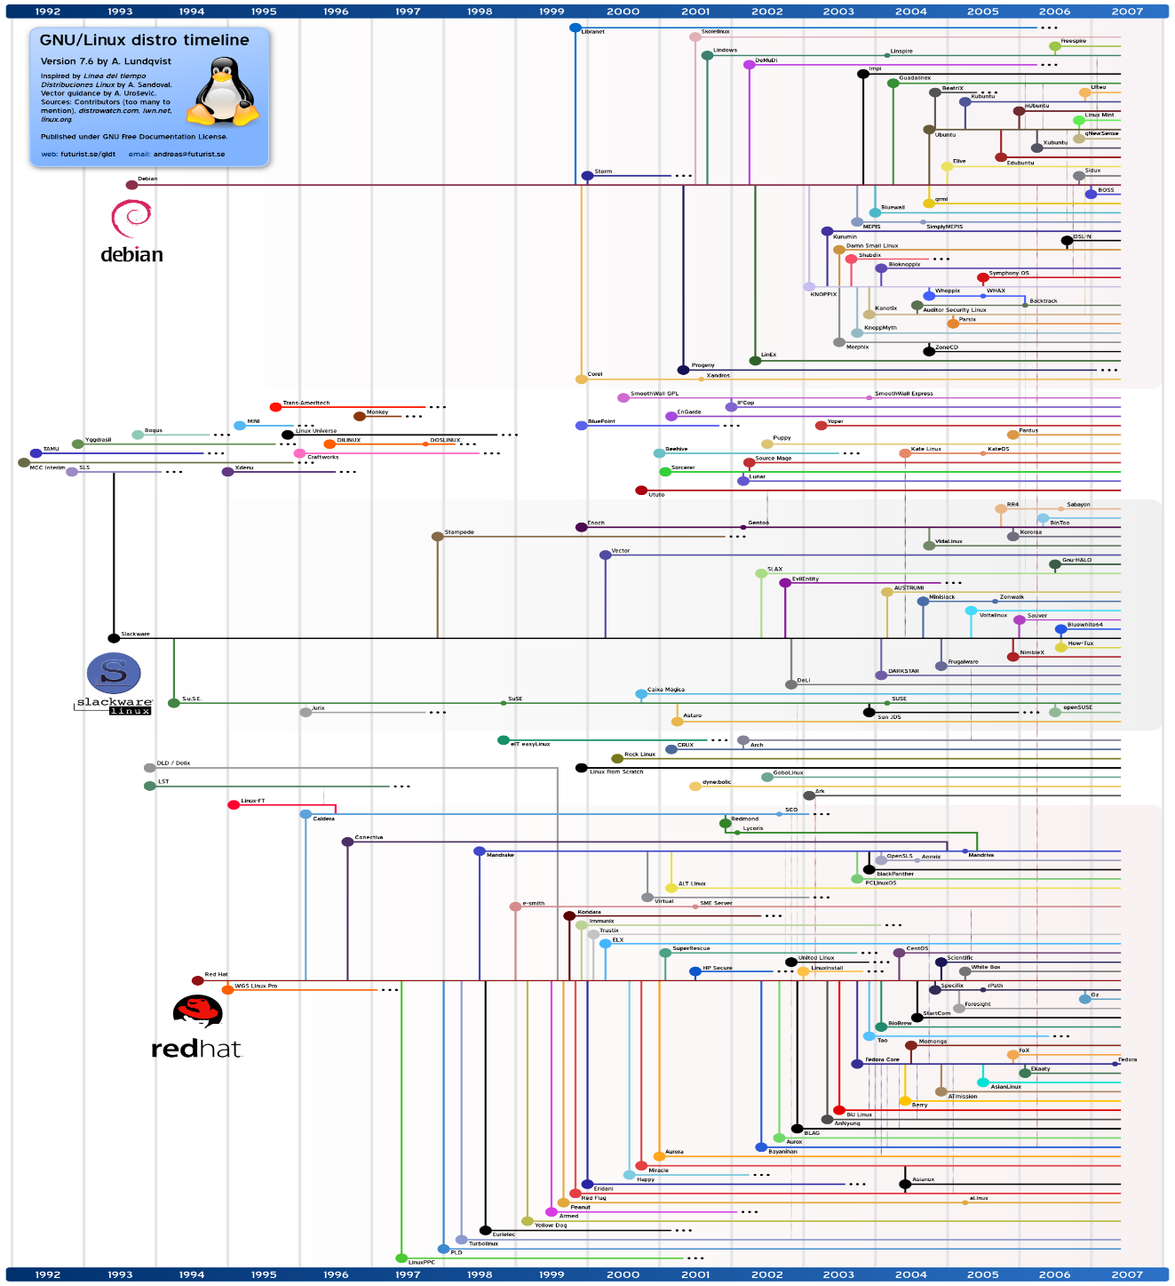
Which Linux Distribution is better?
Ubuntu
Debian
Knoppix
Slackware
Gentoo
CentOS
Redhat

