Slide 1
Inter-process Communication

Slide 2
IPC
One process, sometimes, require the output of other process
Therefore, there is a need of well structured communication among processes.
Not preferring interrupts to draw attention.

Slide 3
IPC
Three issues in IPC-
How one process can pass information to another
Making sure that two or more processes do not get into each other’s way when engaging in critical activities (both wants last 1 MB space of virtual memory)
Proper sequencing when dependency is present (if A produces data that B prints, then B cannot print unless A is producing some data)

Slide 4
Inter-thread Communication
In case of ITC, the same issues are concerns.
The first one is not a headache as threads share some common resources and address space; so, they can easily communicate
But the other twos are issues in ITC as well.

Slide 5
Race Condition
A process wants to print a file.
It enters the file name in a special printer directory
The Printer Daemon periodically checks to see if there is any file to print
If any file is there the Printer Daemon prints them and removes their names from the directory

Slide 6
Race Condition
Imagine our directory has a very large number of slots (numbered 0,1,2,…) and each one can hold a file name
There are two shared variables- out that points to the next file to be printed and in that points to the next free slot in the directory

Slide 7

Race Condition

Slide 8
Race Condition
A reads in and stores the values 7 to its local variable
Then a context switch from A to B occurs
B also reads in and stores the value 7 to its local variable
B continues to run and it stores the name of its file in slot 7 and updates in to 8.
Then it goes off and does other things

Slide 9
Race Condition
A runs again starting from the place it left off
It looks its local variable and finds 7 there and writes the file name in slot 7
Then A sets in to 8
As everything went fine, the printer daemon will not raise any error

Slide 10
Race Condition
Process B never gets the chance
Situations like this where two or more processes are reading or writing some shared data and the final result depends on who ran precisely are called race conditions

Slide 11
Critical Regions
How can we avoid race conditions?
One way to avoid that is prohibiting more than one process from reading and writing the shared data at the same time
This is called Mutual Exclusion

Slide 12
Critical Regions
On the other hand, let’s think in abstract way.
A process is busy doing internal computations and other things that do not lead race conditions
And sometimes it is busy to access shared memory and files or in doing other critical things that lead race conditions
The part of the program where shared memory or resources are accesses is called Critical Regions

Slide 13
Critical Regions
We need four conditions to hold for a good solution with mutual exclusion-
No two processes simultaneously in critical region
No assumptions made about speeds or numbers of CPUs
No process running outside its critical region may block another process
No process must wait forever to enter its critical region

Slide 14

Mutual Exclusion with Critical Regions

Slide 15
How can we achieve mutual exclusion?
Now, let’s examine various proposals to achieve mutual exclusion
While one process is busy to update shared memory in its critical region, no other process will enter its critical region and cause trouble

Slide 16
Disabling Interrupts
When a process enters into its critical region, it disables all interrupts
While leaving its critical region, it re-enables all interrupts
Unattractive and unwise to give user processes the power of turning off interrupts. What if one of them did it and never turned them on again!! ☹
That is the end of the system!!! ☹
It is often useful technique within the OS itself but not suitable as a general mutual exclusion mechanism

Slide 17
Lock Variables
It’s a software solution
When a process wants to enter into the critical region, it checks the lock variable
If it is 0, the process sets it to 1 and enters into its critical region
If it is 1, the process waits

Slide 18
Lock Variables
One process reads the lock and sees 0
Before it sets 1, another process is scheduled, runs and sets the lock 1
When the first process runs, it will also set the lock 1
Two processes will be in their critical regions in the same time.

Slide 19
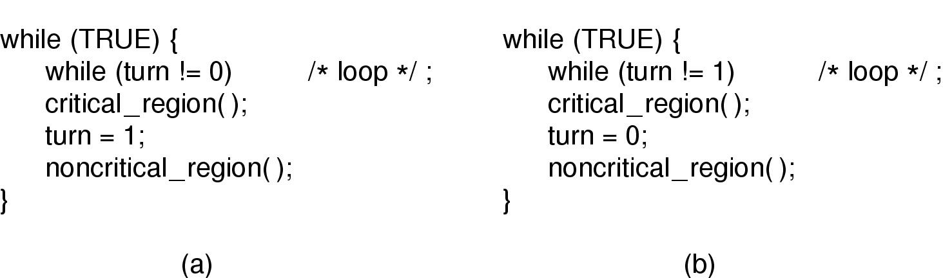
Strict Alternation
turn is a variable initially 0 keeps track of whose turn it is to enter critical regions
Process 0 inspects turn and finds 0 and enters into its critical region
Process 1 finds turn to be 0 and continuously tests the value of turn
Continuously testing a variable until some value appears is called Busy Waiting

Slide 20
Strict Alternation
It should usually be avoided as it wastes CPU time
Can be useful when short busy waiting is probable
Requires strict alternating process to provide better result
Inefficient when one process is much slower than the other

Slide 21
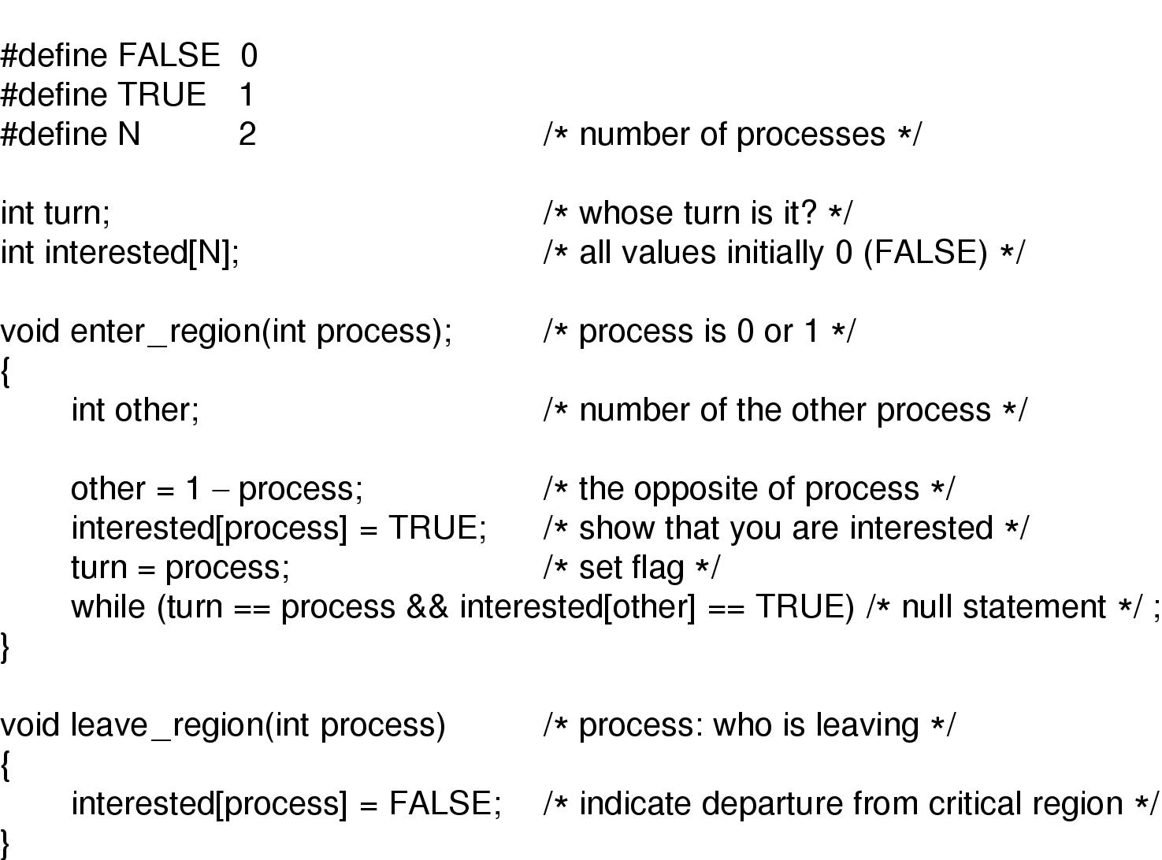
Peterson’s Solution

Slide 22
Common Problem
So far, the techniques we learnt (except disabling interrupts)-
Lock variables
Strict Alternation
Peterson’s Solution
To achieve mutual exclusion, all have a common problem- Busy Waiting
In case of prioritized scheduling, low prioritized processes will never be fed if Busy Waiting takes place

Slide 23
Different Mechanisms with Sleep and Wake
Now, we will see more mechanisms to achieve mutual exclusion
These techniques will use Sleep and Wake- two system calls
Sleep causes a process to be suspended until another process wakes it up
Wake causes a process to wake up

Slide 24
The Producer-Consumer Problem
When the producer sees a full buffer and goes to sleep. When the consumer takes out an item, it awakes the producer
When the consumer sees an empty buffer and goes to sleep. When the producer puts an item, it awakes the consumer

Slide 25
The Producer-Consumer Problem
We will use count as a variable to stop race conditions
If the maximum no of information the buffer stores in N, then producer first checks if count = N. If yes, then it sleeps; otherwise it will add an item and increment count by 1
The consumer tests count. If count = 0, then it sleeps; otherwise it removes an information and decrements count by 1

Slide 26
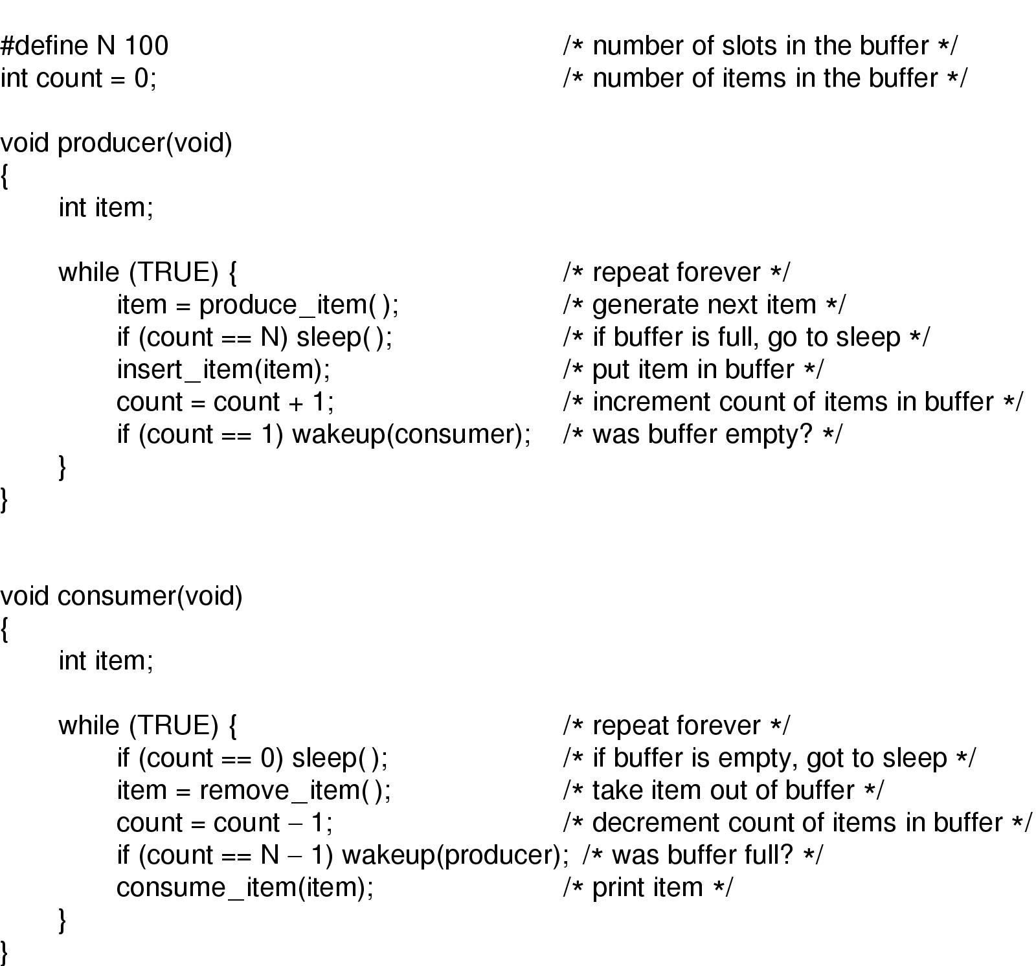
The Producer-Consumer Problem

Slide 27
The Producer-Consumer Problem
Two processes share a common, fixed-sized buffer
The producer puts information into the buffer
The consumer takes it out
Problem arises when-
Producer wants to put information into a buffer that is full
Consumer wants to get information from a buffer that is empty

Slide 28
The Producer-Consumer Problem
The buffer is empty; the consumer is about to read count = 0
Scheduler decides at that very instant to stop consumer and start producer
The producer inserts an item and increases count by 1
The producer will wake the consumer up
The consumer was not logically sleeping. So, wake signal is lost.
The consumer, on its next run, sees count = 0 and sleeps

Slide 29
The Producer-Consumer Problem
Soon, the producer fills up the buffer and also goes to sleep
Both will sleep forever
The main problem here is the lost wake up signal.
If it were not lost, everything would have worked
To solve this problem, we can use wake up waiting bit
When a wake up is sent to a process (producer or consumer) that is not sleeping, this bit will be set.
When the sender goes to sleep, it checks this bit
If it is on, then the process will not sleep itself (because someone MAYBE sleeping)

Slide 30
Semaphores
It is simply a variable that holds the number of wakeups saved for future use
It is 0 indicating that no wakeups are saved
It is a positive value indicating number of wakeups saved

Slide 31
Semaphores
There are 2 operations on semaphores-
Down- checks if value of semaphore is greater than 0. if yes, it decrements the value and continues. If no, then it is put to sleep.
Up- increments its value by 1. If there were sleeping processes, any one of them randomly is awakened.
It is guaranteed that if one semaphore operation is started, no other process can access it. They will have their chance after operating process is completed/ blocked

Slide 32
Producer-Consumer Problem with Semaphores

Slide 33
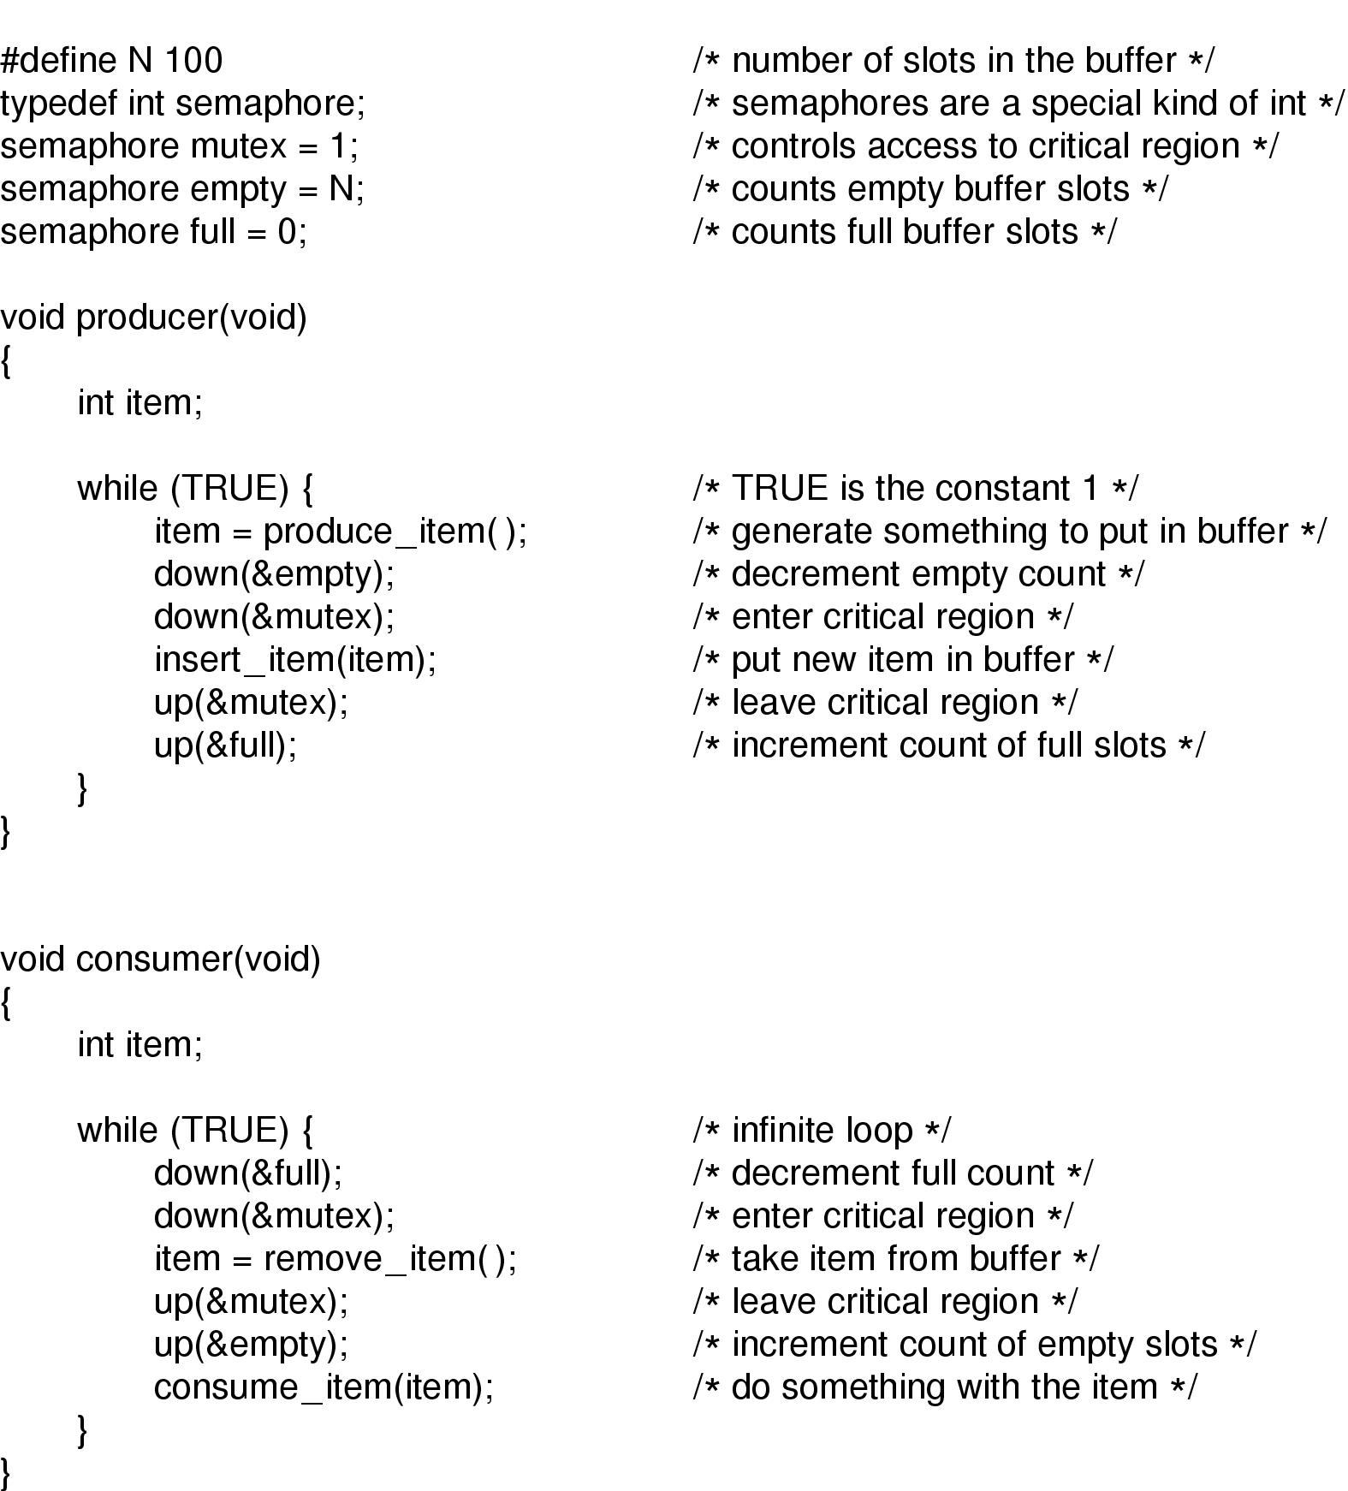

Slide 34
Producer-Consumer Problem with Semaphores
With each semaphore there is an associated waiting queue
Each entry in a waiting queue has two data items:
  value (of type integer)
  pointer to next record in the list
Two operations:
  block – place the process invoking the operation on the appropriate waiting queue
  wakeup – remove one of processes in the waiting queue and place it in the ready queue
typedef struct{
int value;
struct process *list;
} semaphore;

Slide 35
Producer-Consumer Problem with Semaphores
wait(semaphore *S) {
S->value--;
if (S->value < 0) {
add this process to S->list;
block();
}
}
signal(semaphore *S) {
S->value++;
if (S->value <= 0) {
remove a process P from S->list;
wakeup(P);
}
}

Slide 36
Producer-Consumer Problem with Semaphores
n buffers, each can hold one item
Semaphore mutex initialized to the value 1
Semaphore full initialized to the value 0
Semaphore empty initialized to the value n

Slide 37
Producer-Consumer Problem with Semaphores
The structure of the producer process
do {
...
/* produce an item in next_produced */
...
wait(empty);
wait(mutex);
...
/* add next produced to the buffer */
...
signal(mutex);
signal(full);
} while (true);

Slide 38
Producer-Consumer Problem with Semaphores
The structure of the consumer process
Do {
wait(full);
wait(mutex);
...
/* remove an item from buffer to next_consumed */
...
signal(mutex);
signal(empty);
...
/* consume the item in next consumed */
...
} while (true);

Slide 39
Barriers
Some applications are divided into phases
And have the rule that no process may proceed to the next phase until all processes are ready to proceed to the next phase.
This behaviour maybe achieved by placing a Barrier at the end of each phase.
When a process reaches the barrier, it is blocked until all processes reach the barrier.

Slide 40
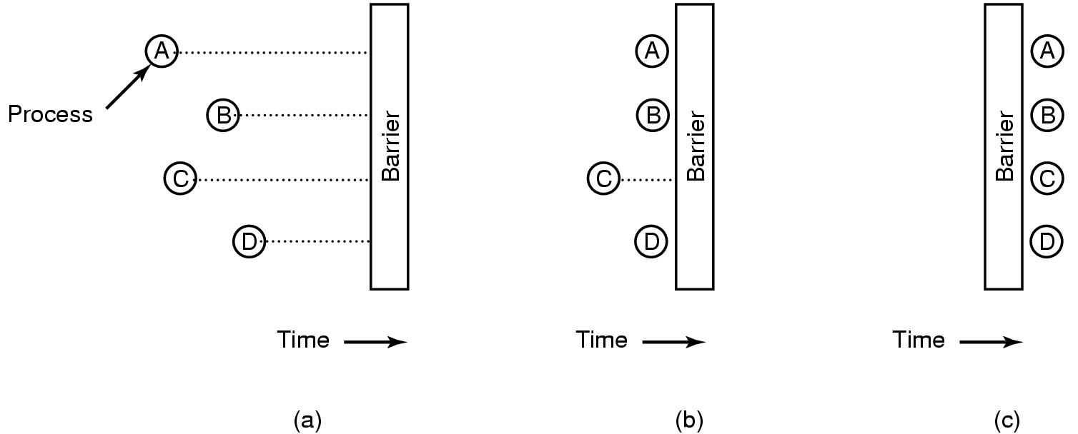
Barriers
Barriers

Slide 41
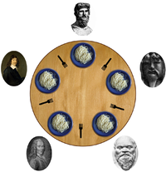
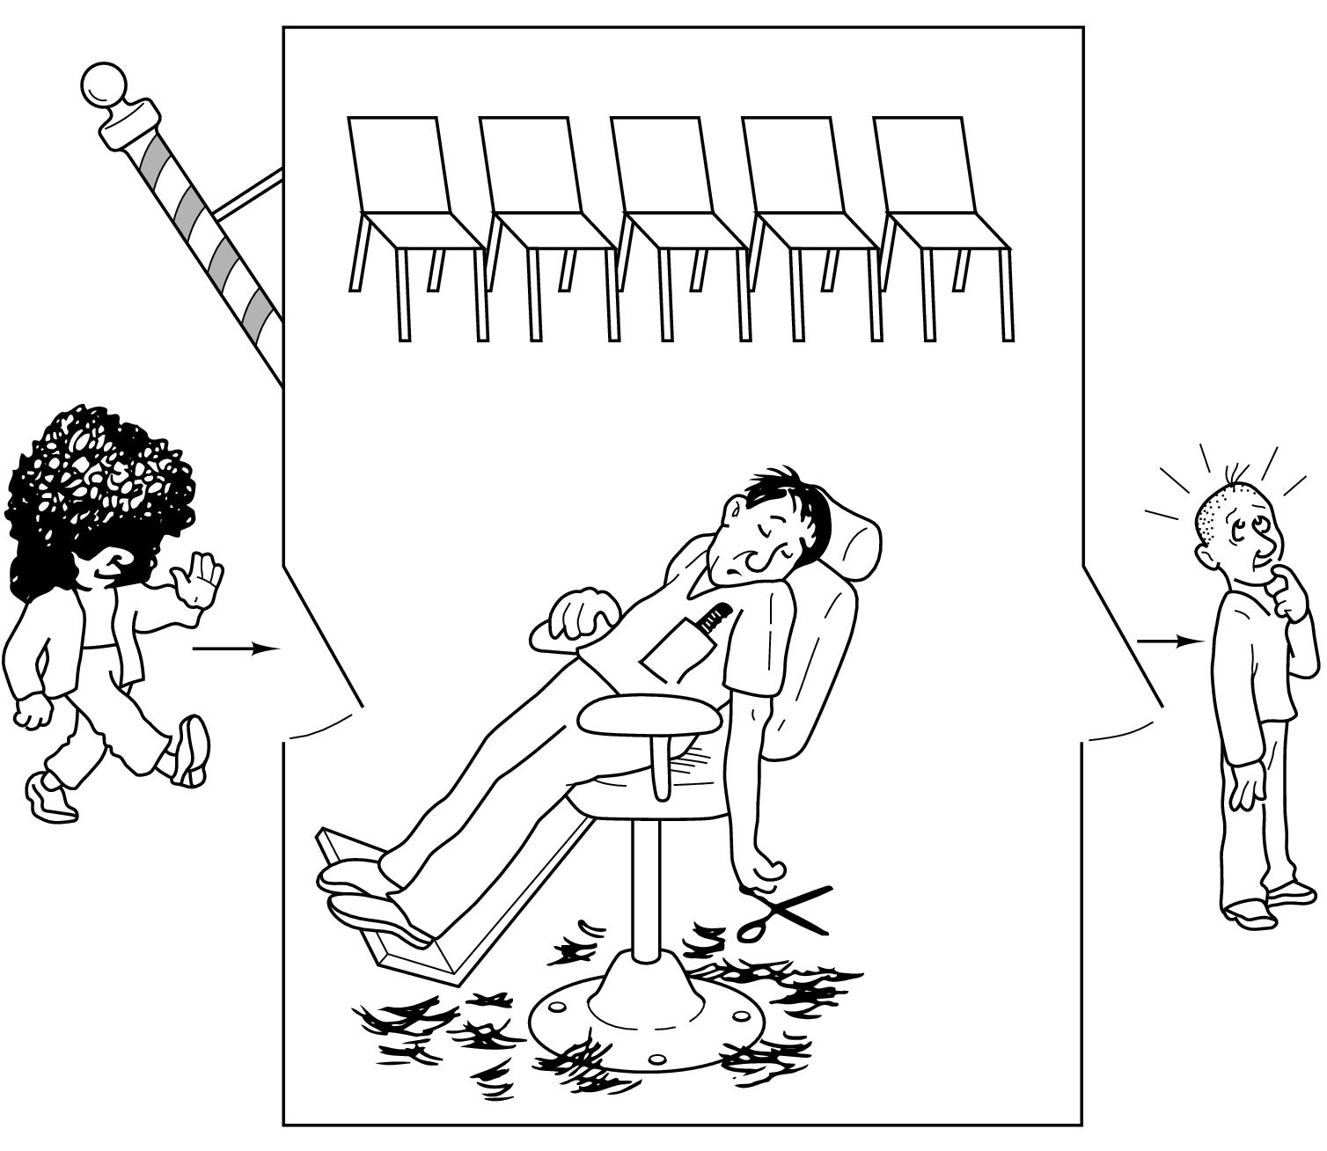
Classical IPC Problems

Slide 42

Dining Philosopher Problem
Five Philosophers seated around the circular table
Each has a plate of Spaghetti
Each needs two forks to eat it
Between each pair of plates there is one fork

Slide 43
Dining Philosopher Problem
The lives of the philosophers consist of two things- eat and think
When a philosopher is hungry, he tries to acquire his left/ right fork, one at a time, in either order
He only eats after successful acquisition of the forks
He eats for a while and then puts them back to think

Slide 44
Dining Philosopher Problem
Is it possible to have a solution so that no philosophers will be annoyed? (when his turn is eating, he eats; when his turn is thinking, he thinks)

Slide 45
Solutions
Philosopher will wait until its desired fork is available
He will grab it when it’s available
What if all the five philosophers take their left forks simultaneously?
None will be able to take their right forks; there will be deadlock

Slide 46
Solutions
After taking the left fork, philosopher will check if its right fork is available
If it’s not, philosopher puts back his left fork, wait for some times and proceeds again in similar way
What if all philosophers start simultaneously?
They will never find their right fork available causing starvation

Slide 47
Solutions
Using random start timer can solve this problem, but not ultimately
Ethernet LAN works in this way, and this happens to be finer solution, but again, not the best; there is always a chance to have a failure

Slide 48
Solutions
Well, there is a solution that will stop deadlock and starvation
When philosopher wants to acquire a fork, she downs mutex; when she releases, she ups mutex
The only drawback is only 1 of 5 philosophers can eat at a time though there is a best chance of 2 philosophers eating at same time

Slide 49
Solutions
Our last solution will be deadlock free and achieve maximum parallelism.
A philosopher will have 3 states- eating, thinking, or hungry (trying to acquire forks)
A philosopher will move to eating state only if none of the neighbours is eating
Only need is that each philosopher will have individual semaphores

Slide 50
Sample Solution
The structure of Philosopher i :
    do {
    wait (chopstick[i] );
    wait (chopStick[ (i + 1) % 5] );
    // eat
    signal (chopstick[i] );
    signal (chopstick[ (i + 1) % 5] );
    // think
    } while (TRUE);

Slide 51
The Readers-Writers Problem
Dining philosopher problem defines the situation where processes compete for limited resources
The Readers-Writers problem defines the situation where database access is required.
A reader reads… the writer writes… but the reader is away and with an old value from the database: simply, this is the readers-writers problem

Slide 52
Solutions
When a reader comes along, it UPs a semaphore- means, hey, we are reading, do not disturb
If a writer comes, then it has to wait.
If more readers come, they are allowed

Slide 53
Solution
When an active reader is reading, then a writer comes.
It sees that a reader is reading, the writer then waits
If more reader comes, they are queued
When the active reader finishes, the writer takes place its schedule
After finishing of writer, the queued readers are given chances.

Slide 54
The Sleeping Barber Problem
In a barber shop, there is one barber, some chairs and some customers
A barber sleeps if there is no customer (not even on chairs, waiting for a haircut ☹)
A customer wakes up the barber if it’s his turn to get his haircut
A customer waits if there is any chair left
A customer leaves, if all the chairs are occupied

Slide 55
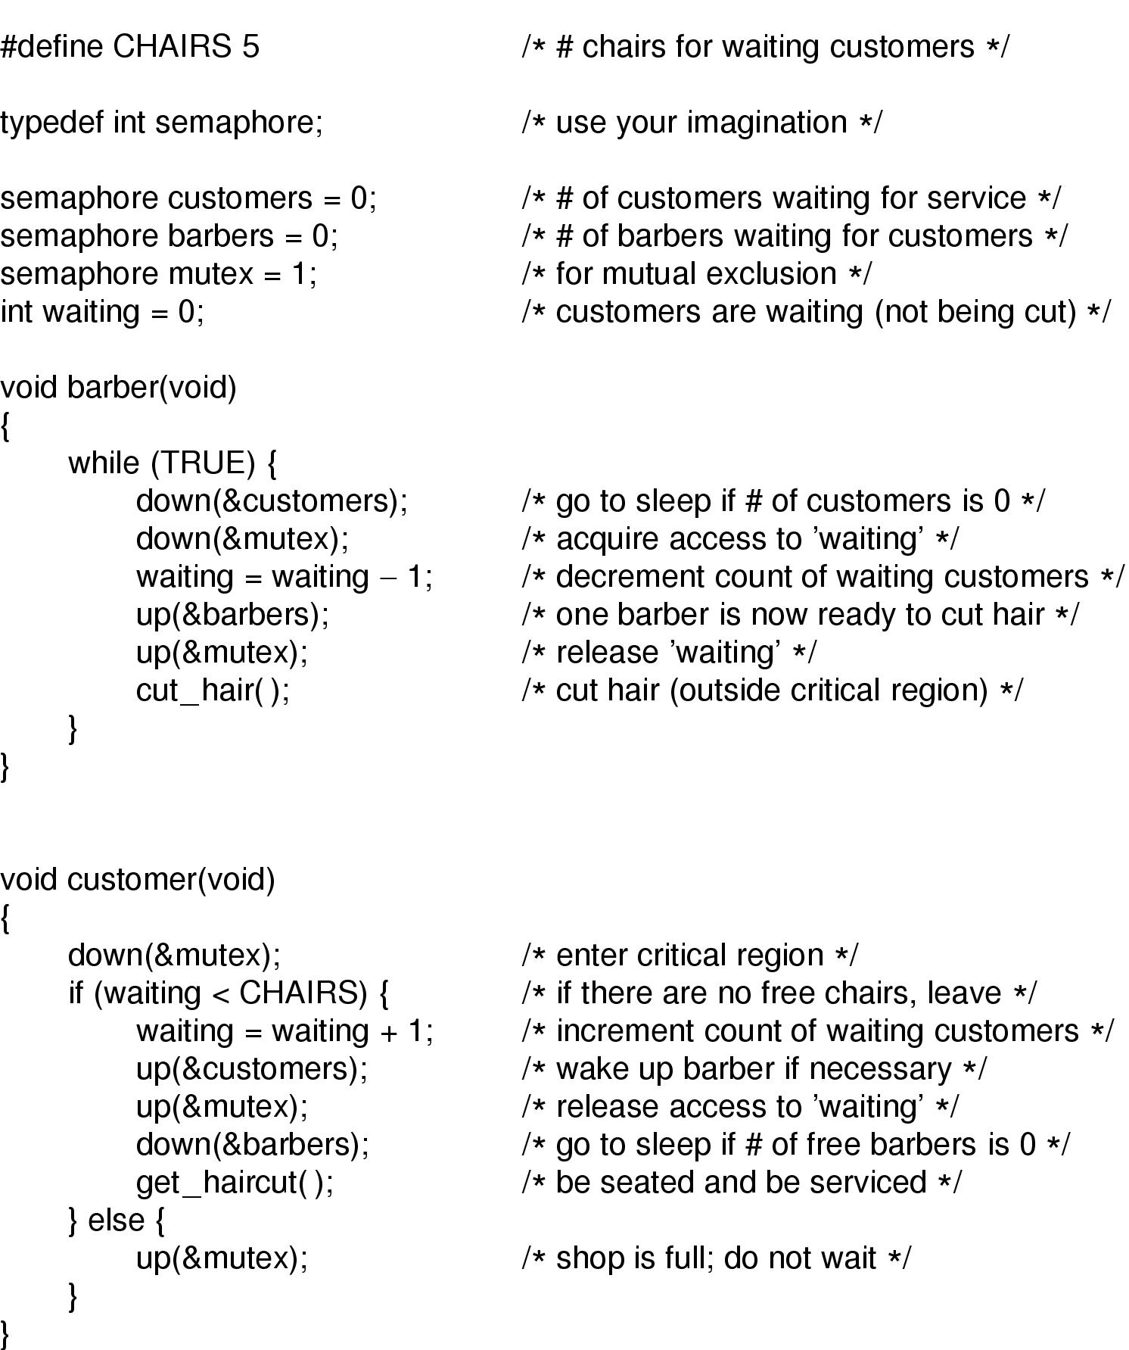
Solution

Slide 56
Reference
Modern Operating Systems (2nd Edition)
by Andrew S. Tanenbaum

