Slide 1
Chapter 9: Virtual Memory

Slide 2
Chapter 9: Virtual Memory
Background
Demand Paging
Copy-on-Write
Page Replacement
Allocation of Frames
Thrashing
Memory-Mapped Files
Allocating Kernel Memory
Other Considerations
Operating-System Examples

Slide 3
Objectives
To describe the benefits of a virtual memory system
To explain the concepts of demand paging, page-replacement algorithms, and allocation of page frames
To discuss the principle of the working-set model

Slide 4
Background
Virtual memory – a technique that allows the execution of processes that may not be completely in memory
  Only part of the program needs to be in memory for execution
  Logical address space can therefore be much larger than physical address space
  Allows address spaces to be shared by several processes
  Allows more efficient mechanism for process creation (fork shares pages)
Virtual memory can be implemented via:
  Demand paging
  Demand segmentation

Slide 5
Background
Memory management algorithms were necessary because instructions being executed must be brought in physical memory.
In many cases, the entire program is not needed. For instances:
Programs often have code to handle unusual error conditions. Since these errors seldom, this code is almost never executed
Array, lists and tables are often allocated more memory that they actually need
The ability to execute a program that is only partially in memory would confer many benefits----
A program would no longer be constrained by the amount of physical memory
More program could be run at the same time
Less I/O would be needed to load or swap each user program into memory, so each user program would run fast.

Slide 6
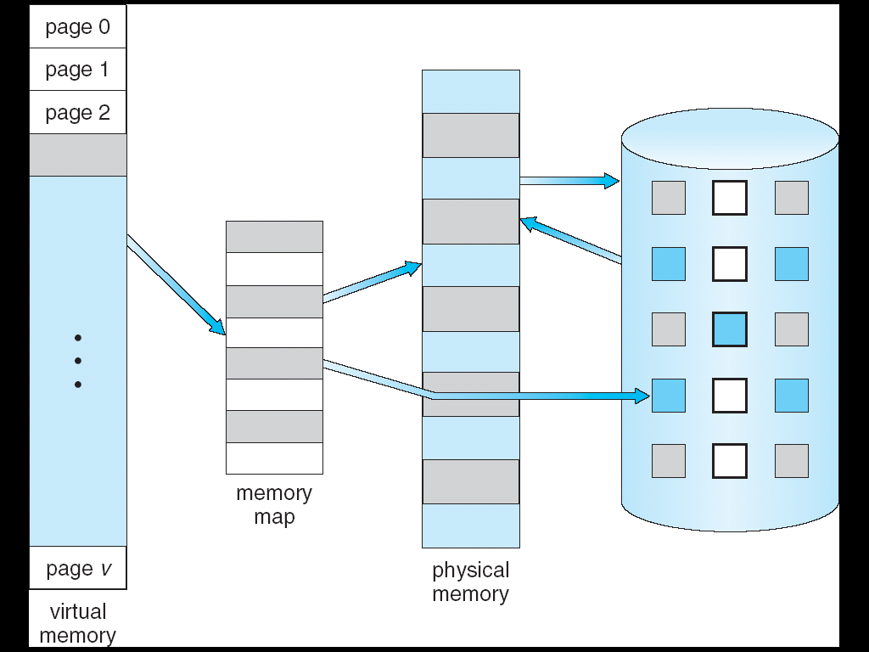
Virtual Memory That is Larger Than Physical Memory
⇒

Slide 7
Demand Paging
Similar to a paging system with swapping
Bring a page into memory only when it is needed
  Less I/O needed
  Less memory needed
  Faster response
  More users
  We use lazy swapper.
Page is needed ⇒ reference to it
  invalid reference ⇒ abort
  not-in-memory ⇒ bring to memory
Lazy swapper – never swap page into memory unless it’s needed
  Swapper that deals with pages is a pager

Slide 8
Basic Concept
When a process is to be swapped in, the pager guesses which pages will be used before the process is swapped out again.
Thus, it avoids reading into memory pages that will not be used anyway, decreasing the swap time and the amount of physical memory needed.
With this scheme, we need some form of hardware support to distinguish between those pages that are in memory and those pages that are on the disk.
The valid-invalid bit scheme can be used for this purpose.

Slide 9
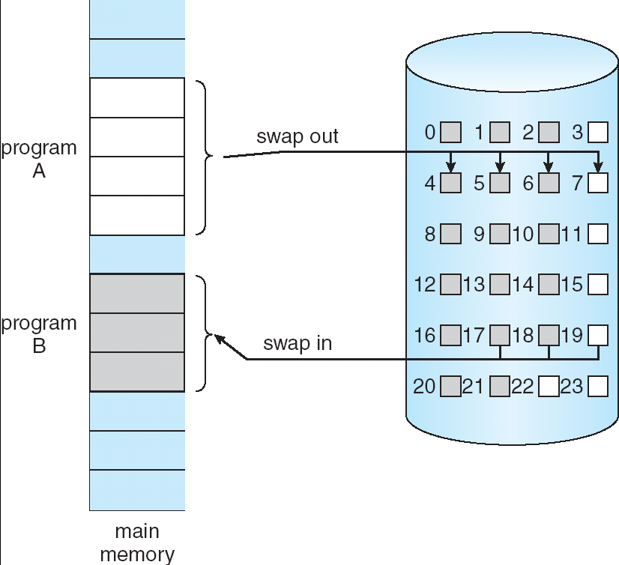
Transfer of a Paged Memory to Contiguous Disk Space

Slide 10
Valid-Invalid Bit
With each page table entry a valid–invalid bit is associated
(v ⇒ in-memory, i ⇒ not-in-memory)
Initially valid–invalid bit is set to i on all entries
Example of a page table snapshot:
During address translation, if valid–invalid bit in page table entry
is i ⇒ page fault
Frame #
valid-invalid bit
v
v
v
v
i
….
i
i
page table

Slide 11

Page Table When Some Pages Are Not in Main Memory

Slide 12
Page Fault
Access to a page marked invalid causes a page fault trap.
The procedure for handling this page fault is straightforward:
Operating system checks an internal table for this process to determine whether the reference was a valid or invalid memory access
If the reference is invalid, we terminate the process. If it was valid, but we have not yet brought in that page, we now page it in.
Fine a free frame
Swap page into frame
Reset tables
Set validation bit = v
Restart the instruction that caused the page fault

Slide 13

Steps in Handling a Page Fault

Slide 14
Page Fault
In the extreme case, we could start executing a process with no pages in memory.
When the OS sets the instruction pointer to the first instruction of the process, which is on a non-memory-resident page, the process immediately faults for the page.
After this page is brought into memory, the process continues to execute, faulting is necessary until every page that it needs is in memory.
At that point, it can execute with no more fault
This scheme is called----pure demand paging.
Hardware needed for demand paging:
Page table
Secondary memory

Slide 15
Performance of demand paging
A page fault causes the following sequence to occur:
Trap the Operating System
Save the user registers and process state
Determine that the interrupt was a page fault
Check that the page reference was legal and determine the location of the page on the disk
Issue a read from the disk to a free frame
Wait in a queue for this device until the read request is services
Wait for the device seek and/or latency time
Begin the transfer of the page to a free frame
While waiting, allocate the CPU to some other user
Interrupt from the disk (I/O completed)
Determine that the interrupt was from the disk
Correct the page table and other tables to show that the desired page is now in memory
Wait for the CPU to be allocated to this process again
Restore the user registers, process state and new page table, then resume the interrupted instruction.

Slide 16
Process Creation
Virtual memory allows other benefits during process creation
  Copy-on-Write
    No need to duplicate unmodified pages.
  Memory-Mapped Files (later)

Slide 17
Copy-on-Write
Copy-on-Write (COW) allows both parent and child processes to initially share the same pages in memory
  Page only copied if either process modifies a shared page
COW allows more efficient process creation as only modified pages are copied
Free pages are allocated from a pool of zeroed-out pages
  Zeroing pages protects information of previous users

Slide 18
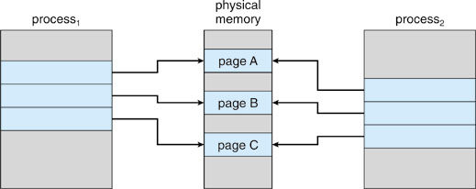
Before Process 1 Modifies Page C

Slide 19
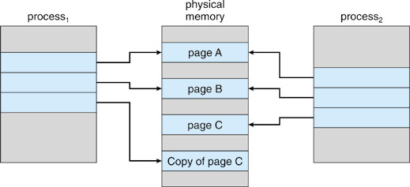
After Process 1 Modifies Page C

Slide 20
What happens if there is no free frame?
Page replacement – find a page in memory and swap it out
  Replacement algorithm selects the victim page
  Performance – want an algorithm which will result in minimum number of page faults
Same page may be brought into memory several times

Slide 21
Page Replacement
Prevent over-allocation of memory by modifying page-fault service routine to include page replacement
Use modify (dirty) bit to reduce overhead of page transfers
  If victim page is unmodified, then no need to write it to disk
Page replacement completes separation between logical memory and physical memory – large virtual memory can be provided on a smaller physical memory

Slide 22

Need For Page Replacement

Slide 23
Basic Page Replacement
Find the location of the desired page on disk
Find a free frame:
- If there is a free frame, then use it
- If there is no free frame, use a page replacement algorithm to select a victim frame
Bring the desired page into the (newly) free frame; update the page and frame tables
Restart the interrupted instruction of the process

Slide 24

Page Replacement

Slide 25
Page Replacement Algorithms
Want lowest page-fault rate
Evaluate algorithm by running it on a particular string of memory references (reference string) and computing the number of page faults on that string

Slide 26

FIFO Page Replacement

Slide 27
First-In-First-Out (FIFO) Algorithm
Reference string: 1, 2, 3, 4, 1, 2, 5, 1, 2, 3, 4, 5
3 frames (3 pages can be in memory at a time per process)
4 frames
Belady’s Anomaly: more frames may precipitate more page faults
1
1
4
5
2
2
1
3
9 page faults
3
3
2
4
1
1
5
4
2
2
1
5
10 page faults
3
3
2
4
4
3

Slide 28
Least Recently Used (LRU) Algorithm
Reference string: 1, 2, 3, 4, 1, 2, 5, 1, 2, 3, 4, 5
Considered good, but difficult to implement
Like all stack algorithms, LRU does not suffer from Belady’s anomaly
  For stack algorithms, the set of pages in memory for n frames is always a subset of the set of pages that would be in memory with n+1 frames.
1
1
1
1
5
2
2
2
2
2
3
5
5
4
4
4
4
3
3
3

Slide 29

LRU Page Replacement

Slide 30
LRU Algorithm – Implementations
Counter implementation
  Every page entry has a counter; every time page is referenced through this entry, copy the clock into the counter
  When a page needs to be replaced, scan the counters and select the minimum value as the victim
Stack implementation
  Keep a stack of page numbers in a doubly-linked form:
  Page referenced:
    move it to the top
    requires 6 pointers to be changed
  No search for replacement

Slide 31

Use Of A Stack to Record The Most Recent Page References

Slide 32
Allocation of Frames
Each process needs minimum number of pages
Example: IBM 370 – 6 pages to handle SS MOVE instruction:
  instruction is 6 bytes, might span 2 pages
  2 pages to handle from
  2 pages to handle to
Two major allocation schemes
  fixed allocation
  priority allocation

Slide 33


Fixed Allocation
Equal allocation – For example, if there are 100 frames and 5 processes, give each process 20 frames.
Proportional allocation – Allocate according to the size of process

Slide 34
Priority Allocation
Proportional allocation scheme using priority instead of size
If process P_{i} generates a page fault,
  select for replacement one of its own frames
  select for replacement a frame from a process with lower priority number
Why allocate more frames to higher-priority processes?

Slide 35
Global vs. Local Allocation
Global replacement – process selects a replacement frame from the set of all frames; one process can take a frame from another
Local replacement – each process selects from only its own set of allocated frames
  Number of frames allocated per process doesn’t change
  Pages in memory for process P is only affected by the paging behavior of process P itself.

Slide 36
End of Chapter 9

