Slide 1
Overview of Software Engineering
CSE-323

Slide 2


What is software?
Computer programs and associated documentation
Software products may be developed for a particular customer or may be developed for a general market
Software products may be
  Generic/COTS - developed to be sold to a range of different customers
  Custom- developed for a customer according to their specification

Slide 3
Engineering
Engineering is …
  The application of scientific principles and methods to the construction of useful structures & machines
Examples
  Mechanical engineering
  Computer engineering
  Civil engineering
  Chemical engineering
  Electrical engineering
  Nuclear engineering
  Aeronautical engineering

Slide 4
Software Engineering
The term is 35 years old: NATO Conferences
  Garmisch, Germany, October 7-11, 1968
  Rome, Italy, October 27-31, 1969
The reality is it is finally beginning to arrive
  Computer science one the scientific basis
    Years of studies/experience/statistics provide basis too
  Many aspects have been made systematic
    Methods/methodologies/techniques
    Languages
    Tools
    Processes

Slide 5
Why Engineer Software ?
The problem is complexity
Many sources, but size is a key:
  Mozilla contains about 10 Million lines of code
  UNIX contains 4 million lines of code
  Windows XP contains 45 million lines of code
Second is role and combinatorics of “state”
Third is uncertainty of “inputs” and their timing
Fourth is the continuing changing “environment” and demands.
Software engineering is about managing
all the sources of complexity to
produce effective software.

Slide 6
Software Engineering in a Nutshell
Scope
  study of software process, development/management principles, techniques, tools and notations
Goal
  production of quality software, delivered on time, within budget, satisfying customers’ requirements and users’ needs

Slide 7

What does a software engineer do?
Software engineers should
  adopt a systematic and organised approach to all aspects of software development.
  use appropriate tools and techniques depending on
    the problem to be solved,
    the development constraints and
    the resources available
  Understand and communicate processes for improved software development within their organization
  Be effective team members and/or leaders.
  Can be very technical or more managerial depending on organizational need.

Slide 8
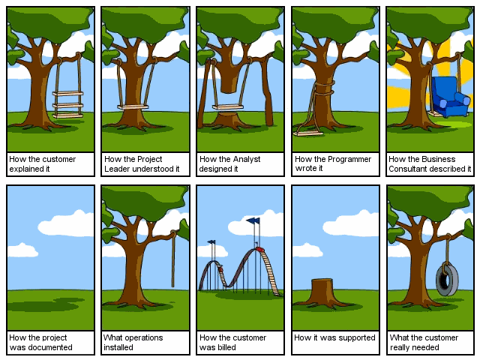

Slide 9
Difficulties?
SE is a unique brand of engineering
  Software is malleable/manipulable
  Software construction is human-intensive
  Software is intangible and generally invisible
  Software problems are unprecedentedly complex
  Software directly depends upon the hardware
    It is at the top of the system engineering “food chain”
  Software solutions require unusual rigor/validity

Slide 10
Software Engineering ≠ Software Programming
Software programming
  Single developer
  “Toy” applications
  Short lifespan
  Single or few stakeholders
    Architect = Developer = Manager = Tester = Customer = User
  One-of-a-kind systems
  Built from scratch
  Minimal maintenance

Slide 11
Software Engineering ≠ Software Programming
Software engineering
  Teams of developers with multiple roles
  Complex systems
  Indefinite lifespan
  Numerous stakeholders
    Architect ≠ Developer ≠ Manager ≠ Tester ≠ Customer ≠ User
  System families
  Maintenance accounts for 60%-80% of overall development costs

Slide 12
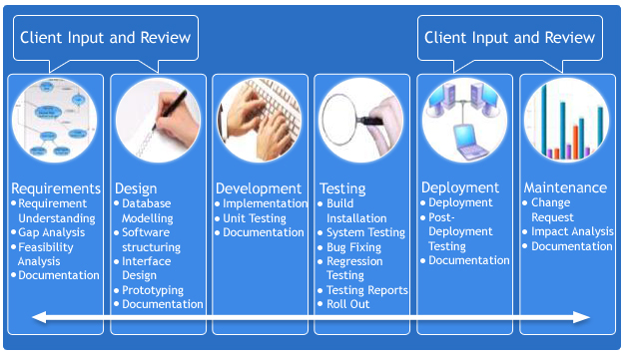
Software Development Life Cycle

Slide 13
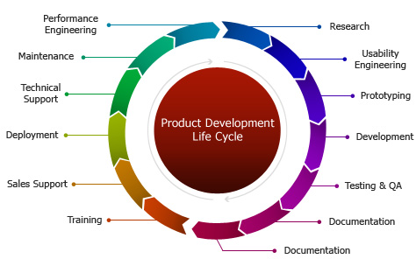

Slide 14
Things to know
Basics of Software and Software Engineering
Review of Object Orientation
Basing Software Development on Reusable Technology
Developing Requirements
Modelling with Classes
Using Design Patterns
Focusing on Users and Their Tasks
Modelling Interactions and Behaviour
Architecting and Designing Software
Testing and Inspecting to Ensure High Quality
Managing the Software Process

Slide 15
Let’s See some Job responsibilities
Software Engineer, Google
Responsibilities:
Provide technical and architectural leadership for one or more software engineering teams.
Architect, design, and develop (hands-on) large-scale, complex infrastructure systems.
Use your technical influence to drive innovation and engineering standards/best practices across Engineering

Slide 16
Let’s See some Job responsibilities
Software Engineer, Cisco
Responsibilities:
• Design/Develop Windows client application or components on Windows OS using C++.
• Expose fully to the entire product development cycle, from algorithmic development, software implementation, software
testing and customer satisfaction;
• Interact with cross function groups (Product Manager, Engineer Manager) in the company to deliver high quality product to customers.

Slide 17
What Google thinks?
“ As a software engineer at Google, you yearn to create and implement full product life-cycles – not just code solutions. You have a solid foundation in computer science, you consistently come up with new ideas and you naturally strive for a deep understanding of products in order to be able to continually improve on them. “

Slide 18
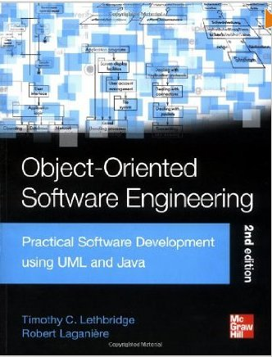
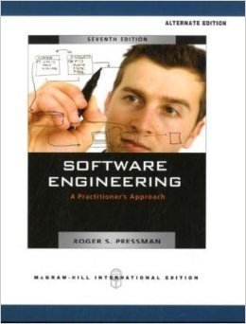

Reference books

