Slide 1
Object-Oriented Software Engineering
Chapter 2:
Review of Object Orientation

Slide 2
What is Object Orientation?
Procedural paradigm:
Software is organized around the notion of procedures
Procedural abstraction
Works as long as the data is simple
Adding data abstractions groups together the pieces of data that describe some entity
Helps reduce the system’s complexity.
Such as Records and structures
Object oriented paradigm:
Organizing procedural abstractions in the context of data abstractions

Slide 3
Object Oriented paradigm
All computations are performed in the context of objects.
The objects are instances of classes, which:
are data abstractions
contain procedural abstractions that operate on the objects
A running program can be seen as a collection of objects collaborating to perform a given task

Slide 4
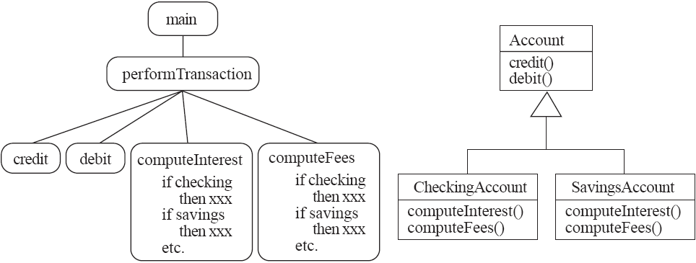
A View of the Two paradigms

Slide 5
Classes and Objects
Object
A chunk of structured data in a running software system
Has properties
Represent its state
Has behaviour
How it acts and reacts
May simulate the behaviour of an object in the real world

Slide 6
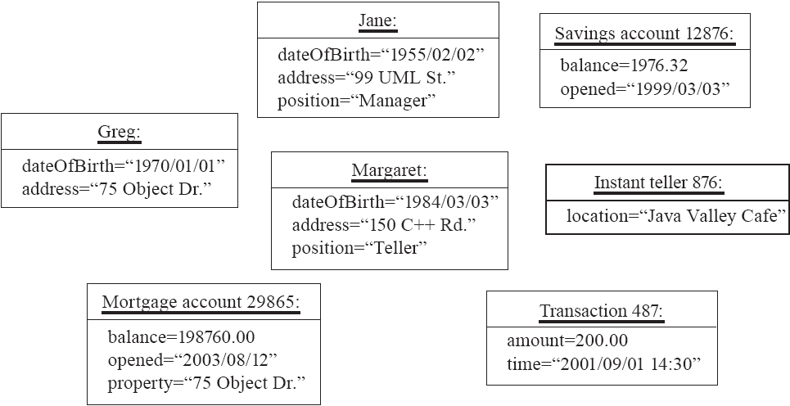
Objects: Shown as a UML instance diagram

Slide 7
Classes
A class:
A unit of abstraction in an object oriented (OO) program
Represents similar objects
Its instances
A kind of software module
Describes its instances’ structure (properties)
Contains methods to implement their behaviour

Slide 8
Is Something a Class or an Instance?
Something should be a class if it could have instances
Something should be an instance if it is clearly a single member of the set defined by a class
Film
Class; instances are individual films.
Reel of Film:
Class; instances are physical reels
Film reel with serial number SW19876
Instance of ReelOfFilm
Science Fiction
Instance of the class Genre.
Science Fiction Film
Class; instances include ‘Star Wars’
Showing of ‘Star Wars’ in the Phoenix Cinema at 7 p.m.:
Instance of ShowingOfFilm

Slide 9
Naming classes
Use capital letters
E.g. BankAccount not bankAccount
Use singular nouns
Use the right level of generality
E.g. Municipality, not City
Make sure the name has only one meaning
E.g. ‘bus’ has several meanings

Slide 10
Instance Variables
Variables defined inside a class corresponding to data present in each instance
Also called fields or member variables
Attributes
Simple data
E.g. name, dateOfBirth
Associations
Relationships to other important classes
E.g. supervisor, coursesTaken
More on these in Chapter 5

Slide 11
Variables vs. Objects
A variable
Refers to an object
May refer to different objects at different points in time
An object can be referred to by several different variables at the same time
Type of a variable
Determines what classes of objects it may contain

Slide 12
Class variables
A class variable’s value is shared by all instances of a class.
Also called a static variable
If one instance sets the value of a class variable, then all the other instances see the same changed value.
Class variables are useful for:
Default or ‘constant’ values (e.g. PI)
Lookup tables and similar structures
Caution: do not over-use class variables

Slide 13
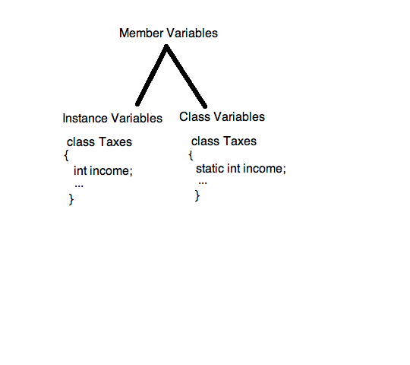

Slide 14
Methods, Operations and Polymorphism
Operation
A higher-level procedural abstraction that specifies a type of behaviour
Independent of any code which implements that behaviour
E.g. calculating area (in general)

Slide 15
Methods, Operations and Polymorphism
Method
A procedural abstraction used to implement the behaviour of a class
Several different classes can have methods with the same name
They implement the same abstract operation in ways suitable to each class
E.g. calculating area in a rectangle is done differently from in a circle

Slide 16
Polymorphism
A property of object oriented software by which an abstract operation may be performed in different ways in different classes.
Requires that there be multiple methods of the same name
The choice of which one to execute depends on the object that is in a variable
Reduces the need for programmers to code many if-else or switch statements

Slide 17
Organizing Classes into Inheritance Hierarchies
Superclasses
Contain features common to a set of subclasses
Inheritance hierarchies
Show the relationships among superclasses and subclasses
A triangle shows a generalization
Inheritance
The implicit possession by all subclasses of features defined in its superclasses

Slide 18
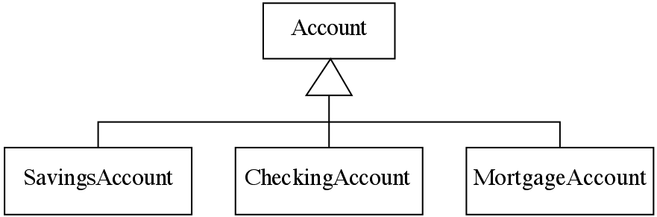
An Example Inheritance Hierarchy
Inheritance
The implicit possession by all subclasses of features defined in its superclasses

Slide 19
The Isa Rule
Always check generalizations to ensure they obey the isa rule
“A checking account is an account”
“A village is a municipality”
Should ‘Province’ be a subclass of ‘Country’?
No, it violates the isa rule
“A province is a country” is invalid!

Slide 20
A possible inheritance hierarchy of mathematical objects

Slide 21
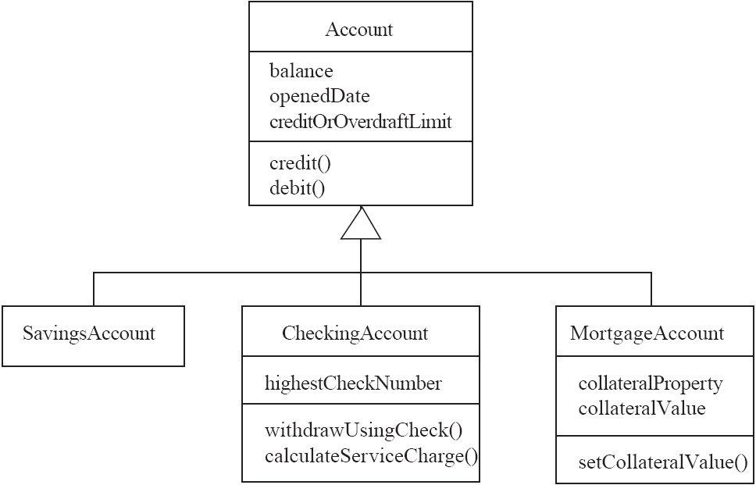
Make Sure all Inherited Features Make Sense in Subclasses

Slide 22
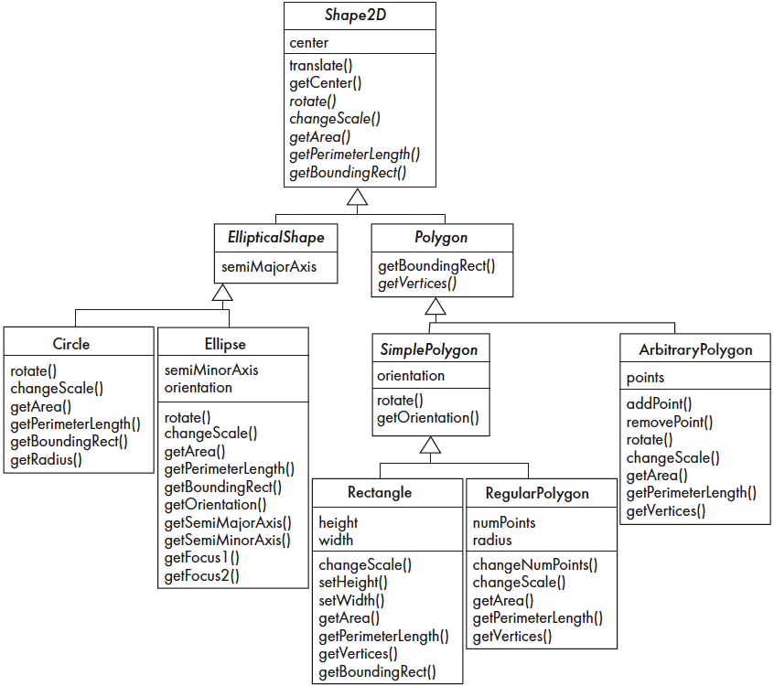
Inheritance, Polymorphism and Variables

Slide 23
Abstract Classes and Methods
An operation should be declared to exist at the highest class in the hierarchy where it makes sense
The operation may be abstract (lacking implementation) at that level
If so, the class also must be abstract
No instances can be created
The opposite of an abstract class is a concrete class
If a superclass has an abstract operation then its subclasses at some level must have a concrete method for the operation
Leaf classes must have or inherit concrete methods for all operations
Leaf classes must be concrete

Slide 24
Abstract Classes and Methods e.g.
Say you have a three printers that you would need to write a driver for, Lexmark, Canon, and HP.
All three printers will have the print() and getSystemResource() methods.
However, only print() will be different for each printer. getSystemResource() remains the same throughout the three printers. You also have another concern, you would like to apply polymorphism.
So since getSystemResource() is the same for all three printers, so this can be pushed up to the super class to be implemented.

Slide 25
Abstract Classes and Methods e.g.
public abstract class Printer
{ public void getSystemResource()
{ // real implementation of getting system resources }
public abstract void print();
}
public class Canon extends Printer
{ public void print()
{ // here you will provide the implementation of print pertaining to Canon } }
public class HP extends Printer
{ public void print()
{ // here you will provide the implementation of print pertaining to HP } }
public class Lexmark extends Printer
{ public void print()
{ // here you will provide the implementation of print pertaining to Lexmark } }

Slide 26
Abstract Classes and Methods e.g.
Notice that HP, Canon and Lexmark classes do not provide the implementation of getSystemResource().
Finally, in your main class, you can do the following:
public static void main(String args[])
{
Printer printer = new HP();
printer.getSystemResource();
printer.print();
}

Slide 27
Abstract Classes and Methods e.g.
The abstract methods merely define a contract that derived classes must implement. It's is the way how you ensure that they actually always will.
So let's take another example of an abstract class Shape. It would have an abstract method draw() that should draw it. (Shape is abstract, because we do not know how to draw a general shape)
By having abstract method draw in Shape we guarantee that all derived classed, that actually can be drawn, for example Circle do implement draw.
Later if we forget to implement draw in some class, that is derived from Shape, compiler will actually help as giving an error.

Slide 28
Overriding
A method would be inherited, but a subclass contains a new version instead
For extension
E.g. SavingsAccount might charge an extra fee following every debit
For optimization
E.g. The getPerimeterLength method in Circle is much simpler than the one in Ellipse
For restriction (best to avoid)
E.g. scale(x,y) would not work in Circle

Slide 29
Overriding e.g.
class Animal
{ public void move()
{ System.out.println("Animals can move"); } }
class Dog extends Animal
{ public void move()
{ System.out.println("Dogs can walk and run"); } }
public class TestDog
{
public static void main(String args[])
{ Animal a = new Animal(); // Animal reference and object
Animal b = new Dog(); // Animal reference but Dog object
a.move();// runs the method in Animal class
b.move();//Runs the method in Dog class } }

Slide 30
How a decision is made about which method to run
1. If there is a concrete method for the operation in the current class, run that method.
2. Otherwise, check in the immediate superclass to see if there is a method there; if so, run it.
3. Repeat step 2, looking in successively higher superclasses until a concrete method is found and run.
4. If no method is found, then there is an error
In Java and C++ the program would not have compiled

Slide 31
Dynamic binding
Occurs when decision about which method to run can only be made at run time
Needed when:
A variable is declared to have a superclass as its type, and
There is more than one possible polymorphic method that could be run among the type of the variable and its subclasses

Slide 32
Key Terminology
Abstraction
Object -> something in the world
Class -> objects
Superclass -> subclasses
Operation -> methods
Attributes and associations -> instance variables
Modularity
Code is divided into classes, and classes into methods
Encapsulation
Details can be hidden in classes
This gives rise to information hiding:
Programmers do not need to know all the details of a class

Slide 33
The Basics of Java
History
The first object oriented programming language was Simula-67
designed to allow programmers to write simulation programs
In the early 1980’s, Smalltalk was developed at Xerox PARC
New syntax, large open-source library of reusable code, bytecode, platform independence, garbage collection.
late 1980’s, C++ was developed by B. Stroustrup,
Recognized the advantages of OO but also recognized that there were tremendous numbers of C programmers
In 1991, engineers at Sun Microsystems started a project to design a language that could be used in consumer ‘smart devices’: Oak
When the Internet gained popularity, Sun saw an opportunity to exploit the technology.
The new language, renamed Java, was formally presented in 1995 at the SunWorld ’95 conference.

Slide 34
Java documentation
Looking up classes and methods is an essential skill
Looking up unknown classes and methods will get you a long way towards understanding code
Java documentation can be automatically generated by a program called Javadoc
Documentation is generated from the code and its comments.

Slide 35
Overview of Java
The next few slides will remind you of several key Java features
Not in the book
References:
1. http://docs.oracle.com/javase/tutorial/index.html
2. http://www.java2s.com/
3. http://www.tutorialspoint.com/java/
4. http://www.javacodegeeks.com/2013/01/15-online-learning-websites-that-you-should-check-out.html

Slide 36
Characters and Strings
Character is a class representing Unicode characters
More than a byte each
Represent any world language
char is a primitive data type containing a Unicode character
String is a class containing collections of characters
+ is the operator used to concatenate strings

Slide 37
Arrays and Collections
Arrays are of fixed size and lack methods to manipulate them
ArrayList is the most widely used class to hold a collection of other objects
More powerful than arrays, but less efficient
Iterators are used to access members of Vectors
Enumerations were formally used, but were more complex
a = new ArrayList();
Iterator i = a.iterator();
while(i.hasNext())
{
aMethod(i.next());
}

Slide 38
Casting
Java is very strict about types
If variable v is declared to have type X, you can only invoke operations on v that are defined in X or its superclasses
Even though an instance of a subclass of X may be actually stored in the variable
If you know an instance of a subclass is stored, then you can cast the variable to the subclass
E.g. if I know a Vector contains instances of String, I can get the next element of its Iterator using:
(String)i.next();
To avoid casting you could also have used templates::
a = ArrayList<String>; i=a.iterator(); i.next()
using

Slide 39
Exceptions
“What ever can happen, will happen."
Anything that can go wrong should result in the raising of an Exception
Exception is a class with many subclasses for specific things that can go wrong
Use a try - catch block to trap an exception
try
{
// some code
}
catch (ArithmeticException e)
{
// code to handle division by zero
}

Slide 40
Interfaces
Like abstract classes, but cannot have executable statements
Define a set of operations that make sense in several classes
Abstract Data Types
A class can implement any number of interfaces
It must have concrete methods for the operations
You can declare the type of a variable to be an interface
This is just like declaring the type to be an abstract class
Important interfaces in Java’s library include
Runnable, Collection, Iterator, Comparable, Cloneable

Slide 41
Packages and importing
A package combines related classes into subsystems
All the classes in a particular directory
Classes in different packages can have the same name
Although not recommended
Importing a package is done as follows:
import finance.banking.accounts.*;

Slide 42
Access control
Applies to methods and variables
public
Any class can access
protected
Only code in the package, or subclasses can access
(blank)
Only code in the package can access
private
Only code written in the class can access
Inheritance still occurs!

Slide 43
Threads and concurrency
Thread:
Sequence of executing statements that can be running concurrently with other threads
To create a thread in Java:
1. Create a class implementing Runnable or extending Thread
2. Implement the run method as a loop that does something for a period of time
3. Create an instance of this class
4. Invoke the start operation, which calls run

Slide 44
Programming Style Guidelines
Remember that programs are for people to read
Always choose the simpler alternative
Reject clever code that is hard to understand
Shorter code is not necessarily better
Choose good names
Make them highly descriptive
Do not worry about using long names

Slide 45
Programming style …
Comment extensively
Comment whatever is non-obvious
Do not comment the obvious
Comments should be 25-50% of the code
Organize class elements consistently
Variables, constructors, public methods then private methods
Be consistent regarding layout of code

Slide 46
Programming style …
Avoid duplication of code
Do not ‘clone’ if possible
Create a new method and call it
Cloning results in two copies that may both have bugs
When one copy of the bug is fixed, the other may be forgotten

Slide 47
Programming style ...
Adhere to good object oriented principles
E.g. the ‘isa rule’
Prefer private as opposed to public
Do not mix user interface code with non-user interface code
Interact with the user in separate classes
This makes non-UI classes more reusable

Slide 48
Difficulties and Risks in Programming
Language evolution and deprecated features:
Java is evolving, so some features are ‘deprecated’ at every release
Efficiency can be a concern in some object oriented systems
Java can be less efficient than other languages
VM-based
Dynamic binding

