Slide 1
Object-Oriented Software Engineering Practical Software Development using UML and Java
Chapter 4:
Developing Requirements

Slide 2
Domain Analysis
The process by which a software engineer learns about the domain to better understand the problem:
The domain is the general field of business or technology in which the clients will use the software
A domain expert is a person who has a deep knowledge of the domain
Benefits of performing domain analysis:
Faster development
Better system
Anticipation of extensions

Slide 3
Domain Analysis document
Best put on a website (e.g. a Wiki) as descriptive test and diagrams with links to relevant information
A. Quick summary
B. Glossary
C. General knowledge about the domain
D. Customers and users
E. The environment
F. Tasks and procedures currently performed
G. Competing software
H. Similarities to other domains

Slide 4
The Starting Point for Software Projects
green field project

Slide 5
Defining the Problem and the Scope
A problem can be expressed as:
A difficulty the users or customers are facing,
Or as an opportunity that will result in some benefit such as improved productivity or sales.
The solution to the problem normally will entail developing software
A good problem statement is short and succinct

Slide 6
Defining the Scope
Narrow the scope by defining a more precise problem
List all the things you might imagine the system doing
Exclude some of these things if too broad
Determine high-level goals if too narrow
Example: A university registration system

Slide 7
Defining the Scope

Slide 8
What is a Requirement ?
It is a statement describing either
1) an aspect of what the proposed system must do,
or 2) a constraint on the system’s development.
In either case it must contribute in some way towards adequately solving the customer’s problem;
the set of requirements as a whole represents a negotiated agreement among the stakeholders.

Slide 9
Types of Requirements
Functional requirements
Describe what the system should do
Quality requirements
Constraints on the design to meet specified levels of quality
Platform requirements
Constraints on the environment and technology of the system
Process requirements
Constraints on the project plan and development methods

Slide 10
Functional Requirements
What inputs the system should accept
What outputs the system should produce
What data the system should store that other systems might use
What computations the system should perform
The timing and synchronization of the above

Slide 11
Quality Requirements
All must be verifiable
Examples: Constraints on
Response time
Throughput
Resource usage
Reliability
Availability
Recovery from failure
Allowances for maintainability and enhancement
Allowances for reusability

Slide 12
Use-Cases: describing how the user will use the system
A use case is a typical sequence of actions that a user performs in order to complete a given task
The objective of use case analysis is to model the system from the point of view of
… how users interact with this system
… when trying to achieve their objectives.
It is one of the key activities in requirements analysis
A use case model consists of
a set of use cases
an optional description or diagram indicating how they are related

Slide 13
Use cases
A use case should
Cover a sequence of steps
Describe the user’s interaction with the system ...
Not the computations the system performs.
Be as independent as possible from any particular user interface design.
Only include actions in which the actor interacts with the computer.
Not actions a user does manually

Slide 14
How to describe a single use case
A. Name: Short and descriptive.
B. Actors: Types of users that will do this
C. Goals: What are the actors trying to achieve.
D. Preconditions: State of the system before the use case.
E. Summary: Short informal description.
F. Related use cases.
G. Steps: Describe each step using a 2-column format.
H. Postconditions: State of the system after completion.
A and G are the most important

Slide 15
Use case diagrams

Slide 16
Extensions
Used to make optional interactions explicit or to handle exceptional cases.
Keep the description of the basic use case simple.

Slide 17
Generalizations
Much like superclasses in a class diagram.
A generalized use case represents several similar use cases.
One or more specializations provides details of the similar use cases.

Slide 18
Inclusions
Allow one to express commonality between several different use cases.
Are included in other use cases
Even very different use cases can share sequence of actions.
Enable you to avoid repeating details in multiple use cases.
Represent the performing of a lower-level task with a lower-level goal.

Slide 19
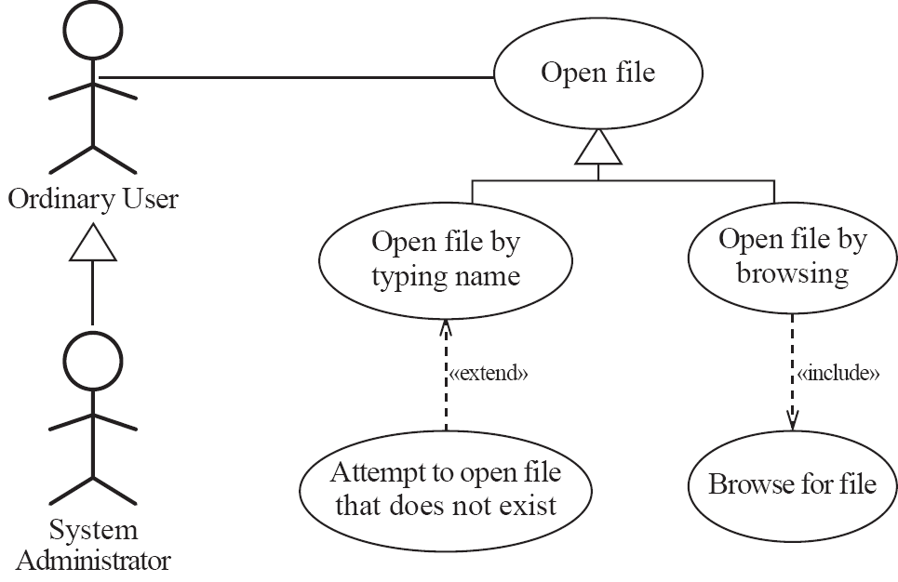
Example of generalization, extension and inclusion

Slide 20
Example description of a use case

Slide 21
Example (continued)

Slide 22
Example (continued)

Slide 23
Example (continued)

Slide 24
Example (continued)

Slide 25
Modeling: Choosing use cases on which to focus
Often one use case (or a very small number) can be identified as central to the system
The entire system can be built around this particular use case
There are other reasons for focusing on particular use cases:
Some use cases will represent a high risk because for some reason their implementation is problematic
Some use cases will have high political or commercial value

Slide 26
The benefits of basing software development on use cases
Use cases can
Help to define the scope of the system
Be used to plan the development process
Be used to both develop and validate the requirements
Form the basis for the definition of test cases
Be used to structure user manuals

Slide 27
User stories vs. use cases
The term ‘user stories’ is used in agile development
Conceptually very similar to use cases
Typically less formal

Slide 28
Techniques for Gathering and Analysing Requirements
Observation
Read documents and discuss requirements with users
Shadowing important potential users as they do their work
ask the user to explain everything he or she is doing
Session video taping
Interviewing
Conduct a series of interviews
Ask about specific details
Ask about the stakeholder’s vision for the future
Ask if they have alternative ideas
Ask for other sources of information
Ask them to draw diagrams

Slide 29
Gathering and Analysing Requirements...
Brainstorming
Appoint an experienced moderator
Arrange the attendees around a table
Decide on a ‘trigger question’
Ask each participant to write an answer and pass the paper to its neighbour
Joint Application Development (JAD) is a technique based on intensive brainstorming sessions

Slide 30
Gathering and Analysing Requirements...
Prototyping
The simplest kind: paper prototype.
a set of pictures of the system that are shown to users in sequence to explain what would happen
The most common: a mock-up of the system’s UI
Written in a rapid prototyping language
Does not normally perform any computations, access any databases or interact with any other systems
May prototype a particular aspect of the system

Slide 31
Gathering and Analysing Requirements...
Use case analysis
Determine the classes of users that will use the facilities of this system (actors)
Determine the tasks that each actor will need to do with the system

Slide 32
Level of detail required in requirements
More detailed requirements are likely needed when
The system is large and complex
There is a need to interface to hardware or other systems
Clients and users are in a very technical domain
Engineering, science, financial analysis, etc.
There could be large costs, safety issues or security issues if the requirements are faulty

Slide 33
Reviewing Requirements
Each individual requirement should
Have benefits that outweigh the costs of development
Be important for the solution of the current problem
Be expressed using a clear and consistent notation
Be unambiguous
Be logically consistent
Lead to a system of sufficient quality
Be realistic with available resources
Be verifiable
Be uniquely identifiable
Does not over-constrain the design of the system

Slide 34
Key qualities of requirements
The requirements should be:
sufficiently complete
well organized
clear
agreed to by all the stakeholders
Traceability:

Slide 35
Managing Changing Requirements
Requirements change because:
Business process changes
Technology changes
The problem becomes better understood
Requirements analysis never stops
Continue to interact with the clients and users

Slide 36
Managing Changing Requirements
The benefits of changes must outweigh the costs.
Certain small changes (e.g. look and feel of the UI) are usually quick and easy to make at relatively little cost.
Larger-scale changes have to be carefully assessed
Forcing unexpected changes into a partially built system will probably result in a poor design and late delivery
Some changes are enhancements in disguise
Avoid making the system bigger, only make it better

