Slide 1
Object-Oriented Software Engineering Practical Software Development using UML and Java
Chapter 5:
Modelling with Classes

Slide 2
What is UML?
The Unified Modelling Language is a standard graphical language for modelling object oriented software
Developed by Rumbaugh, Booch and Jacobson
Based on earlier languages they had each developed
They worked together at the Rational Software Corporation, later bought by IBM
Much development of UML has been done at IBM Rational Ottawa
In 1997 the Object Management Group (OMG) started the process of UML standardization

Slide 3
UML diagrams
Class diagrams
describe classes and their relationships
Interaction diagrams
Sequence and communication diagrams
Show the behaviour of systems in terms of how objects interact with each other
State diagrams and activity diagrams
show how systems or classes behave internally
Component and deployment diagrams
show how the various components of systems are arranged logically and physically

Slide 4
Essentials of UML Class Diagrams
The main symbols shown on class diagrams are:
Classes
represent the types of data themselves
Associations
represent linkages between instances of classes
Attributes
are simple data found in classes and their instances
Operations
represent the abstract functions performed by the classes and their instances, as well as specific methods implementing these
Generalizations
group classes into inheritance hierarchies

Slide 5
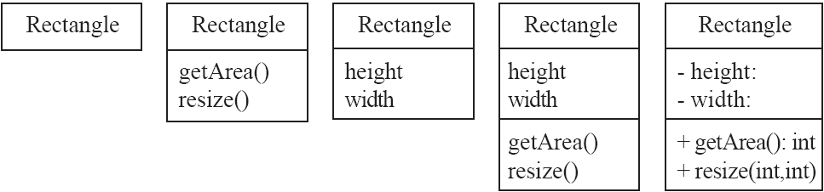
Classes
A class is simply represented as a box with the name of the class inside
The diagram may also show the attributes and operations
The complete signature of an operation is:
operationName(parameterName: parameterType …): returnType

Slide 6
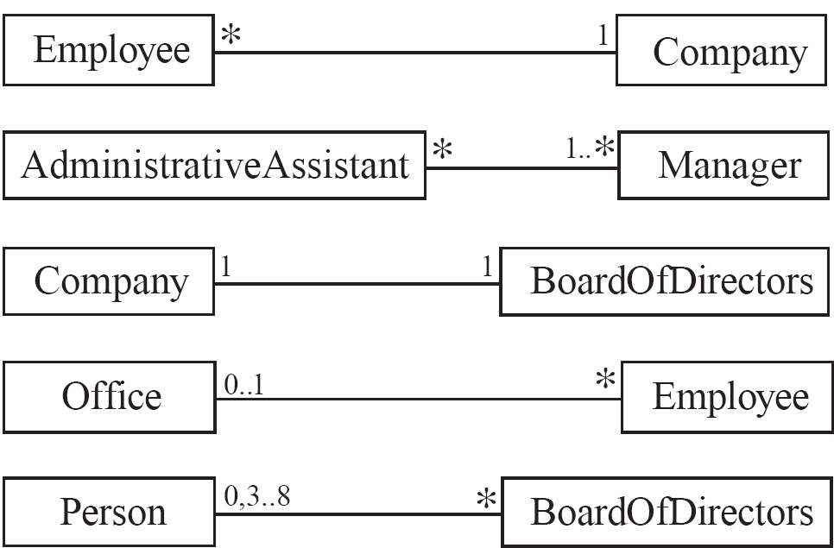
Associations and Multiplicity
An association is used to show how two classes are related to each other
Symbols indicating multiplicity are shown at each end of the association

Slide 7
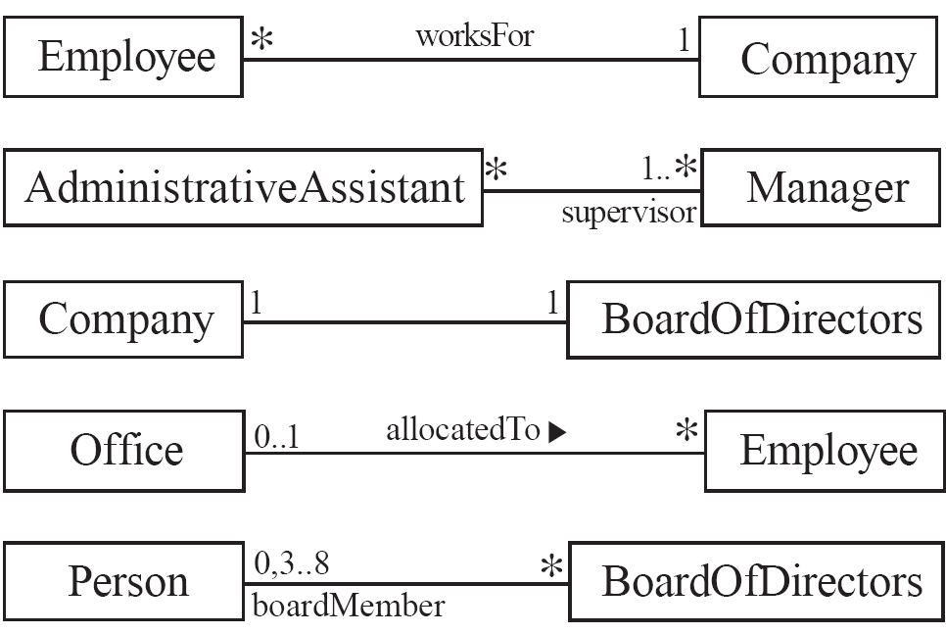
Labelling associations
Each association can be labelled, to make explicit the nature of the association

Slide 8
Analyzing and validating associations
Many-to-one
A company has many employees,
An employee can only work for one company.
This company will not store data about the moonlighting activities of employees!
A company can have zero employees
E.g. a ‘shell’ company
It is not possible to be an employee unless you work for a company
Employee
*
worksFor
1
Company

Slide 9
Analyzing and validating associations
Many-to-many
An assistant can work for many managers
A manager can have many assistants
Assistants can work in pools
Managers can have a group of assistants
Some managers might have zero assistants.
Is it possible for an assistant to have, perhaps temporarily, zero managers?
*
1..*
*
*
*
*
Assistant
*
Manager
supervisor
Open in Umple

Slide 10
Analyzing and validating associations
One-to-one
For each company, there is exactly one board of directors
A board is the board of only one company
A company must always have a board
A board must always be of some company
1
1
Open in Umple

Slide 11
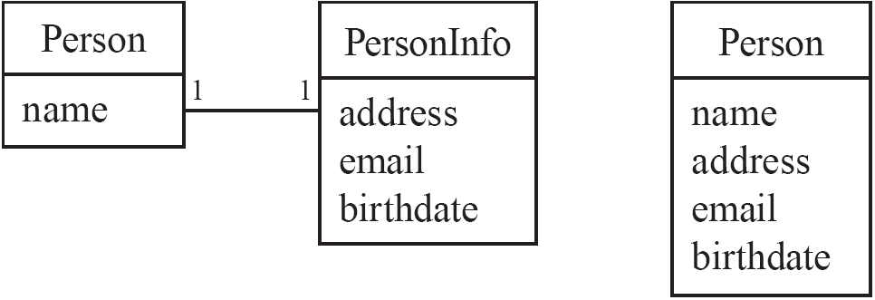
Analyzing and validating associations
Avoid unnecessary one-to-one associations
Avoid this do this

Slide 12
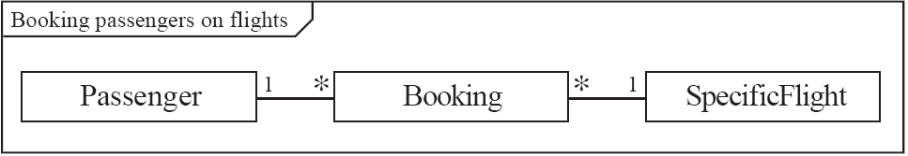
A more complex example
A booking is always for exactly one passenger
no booking with zero passengers
a booking could never involve more than one passenger.
A Passenger can have any number of Bookings
a passenger could have no bookings at all
a passenger could have more than one booking
The frame around this diagram is an optional feature that any UML 2.0 may possess.

Slide 13
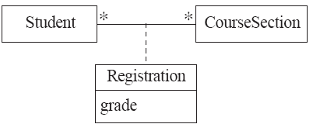

Association classes
Sometimes, an attribute that concerns two associated classes cannot be placed in either of the classes
The following are equivalent
Open in Umple and extended example

Slide 14
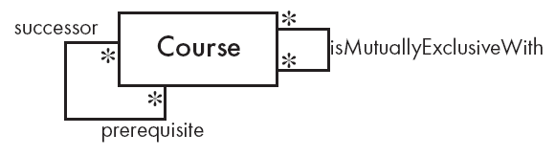
Reflexive associations
It is possible for an association to connect a class to itself
Open in Umple

Slide 15
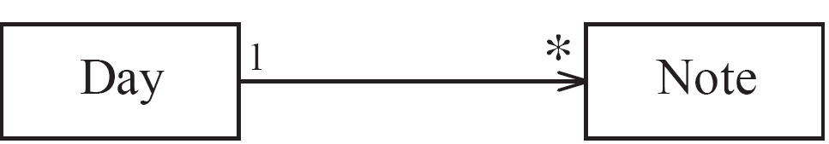
Directionality in associations
Associations are by default bi-directional
It is possible to limit the direction of an association by adding an arrow at one end
Open in Umple

Slide 16
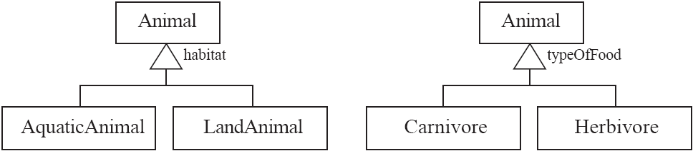
Generalization
Specializing a superclass into two or more subclasses
A generalization set is a labeled group of generalizations with a common superclass
The label (sometimes called the discriminator) describes the criteria used in the specialization

Slide 17
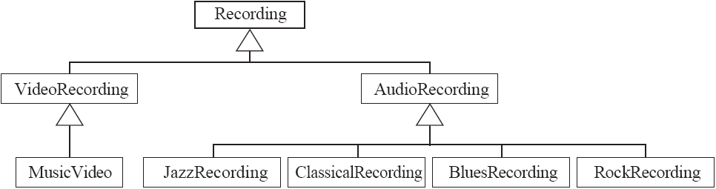
Avoiding unnecessary generalizations
Inappropriate hierarchy of
classes, which should be
instances

Slide 18
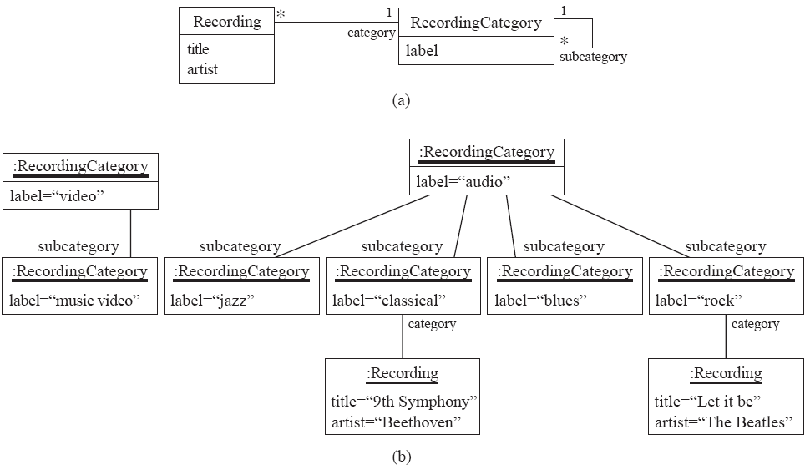
Avoiding unnecessary generalizations (cont)
Open in Umple
Improved class diagram, with its corresponding instance diagram

Slide 19
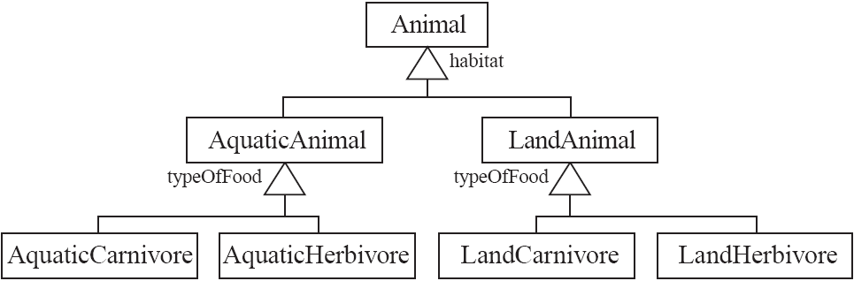
Handling multiple discriminators
Creating higher-level generalization

Slide 20
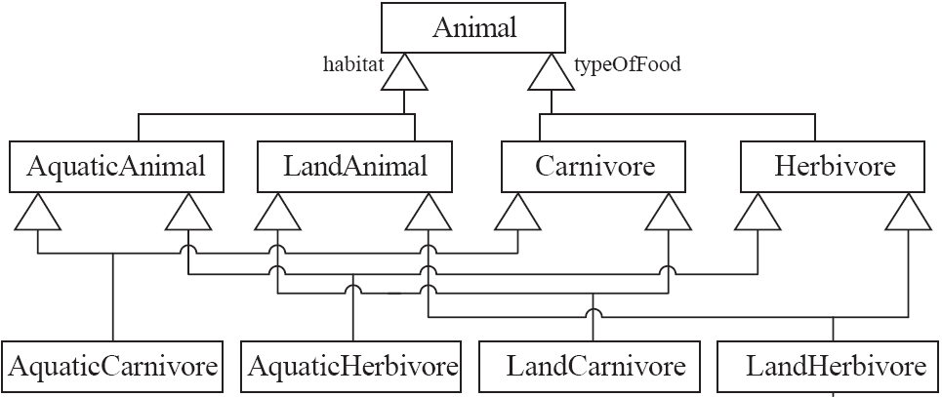
Handling multiple discriminators
Using multiple inheritance
Using the Player-Role pattern (in Chapter 6)

Slide 21
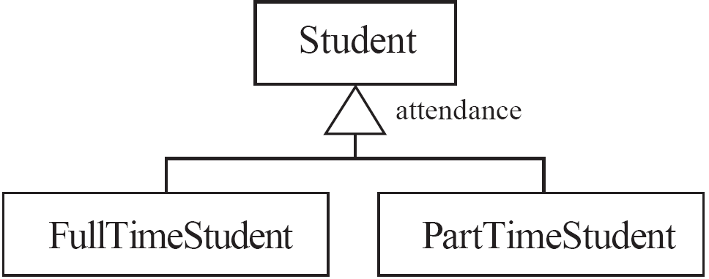
Avoiding having instances change class
An instance should never need to change class

Slide 22
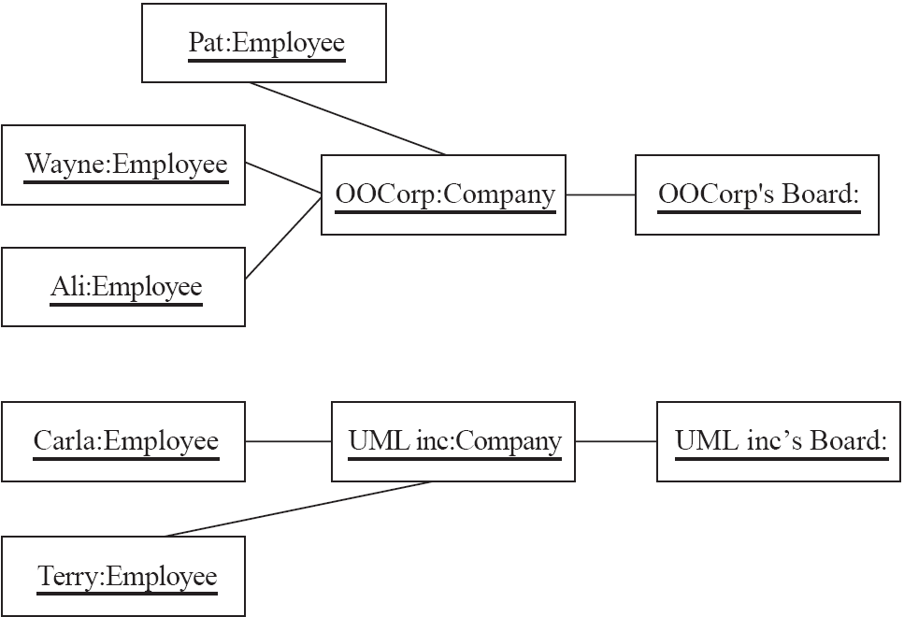
Object Diagrams
A link is an instance of an association
In the same way that we say an object is an instance of a class

Slide 23
Associations versus generalizations in object diagrams
Associations describe the relationships that will exist between instances at run time.
When you show an instance diagram generated from a class diagram, there will be an instance of both classes joined by an association
Generalizations describe relationships between classes in class diagrams.
They do not appear in instance diagrams at all.
An instance of any class should also be considered to be an instance of each of that class’s superclasses

Slide 24
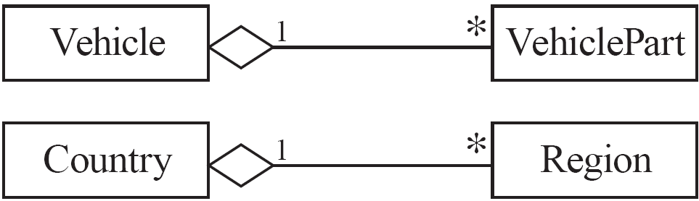
More Advanced Features: Aggregation
Aggregations are special associations that represent ‘part-whole’ relationships.
The ‘whole’ side is often called the assembly or the aggregate
This symbol is a shorthand notation association named isPartOf

Slide 25
When to use an aggregation
As a general rule, you can mark an association as an aggregation if the following are true:
You can state that
the parts ‘are part of’ the aggregate
or the aggregate ‘is composed of’ the parts
When something owns or controls the aggregate, then they also own or control the parts

Slide 26
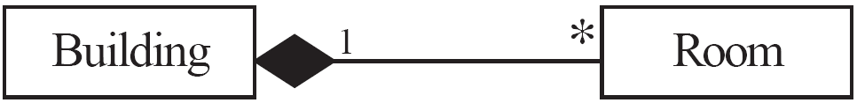
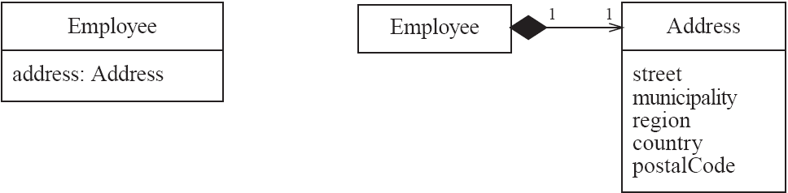
Composition
A composition is a strong kind of aggregation
if the aggregate is destroyed, then the parts are destroyed as well
Two alternatives for addresses

Slide 27
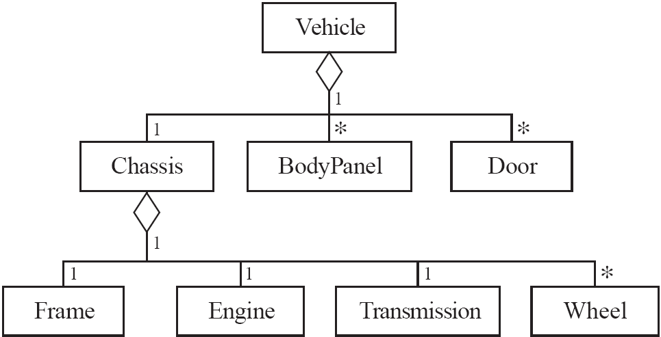
Aggregation hierarchy

Slide 28

Propagation
A mechanism where an operation in an aggregate is implemented by having the aggregate perform that operation on its parts
At the same time, properties of the parts are often propagated back to the aggregate
Propagation is to aggregation as inheritance is to generalization.
The major difference is:
inheritance is an implicit mechanism
propagation has to be programmed when required

Slide 29
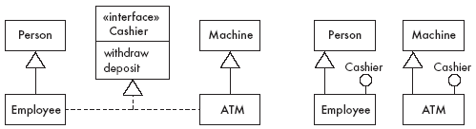
Interfaces
An interface describes a portion of the visible behaviour of a set of objects.
An interface is similar to a class, except it lacks instance variables and implemented methods

Slide 30
Notes and descriptive text
Descriptive text and other diagrams
Embed your diagrams in a larger document
Text can explain aspects of the system using any notation you like
Highlight and expand on important features, and give rationale
Notes:
A note is a small block of text embedded in a UML diagram
It acts like a comment in a programming language

Slide 31
Object Constraint Language (OCL)
OCL is a specification language designed to formally specify constraints in software modules
An OCL expression simply specifies a logical fact (a constraint) about the system that must remain true
A constraint cannot have any side-effects
it cannot compute a non-Boolean result nor modify any data.
OCL statements in class diagrams can specify what the values of attributes and associations must be

Slide 32
OCL statements
OCL statements can be built from:
References to role names, association names, attributes and the results of operations
The logical values true and false
Logical operators such as and, or, =, >, < or <> (not equals)
String values such as: ‘a string’
Integers and real numbers
Arithmetic operations *, /, +, -

Slide 33
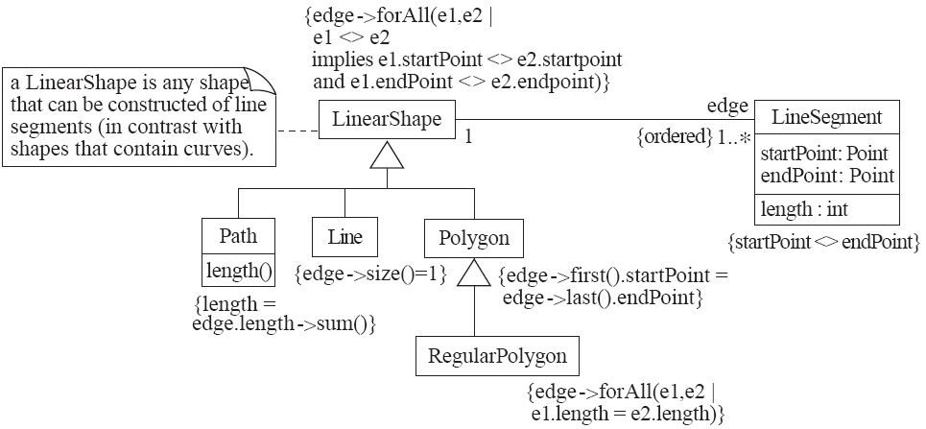
An example: constraints on Polygons

Slide 34
The Process of Developing Class Diagrams
You can create UML models at different stages and with different purposes and levels of details
Exploratory domain model:
Developed in domain analysis to learn about the domain
System domain model:
Models aspects of the domain represented by the system(during requirements analysis)
System model:
Includes also classes used to build the user interface and system architecture

Slide 35
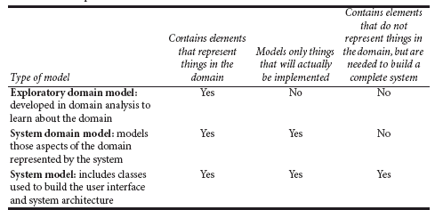
System domain model vs System model

Slide 36
System domain model vs System model
The system domain model omits many classes that are needed to build a complete system
Can contain less than half the classes of the system.
Should be developed to be used independently of particular sets of
user interface classes
architectural classes
The complete system model includes
The system domain model
User interface classes such as windows, menus, commands and forms.
Architectural classes such as clients, servers, files and databases.
Utility classes that make parts of the system more reusable, easier to maintain or easier to connect to other systems.

Slide 37
Suggested sequence of activities
Identify a first set of candidate classes
Add associations and attributes
Find generalizations
List the main responsibilities of each class
Decide on specific operations
Iterate over the entire process until the model is satisfactory
Add or delete classes, associations, attributes, generalizations, responsibilities or operations
Identify interfaces
Apply design patterns (Chapter 6)
Don’t be too disorganized. Don’t be too rigid either.

Slide 38
Identifying classes
When developing a domain model you tend to discover classes
When you work on the user interface or the system architecture, you tend to invent classes
Needed to solve a particular design problem
(Inventing may also occur when creating a domain model)
Reuse should always be a concern
Frameworks
System extensions
Similar systems

Slide 39
A simple technique for discovering domain classes
Look at a source material such as a description of requirements
Extract the nouns and noun phrases
Eliminate nouns that:
are redundant (more name for one class)
represent instances
are vague or highly general
not needed in the application
Pay attention to classes in a domain model that represent ‘types of users’ or other actors.
You would only keep such classes if storing and manipulating this information is actually part of the domain.

Slide 40
Airline Reservation System
Ootumlia Airlines runs sightseeing flights from Java Valley, the capital of Ootumlia.
The reservation system keeps track of passengers who will be flying in specific seats on various flights, as well as people who will form the crew.
For the crew, the system needs to track what everyone does, and who supervises whom.
Ootumlia Airlines runs several daily numbered flights on a regular schedule.
Ootumlia Airlines expects to expand in the future, therefore the system needs to be flexible; in particular, it will be adding a frequent-flier plan.

Slide 41
Q&A
Q: List the nouns and noun phrases that might end up being classes in a system domain model. For those nouns that should not become classes, explain why not.

Slide 42
Q&A
A : Nouns that are put on an initial list of classes include: Flight, Passenger, Employee.
Other nouns or noun phrases that we choose not to include in the initial list of classes:
❏ ‘Java Valley’, ‘Ootumlia’. These are instances.
❏ ‘Reservation system’. This is not a class because it is part of the system.
❏ ‘Sightseeing Flight’. Rejected in favor of Flight, since the latter is more general and therefore makes the system more flexible.
❏ ‘Seat’. Appears to be an attribute of Flight.

Slide 43
Q&A
❏ ‘Crew’. This word implies the entire crew, when we really want to store information about individual members of that crew. We could have created a class CrewMember, but Employee seemed more flexible -allowing us to use the class in future for people who are not actually crew members.
❏ ‘Schedule’. This is a word that describes a complex bundle of information that would be better represented by classes such as Flight, and the attributes and associations of those classes.
❏ ‘Future’. This is a noun, but it is not part of the system to be developed.
❏ ‘Frequent Flier Plan’. This is not part of the current scope.

Slide 44
Identifying associations and attributes
Start with classes you think are most central and important
Decide on the clear and obvious data it must contain and its relationships to other classes.
Avoid adding many associations and attributes to a class
A system is simpler if it manipulates less information

Slide 45
Tips about identifying and specifying valid associations
An association should exist if a class
possesses
controls
is connected to
is related to
is a part of
has as parts
is a member of, or
has as members
some other class in your model
Specify the multiplicity at both ends
Label it clearly.

Slide 46
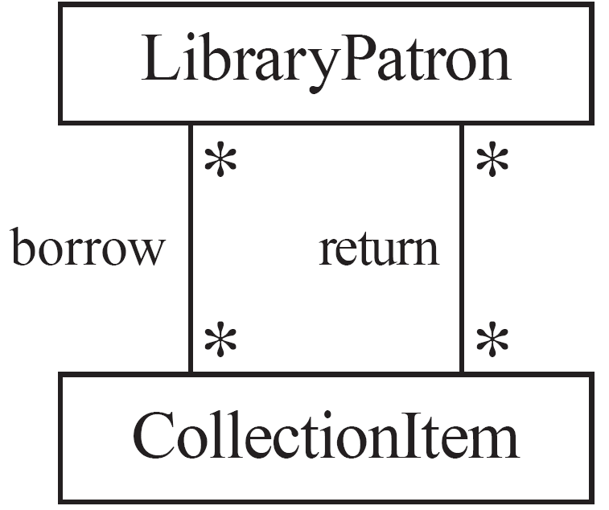
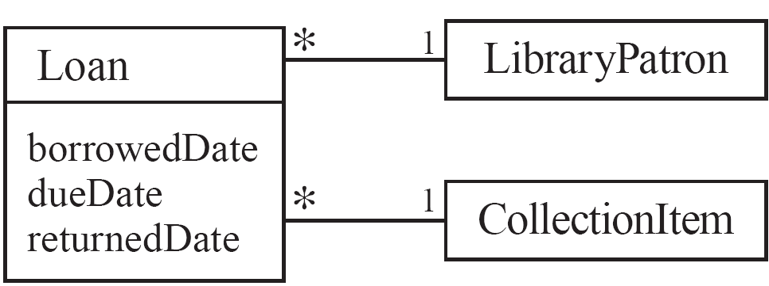
Actions versus associations
A common mistake is to represent actions as if they were associations
Better: The
borrow
operation creates a
Loan
, and
Bad, due to the use of associations
the
return
operation sets the
returnedDate
that are actions
attribute.

Slide 47
Identifying attributes
Look for information that must be maintained about each class
Several nouns rejected as classes, may now become attributes
An attribute should generally contain a simple value
E.g. string, number

Slide 48
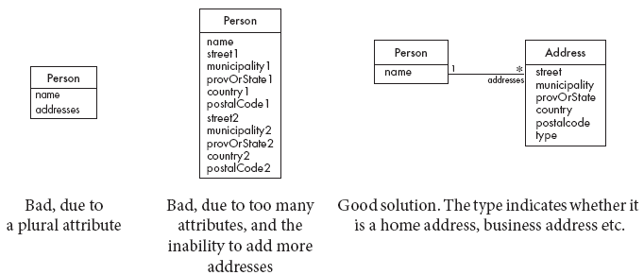
Tips about identifying and specifying valid attributes
It is not good to have many duplicate attributes
If a subset of a class’s attributes form a coherent group, then create a distinct class containing these attributes

Slide 49
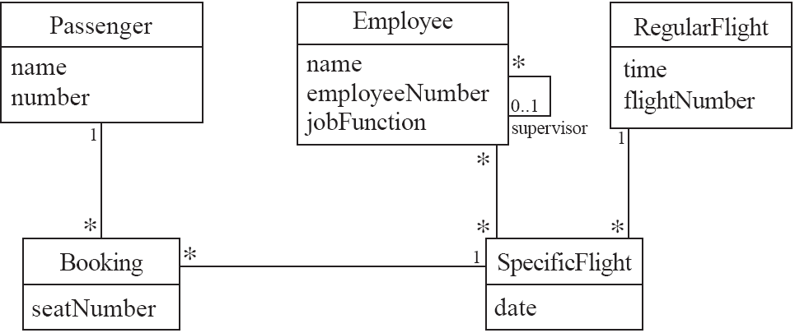
Airline example (attributes and associations)

Slide 50
Identifying generalizations and interfaces
There are two ways to identify generalizations:
bottom-up
Group together similar classes creating a new superclass
top-down
Look for more general classes first, specialize them if needed
Create an interface, instead of a superclass if
The classes are very dissimilar except for having a few operations in common
One or more of the classes already have their own superclasses

Slide 51
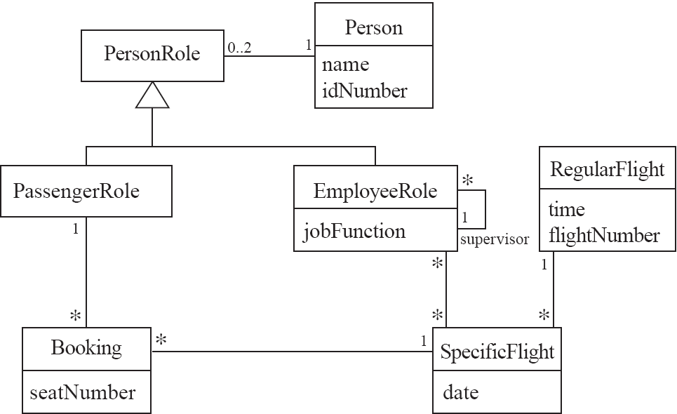
An example (generalization)

Slide 52
Allocating responsibilities to classes
A responsibility is something that the system is required to do.
Each functional requirement must be attributed to one of the classes
All the responsibilities of a given class should be clearly related.
If a class has too many responsibilities, consider splitting it into distinct classes
If a class has no responsibilities attached to it, then it is probably useless
When a responsibility cannot be attributed to any of the existing classes, then a new class should be created
To determine responsibilities
Perform use case analysis
Look for verbs and nouns describing actions in the system description

Slide 53
Categories of responsibilities
Setting and getting the values of attributes
Creating and initializing new instances
Loading to and saving from persistent storage
Destroying instances
Adding and deleting links of associations
Copying, converting, transforming, transmitting or outputting
Computing numerical results
Navigating and searching
Other specialized work

Slide 54
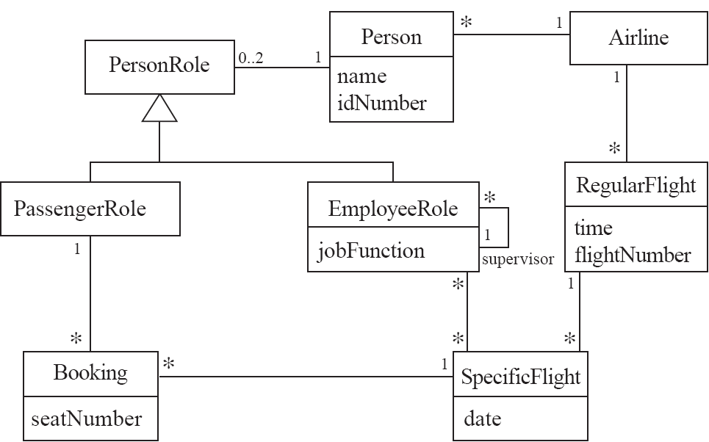
An example (responsibilities)
Creating a new regular flight
Searching for a flight
Modifying attributes of a flight
Creating a specific flight
Booking a passenger
Canceling a booking

Slide 55
Prototyping a class diagram on paper
As you identify classes, you write their names on small cards
As you identify attributes and responsibilities, you list them on the cards
If you cannot fit all the responsibilities on one card:
this suggests you should split the class into two related classes.
Move the cards around on a whiteboard to arrange them into a class diagram.
Draw lines among the cards to represent associations and generalizations.

Slide 56
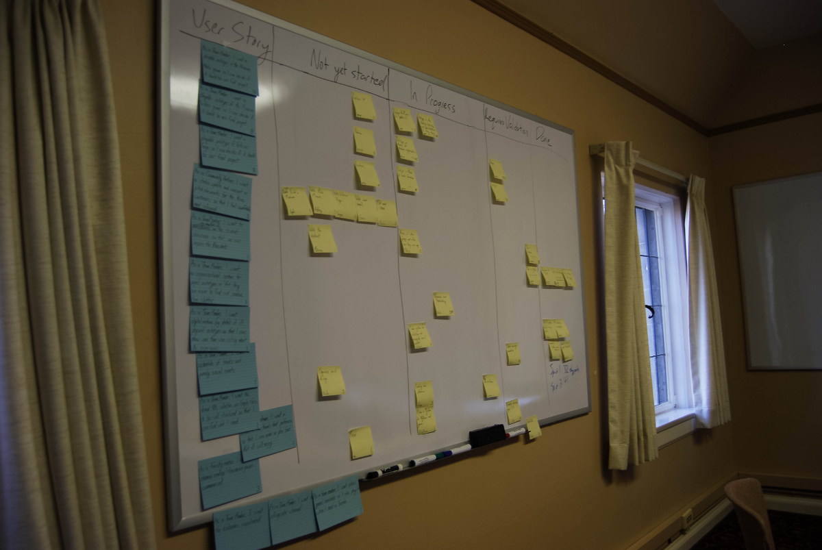
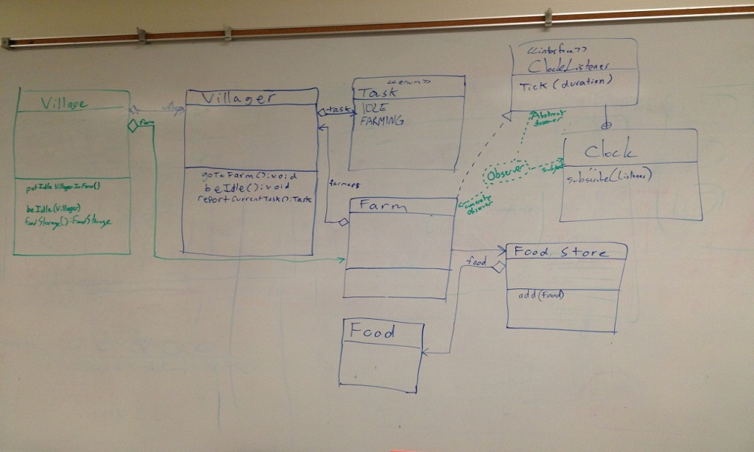
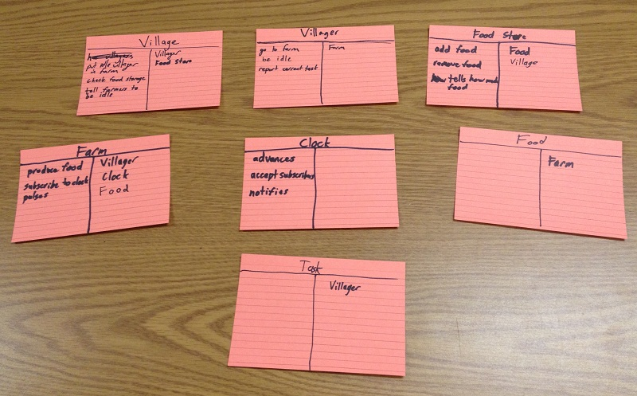
Example

Slide 57
Identifying operations
Operations are needed to realize the responsibilities of each class
There may be several operations per responsibility
The main operations that implement a responsibility are normally declared public
Other methods that collaborate to perform the responsibility must be as private as possible

Slide 58
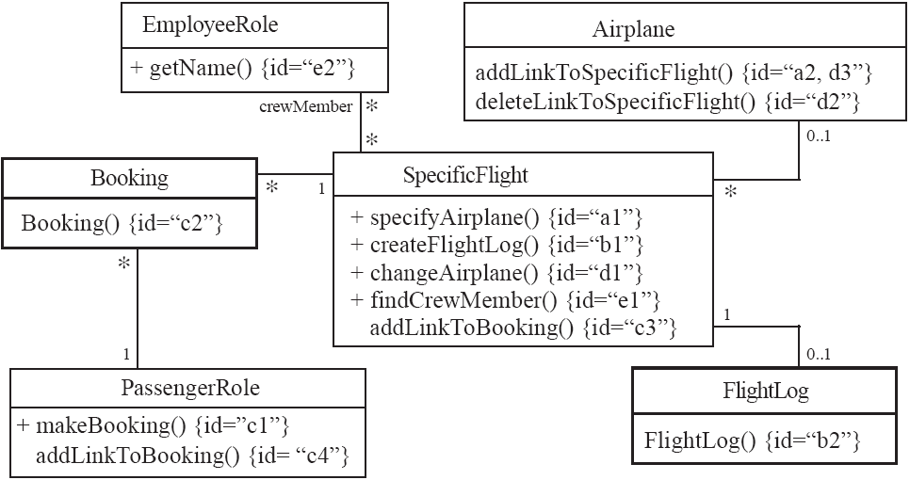
An example (class collaboration)

Slide 59
Class collaboration ‘a’
*
0..1
SpecificFlight
Airplane
Making a bi-directional link between two existing objects;
e.g. adding a link between an instance of SpecificFlight and an instance of Airplane.
1. (public) The instance of SpecificFlight
makes a one-directional link to the instance of Airplane
then calls operation 2.
2. (non-public) The instance of Airplane
makes a one-directional link back to the instance of SpecificFlight

Slide 60
Class collaboration ‘b’
1
Creating an object and linking it to an existing object
e.g. creating a FlightLog, and linking it to a SpecificFlight.
1. (public) The instance of SpecificFlight
calls the constructor of FlightLog (operation 2)
then makes a one-directional link to the new instance of FlightLog.
2. (non-public) Class FlightLog’s constructor
makes a one-directional link back to the instance of SpecificFlight.

Slide 61
Class collaboration ‘c’
1
1
Creating an association class, given two existing objects
e.g. creating an instance of Booking, which will link a SpecificFlight to a PassengerRole.
1. (public) The instance of PassengerRole
calls the constructor of Booking (operation 2).
2. (non-public) Class Booking’s constructor, among its other actions
makes a one-directional link back to the instance of PassengerRole
makes a one-directional link to the instance of SpecificFlight
calls operations 3 and 4.
3. (non-public) The instance of SpecificFlight
makes a one-directional link to the instance of Booking.
4. (non-public) The instance of PassengerRole
makes a one-directional link to the instance of Booking.

Slide 62
Class collaboration ‘d’
Changing the destination of a link
e.g. changing the Airplane of to a SpecificFlight, from airplane1 to airplane2
1. (public) The instance of SpecificFlight
deletes the link to airplane1
makes a one-directional link to airplane2
calls operation 2
then calls operation 3.
2. (non-public) airplane1
deletes its one-directional link to the instance of SpecificFlight.
3. (non-public) airplane2
makes a one-directional link to the instance of SpecificFlight.

Slide 63
Class collaboration ‘e’
Searching for an associated instance
e.g. searching for a crew member associated with a SpecificFlight that has a certain name.
1. (public) The instance of SpecificFlight
creates an Iterator over all the crewMember links of the SpecificFlight
for each of them call operation 2, until it finds a match.
2. (may be public) The instance of EmployeeRole returns its name.

Slide 64
Implementing Class Diagrams in Java
Attributes are implemented as instance variables
Generalizations are implemented using extends
Interfaces are implemented using implements
Associations are normally implemented using instance variables
Divide each two-way association into two one-way associations
so each associated class has an instance variable.
For a one-way association where the multiplicity at the other end is ‘one’ or ‘optional’
declare a variable of that class (a reference)
For a one-way association where the multiplicity at the other end is ‘many’:
use a collection class implementing List, such as Vector

Slide 65
Example: SpecificFlight
class SpecificFlight
{
private Calendar date;
private RegularFlight regularFlight;
...
// Constructor that should only be called from
// addSpecificFlight
SpecificFlight( Calendar aDate, RegularFlight aRegularFlight)
{
date = aDate;
regularFlight = aRegularFlight;
}
}

Slide 66
Example: RegularFlight
class RegularFlight
{
private List specificFlights;
...
// Method that has primary responsibility
public void addSpecificFlight(Calendar aDate)
{
SpecificFlight newSpecificFlight;
newSpecificFlight = new SpecificFlight(aDate, this);
specificFlights.add(newSpecificFlight);
}
...
}

Slide 67
Difficulties and Risks when creating class diagrams
Modeling is particularly difficult skill
Even excellent programmers have difficulty thinking at the appropriate level of abstraction
Education traditionally focus more on design and programming than modeling
Resolution:
Ensure that tem members have adequate training
Have experienced modeler as part of the team
Review all models thoroughly

