Slide 1
Object-Oriented Software Engineering Practical Software Development using UML and Java
Chapter 7:
Focusing on Users and Their Tasks

Slide 2
User Centred Design
Software development should focus on the needs of users
Understand your users
Design software based on an understanding of the users’ tasks
Ensure users are involved in decision making processes
Design the user interface following guidelines for good usability
Have users work with and give their feedback about prototypes, on-line help and draft user manuals

Slide 3
The importance of focusing on users
Reduced training and support costs
Reduced time to learn the system
Greater efficiency of use
Reduced costs by only developing features that are needed
Reduced costs associated with changing the system later
Better prioritizing of work for iterative development
Greater attractiveness of the system, so users will be more willing to buy and use it

Slide 4
Characteristics of Users
Software engineers must develop an understanding of the users
Goals for using the system
Potential patterns of use
Demographics
Knowledge of the domain and of computers
Physical ability
Psychological traits and emotional feelings

Slide 5
Basics of User Interface Design
User interface design should be done in conjunction with other software engineering activities.
Do use case analysis to help define the tasks that the UI must help the user perform.
Do iterative UI prototyping to address the use cases.
Results of prototyping will enable you to finalize the requirements.

Slide 6
Usability vs. Utility
Does the system provide the raw capabilities to allow the user to achieve their goal?
This is utility.
Does the system allow the user to learn and to use the raw capabilities easily?
This is usability.
Both utility and usability are essential
They must be measured in the context of particular types of users.

Slide 7
Aspects of usability
Usability can be divided into separate aspects:
Learnability
The speed with which a new user can become proficient with the system.
Efficiency of use
How speed with which an expert user can do their work.
Error handling
The extent to which it prevents the user from making errors, detects errors, and helps to correct errors.
Acceptability.
The extent to which users like the system.

Slide 8
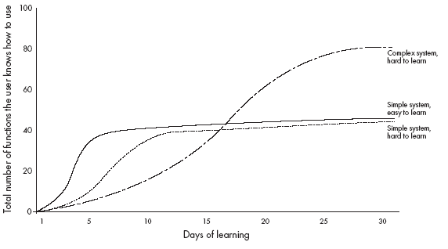
Different learning curves

Slide 9
Usability Principles
1: Do not rely only on usability guidelines – always test with users.
Usability guidelines have exceptions
You can only be confident that a UI is good if you test it successfully with users.
2: Base UI designs on users’ tasks.
Perform use case analysis to structure the UI.
3: Ensure that the sequences of actions to achieve a task are as simple as possible.
Reduce the amount of reading and manipulation the user has to do.
Ensure the user does not have to navigate anywhere to do subsequent steps of a task.

Slide 10
Usability Principles
4: Ensure that the user always knows what he or she can and should do next.
Ensure that the user can see what commands are available and are not available.
Make the most important commands stand out.
5: Provide good feedback including effective error messages.
Inform users of the progress of operations and of their location as they navigate.
When something goes wrong explain the situation in adequate detail and help the user to resolve the problem.

Slide 11
Usability Principles
6: Ensure that the user can always get out, go back or undo an action.
Ensure that all operations can be undone.
Ensure it is easy to navigate back to where the user came from.
7: Ensure that response time is adequate.
Users are very sensitive to slow response time
They compare your system to others.
Keep response time less than a second for most operations.
Warn users of longer delays and inform them of progress.

Slide 12
Usability Principles
8: Use understandable encoding techniques.
Choose encoding techniques with care.
Use labels to ensure all encoding techniques are fully understood by users.
9: Ensure that the UI’s appearance is uncluttered.
Avoid displaying too much information.
Organize the information effectively.

Slide 13
Usability Principles
10: Consider the needs of different groups of users.
Accommodate people from different locales and people with disabilities.
Ensure that the system is usable by both beginners and experts.
11: Provide all necessary help.
Organize help well.
Integrate help with the application.
Ensure that the help is accurate.

Slide 14
Usability Principles
12. Be consistent.
Use similar layouts and graphic designs throughout your application.
Follow look-and-feel standards.
Consider mimicking other applications.

Slide 15
Evaluating User Interfaces
Heuristic evaluation
1. Pick some use cases to evaluate.
2. For each window, page or dialog that appears during the execution of the use case
Study it in detail to look for possible usability defects.
3. When you discover a usability defect write down the following information:
A short description of the defect.
Your ideas for how the defect might be fixed.

Slide 16
Evaluating User Interfaces
Evaluation by observation of users
Select users corresponding to each of the most important actors
Select the most important use cases
Write sufficient instructions about each of the scenarios
Arrange evaluation sessions with users
Explain the purpose of the evaluation
Preferably video each session
Converse with the users as they are performing the tasks
When the users finish all the tasks, de-brief them
Take note of any difficulties experienced by the users
Formulate recommended changes

Slide 17
Difficulties and Risks in UI Design
Users differ widely
Account for differences among users when you design the system.
Design it for internationalization.
When you perform usability studies, try the system with many different types of users.
User interface implementation technology changes rapidly
Stick to simpler UI frameworks widely used by others.
Avoid fancy and unusual UI designs involving specialized controls that will be hard to change.

Slide 18
Difficulties and Risks in UI Design
User interface design and implementation can often take the majority of work in an application:
Make UI design an integral part of the software engineering process.
Allocate time for many iterations of prototyping and evaluation.
Developers often underestimate the weaknesses of a GUI
Ensure all software engineers have training in UI development.
Always test with users.
Study the UIs of other software.

