Slide 1
Object-Oriented Software Engineering Practical Software Development using UML and Java
Chapter 9:
Architecting and Designing Software

Slide 2
The Process of Design
Definition:
Design is a problem-solving process whose objective is to find and describe a way:
To implement the system’s functional requirements...
While respecting the constraints imposed by the quality, platform and process requirements...
including the budget
And while adhering to general principles of good quality

Slide 3
Design as a series of decisions
A designer is faced with a series of design issues
These are sub-problems of the overall design problem.
Each issue normally has several alternative solutions:
design options.
The designer makes a design decision to resolve each issue.
This process involves choosing the best option from among the alternatives.

Slide 4
Making decisions
To make each design decision, the software engineer uses:
Knowledge of
the requirements
the design as created so far
the technology available
software design principles and ‘best practices’
what has worked well in the past

Slide 5
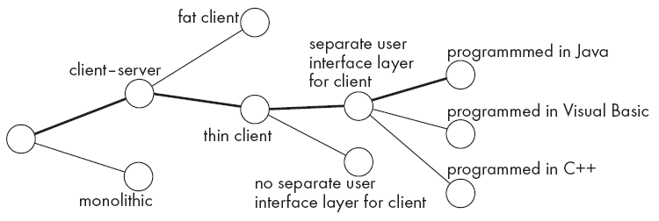
Design space
The space of possible designs that could be achieved by choosing different sets of alternatives is often called the design space
For example:

Slide 6
Component
Any piece of software or hardware that has a clear role.
A component can be isolated, allowing you to replace it with a different component that has equivalent functionality.
Many components are designed to be reusable.
Conversely, some others perform special-purpose functions.

Slide 7
Module
A component that is defined at the programming language level
For example, methods, classes and packages are modules in Java.

Slide 8
System
A logical entity, having a set of definable responsibilities or objectives, and consisting of hardware, software or both.
A system can have a specification which is then implemented by a collection of components.
A system continues to exist, even if its components are changed or replaced.
The goal of requirements analysis is to determine the responsibilities of a system.
Subsystem:
A system that is part of a larger system, and which has a definite interface

Slide 9
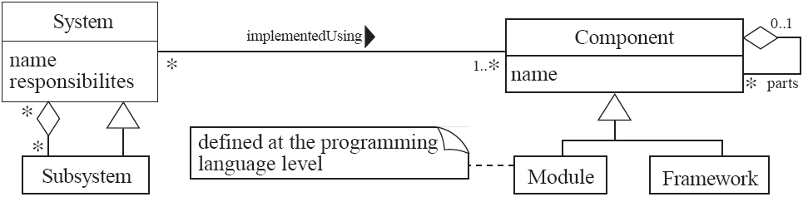
UML diagram of system parts

Slide 10
Top-down and bottom-up design
Top-down design
First design the very high level structure of the system.
Then gradually work down to detailed decisions about low-level constructs.
Finally arrive at detailed decisions such as:
the format of particular data items;
the individual algorithms that will be used.

Slide 11
Top-down and bottom-up design
Bottom-up design
Make decisions about reusable low-level utilities.
Then decide how these will be put together to create high-level constructs.
A mix of top-down and bottom-up approaches are normally used:
Top-down design is almost always needed to give the system a good structure.
Bottom-up design is normally useful so that reusable components can be created.

Slide 12
Different aspects of design
Software architecture :
The division into subsystems and components,
How these will be connected.
How they will interact.
Their interfaces.
Class design:
The various features of classes.
User interface design
Algorithm design:
The design of computational mechanisms.
Protocol design:
The design of communications protocol.

Slide 13
Principles Leading to Good Design
Overall goals of good design:
Increasing profit / reducing cost / increasing revenue
Ensuring that we actually conform with the requirements
Accelerating development
Increasing qualities such as
Usability
Efficiency
Reliability
Maintainability
Reusability

Slide 14
Design Principle 1: Divide and conquer
Trying to deal with something big all at once is normally much harder than dealing with a series of smaller things
Separate people can work on each part.
An individual software engineer can specialize.
Each individual component is smaller, and therefore easier to understand.
Parts can be replaced or changed without having to replace or extensively change other parts.

Slide 15
Design Principle 2: Increase cohesion where possible
A subsystem or module has high cohesion if it keeps together things that are related to each other, and keeps out other things
This makes the system as a whole easier to understand and change
Type of cohesion:
Functional, Layer, Communicational, Sequential, Procedural, Temporal, Utility

Slide 16
Design Principle 3: Reduce coupling where possible
Coupling occurs when there are interdependencies between one module and another
When interdependencies exist, changes in one place will require changes somewhere else.
A network of interdependencies makes it hard to see at a glance how some component works.
Type of coupling:
Content, Common, Control, Stamp, Data, Routine Call, Type use, Inclusion/Import, External

Slide 17
Design Principle 4: Increase abstraction
Ensure that your designs allow you to hide or defer consideration of details, thus reducing complexity
A good abstraction is said to provide information hiding
Abstractions allow you to understand the essence of a subsystem without having to know unnecessary details
Examples of abstractions:
Classes
UML associations
Interfaces
State machines
Domain specific languages (DSLs)

Slide 18
Design Principle 5: Increase reusability where possible
Design the various aspects of your system so that they can be used again in other contexts
Generalize your design as much as possible
Follow the preceding three design principles
Design your system to contain hooks
Simplify your design as much as possible

Slide 19
Design Principle 6: Reuse where possible
Design with reuse is complementary to design for reusability
Actively reusing designs or code allows you to take advantage of the investment you or others have made in reusable components

Slide 20
Design Principle 7: Design for flexibility
Actively anticipate changes that a design may have to undergo in the future, and prepare for them
Reduce coupling and increase cohesion
Create abstractions
Do not hard-code anything
Leave all options open
Do not restrict the options of people who have to modify the system later
Use reusable code and make code reusable

Slide 21
Design Principle 8: Anticipate obsolescence
Plan for changes in the technology or environment so the software will continue to run or can be easily changed
Avoid using early releases of technology
Avoid using software libraries that are specific to particular environments
Avoid using undocumented features or little-used features of software libraries
Avoid using software or special hardware from companies that are less likely to provide long-term support
Use standard languages and technologies that are supported by multiple vendors

Slide 22
Design Principle 9: Design for Portability
Have the software run on as many platforms as possible
Avoid the use of facilities that are specific to one particular environment
E.g. a library only available in Microsoft Windows

Slide 23
Design Principle 10: Design for Testability
Take steps to make testing easier
Design a program to automatically test the software
Discussed more in Chapter 10
Ensure that all the functionality of the code can by driven by an external program, bypassing a graphical user interface
In Java, you can create a main() method in each class in order to exercise the other methods
Use Junit or similar frameworks

Slide 24
Design Principle 11: Design defensively
Never trust how others will try to use a component you are designing
Handle all cases where other code might attempt to use your component inappropriately
Check that all of the inputs to your component are valid: the preconditions
Unfortunately, over-zealous defensive design can result in unnecessarily repetitive checking

Slide 25
Software Architecture
Software architecture is process of designing the global organization of a software system, including:
Dividing software into subsystems.
Deciding how these will interact.
Determining their interfaces.
The architecture is the core of the design, so all software engineers need to understand it.
The architecture will often constrain the overall efficiency, reusability and maintainability of the system.

Slide 26
Architectural Patterns
The notion of patterns can be applied to software architecture.
These are called architectural patterns or architectural styles.
Each allows you to design flexible systems using components
The components are as independent of each other as possible.

Slide 27
The Client-Server and other distributed architectural patterns
There is at least one component that has the role of server, waiting for and then handling connections.
There is at least one component that has the role of client, initiating connections in order to obtain some service.
A further extension is the Peer-to-Peer pattern.
A system composed of various software components that are distributed over several hosts.

Slide 28
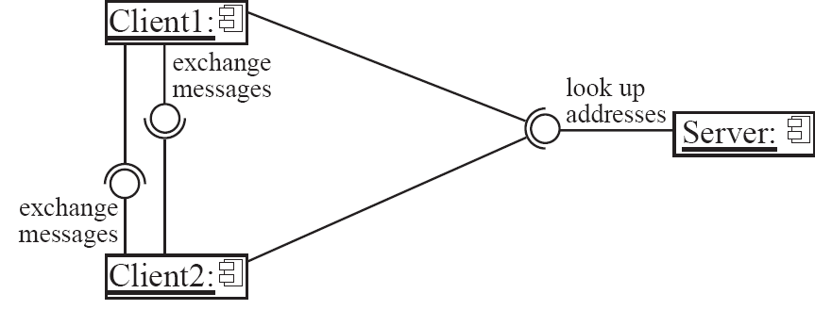
An example of a distributed system

Slide 29
The Transaction-Processing architectural pattern
A process reads a series of inputs one by one.
Each input describes a transaction – a command that typically make some change to the data stored by the system
There is a transaction dispatcher component that decides what to do with each transaction
This dispatches a procedure call or message to one of a series of component that will handle the transaction

Slide 30
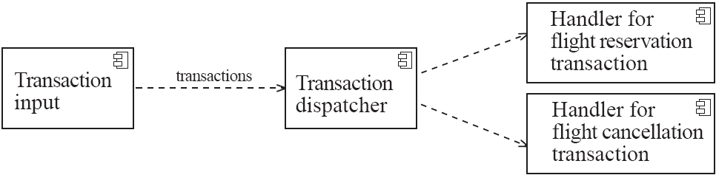
Example of a transaction-processing system

Slide 31
The Model-View-Controller (MVC) architectural pattern
An architectural pattern used to help separate the user interface layer from other parts of the system
The model contains the underlying classes whose instances are to be viewed and manipulated
The view contains objects used to render the appearance of the data from the model in the user interface
The controller contains the objects that control and handle the user’s interaction with the view and the model
The Observable design pattern is normally used to separate the model from the view

Slide 32
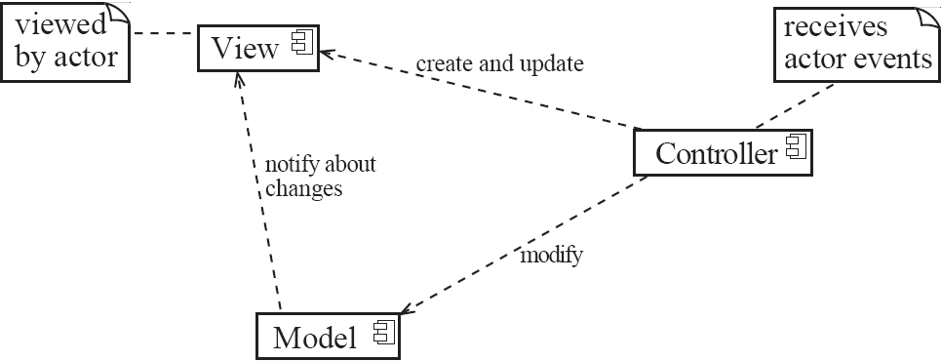
Example of the MVC architecture for the UI

Slide 33
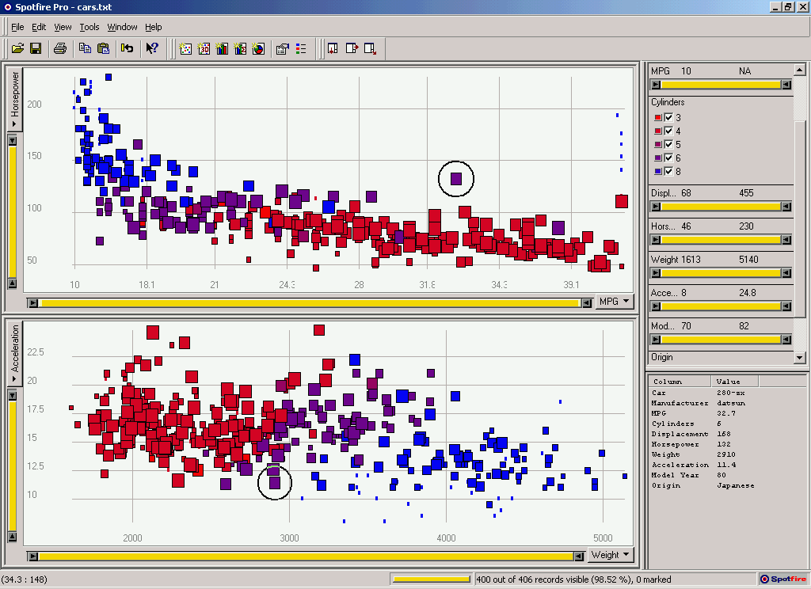

Model-View-Controller (MVC)
refresh,
update
Data display
View
User input
Controller
UI:
events
refresh
manipulate
Data model
Model
Data:

Slide 34
Example of MVC in Web architecture
The View component generates the HTML code to be displayed by the browser.
The Controller is the component that interprets ‘HTTP post’ transmissions.
The Model is the underlying system that manages the information.

Slide 35
Writing a Good Design Document
Design documents as an aid to making better designs
They force you to be explicit and consider the important issues before starting implementation.
They allow a group of people to review the design and therefore to improve it.
Design documents as a means of communication.
To those who will be implementing the design.
To those who will need, in the future, to modify the design.
To those who need to create systems or subsystems of the system.

Slide 36
Structure of a design document
A. Purpose:
What system or part of the system this design document describes.
Make reference to the requirements that are being implemented by this design (traceability) .
B. General priorities:
Describe the priorities used to guide the design process.
C. Outline of the design:
Give a high-level description of the design that allows the reader to quickly get a general feeling for it.
D. Major design issues:
Discuss the important issues that had to be resolved.
Give the possible alternatives that were considered, the final decision and the rationale for the decision.
E. Other details of the design:
Give any other details the reader may want to know that have not yet been mentioned.

Slide 37
Difficulties and Risks in Design
Like modelling, design is a skill that requires considerable experience
Individual software engineers should not attempt the design of large systems
Aspiring software architects should actively study designs of other systems
Poor designs can lead to expensive maintenance
Ensure you follow the principles discussed in this chapter

Slide 38
Difficulties and Risks in Design
It requires constant effort to ensure a software system’s design remains good throughout its life
Make the original design as flexible as possible so as to anticipate changes and extensions.
Ensure that the design documentation is usable and at the correct level of detail
Ensure that change is carefully managed

