Slide 1


Internet of Things
By: Eng. Javier E. Hernandez

Slide 2


About me
Javier Hernandez
BS Computer Engineer, UPRM
Developer
  Data Collection
  Mobile solutions
Contact:
Twitter @soynerdito
Gmail: soynerdito@gmail.com

Slide 3
Agenda
What is?
Is this new?
Why it is important?
Industries
Infrastructure
Challenges
Future

Slide 4

What is the Internet of Things?
Let's ask

Slide 5
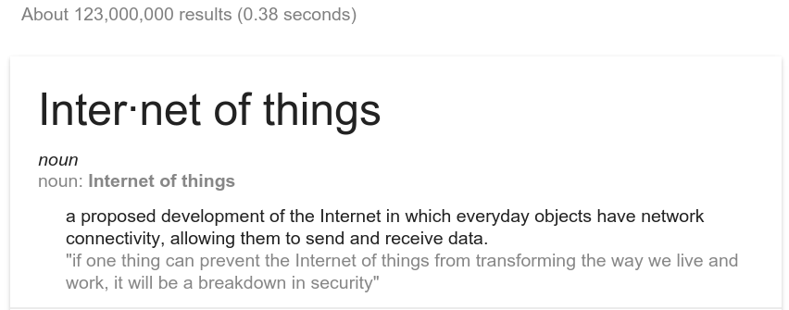
According to Google

Slide 6
“Every object”
What is an object?
  Mobile: phones, tablets, laptops, “phablets”
  Transportation: Car, Bus, Bikes
  Home appliances: Fridge, TV
  Traffic lights
  Doors
  Clothes
  Furniture
  Anything and everything

Slide 7
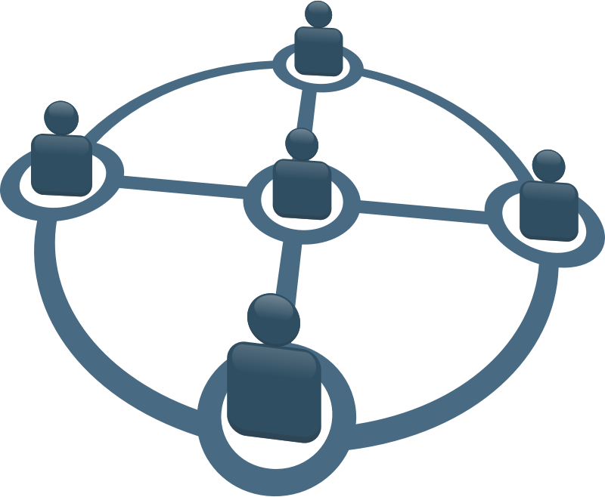
Every object has network connectivity
Some examples may be:
  Wireless
    Bluetooth
    Wifi
    RF
    IRDA
  Wired
    Ethernet
    RS232/RS485
    USB

Slide 8

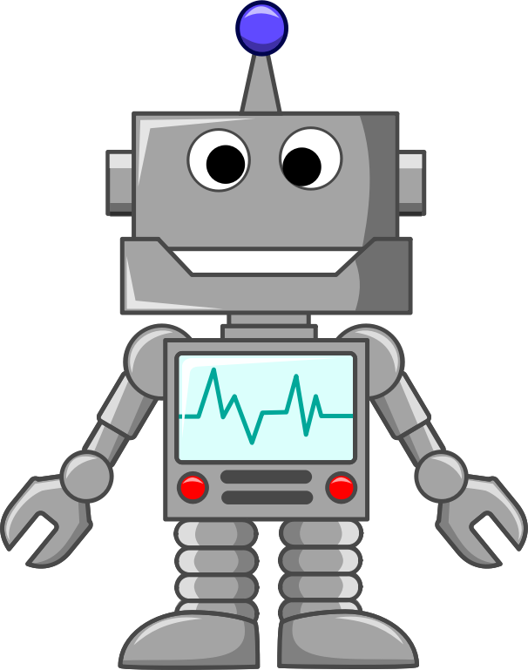
Send and Receive Data
The devices can talk!

Slide 9


Example
Monday 8AM meeting @Office

Slide 10

Monday
Morning
  Wake up on time
  Automatically make coffee
Make Coffee

Slide 11

Monday
Traffic report
  Estimated morning commute delay 30min

Slide 12
Monday
Traffic report
  Estimated morning commute delay 30min
Adjust alarm -30min
Make Coffee

Slide 13

Is this new?
The concept of a network of smart devices was discussed as early as 1982, with a modified Coke machine at Carnegie Mellon University becoming the first internet-connected appliance,[9] able to report its inventory and whether newly loaded drinks were cold.
Source: Wikipedia
http://en.wikipedia.org/wiki/Internet_of_Things

Slide 14




1982?
Also in 1982

Slide 15
Statistics and Projections

Slide 16
UN (medium variant – 2012 revision) and US Census Bureau (June 2012) estimates
Year | UN est. (millions) | Difference | USCB est. (millions) | Difference
2005 | 6514 | – | 6474 | –
2010 | 6916 | 402 | 6864 | 390
2015 | 7324 | 408 | 7250 | 386
2020 | 7717 | 393 | 7628 | 378
2025 | 8083 | 366 | 7984 | 356
2030 | 8425 | 342 | 8315 | 331
2035 | 8743 | 318 | 8619 | 304
2040 | 9039 | 296 | 8899 | 280
2045 | 9308 | 269 | 9154 | 255
2050 | 9551 | 243 | 9383 | 229
Source: http://en.wikipedia.org/wiki/World_population

Slide 17
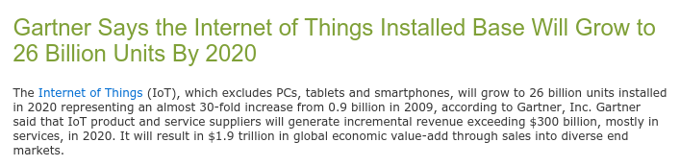
Gartner: 26 Billions devices
26 billions units installed in 2020
Almost 30-fold increase from 0.9 billions in 2009
Source: http://www.gartner.com/newsroom/id/2636073
Diciembre 2013

Slide 18

In not a distant future
Anything and everything that can be connected will be connected. Always
House
Car
Clothes
There is no scape

Slide 19
Will there be enough IPs
IPV6
  A main advantage of IPv6 is increased address space. The 128-bit length of IPv6 addresses is a significant gain over the 32-bit length of IPv4 addresses, allowing for an almost limitless number of unique IP addresses.
Source:
http://whatismyipaddress.com/ip-v6

Slide 20


Why the buzz?
“GE estimating that the “Industrial Internet” has the potential to add $10 to $15 trillion (with a “T”) to global GDP over the next 20 years”
“Cisco increasing to $19 trillion its forecast for the economic value created by the “Internet of Everything” in the year 2020”
Source Forbes: http://www.forbes.com/sites/gilpress/2014/08/22/internet-of-things-by-the-numbers-market-estimates-and-forecasts/
GDP = Gross Domestic Product

Slide 21
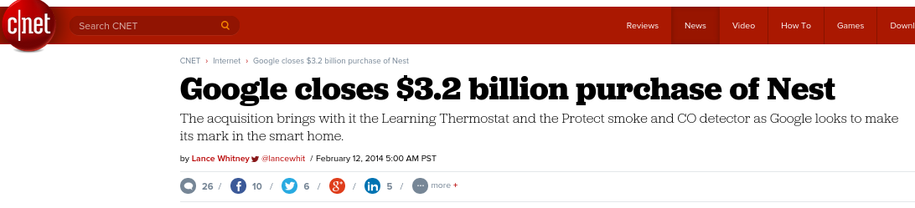
IOT Companies
Nest Labs, Inc. (Nest), a company whose mission is to reinvent devices in the home such as thermostats and smoke alarms

Slide 22
Industries
Technology
Manufacturing
Health
Agriculture
Transportation
Entertainment
Security
...
Everyone

Slide 23



Health industries
24hr health monitor
Link with medical support
Prevention of illness
Call for help

Slide 24
Companies & campaigns

Slide 25
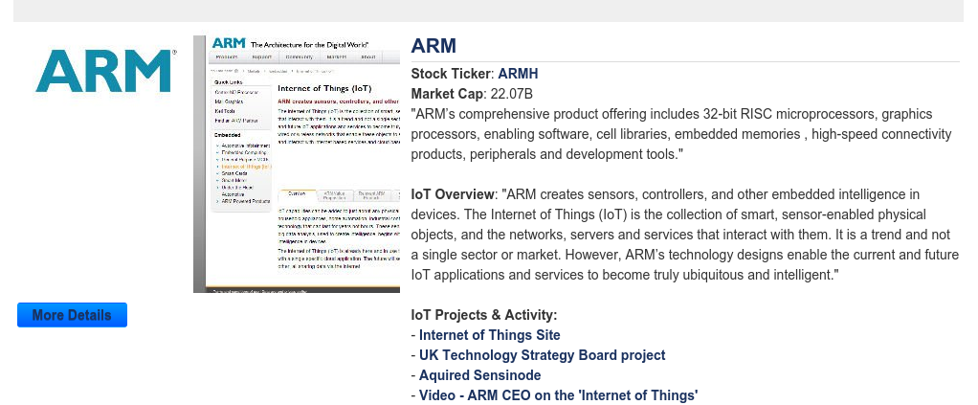
ARM

Slide 26
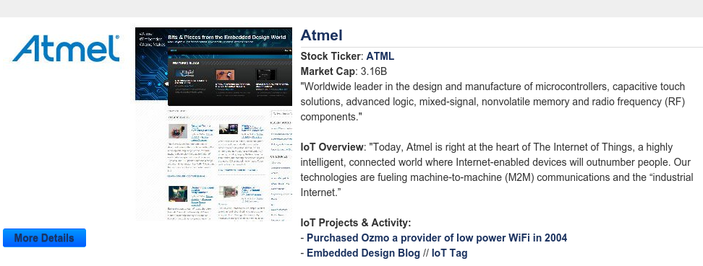
Atmel

Slide 27
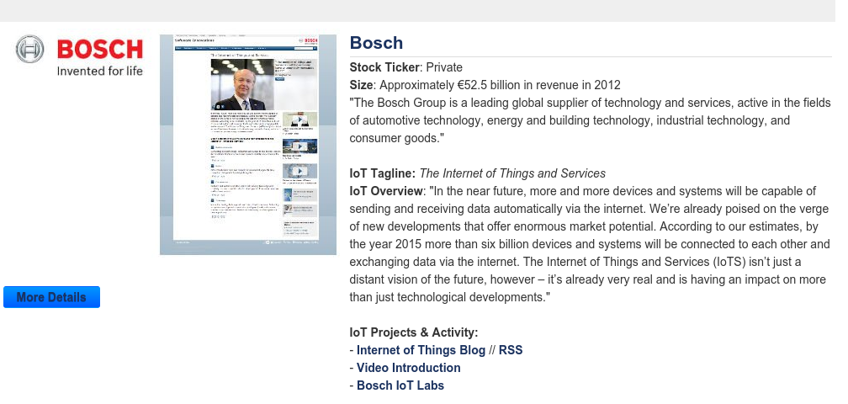
BOSCH

Slide 28
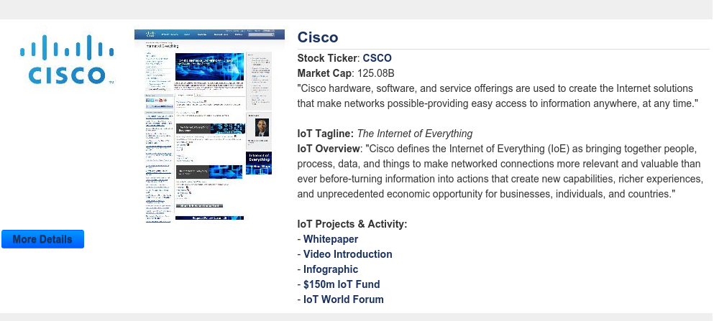
Cisco

Slide 29
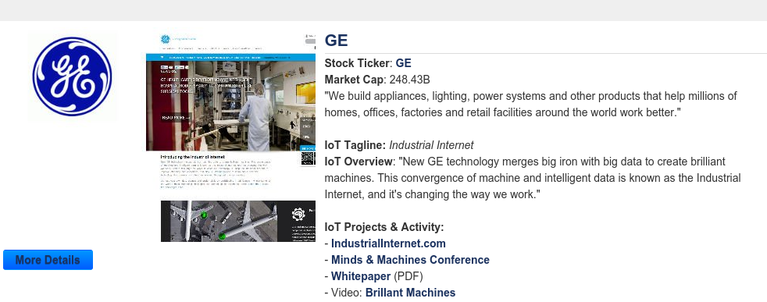
GE

Slide 30
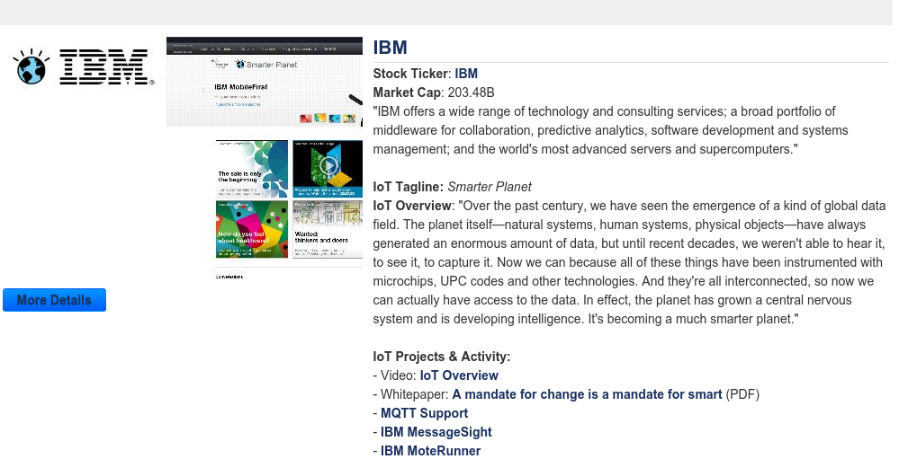
IBM

Slide 31
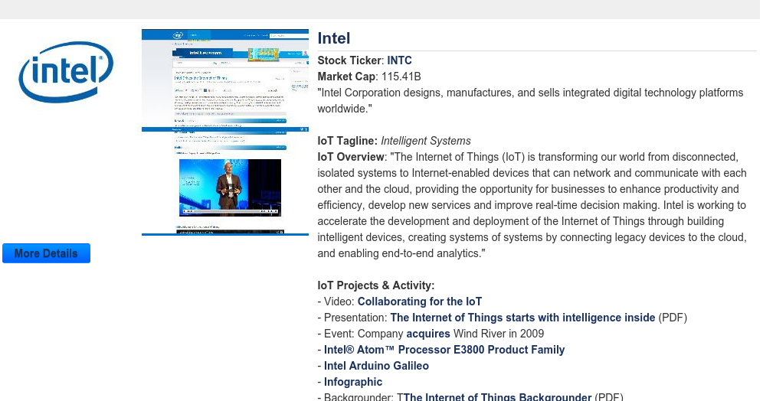
Intel

Slide 32
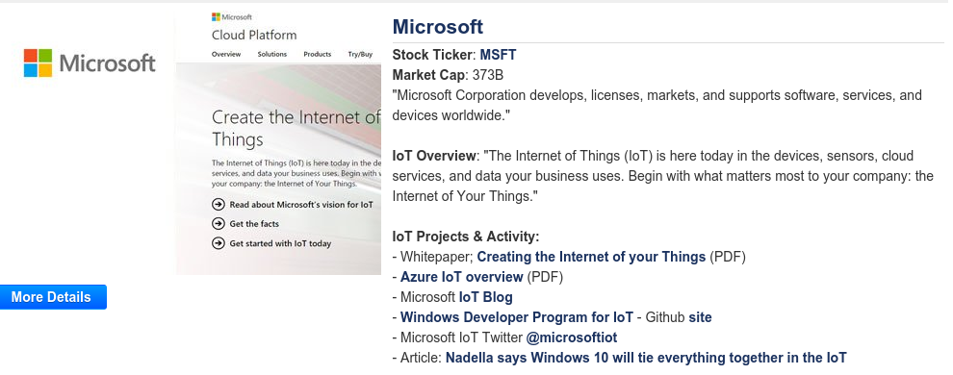

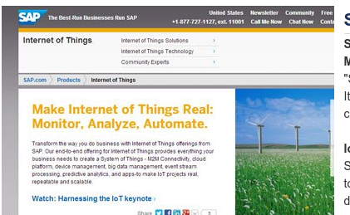
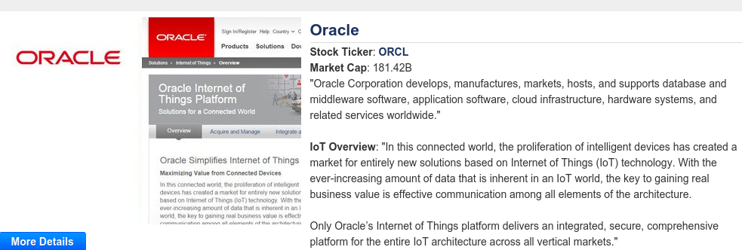
And a lot more

Slide 33
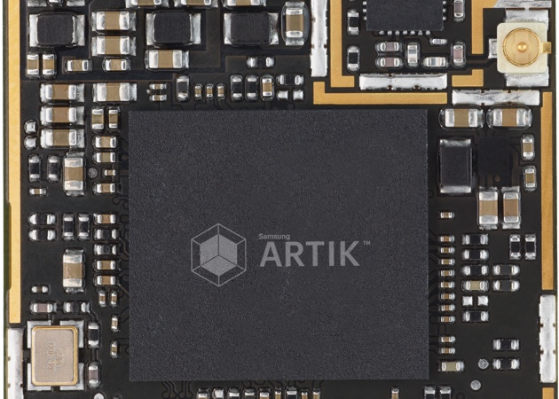
“Samsung's Artik platform aims to jump-start the Internet of Things”
Source: http://www.engadget.com/2015/05/12/samsung-artik-iot/

Slide 34
Samsung continue
“Samsung's been dabbling with the world of connected devices for some time: Last year it bought the IoT company SmartThings for $200 million,”
Artik 1, a tiny 12mm device with Bluetooth and a nine-axis movement sensor; Artik 5, which runs a faster 1 gigahertz dual-core processor and on-board storage; and Artik 10, which is powered by an octa-core processor, 2GB of RAM and 16GB of storage. The latter also includes Wi-Fi and Zigbee connectivity
Source: http://www.engadget.com/2015/05/12/samsung-artik-iot/

Slide 35

Internet

Slide 36


Traditional Internet

Slide 37



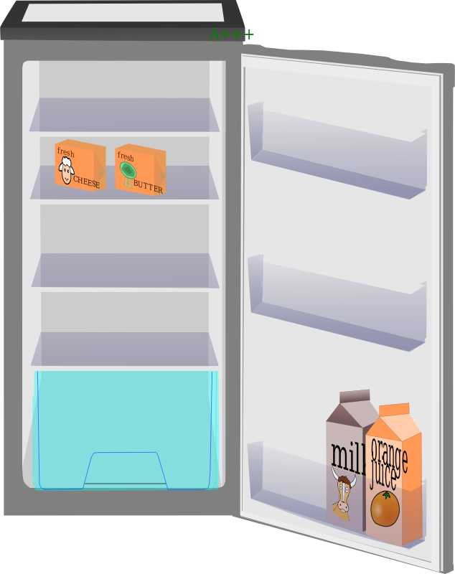
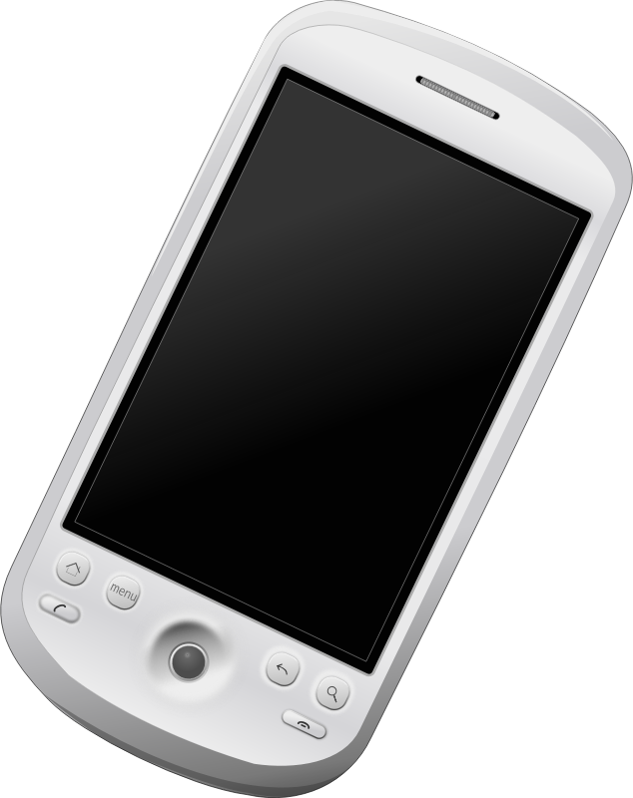
Internet now

Slide 38

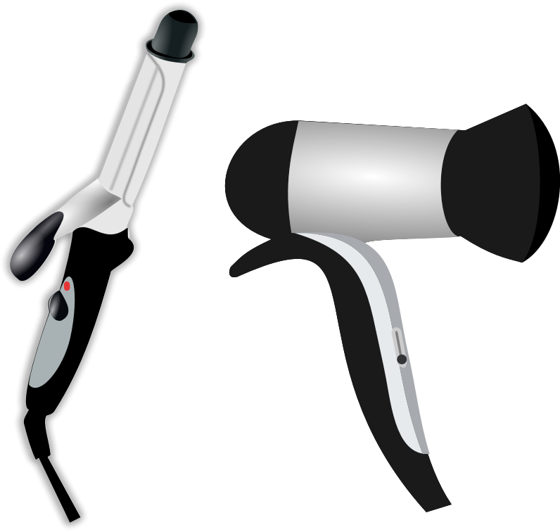

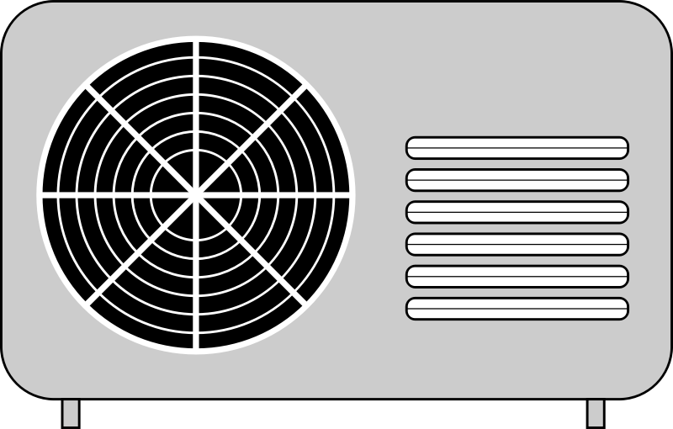
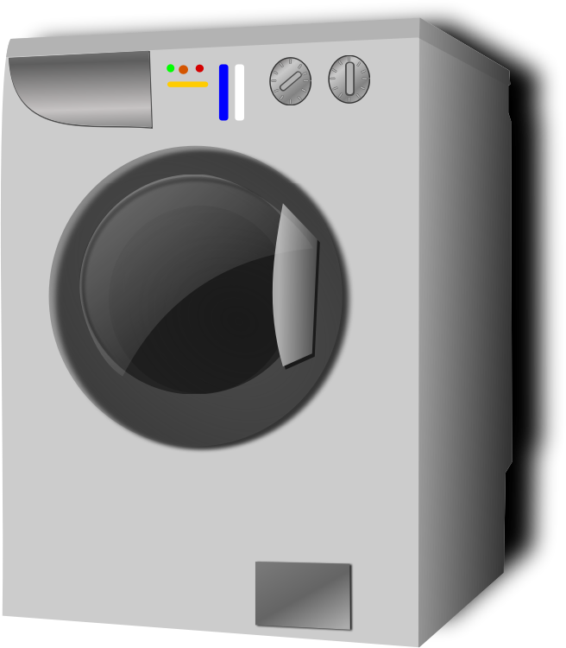

Internet of things everything

Slide 39
Everything is a part of a System

Slide 40
Small systems all over

Slide 41
Interconnected systems

Slide 42
How to Connect things?
?

Slide 43
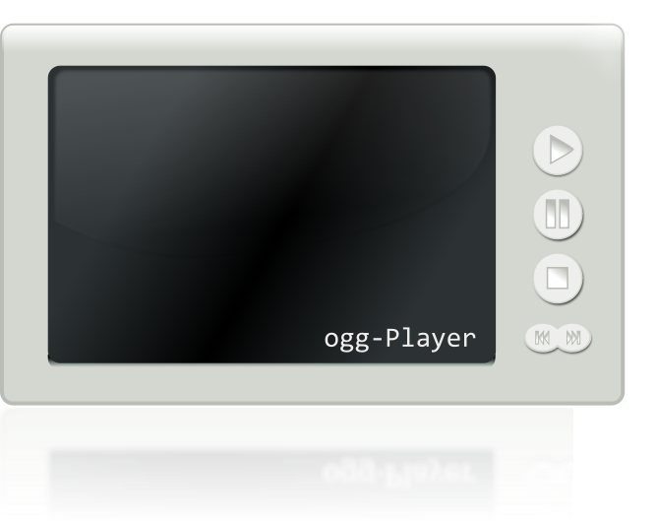
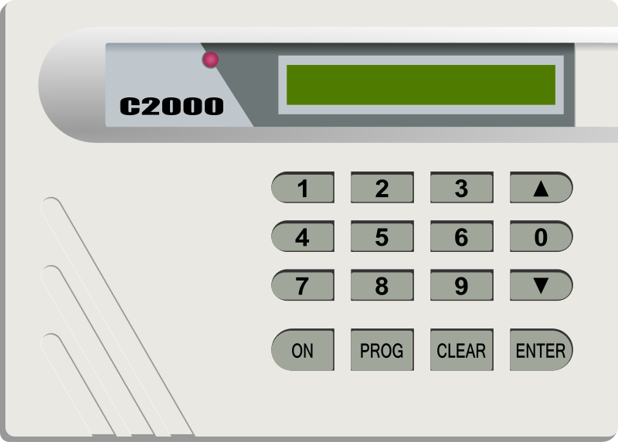
Machine to machine
Protocols
Data access
Compatibility
  Brands
  Device type
Security
Open or proprietary
Bandwidth

Slide 44
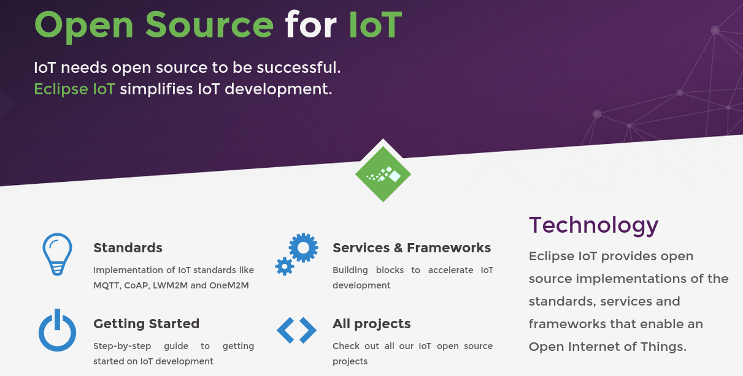
Eclipse http://iot.eclipse.org/

Slide 45
Standards
OMA LightweightM2M
  LightweightM2M is principly a device management protocol, but it should be designed to be able to extend to meet the requirements of applications. LightweightM2M is not restricted to device management, it should be able transfer service / application data.
  OMA LightweightM2M (LWM2M) is an industry standard for device management of M2M/IoT devices. It heavily relies on CoAP and therefore is optimized for communications over sensor or cellular networks.
  OMA LWM2M provides an extensible object model that allows to enable application data exchanges in addition to the core device management features (firmware upgrade, connectivity monitoring, …)
Windows supports OMA-DM
DM Desktop Management

Slide 46
Standards
CoAP
  CoAP (Constrained Application Protocol) is a protocol specialized for use with constrained nodes and networks.
  It implements the REST architectural style, it can be transparently mapped to HTTP. However, CoAP also provides features that go beyond HTTP such as native push notifications and group communication.

Slide 47
Standards
Message Queuing Telemetry Transport (MQTT)
  Protocol designed to connect the physical world devices and networks, with applications and middleware used in IT and Web development.
  Lightweight
  Publish/Subscribe
  Wired/Wireless
  Protocol used by Facebook chat!

Slide 48
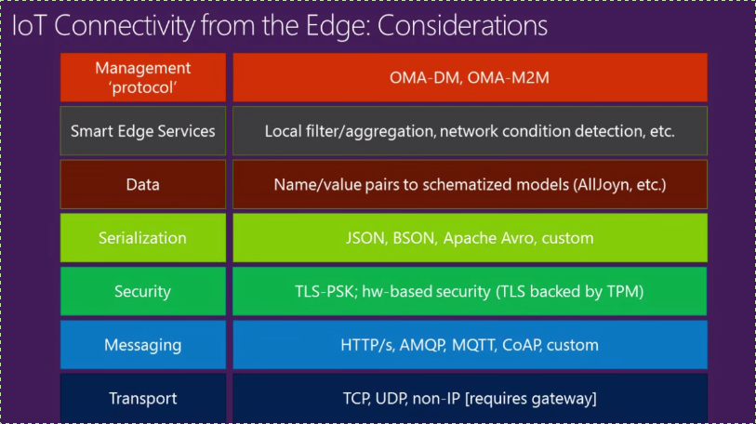
Slide from Microsoft
Source youtube: Microsoft IoT Platform: Architecture Overview
https://youtu.be/q6lYuUJ1mO4?list=PLfRy-jeJHMmx5RKGz5O6nxsvm8mjlevVD

Slide 49
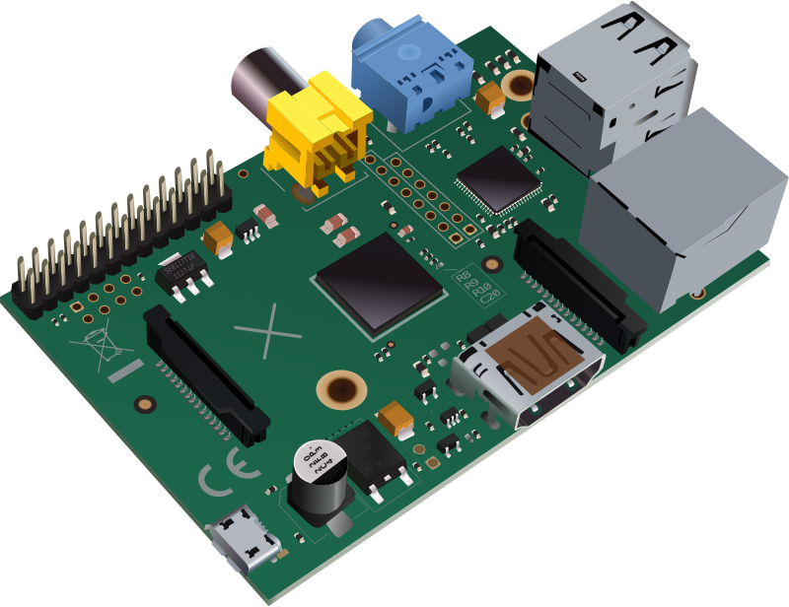
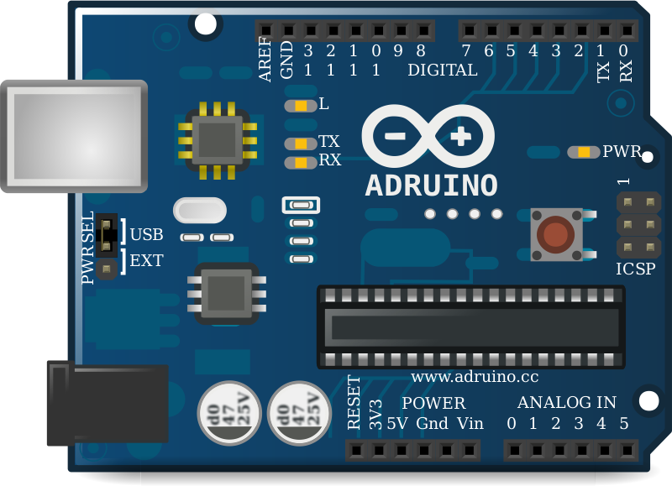
Common hardware
Arduino
Raspberry Pi

Slide 50

MQTT Implementation
MQTT Server
Publisher
Subscriber

Slide 51
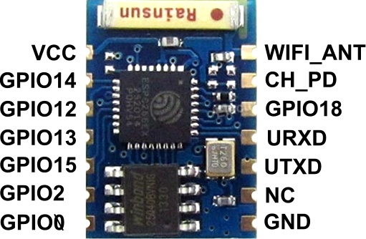
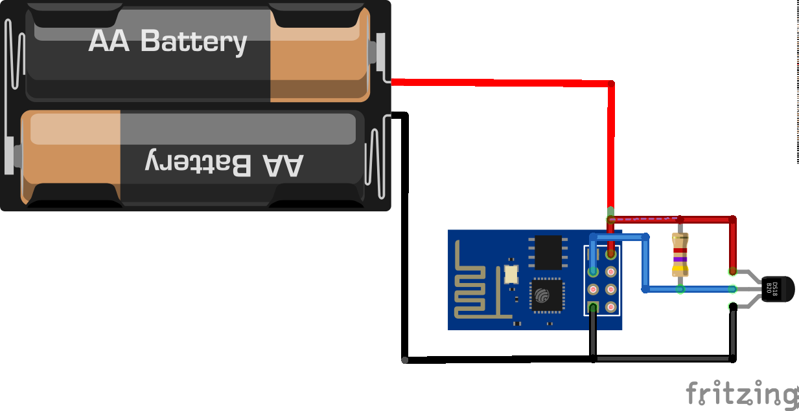
How to get started
Wifi is cheap
Multiple options
ESP8266 < $5

Slide 52
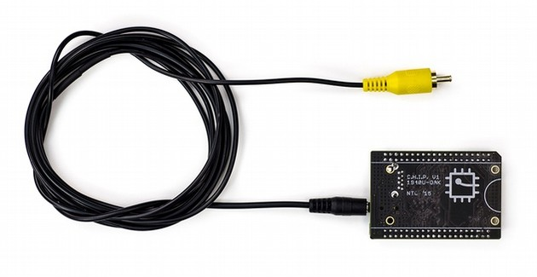
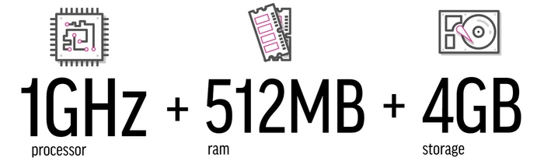
CHIP $9 Computer kickstarter

Slide 53

Systems produces Data
Sensors everywhere
Always new data
History data
Health data
Weather
Entertainment
Analytics
Decision making
Storage

Slide 54
IOT opportunities
Hardware electronic
Products, data collection
  Data Storage
Clothes
Analysis
  Processing power
Security

Slide 55
Some Challenges
Connecting Existing hardware
  Cost
People
  Privacy
Interconnectivity of devices
  Brands
  protocols
Connectivity
  Around 40% of the world population has an internet connection today
  Wikipedia says 51% of PR internet
Security

Slide 56
Internet Users by Country
In 2014, nearly 75% (2.1 billion) of all internet users in the world (2.8 billion) live in the top 20 countries.
The remaining 25% (0.7 billion) is distributed among the other 178 countries, each representing less than 1% of total users.

Slide 57
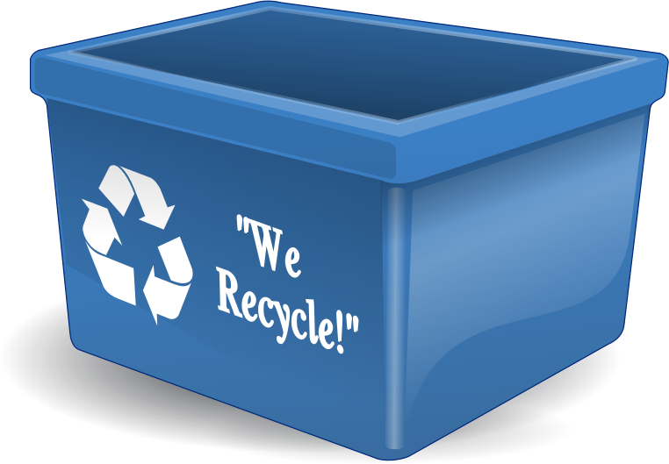
E-waste
“according to United Nations University estimates reported by ITU, 67 million metric tons of electrical and electronic equipment were put on the market in 2013. In the same year, 53 million metric tons of e‑waste (waste electrical and electronic equipment) were disposed of worldwide. “
Source:
https://itunews.itu.int/En/4850-E-waste-and-the-Internet-of-Things.note.aspx

Slide 58
Existing hardware
Legacy products
Home appliance
Exiting elevators
How to automate the old?

Slide 59
Future of Internet of Things
Depends on us

Slide 60
Gracias
Comentarios

