Slide 1
Llevemos la cafetera al internet

Slide 2

Is this new?
The concept of a network of smart devices was discussed as early as 1982, with a modified Coke machine at Carnegie Mellon University becoming the first internet-connected appliance,[9] able to report its inventory and whether newly loaded drinks were cold.
Source: Wikipedia
http://en.wikipedia.org/wiki/Internet_of_Things

Slide 3




1982?
Also in 1982

Slide 4


About me
Javier Hernandez
BS Computer Engineer, UPRM
Developer
  Data Collection
  Mobile solutions
Contact:
Twitter @soynerdito
Gmail: soynerdito@gmail.com

Slide 5
Agenda
Why?
Methodology
  Divide & Conquer
Things to consider
  Components
Guidelines and recommendations
Final goal:
  Slave the dragon and rescue the princes

Slide 6

Clave de hacer un proyecto
Establecer una meta
Research
Ejecutar
Intentar nuevamente
Seguir tratando

Slide 7
Llevemos la cafetera al internet
Pa’ que?!!!

Slide 8


Monday
Morning
  Wake up on time
  Automatically make coffee
Make Coffee

Slide 9
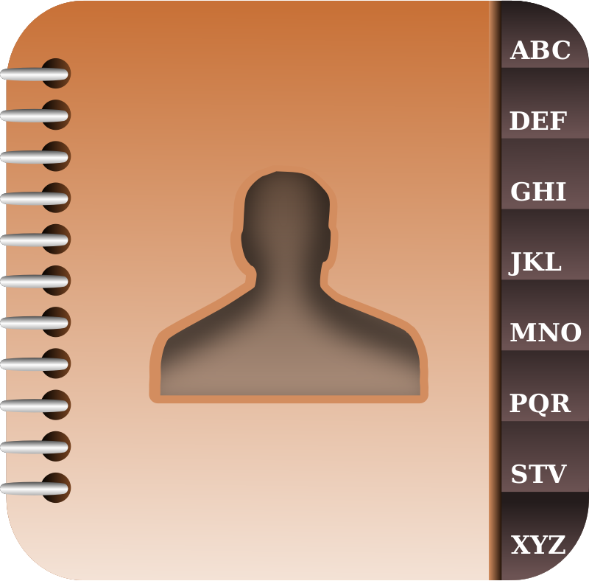
Example
Monday 8AM meeting @Office

Slide 10
Monday
Morning
  Wake up on time
  Automatically make coffee
Make Coffee

Slide 11
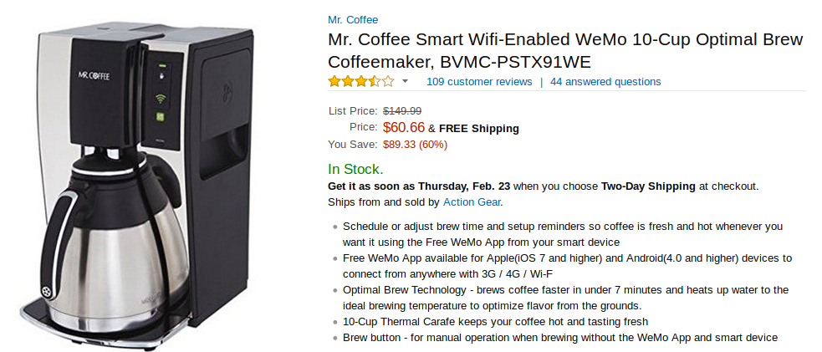
Whaaa?
https://www.amazon.com/Mr-Coffee-Wifi-Enabled-Coffeemaker-BVMC-PSTX91WE/dp/B00LUFSSWG/ref=sr_1_1?ie=UTF8&qid=1487530177&sr=8-1&keywords=internet+coffee+maker

Slide 12
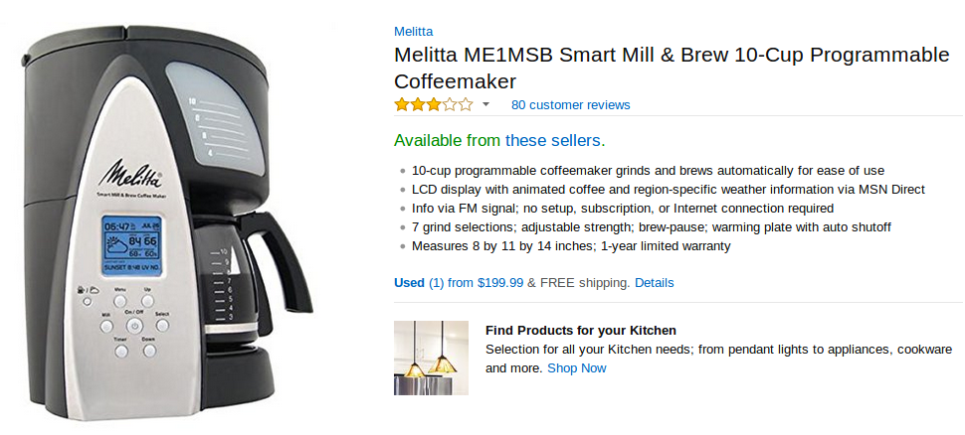
But…..
https://www.amazon.com/Mr-Coffee-Wifi-Enabled-Coffeemaker-BVMC-PSTX91WE/dp/B00LUFSSWG/ref=sr_1_1?ie=UTF8&qid=1487530177&sr=8-1&keywords=internet+coffee+maker

Slide 13

Divide & Conquer
Goal
  On/Off ?
  Information?
  All?
Research
Safety
Mechanical
Electrical
Drink coffee

Slide 14
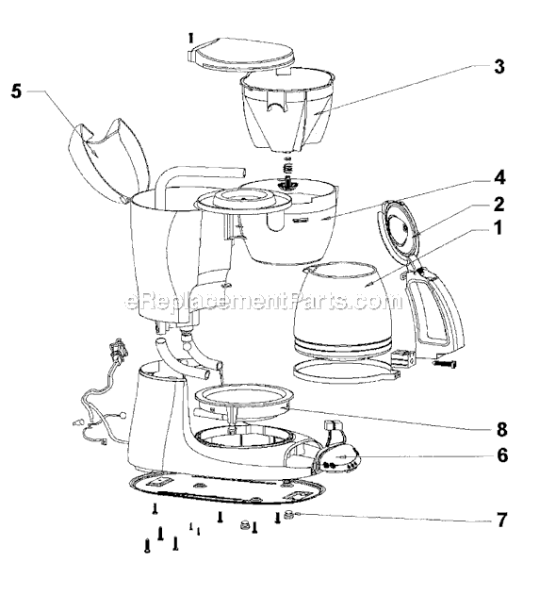
What do we know?
Watter
Switch ON/OFF
Coffee
Fuses…?

Slide 15
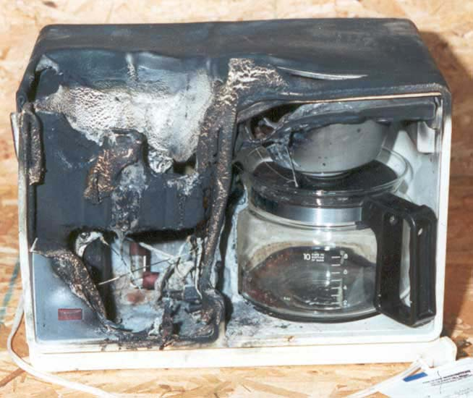
Safety
Risk?

Slide 16

This is fine

Slide 17


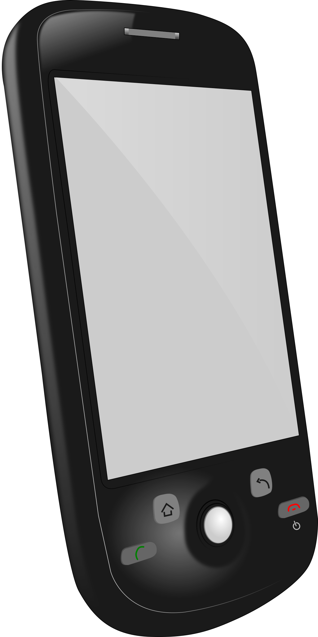


Internet Coffee

Slide 18
Where to start
Intrusive
Non Intrusive

Slide 19
Intrusive
Control raw material
  Raw Coffee
  Watter
  Filter
Sensors:
  Watter level
  Cup presence
  Ambient conditions
  Turn on/off
  alerts

Slide 20
Non Intrusive
Turn ON (could be on schedule)
  Is there coffee?
  Is there watter?
  Is the cup set?

Slide 21
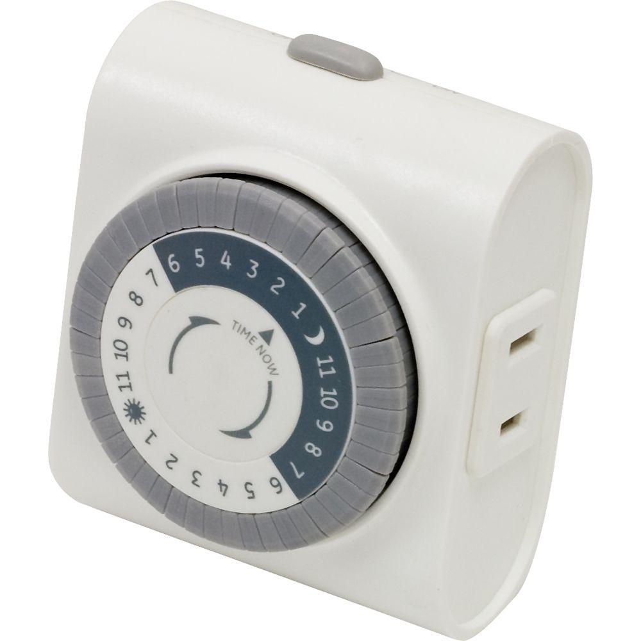

A Simple timer?

Slide 22
Esto no que era Internet of things?

Slide 23
Internet Coffee

Slide 24
What is the Internet of things?

Slide 25
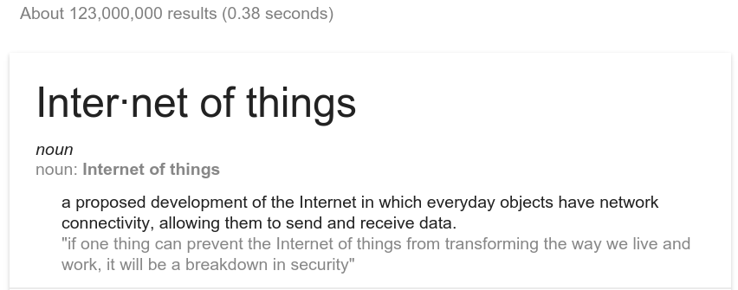
According to Google

Slide 26
“Everyday object”
What is an object?
  Mobile: phones, tablets, laptops, “phablets”
  Transportation: Car, Bus, Bikes
  Home appliances: Fridge, TV
  Traffic lights
  Doors
  Clothes
  Furniture
  Anything and everything

Slide 27
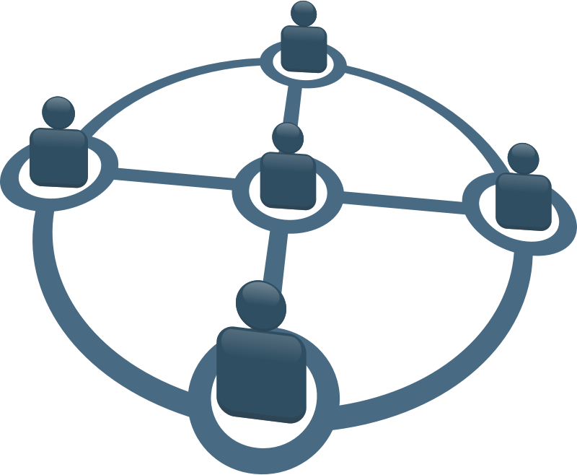
Every object has network connectivity
Some examples may be:
  Wireless
    Bluetooth
    Wifi
    RF
    IRDA
  Wired
    Ethernet
    RS232/RS485
    USB

Slide 28
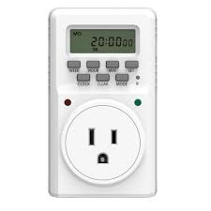
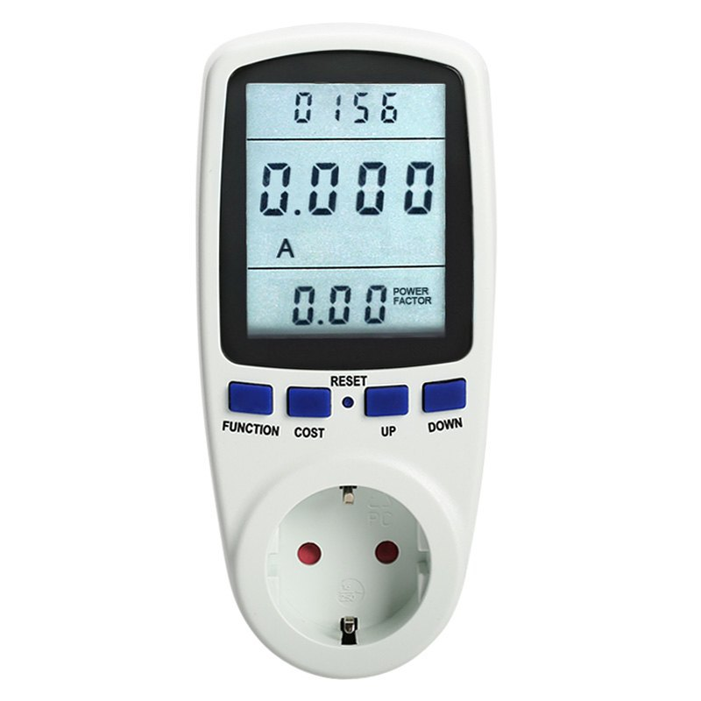
Es este IOT?

Slide 29
In my book
Is any device communicating with something else?
If not, for me it is not!

Slide 30
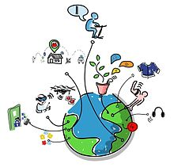
My two cents
Everything and nothing
Loosely used term

Slide 31
Data

Slide 32
Data?
Measurement of anything
Temp, pressure, Internet usage, heart rate ...

Slide 33
Communication

Slide 34

Communication type
Thing to thing

Slide 35

Communication type
Thing to human

Slide 36
Communication methods
Wire
  Serial
    RS232, RS485
      Printers, scanners
  Wiegand interface
    Access control
  Parallel
  Proprietary protocol
  Ethernet
    TCP (http)
Wireless
  2.4Gz, 5Ghz, 900Mhz …
  RF

Slide 37
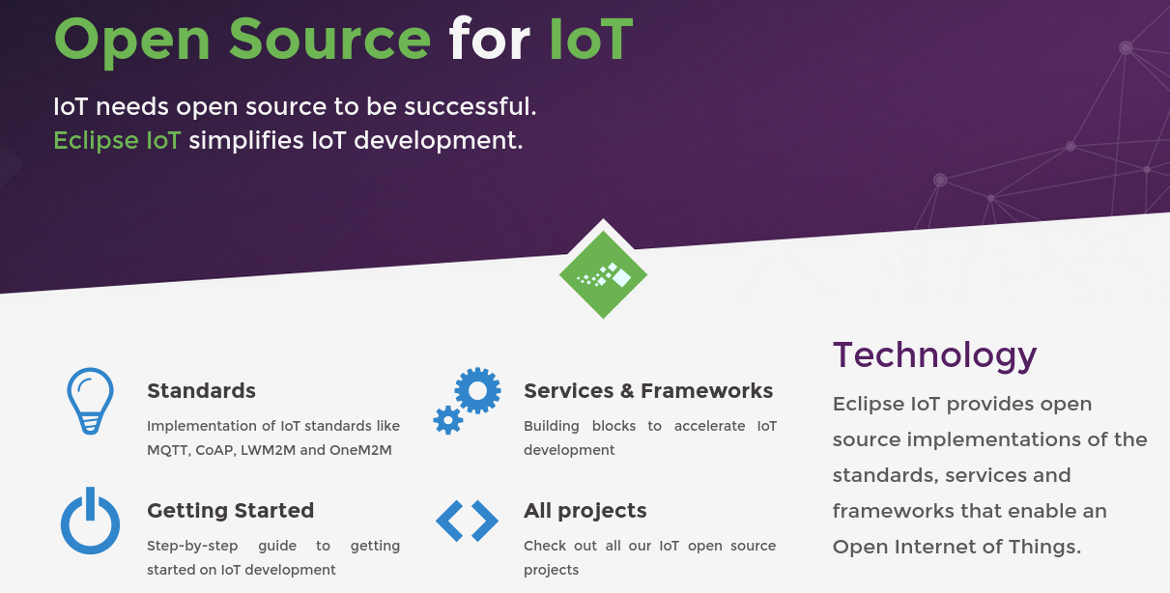
Eclipse http://iot.eclipse.org/

Slide 38
Standards
OMA LightweightM2M
  LightweightM2M is principly a device management protocol, but it should be designed to be able to extend to meet the requirements of applications. LightweightM2M is not restricted to device management, it should be able transfer service / application data.
  OMA LightweightM2M (LWM2M) is an industry standard for device management of M2M/IoT devices. It heavily relies on CoAP and therefore is optimized for communications over sensor or cellular networks.
  OMA LWM2M provides an extensible object model that allows to enable application data exchanges in addition to the core device management features (firmware upgrade, connectivity monitoring, …)
Windows supports OMA-DM
DM Desktop Management

Slide 39
Standards
CoAP
  CoAP (Constrained Application Protocol) is a protocol specialized for use with constrained nodes and networks.
  It implements the REST architectural style, it can be transparently mapped to HTTP. However, CoAP also provides features that go beyond HTTP such as native push notifications and group communication.

Slide 40
Standards
Message Queuing Telemetry Transport (MQTT)
  Protocol designed to connect the physical world devices and networks, with applications and middleware used in IT and Web development.
  Lightweight
  Publish/Subscribe
  Wired/Wireless
  Protocol used by Facebook chat!

Slide 41
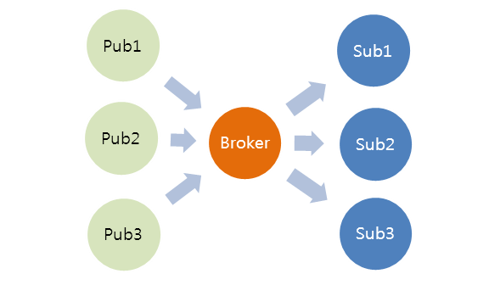
MQTT

Slide 42
Back to the coffee project!

Slide 43

Clean/Prepare
Coffee maker
Ready?
Add Ingredients
Watter
Coffee (arina)
Connect to power
Turn ON
Making coffee

Slide 44

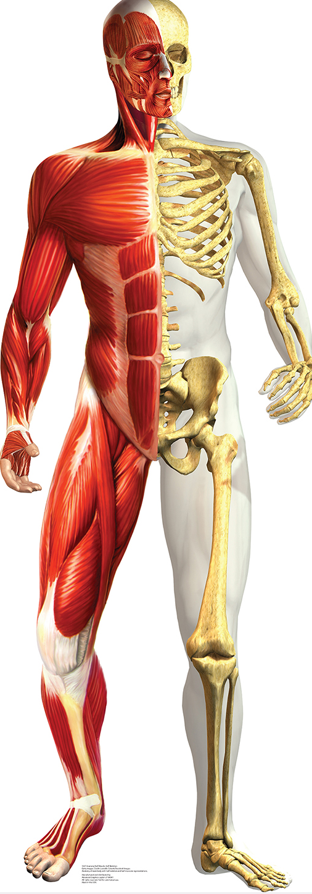

Slide 45
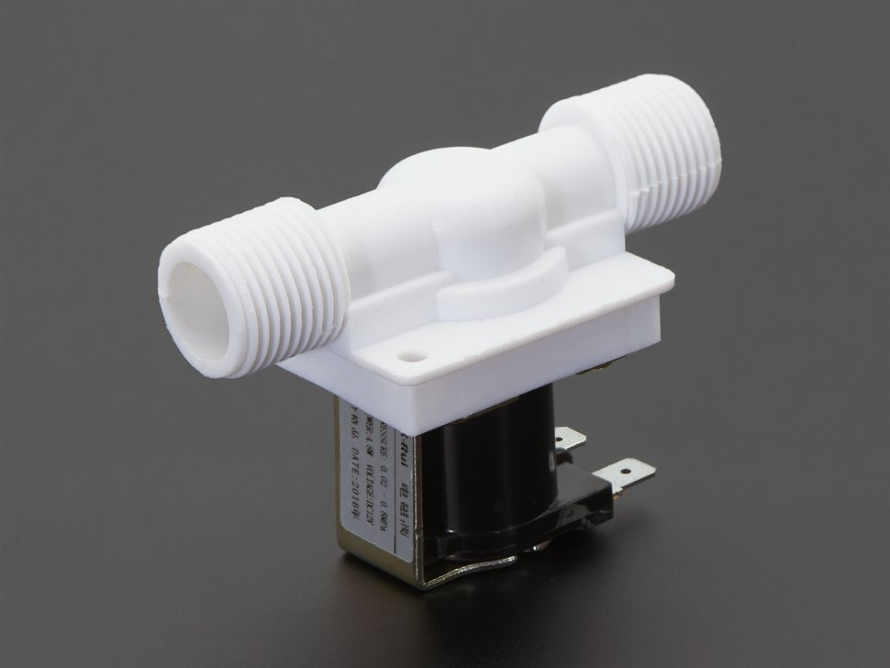
Valve
Control watter
  ON/OFF
Description
  12VDC (320 mA)
  Liquid flow one direction
  Response time (open): ≤ 0.15 sec
  Response time (close): ≤ 0.3 sec
  Actuating voltage: 12VDC (but we found it would work down to 6V)
https://www.adafruit.com/products/997

Slide 46
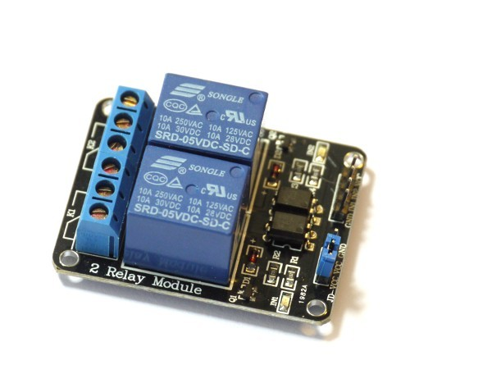
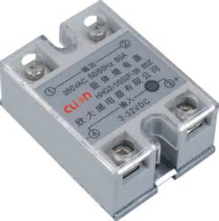
Relay
Mechanical
Solid state

Slide 47
Mechanical relay
Cheap
Physical parts
Make noise
May produce arc
State ON or OFF
Normaly open or close

Slide 48
Solid state
$$
No moving parts
May not be full ON or OFF
May produce heat
Can be faster
Option Opto Isolated

Slide 49
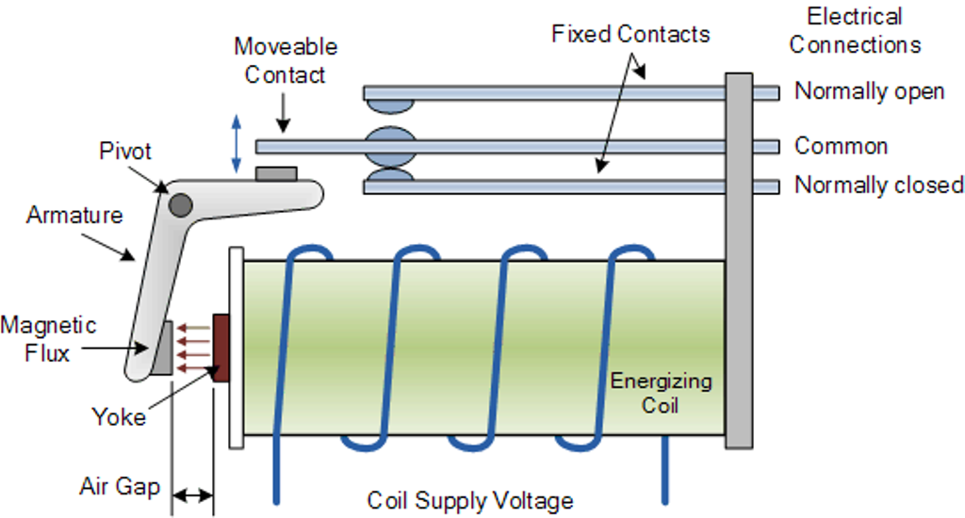
Relay inside

Slide 50
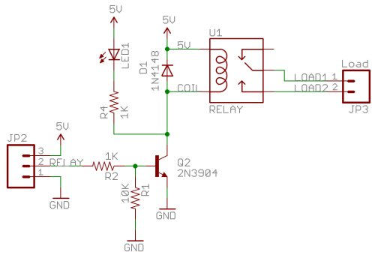
Relay on schematic

Slide 51
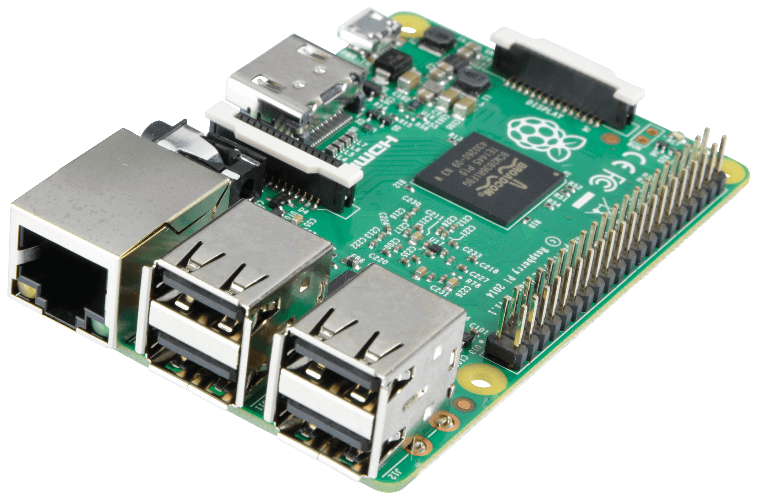
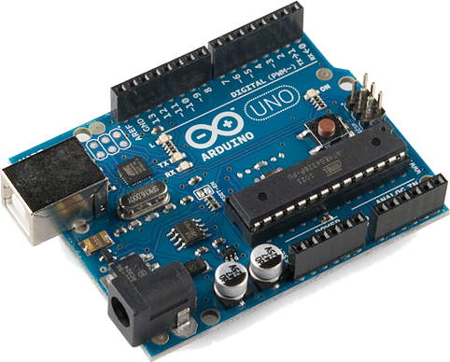
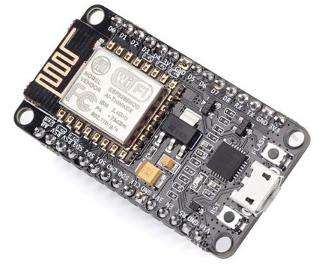

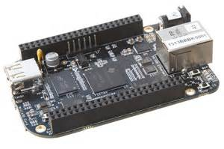
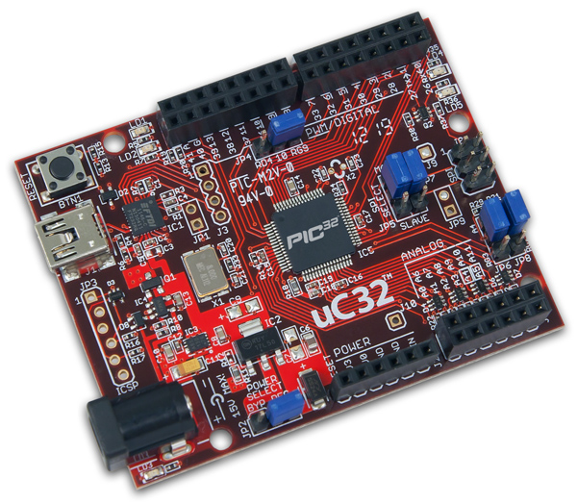
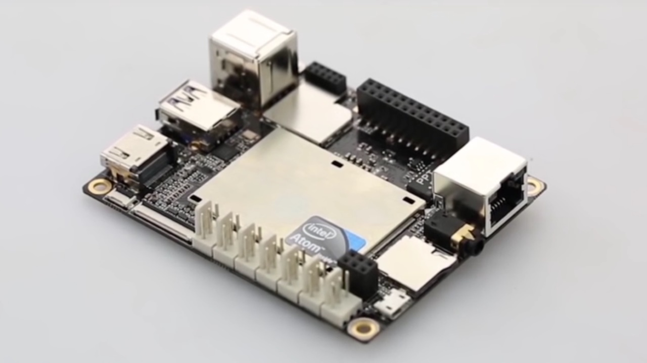
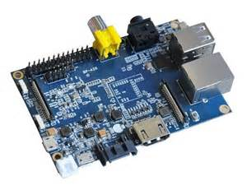
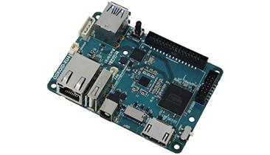
The brains

Slide 52
Raspberry pi
Price $35 +/-
Mini Computer
  Linux, Windows for IOT
  Multi threading
  Languages Python….. a ton
Support
  Tons of documentation
  Tons of projects
Communication
  Wifi, ethernet, bluetooth
  USB
  Digital IO (3VDC)
  HDMI
  Audio out

Slide 53
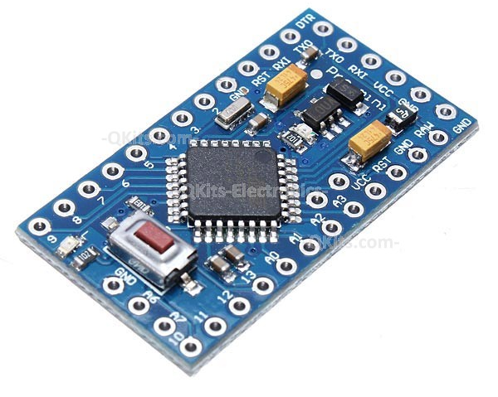
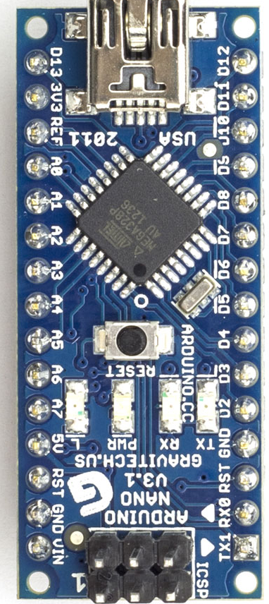
Arduino
Support
Samples
Different form factors
Digital/Analog
UART, I2C, SPI
5VDC logic

Slide 54
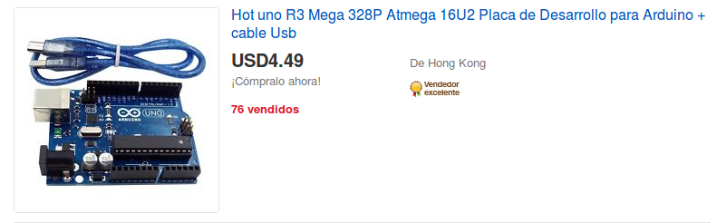
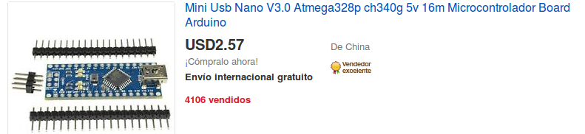
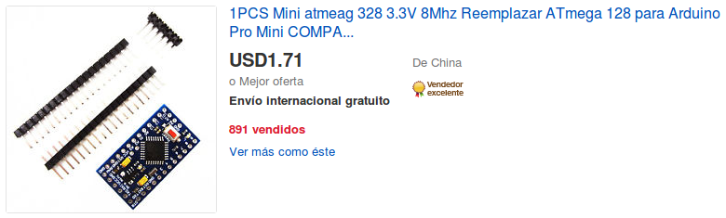
Arduino $$

Slide 55
ESP8266
Wifi 2.4Ghz B,G,N
Cheap ($5 +/-)
Digital IO
Languages
  Python, Lua, C
Uses Arduino platform

Slide 56
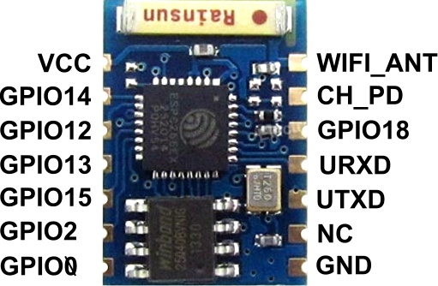
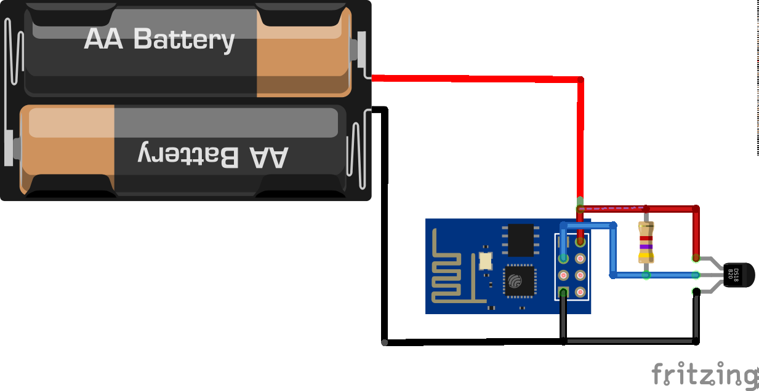
How to get started
Wifi is cheap
Multiple options
ESP8266 < $5

Slide 57
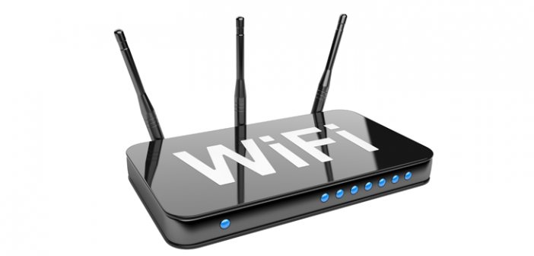
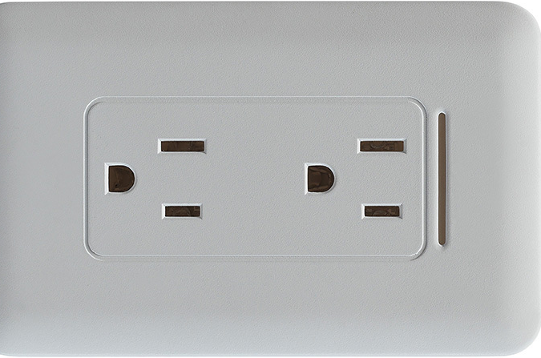
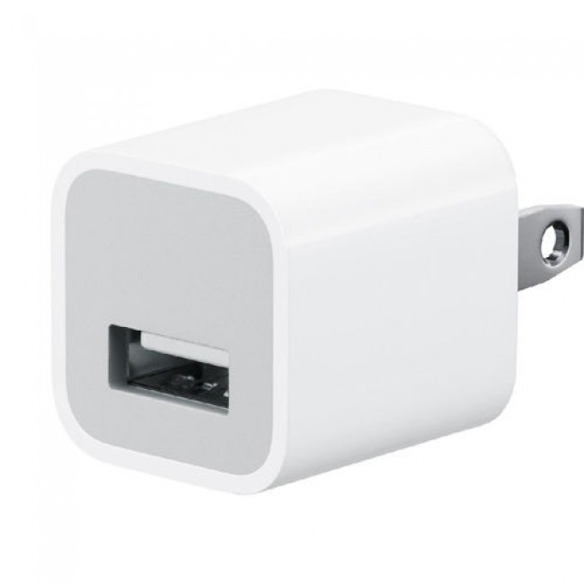
Wires

Slide 58
Internet Users by Country
In 2014, nearly 75% (2.1 billion) of all internet users in the world (2.8 billion) live in the top 20 countries.
The remaining 25% (0.7 billion) is distributed among the other 178 countries, each representing less than 1% of total users.

Slide 59
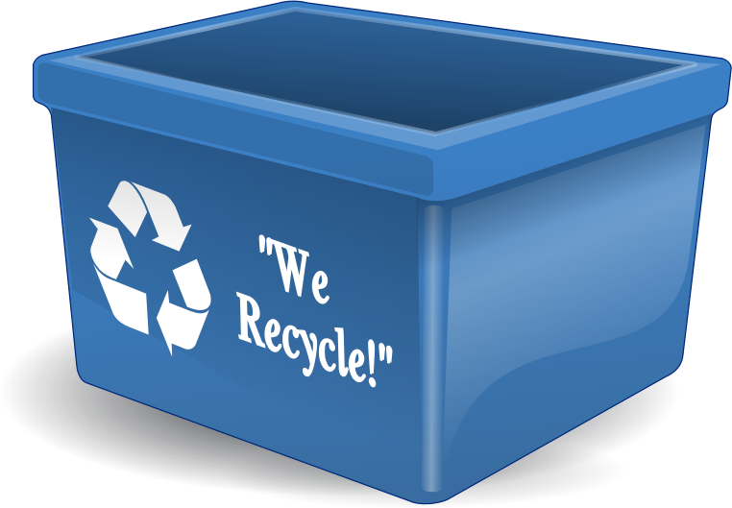
E-waste
“according to United Nations University estimates reported by ITU, 67 million metric tons of electrical and electronic equipment were put on the market in 2013. In the same year, 53 million metric tons of e‑waste (waste electrical and electronic equipment) were disposed of worldwide. “
Source:
https://itunews.itu.int/En/4850-E-waste-and-the-Internet-of-Things.note.aspx

