Slide 1

Internet of things
What? Why? And How?
By: Eng. Javier Hernández

Slide 2

About Me
Computer Engineer
Developer
Nerd
Twitter @soynerdito
soynerdito@gmail.com
Interests (no particular order)
  Programming
  Making
  Security
  Hardware
  Tech communities
  Just now - Agriculture
@Soynerdito

Slide 3
Goals
What is Iot?
Why is so popular?
Gain awareness of challenges
Focus on making our own
Motivate getting hands dirty into making stuff at hobby or business
Notes:
The focus is in getting hands dirty

Slide 4
Iot Background
Definition (What is?)
Notes:
Discuss money projections
Provide Studies with current market impact
Establish it is a growing business worldwide.

Slide 5

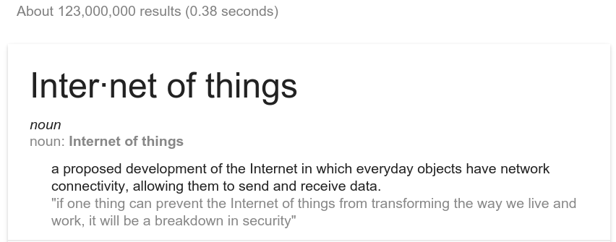
Let’s search for the definition

Slide 6
What is iot? Source: Wikipedia
The Internet of Things (IoT) is the network of physical devices, vehicles, home appliances, and other items embedded with electronics, software, sensors, actuators, and connectivity which enables these things to connect and exchange data,[1][2][3][4] creating opportunities for more direct integration of the physical world into computer-based systems, resulting in efficiency improvements, economic benefits, and reduced human exertions

Slide 7
What is iot? Source: Wikipedia
network of physical devices
  vehicles, home appliances, and other items
embedded with electronics
  software, sensors, actuators, and connectivity
enables things to connect and exchange data
direct integration of the physical world into computer-based systems

Slide 8
What is a device
Mobile phones, tablets, laptops
Transportation: Car, Bus, bikes
Home appliances: Fridge, TV
Traffic lights
Doors
Clothes
Furniture
Anything and everything

Slide 9
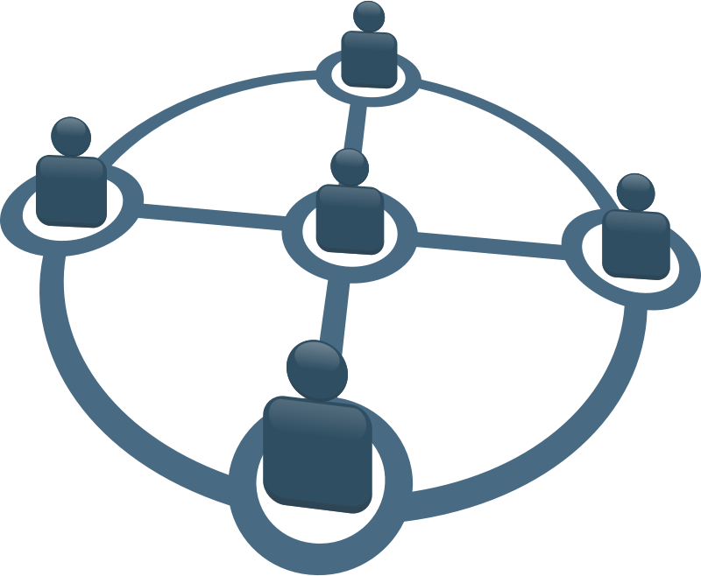
Every device has network connectivity
Some examples may be:
  Wireless
    Bluetooth
    Wifi
    RF
    IRDA
    LoraWAN
  Wired
    Ethernet
    RS232/RS485
    USB

Slide 10
LoRa (Long Range)
uses license-free sub-gigahertz radio frequency bands like 169 MHz, 433 MHz, 868 MHz (Europe) and 915 MHz (North America).
Enables very-long-range transmissions (more than 10 km in rural areas) with low power consumption.The technology is presented in two parts — LoRa, the physical layer and LoRaWAN (Long Range Wide Area Network), the upper layers.
Source: https://en.wikipedia.org/wiki/LoRa

Slide 11
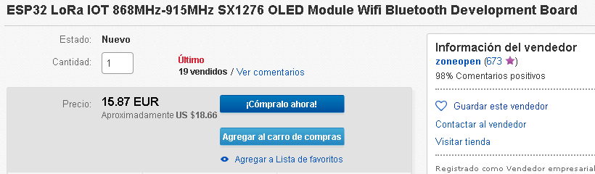
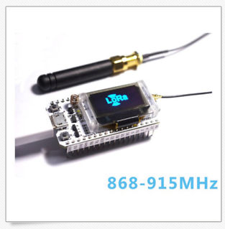
LoRa example
Source: ebay.com

Slide 12

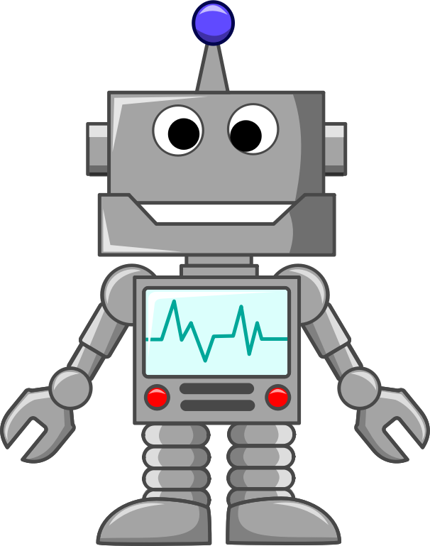
Send and Receive Data
The devices can talk!

Slide 13


Example
Monday 8AM meeting @Office

Slide 14

Monday
Morning
  Wake up on time
  Automatically make coffee
Make Coffee

Slide 15
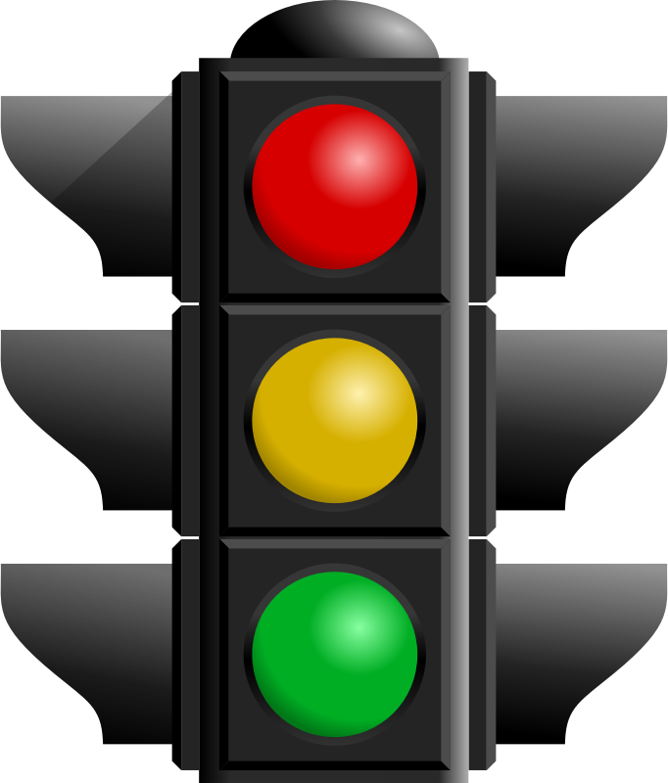
Monday
Traffic report
Estimated morning commute delay 30min

Slide 16
Monday
Traffic report
  Estimated morning commute delay 30min
Adjust alarm -30min
Make Coffee

Slide 17
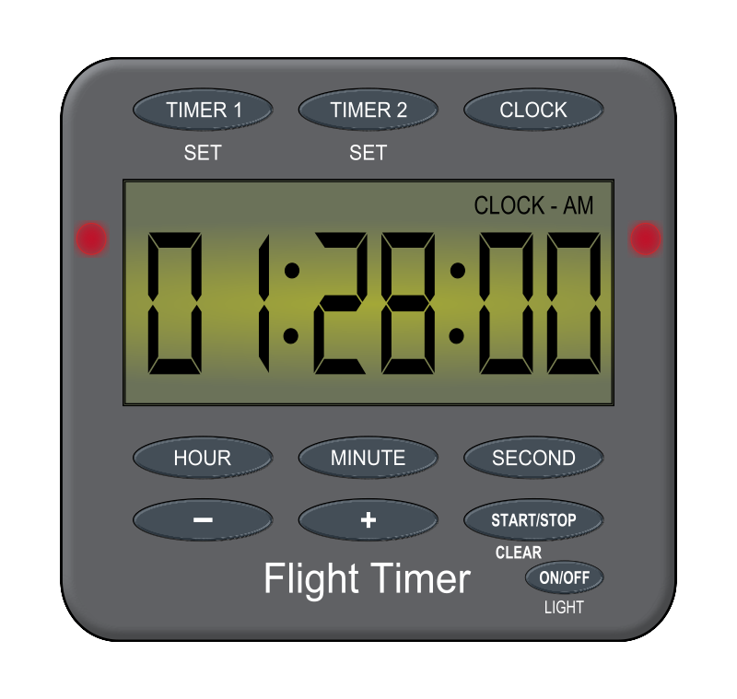


Traditionally
Person set water by timer

Slide 18
Traditionally
Person set water by timer
Is really needed?
Was the plant dry?
Did it rained?
Will there be rain latter today?
Feedback, was it activated?

Slide 19
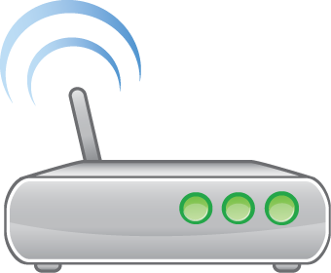





More integrated with internet

Slide 20
“Iot” like solution
Sensors provide information
  Light
  Temperature
  Water
  Soil moisture
  Weather forecast
  Is water available
User feedback

Slide 21

Is this new?
The concept of a network of smart devices was discussed as early as 1982, with a modified Coke machine at Carnegie Mellon University becoming the first internet-connected appliance,[9] able to report its inventory and whether newly loaded drinks were cold.
Source: Wikipedia
http://en.wikipedia.org/wiki/Internet_of_Things

Slide 22




1982?
Also in 1982

Slide 23
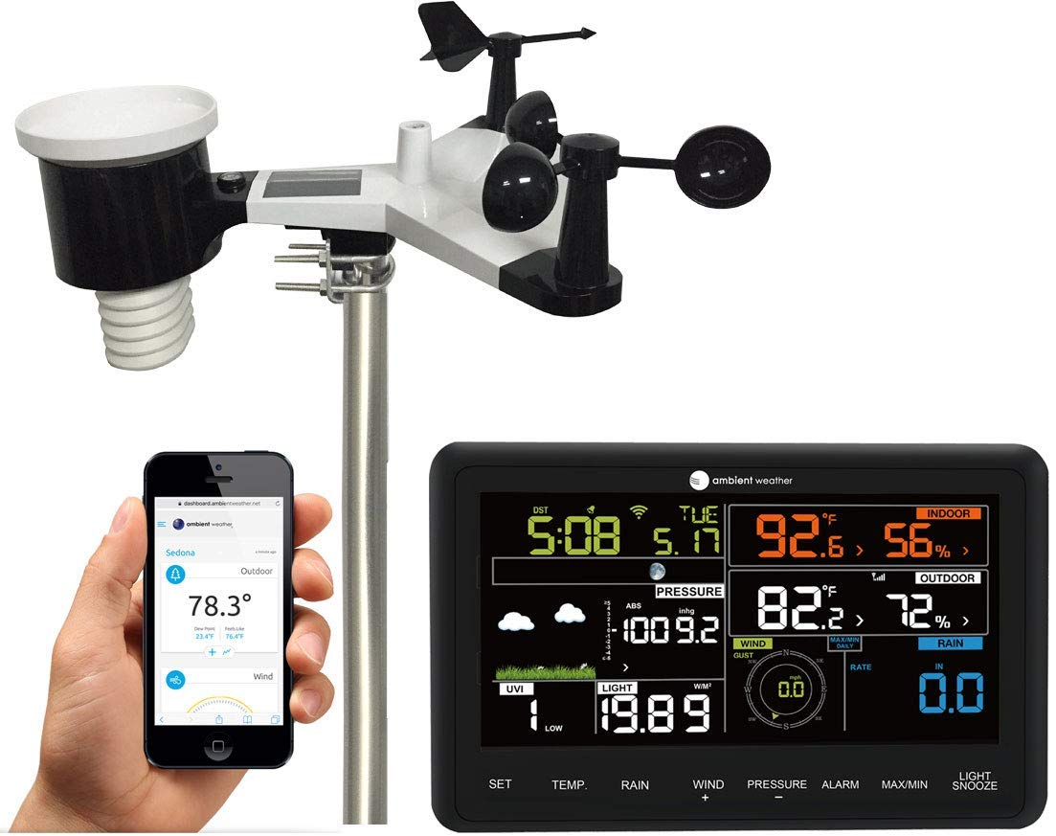
Example: Weather station
Sensor
  Wind speed
  Wind direction
  Rain
  Temperature
  Humidity
  Barometer
Connectivity
  Wifi
Interaction
  App
  Display
Source: Amazon.com
https://www.amazon.com/Ambient-Weather-Professional-Monitoring-Compatible/dp/B01N5TEHLI/ref=sr_1_3?ie=UTF8&qid=1535421699&sr=8-3&keywords=weather+station

Slide 24
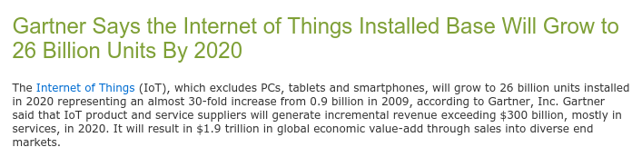
Gartner: 26 Billions devices
26 billions units installed in 2020
Almost 30-fold increase from 0.9 billions in 2009
Source: http://www.gartner.com/newsroom/id/2636073
Diciembre 2013

Slide 25
Will there be enough IPs
IPV6
  A main advantage of IPv6 is increased address space. The 128-bit length of IPv6 addresses is a significant gain over the 32-bit length of IPv4 addresses, allowing for an almost limitless number of unique IP addresses.
Source:
http://whatismyipaddress.com/ip-v6

Slide 26
Iot Background
Why is so popular?
Notes:
Discuss money projections
Provide Studies with current market impact
Establish it is a growing business worldwide.

Slide 27
Industry Insights
The global Internet of Things (IoT) market size was valued at USD 605.69 billion in 2014. Technological proliferation and increasing investments are expected to drive the global market over the next seven years. Significant advances in telecommunication and growing penetration of internet and broadband services have further propelled the growth of Internet of Things (IoT) industry.
Source: https://www.grandviewresearch.com/industry-analysis/iot-market

Slide 28
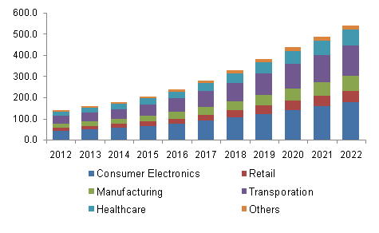
North America IoT market revenue by application, 2012 - 2022 (USD Billion)
Source: https://www.grandviewresearch.com/industry-analysis/iot-market

Slide 29
Companies & Campaigns

Slide 30
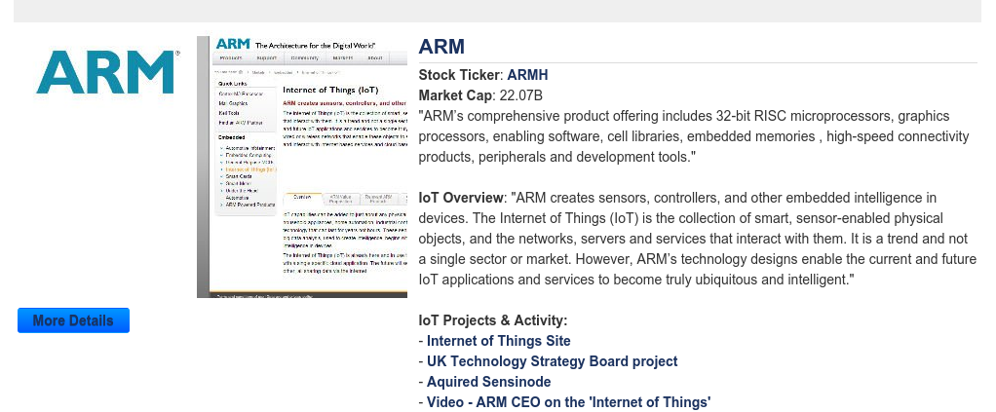
ARM

Slide 31
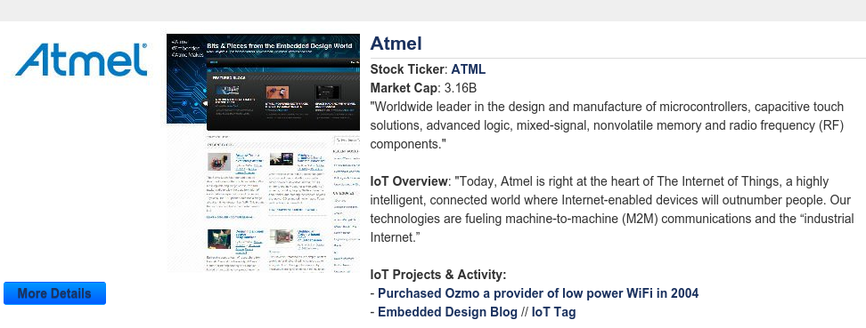
Atmel

Slide 32
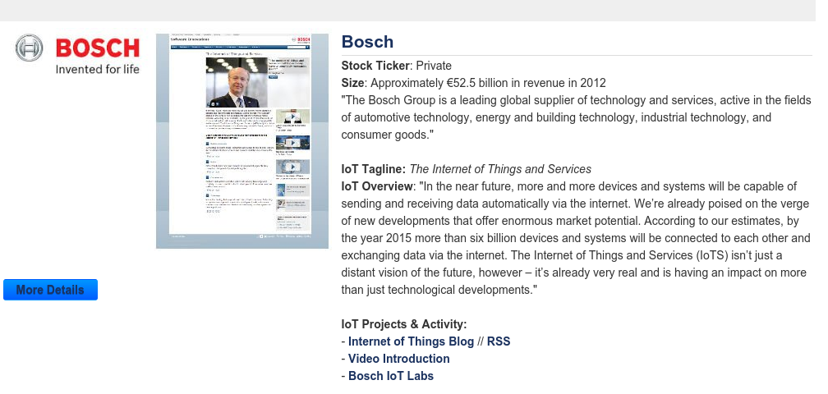
BOSCH

Slide 33
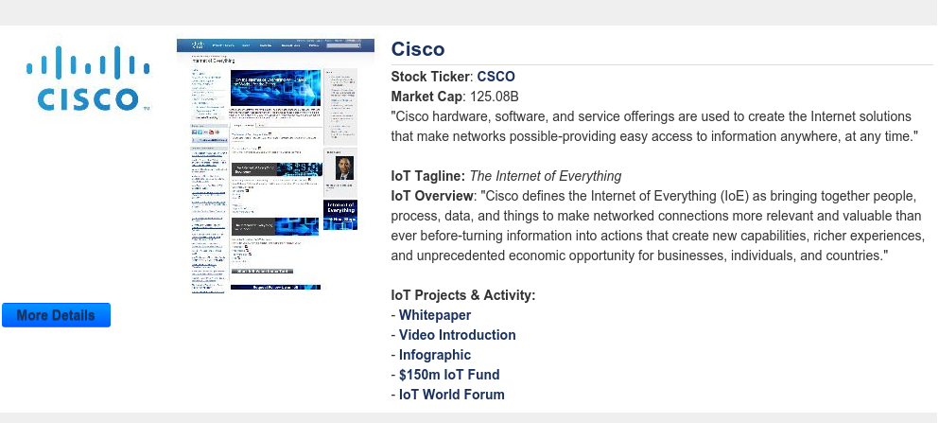
Cisco

Slide 34
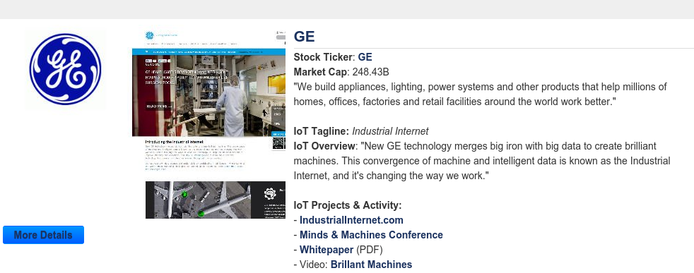
GE

Slide 35
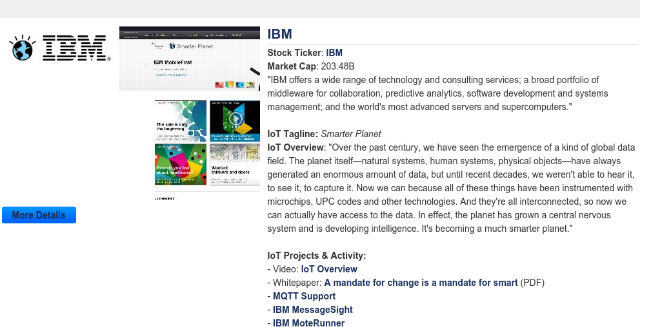
IBM

Slide 36
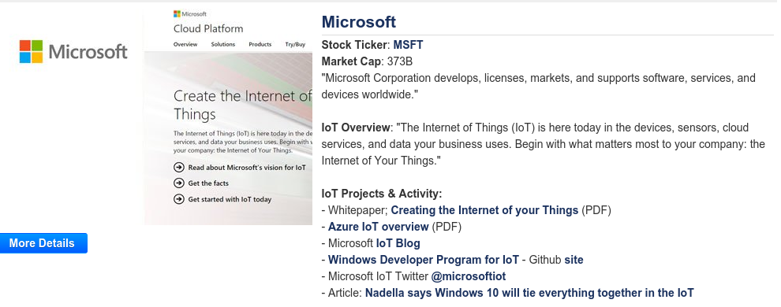

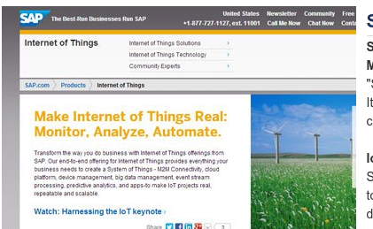
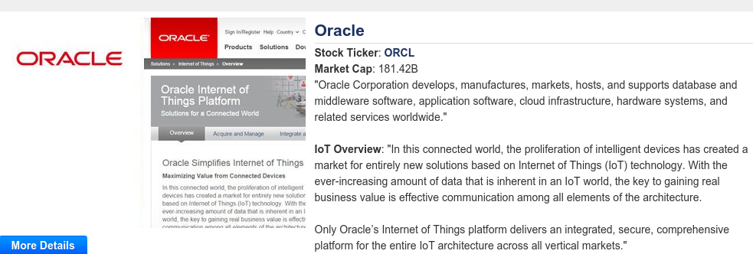
And a lot more

Slide 37
Cool examples
Notes:
System automation in factories
Temperature monitoring of data centers and manufacturing

Slide 38
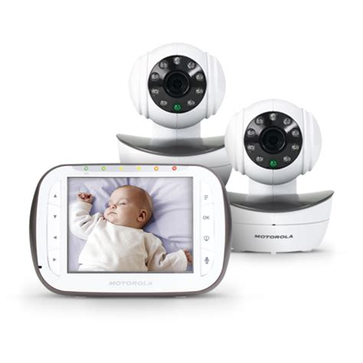
Baby monitor

Slide 39
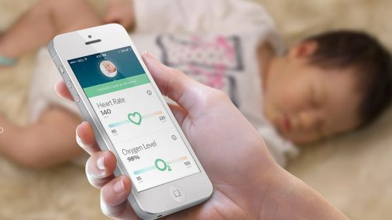
Creepy baby monitoring
Heart rate
Temperature
Awake?

Slide 40
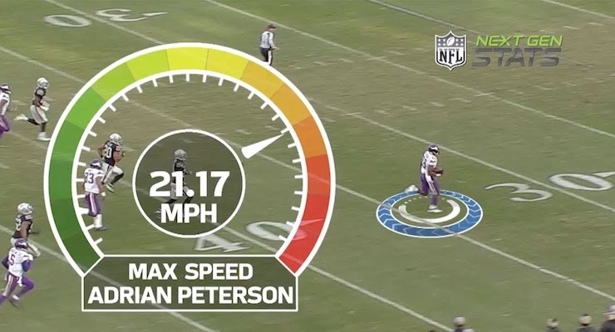
Sports

Slide 41
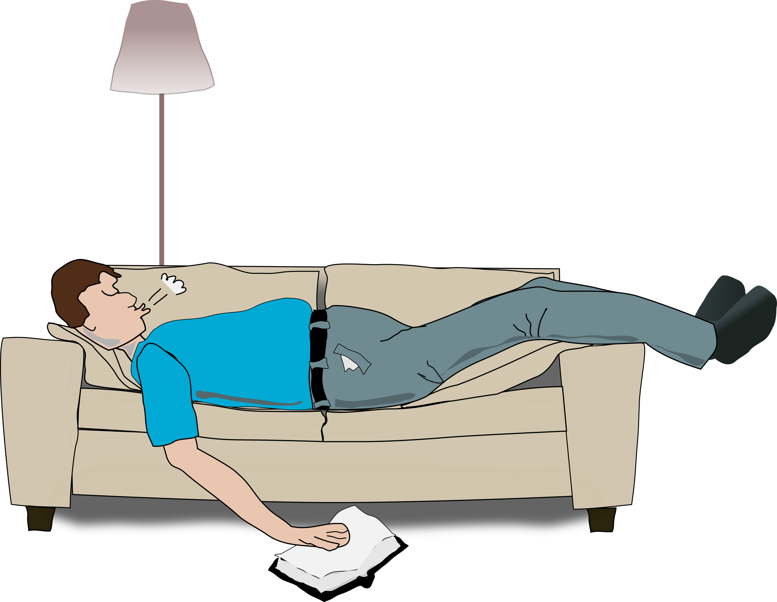



Health

Slide 42
Health
Heart attack
Call ambulance before it happens
Patient with doctor while the attack

Slide 43
Industrial examples
Automation
Quality control
Notes:
System automation in factories
Temperature monitoring of data centers and manufacturing

Slide 44
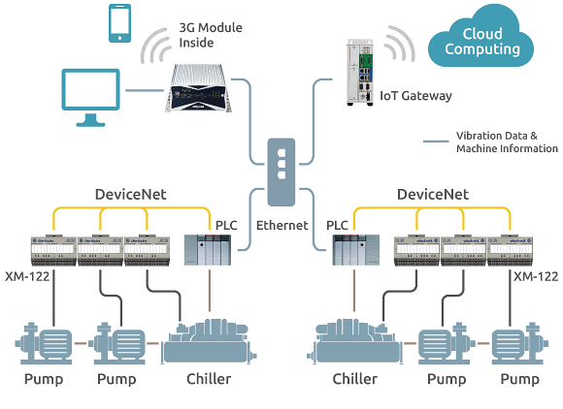
PLC connected
PLC
  Traditionally dedicated network
  Link to Ethernet
  Link to internet (optional)
  External controls/reporting

Slide 45
Industrial key features
Regulation
Efficiency
Quality and safety
  Reduce human error
  Reduce costs
  Monitoring
  Measure processes
  Etc.

Slide 46
Stuxnet
Stuxnet is a malicious computer worm, first uncovered in 2010. Thought to have been in development since at least 2005, Stuxnet targets SCADA systems and is believed to be responsible for causing substantial damage to Iran's nuclear program. Although neither country has openly admitted responsibility, the worm is believed to be a jointly built American/Israeli cyberweapon.
Source: Wikipedia https://en.wikipedia.org/wiki/Stuxnet
Notes:
Stuxnet specifically targets programmable logic controllers (PLCs), which allow the automation of electromechanical processes such as those used to control machinery on factory assembly lines, amusement rides, or centrifuges for separating nuclear material. Exploiting four zero-day flaws,[3] Stuxnet functions by targeting machines using the Microsoft Windows operating system and networks, then seeking out Siemens Step7 software. Stuxnet reportedly compromised Iranian PLCs, collecting information on industrial systems and causing the fast-spinning centrifuges to tear themselves apart.[4] Stuxnet’s design and architecture are not domain-specific and it could be tailored as a platform for attacking modern supervisory control and data acquisition (SCADA) and PLC systems (e.g., in factory assembly lines or power plants), the majority of which reside in Europe, Japan and the US.[5] Stuxnet reportedly ruined almost one fifth of Iran's nuclear centrifuges.[6] Targeting industrial control systems, the worm infected over 200,000 computers and caused 1,000 machines to physically degrade.[7]
Stuxnet has three modules: a worm that executes all routines related to the main payload of the attack; a link file that automatically executes the propagated copies of the worm; and a rootkit component responsible for hiding all malicious files and processes, preventing detection of the presence of Stuxnet.[8] It is typically introduced to the target environment via an infected USB flash drive, thereby crossing any air gap. The worm then propagates across the network, scanning for Siemens Step7 software on computers controlling a PLC. In the absence of either criterion, Stuxnet becomes dormant inside the computer. If both the conditions are fulfilled, Stuxnet introduces the infected rootkit onto the PLC and Step7 software, modifying the codes and giving unexpected commands to the PLC while returning a loop of normal operations system values feedback to the users.[9][10]
In 2015, Kaspersky Labs noted that the Equation Group had used two of the same zero-day attacks, prior to their use in Stuxnet, and commented that: "the similar type of usage of both exploits together in different computer worms, at around the same time, indicates that the Equation Group and the Stuxnet developers are either the same or working closely together".[11]

Slide 47
Nuclear plant?
Who cares?
Notes:
System automation in factories
Temperature monitoring of data centers and manufacturing

Slide 48
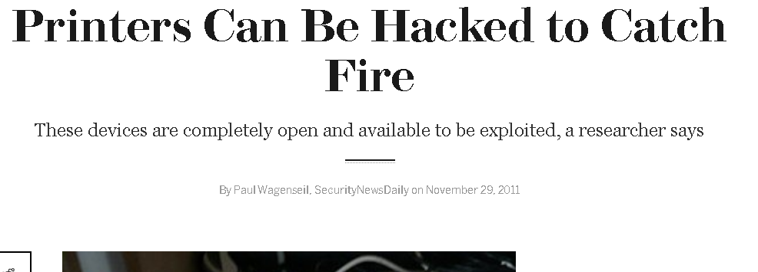
HP Printer hack

Slide 49
Security
Communication protocols
  Encrypted, vulnerable?
Who can decide what?
  Users and user validation
  Data storage
Is it accessible from the network?
  What network?
  By whom?
Worst case scenario what could happen

Slide 50
Some considerations
Keep up to date
  Security patches
  Devices end of life, support
Fail over plans
  What if the system is down
Integration with other systems
Constant validation, testing
  False alarms (system integrity)
Expected service life

Slide 51
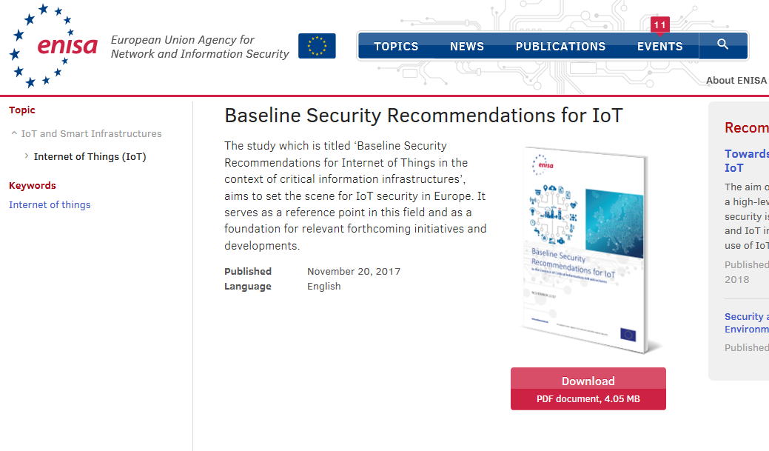
Reference
https://www.enisa.europa.eu/publications/baseline-security-recommendations-for-iot

Slide 52
Home examples
Products in the market
Home made
Notes:
Switches, bulps, Alexa, Google device, Apple device,
Air conditioners

Slide 53
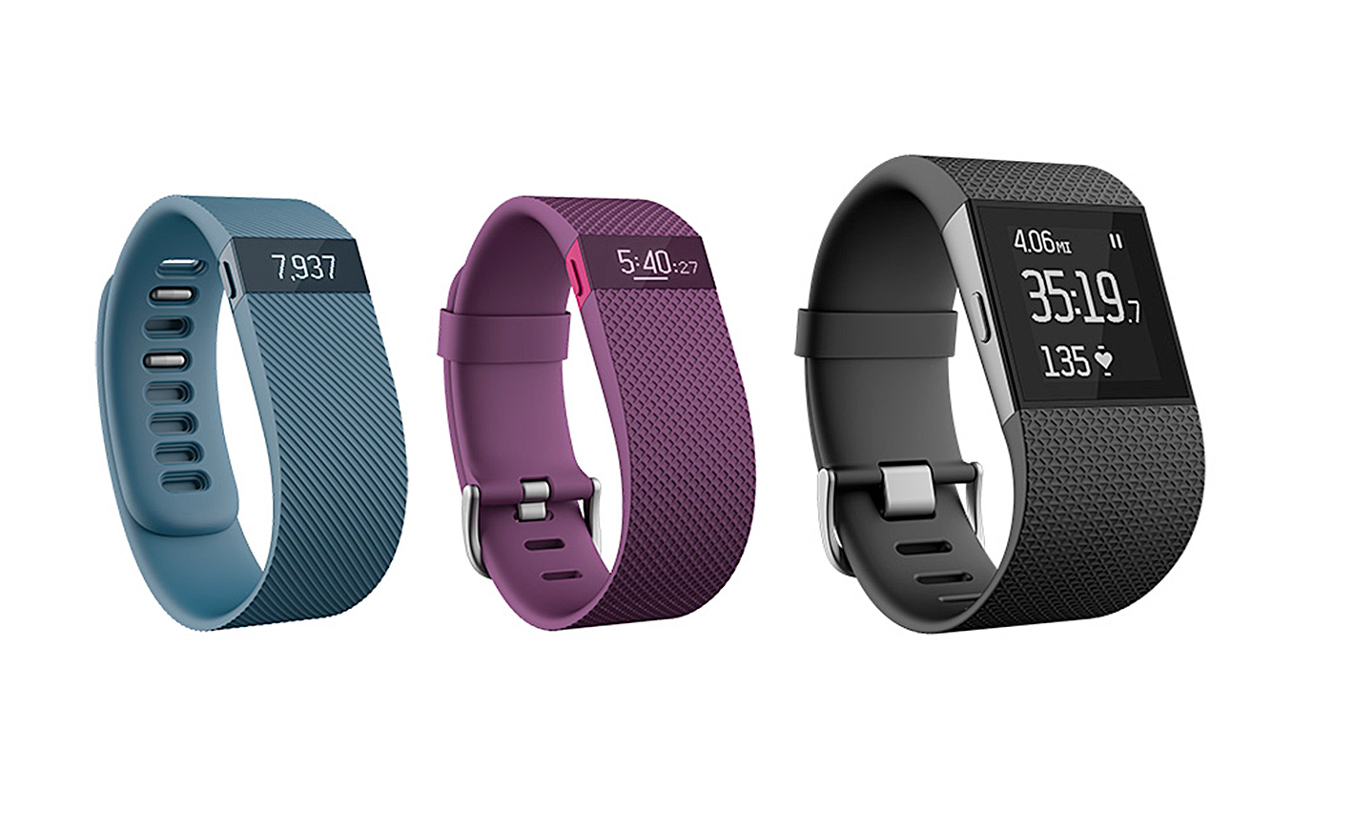
Exercise
Fitbit

Slide 54


Slide 55
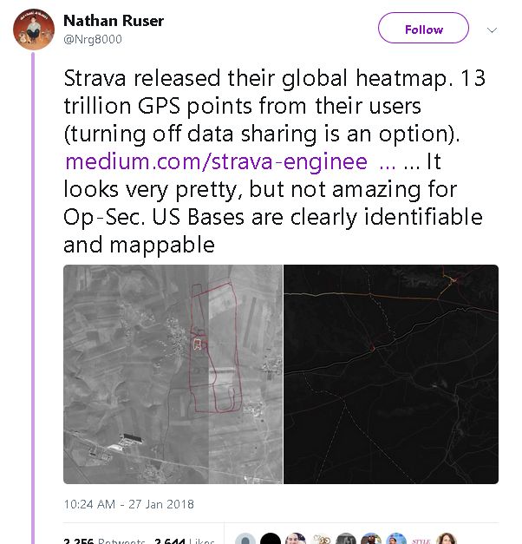
US Bases identifiable and mappable

Slide 56
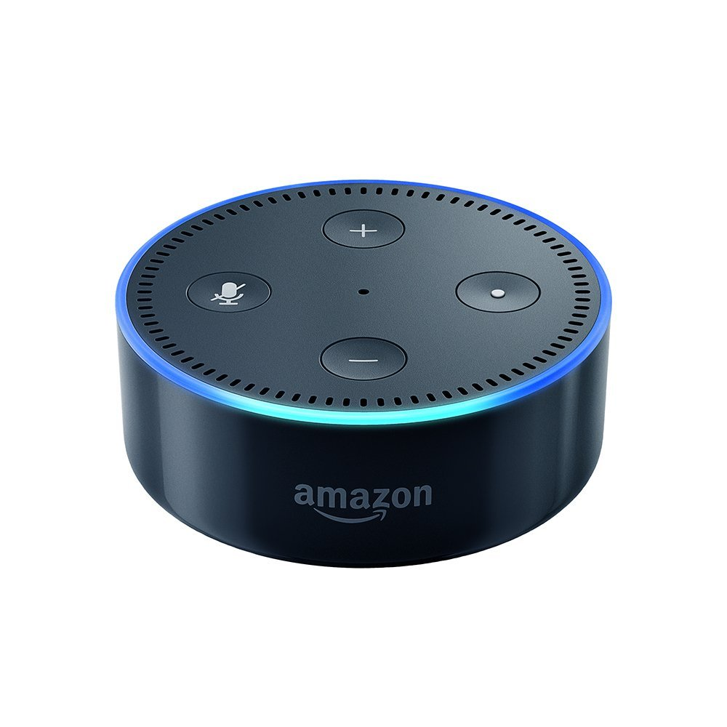
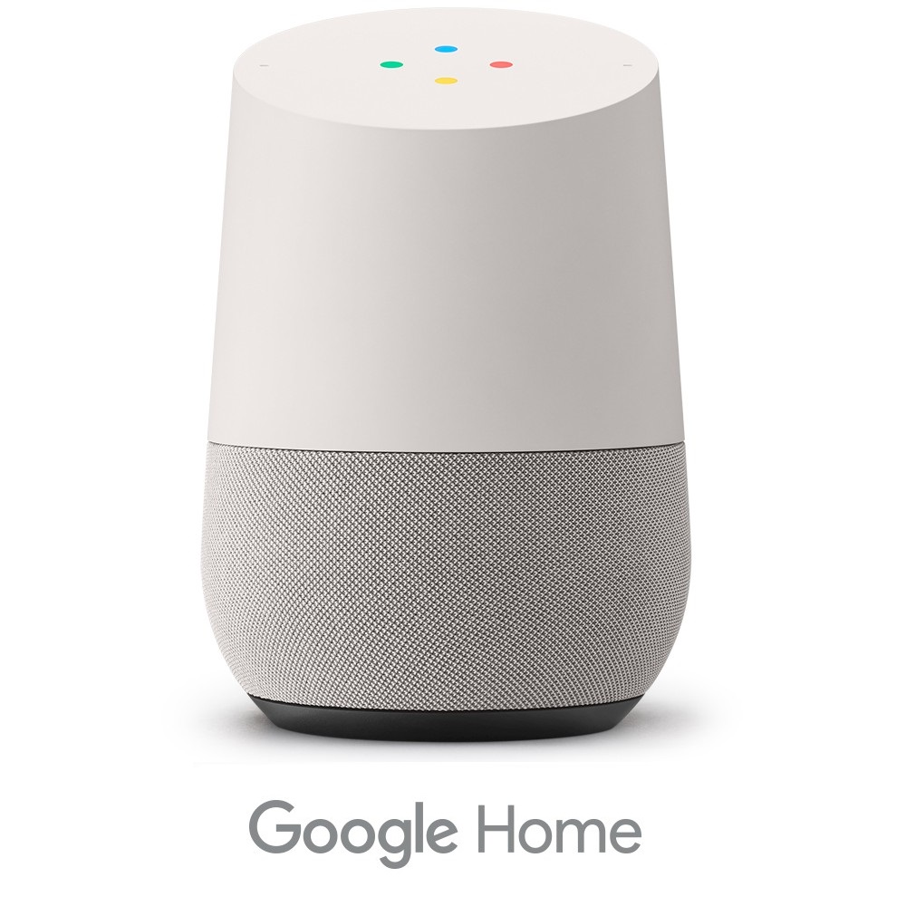
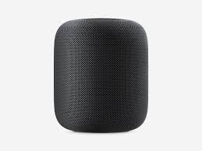
Digital Assistants
News
  Traffic, weather
Agenda
Entertainment
Control other stuff

Slide 57
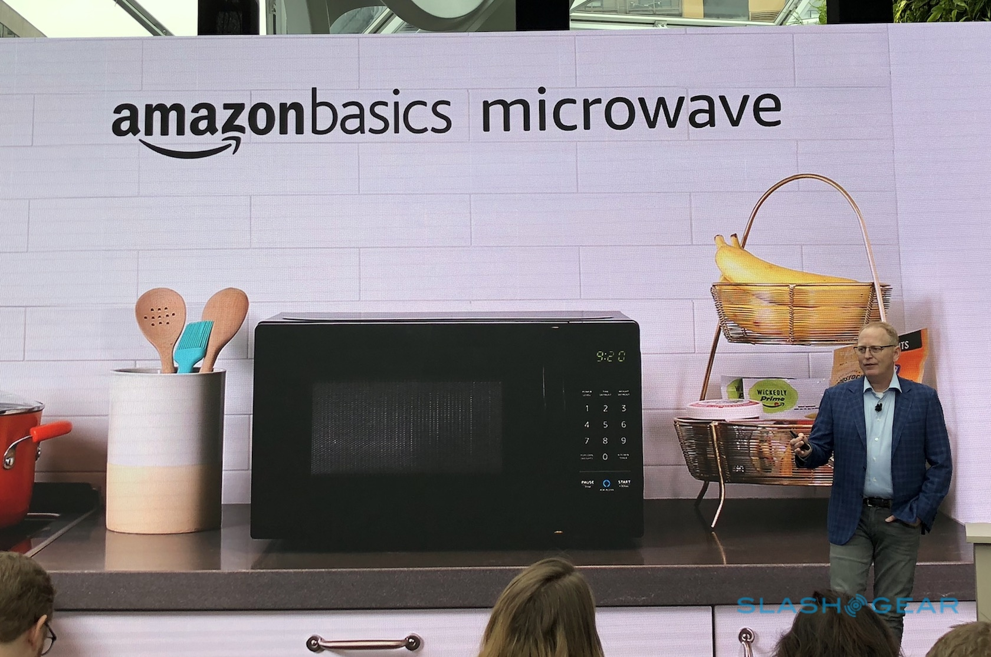
Microwave

Slide 58



Traditional Internet

Slide 59

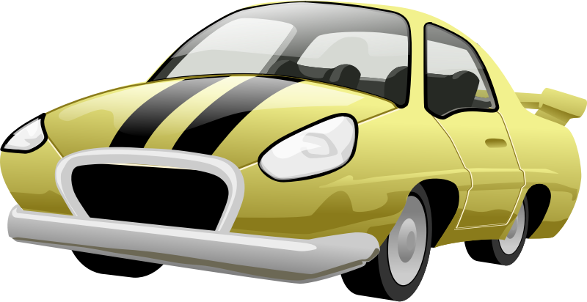

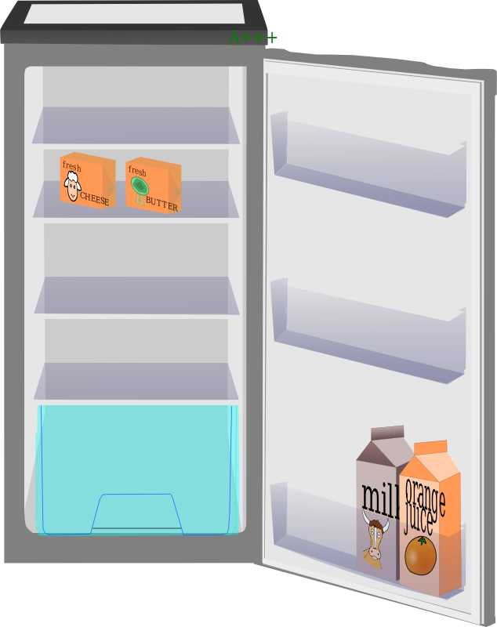
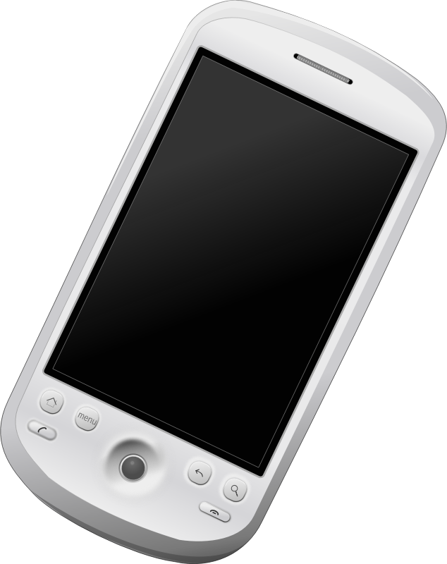
Internet Now...

Slide 60

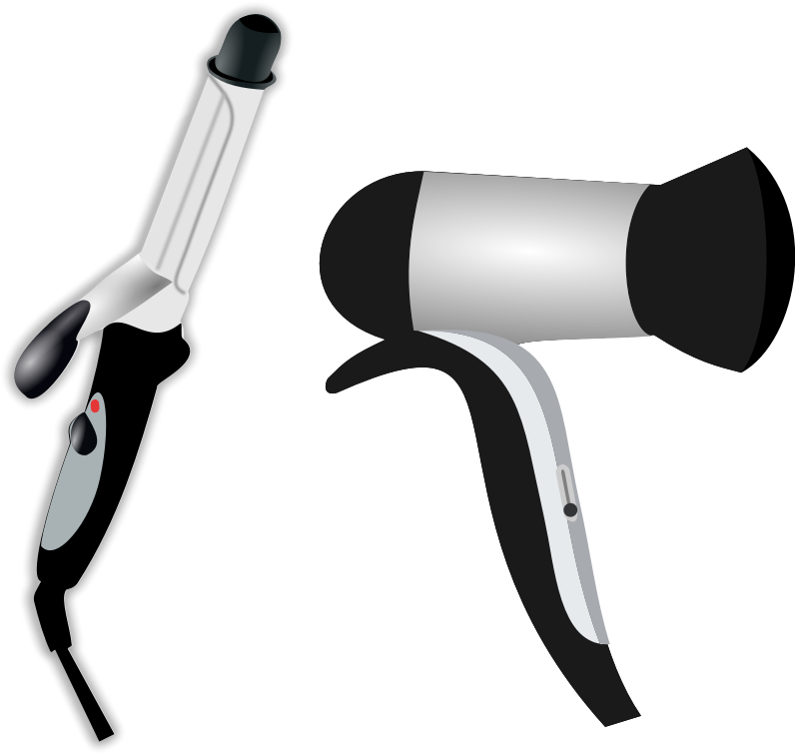

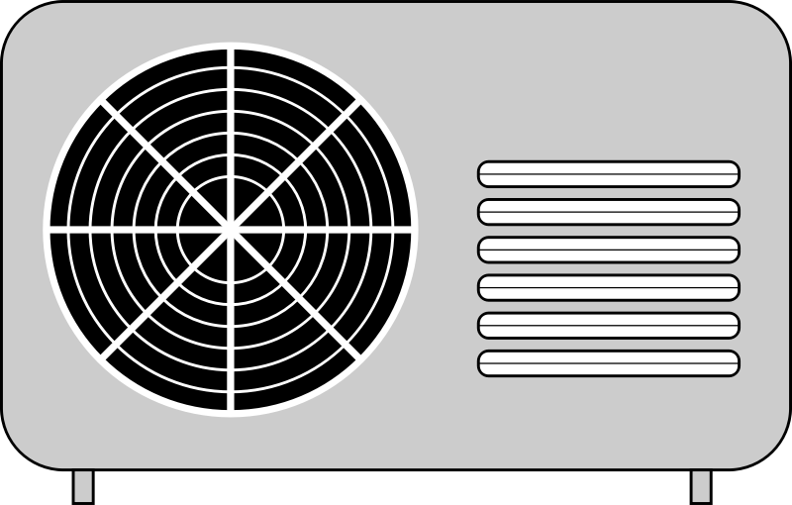
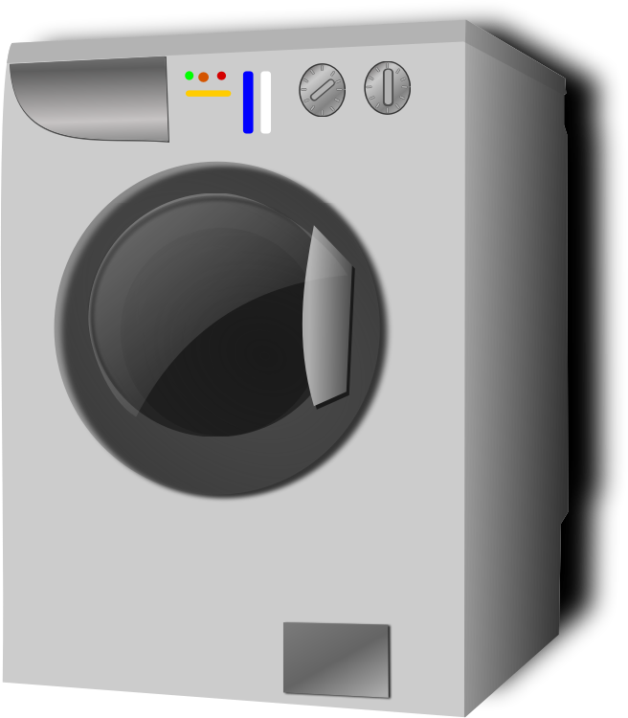

Internet of things everything

Slide 61
Everything is a part of a System

Slide 62
Small systems all over

Slide 63
Interconnected systems

Slide 64
How to Connect things?

Slide 65
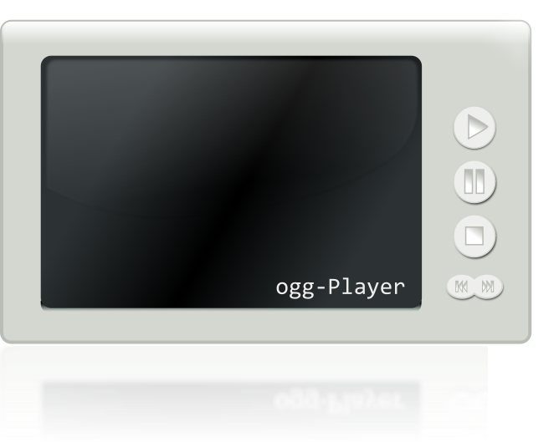
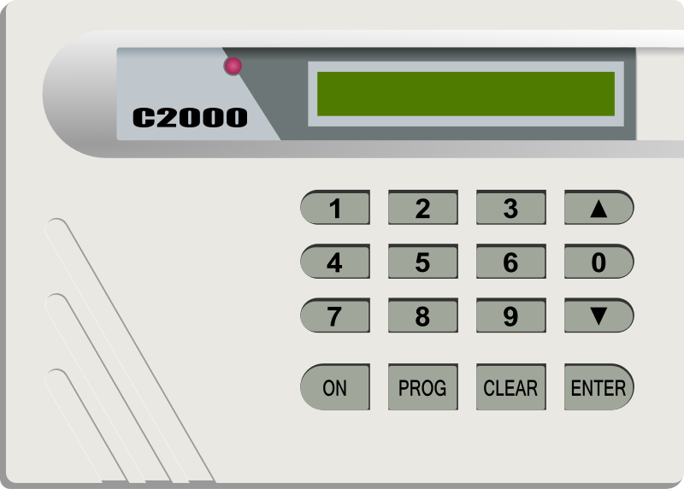
Machine to machine
Protocols
Data access
Compatibility
Brands
Device type
Security
Open or proprietary
Bandwidth

Slide 66
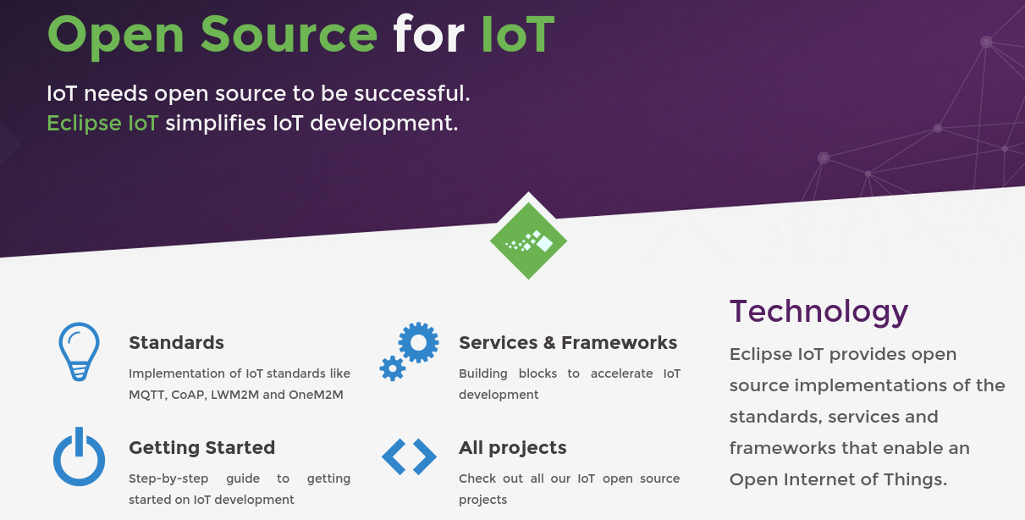
Eclipse http://iot.eclipse.org/

Slide 67
Standards
OMA LightweightM2M
LightweightM2M is principly a device management protocol, but it should be designed to be able to extend to meet the requirements of applications. LightweightM2M is not restricted to device management, it should be able transfer service / application data.
OMA LightweightM2M (LWM2M) is an industry standard for device management of M2M/IoT devices. It heavily relies on CoAP and therefore is optimized for communications over sensor or cellular networks.
OMA LWM2M provides an extensible object model that allows to enable application data exchanges in addition to the core device management features (firmware upgrade, connectivity monitoring, …)

Slide 68
Standards
CoAP
  CoAP (Constrained Application Protocol) is a protocol specialized for use with constrained nodes and networks.
  It implements the REST architectural style, it can be transparently mapped to HTTP. However, CoAP also provides features that go beyond HTTP such as native push notifications and group communication.

Slide 69
Standards
Message Queuing Telemetry Transport (MQTT)
  Protocol designed to connect the physical world devices and networks, with applications and middleware used in IT and Web development.
  Lightweight
  Publish/Subscribe
  Wired/Wireless
  Protocol used by Facebook chat!

Slide 70
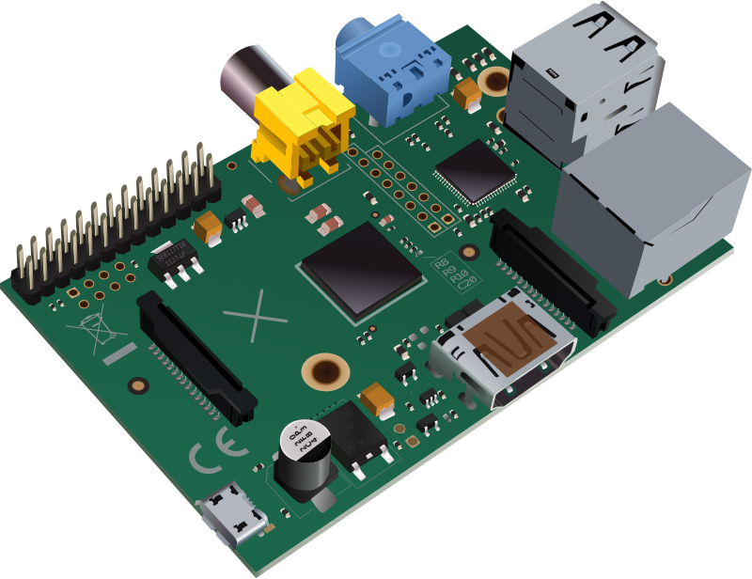
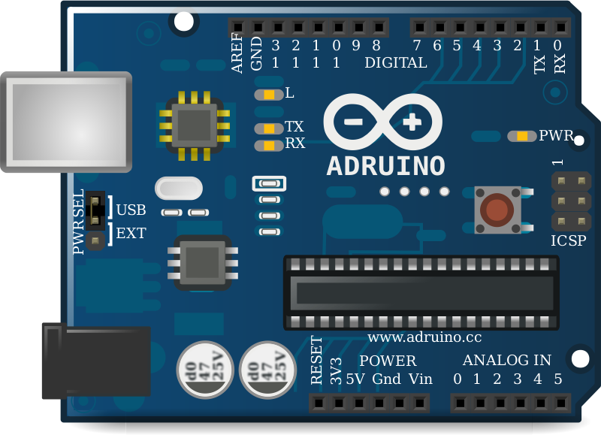
Common hardware
Arduino
Raspberry Pi

Slide 71


MQTT Implementation
MQTT Server
Publisher
Subscriber

Slide 72
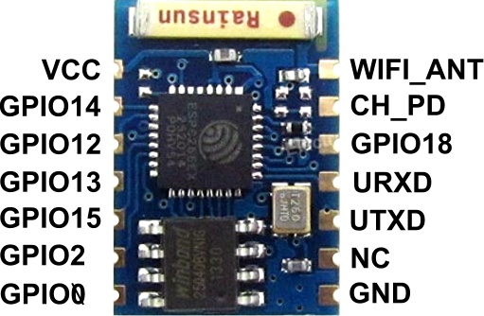
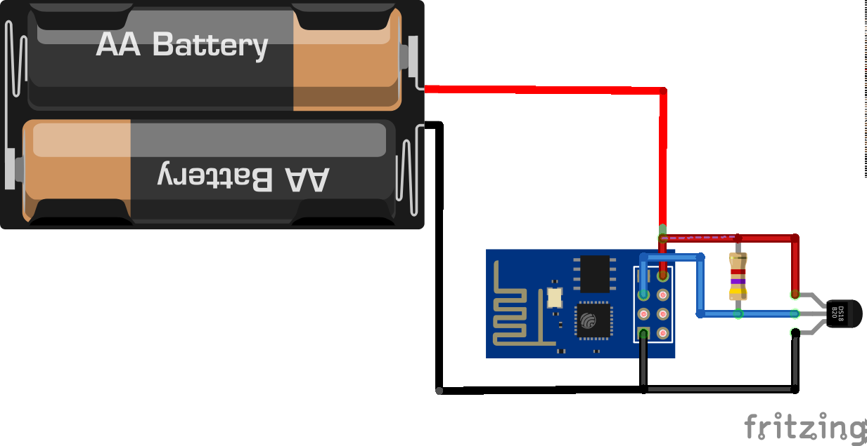
How to get started
Wifi is cheap
Multiple options
ESP8266 < $5

Slide 73
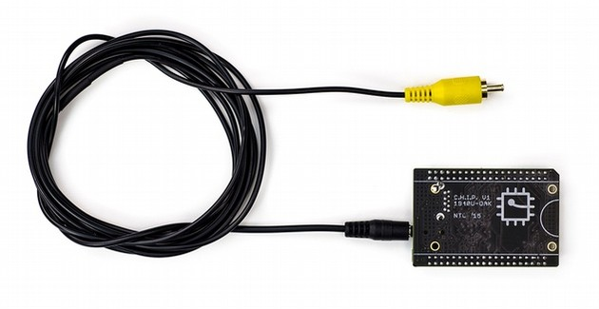
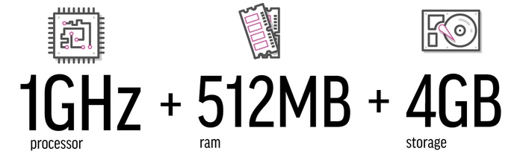
CHIP $9 Computer

Slide 74
IOT opportunities
Hardware electronic
Products, data collection
  Data Storage
Clothes
Analysis
  Processing power
Security

Slide 75
Some Challenges
Connecting Existing hardware
  Cost
People
  Privacy
Inter-connectivity of devices
  Brands
  protocols
Connectivity
  Around 40% of the world population has an internet connection today
  Wikipedia says 51% of PR internet
Security

Slide 76
Internet Users by Country
In 2014, nearly 75% (2.1 billion) of all internet users in the world (2.8 billion) live in the top 20 countries.
The remaining 25% (0.7 billion) is distributed among the other 178 countries, each representing less than 1% of total users.

Slide 77
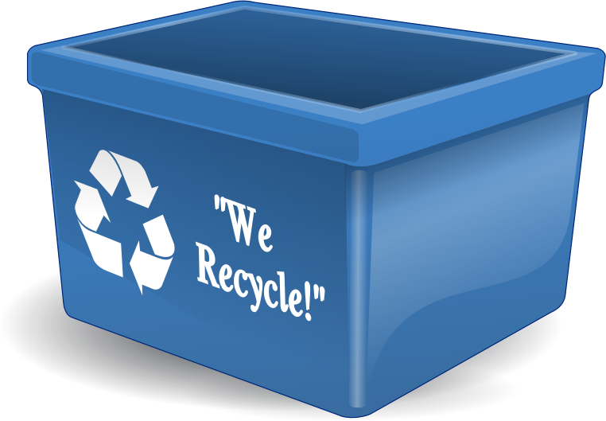
E-waste
“according to United Nations University estimates reported by ITU, 67 million metric tons of electrical and electronic equipment were put on the market in 2013. In the same year, 53 million metric tons of e‑waste (waste electrical and electronic equipment) were disposed of worldwide. “
Source:
https://itunews.itu.int/En/4850-E-waste-and-the-Internet-of-Things.note.aspx

Slide 78
Live demos
Build demo
Making it blink
Notes:
Build a hardware prototype and link it to a network and interact somehow with it.

Slide 79
Wemos D1 mini
ESP8266
Programming with arduino
Led Connected to pin D0

Slide 80
Dotnet new console
using System;
using System.Text;
using System.Threading;
using MQTTnet;
using MQTTnet.Client;
using MQTTnet.Implementations;
namespace mqttConsole
{
class Program
{
static async System.Threading.Tasks.Task Main(string[] args)
{
Console.WriteLine("Hello World!");
// Use TCP connection.
var options = new MqttClientOptionsBuilder()
//.WithTcpServer("broker.hivemq.com", 1883) // Port is optional
//.WithTcpServer("iot.eclipse.org", 1883) // Port is optional
.WithTcpServer("test.mosquitto.org", 1883) // Port is optional
.Build();
// Create a new MQTT client.
var factory = new MqttFactory();
var mqttClient = factory.CreateMqttClient();
mqttClient.ApplicationMessageReceived += (s, e) =>
{
Console.WriteLine("### RECEIVED APPLICATION MESSAGE ###");
Console.WriteLine($"+ Topic = {e.ApplicationMessage.Topic}");
Console.WriteLine($"+ Payload = {Encoding.UTF8.GetString(e.ApplicationMessage.Payload)}");
Console.WriteLine($"+ QoS = {e.ApplicationMessage.QualityOfServiceLevel}");
Console.WriteLine($"+ Retain = {e.ApplicationMessage.Retain}");
Console.WriteLine();
};
mqttClient.Connected += async (s, e) =>
{
Console.WriteLine("### CONNECTED WITH SERVER ###");
// Subscribe to a topic
await mqttClient.SubscribeAsync(new TopicFilterBuilder().WithTopic("outTopic").Build());
Console.WriteLine("### SUBSCRIBED ###");
};
await mqttClient.ConnectAsync(options);
string inputLine = "";
do
{
inputLine = Console.ReadLine();
if (inputLine?.Length > 0)
{
await mqttClient.PublishAsync(
new MqttApplicationMessageBuilder()
.WithTopic("inTopic")
.WithPayload(inputLine)
.Build() );
}
}
while (inputLine?.Length > 0);
}
}
}

Slide 81
Project file
<Project Sdk="Microsoft.NET.Sdk">
<PropertyGroup>
<LangVersion>latest</LangVersion>
<OutputType>Exe</OutputType>
<TargetFramework>netcoreapp2.1</TargetFramework>
</PropertyGroup>
<ItemGroup>
<PackageReference Include="MQTTnet" Version="2.8.4"/>
</ItemGroup>
</Project>

Slide 82
Arduino example
/*
Basic ESP8266 MQTT example
This sketch demonstrates the capabilities of the pubsub library in combination
with the ESP8266 board/library.
It connects to an MQTT server then:
- publishes "hello world" to the topic "outTopic" every two seconds
- subscribes to the topic "inTopic", printing out any messages
it receives. NB - it assumes the received payloads are strings not binary
- If the first character of the topic "inTopic" is an 1, switch ON the ESP Led,
else switch it off
It will reconnect to the server if the connection is lost using a blocking
reconnect function. See the 'mqtt_reconnect_nonblocking' example for how to
achieve the same result without blocking the main loop.
To install the ESP8266 board, (using Arduino 1.6.4+):
- Add the following 3rd party board manager under "File -> Preferences -> Additional Boards Manager URLs":
http://arduino.esp8266.com/stable/package_esp8266com_index.json
- Open the "Tools -> Board -> Board Manager" and click install for the ESP8266"
- Select your ESP8266 in "Tools -> Board"
*/
#include <ESP8266WiFi.h>
#include <PubSubClient.h>
// Update these with values suitable for your network.
const char* ssid = "....";
const char* password = "....";
const char* mqtt_server = "test.mosquitto.org";
WiFiClient espClient;
PubSubClient client(espClient);
long lastMsg = 0;
char msg[50];
int value = 0;
void setup() {
pinMode(BUILTIN_LED, OUTPUT); // Initialize the BUILTIN_LED pin as an output.
pinMode(D0, OUTPUT);
Serial.begin(115200);
setup_wifi();
client.setServer(mqtt_server, 1883);
client.setCallback(callback);
}
void setup_wifi() {
delay(10);
// We start by connecting to a WiFi network
Serial.println();
Serial.print("Connecting to ");
Serial.println(ssid);
WiFi.begin(ssid, password);
while (WiFi.status() != WL_CONNECTED) {
delay(500);
Serial.print(".");
}
Serial.println("");
Serial.println("WiFi connected");
Serial.println("IP address: ");
Serial.println(WiFi.localIP());
}
void callback(char* topic, byte* payload, unsigned int length) {
Serial.print("Message arrived [");
Serial.print(topic);
Serial.print("] ");
for (int i = 0; i < length; i++) {
Serial.print((char)payload[i]);
}
Serial.println();
// Switch on the LED if an 1 was received as first character
if ((char)payload[0] == '1') {
client.publish("outTopic", "Appagando");
digitalWrite(D0, LOW); // Turn the LED on (Note that LOW is the voltage level
// but actually the LED is on; this is because
// it is acive low on the ESP-01)
} else {
digitalWrite(D0, HIGH); // Turn the LED off by making the voltage HIGH
client.publish("outTopic", "Prendiendo");
}
}
void reconnect() {
// Loop until we're reconnected
while (!client.connected()) {
Serial.print("Attempting MQTT connection...");
// Attempt to connect
if (client.connect("ESP8266Client")) {
Serial.println("connected");
// Once connected, publish an announcement...
//client.publish("outTopic", "hello world");
// ... and resubscribe
client.subscribe("inTopic");
} else {
Serial.print("failed, rc=");
Serial.print(client.state());
Serial.println(" try again in 5 seconds");
// Wait 5 seconds before retrying
delay(5000);
}
}
}
void loop() {
if (!client.connected()) {
reconnect();
}
client.loop();
long now = millis();
if (now - lastMsg > 2000) {
lastMsg = now;
++value;
//snprintf (msg, 75, "hello world #%ld", value);
// Serial.print("Publish message: ");
//Serial.println(msg);
//client.publish("outTopic", msg);
}
}

Slide 83
Arduino source wifiManager
#include <ESP8266WiFi.h> //https://github.com/esp8266/Arduino
//needed for library
#include <DNSServer.h>
#include <ESP8266WebServer.h>
#include <WiFiManager.h> //https://github.com/tzapu/WiFiManager
#include <ESP8266WiFi.h>
#include <PubSubClient.h>
//Mqtt stuff
WiFiClient espClient;
PubSubClient client(espClient);
long lastMsg = 0;
char msg[50];
int value = 0;
const char* mqtt_server = "test.mosquitto.org";
//for LED status
#include <Ticker.h>
Ticker ticker;
void tick()
{
//toggle state
int state = digitalRead(BUILTIN_LED); // get the current state of GPIO1 pin
digitalWrite(BUILTIN_LED, !state); // set pin to the opposite state
}
//gets called when WiFiManager enters configuration mode
void configModeCallback (WiFiManager *myWiFiManager) {
Serial.println("Entered config mode");
Serial.println(WiFi.softAPIP());
//if you used auto generated SSID, print it
Serial.println(myWiFiManager->getConfigPortalSSID());
//entered config mode, make led toggle faster
ticker.attach(0.2, tick);
}
void setup() {
// put your setup code here, to run once:
Serial.begin(115200);
//For mqtt stuff
pinMode(D0, OUTPUT);
//set led pin as output
pinMode(BUILTIN_LED, OUTPUT);
// start ticker with 0.5 because we start in AP mode and try to connect
ticker.attach(0.6, tick);
//WiFiManager
//Local intialization. Once its business is done, there is no need to keep it around
WiFiManager wifiManager;
//reset settings - for testing
//wifiManager.resetSettings();
//set callback that gets called when connecting to previous WiFi fails, and enters Access Point mode
wifiManager.setAPCallback(configModeCallback);
//fetches ssid and pass and tries to connect
//if it does not connect it starts an access point with the specified name
//here "AutoConnectAP"
//and goes into a blocking loop awaiting configuration
if (!wifiManager.autoConnect()) {
Serial.println("failed to connect and hit timeout");
//reset and try again, or maybe put it to deep sleep
ESP.reset();
delay(1000);
}
//if you get here you have connected to the WiFi
Serial.println("connected...yeey :)");
ticker.detach();
//keep LED on
digitalWrite(BUILTIN_LED, LOW);
client.setServer(mqtt_server, 1883);
client.setCallback(callback);
}
void callback(char* topic, byte* payload, unsigned int length) {
Serial.print("Message arrived [");
Serial.print(topic);
Serial.print("] ");
for (int i = 0; i < length; i++) {
Serial.print((char)payload[i]);
}
Serial.println();
// Switch on the LED if an 1 was received as first character
if ((char)payload[0] == '1') {
client.publish("outTopic", "Appagando");
digitalWrite(D0, LOW); // Turn the LED on (Note that LOW is the voltage level
// but actually the LED is on; this is because
// it is acive low on the ESP-01)
} else {
digitalWrite(D0, HIGH); // Turn the LED off by making the voltage HIGH
client.publish("outTopic", "Prendiendo");
}
}
void reconnect() {
// Loop until we're reconnected
while (!client.connected()) {
Serial.print("Attempting MQTT connection...");
// Attempt to connect
if (client.connect("ESP8266Client")) {
Serial.println("connected");
// Once connected, publish an announcement...
//client.publish("outTopic", "hello world");
// ... and resubscribe
client.subscribe("inTopic");
} else {
Serial.print("failed, rc=");
Serial.print(client.state());
Serial.println(" try again in 5 seconds");
// Wait 5 seconds before retrying
delay(5000);
}
}
}
void loop() {
if (!client.connected()) {
reconnect();
}
client.loop();
long now = millis();
if (now - lastMsg > 2000) {
lastMsg = now;
++value;
//snprintf (msg, 75, "hello world #%ld", value);
// Serial.print("Publish message: ");
//Serial.println(msg);
//client.publish("outTopic", msg);
}
}

