Slide 1

Internet of things
What? Why? And How?
By: Eng. Javier Hernández

Slide 2

About Me
Computer Engineer
Developer
Nerd
Twitter @soynerdito
soynerdito@gmail.com
Interests (no particular order)
  Programming
  Making
  Security
  Hardware
  Tech communities
  Just now - Agriculture
@Soynerdito

Slide 3
Goals
What is Iot?
Why is so popular?
Gain awareness of challenges
Focus on making our own
Motivate getting hands dirty into making stuff at hobby or business
Slides at:
https://github.com/soynerdito/InternetOfThingsTalk
Notes:
The focus is in getting hands dirty

Slide 4
Iot Background
Definition (What is?)
Notes:
Discuss money projections
Provide Studies with current market impact
Establish it is a growing business worldwide.

Slide 5

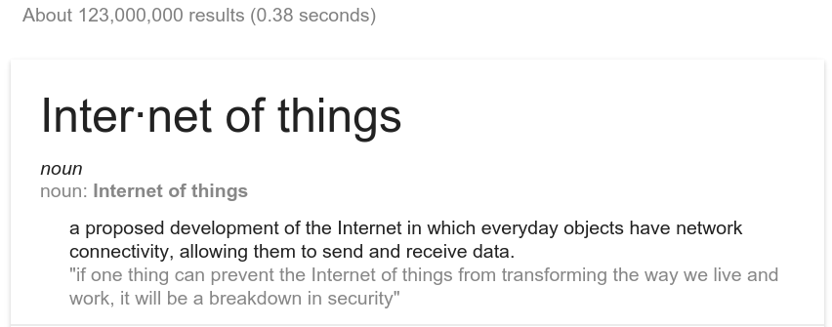
Let’s search for the definition

Slide 6
What is iot? Source: Wikipedia
The Internet of Things (IoT) is the network of physical devices, vehicles, home appliances, and other items embedded with electronics, software, sensors, actuators, and connectivity which enables these things to connect and exchange data, creating opportunities for more direct integration of the physical world into computer-based systems, resulting in efficiency improvements, economic benefits, and reduced human exertions

Slide 7
What is iot? Source: Wikipedia
network of physical devices
  vehicles, home appliances, and other items
embedded with electronics
  software, sensors, actuators, and connectivity
enables things to connect and exchange data
direct integration of the physical world into computer-based systems

Slide 8
What is a device
Mobile phones, tablets, laptops
Transportation: Car, Bus, bikes
Home appliances: Fridge, TV
Traffic lights
Doors
Clothes
Furniture
Anything and everything

Slide 9
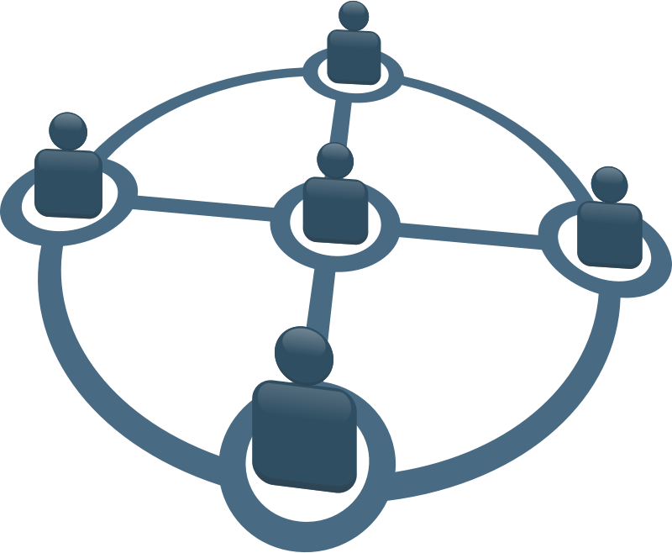
Every device has network connectivity
Some examples may be:
  Wireless
    Bluetooth
    Wifi
    RF
    IRDA
    LoraWAN
  Wired
    Ethernet
    RS232/RS485
    USB

Slide 10
LoRa (Long Range)
uses license-free sub-gigahertz radio frequency bands like 169 MHz, 433 MHz, 868 MHz (Europe) and 915 MHz (North America).
Enables very-long-range transmissions (more than 10 km in rural areas) with low power consumption.The technology is presented in two parts — LoRa, the physical layer and LoRaWAN (Long Range Wide Area Network), the upper layers.
Source: https://en.wikipedia.org/wiki/LoRa

Slide 11
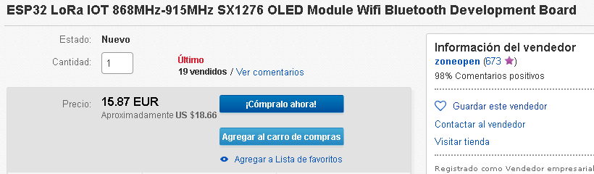
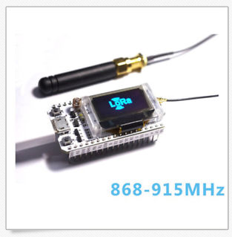
LoRa example
Source: ebay.com

Slide 12


Send and Receive Data
The devices can talk!

Slide 13


Example
Monday 8AM meeting @Office

Slide 14

Monday
Morning
  Wake up on time
  Automatically make coffee
Make Coffee

Slide 15

Monday
Traffic report
Estimated morning commute delay 30min

Slide 16
Monday
Traffic report
  Estimated morning commute delay 30min
Adjust alarm -30min
Make Coffee

Slide 17
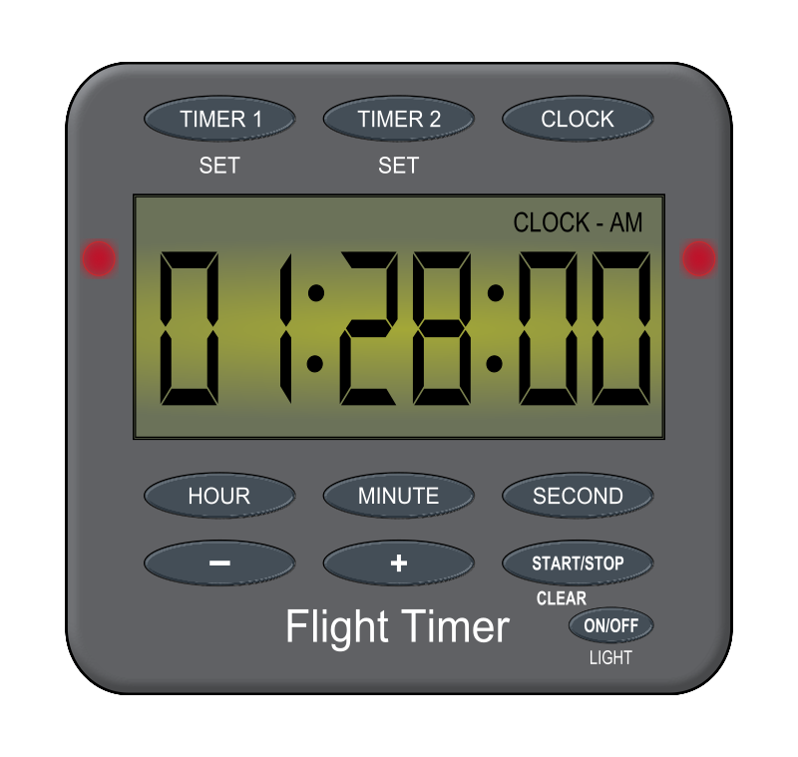


Traditionally
Person set water by timer

Slide 18
Traditionally
Person set water by timer
Is really needed?
Was the plant dry?
Did it rained?
Will there be rain latter today?
Feedback, was it activated?

Slide 19






More integrated with internet

Slide 20
“Iot” like solution
Sensors provide information
  Light
  Temperature
  Water
  Soil moisture
  Weather forecast
  Is water available
User feedback

Slide 21
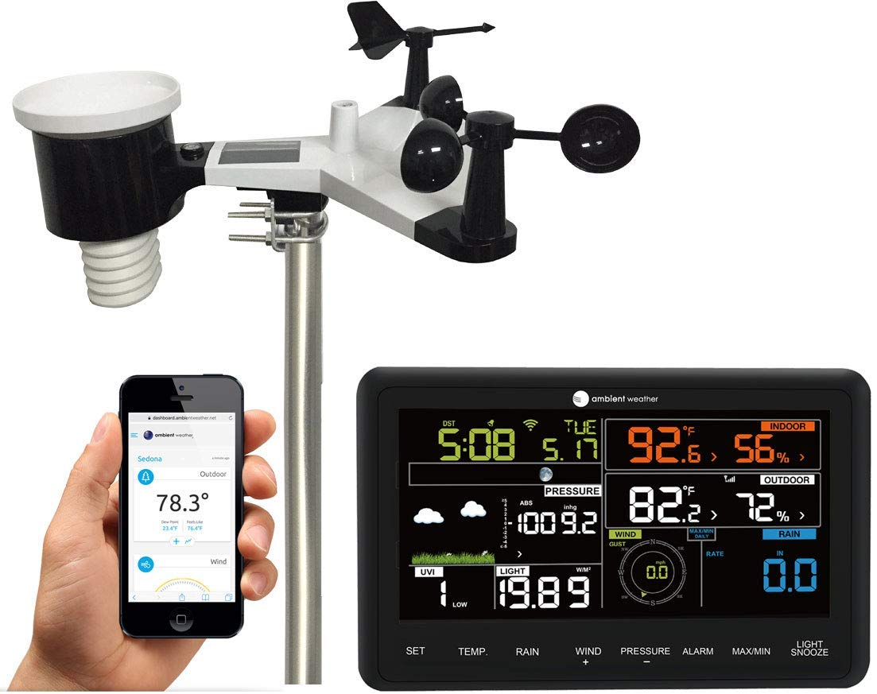
Example: Weather station
Sensor
  Wind speed
  Wind direction
  Rain
  Temperature
  Humidity
  Barometer
Connectivity
  Wifi
Interaction
  App
  Display
Source: Amazon.com
https://www.amazon.com/Ambient-Weather-Professional-Monitoring-Compatible/dp/B01N5TEHLI/ref=sr_1_3?ie=UTF8&qid=1535421699&sr=8-3&keywords=weather+station

Slide 22
Iot Background
Why is so popular?
Notes:
Discuss money projections
Provide Studies with current market impact
Establish it is a growing business worldwide.

Slide 23
Industry Insights
The global Internet of Things (IoT) market size was valued at USD 605.69 billion in 2014. Technological proliferation and increasing investments are expected to drive the global market over the next seven years. Significant advances in telecommunication and growing penetration of internet and broadband services have further propelled the growth of Internet of Things (IoT) industry.
Source: https://www.grandviewresearch.com/industry-analysis/iot-market

Slide 24
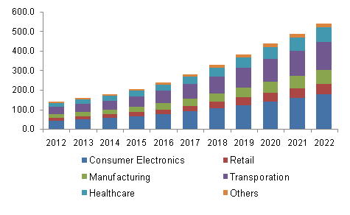
North America IoT market revenue by application, 2012 - 2022 (USD Billion)
Source: https://www.grandviewresearch.com/industry-analysis/iot-market

Slide 25
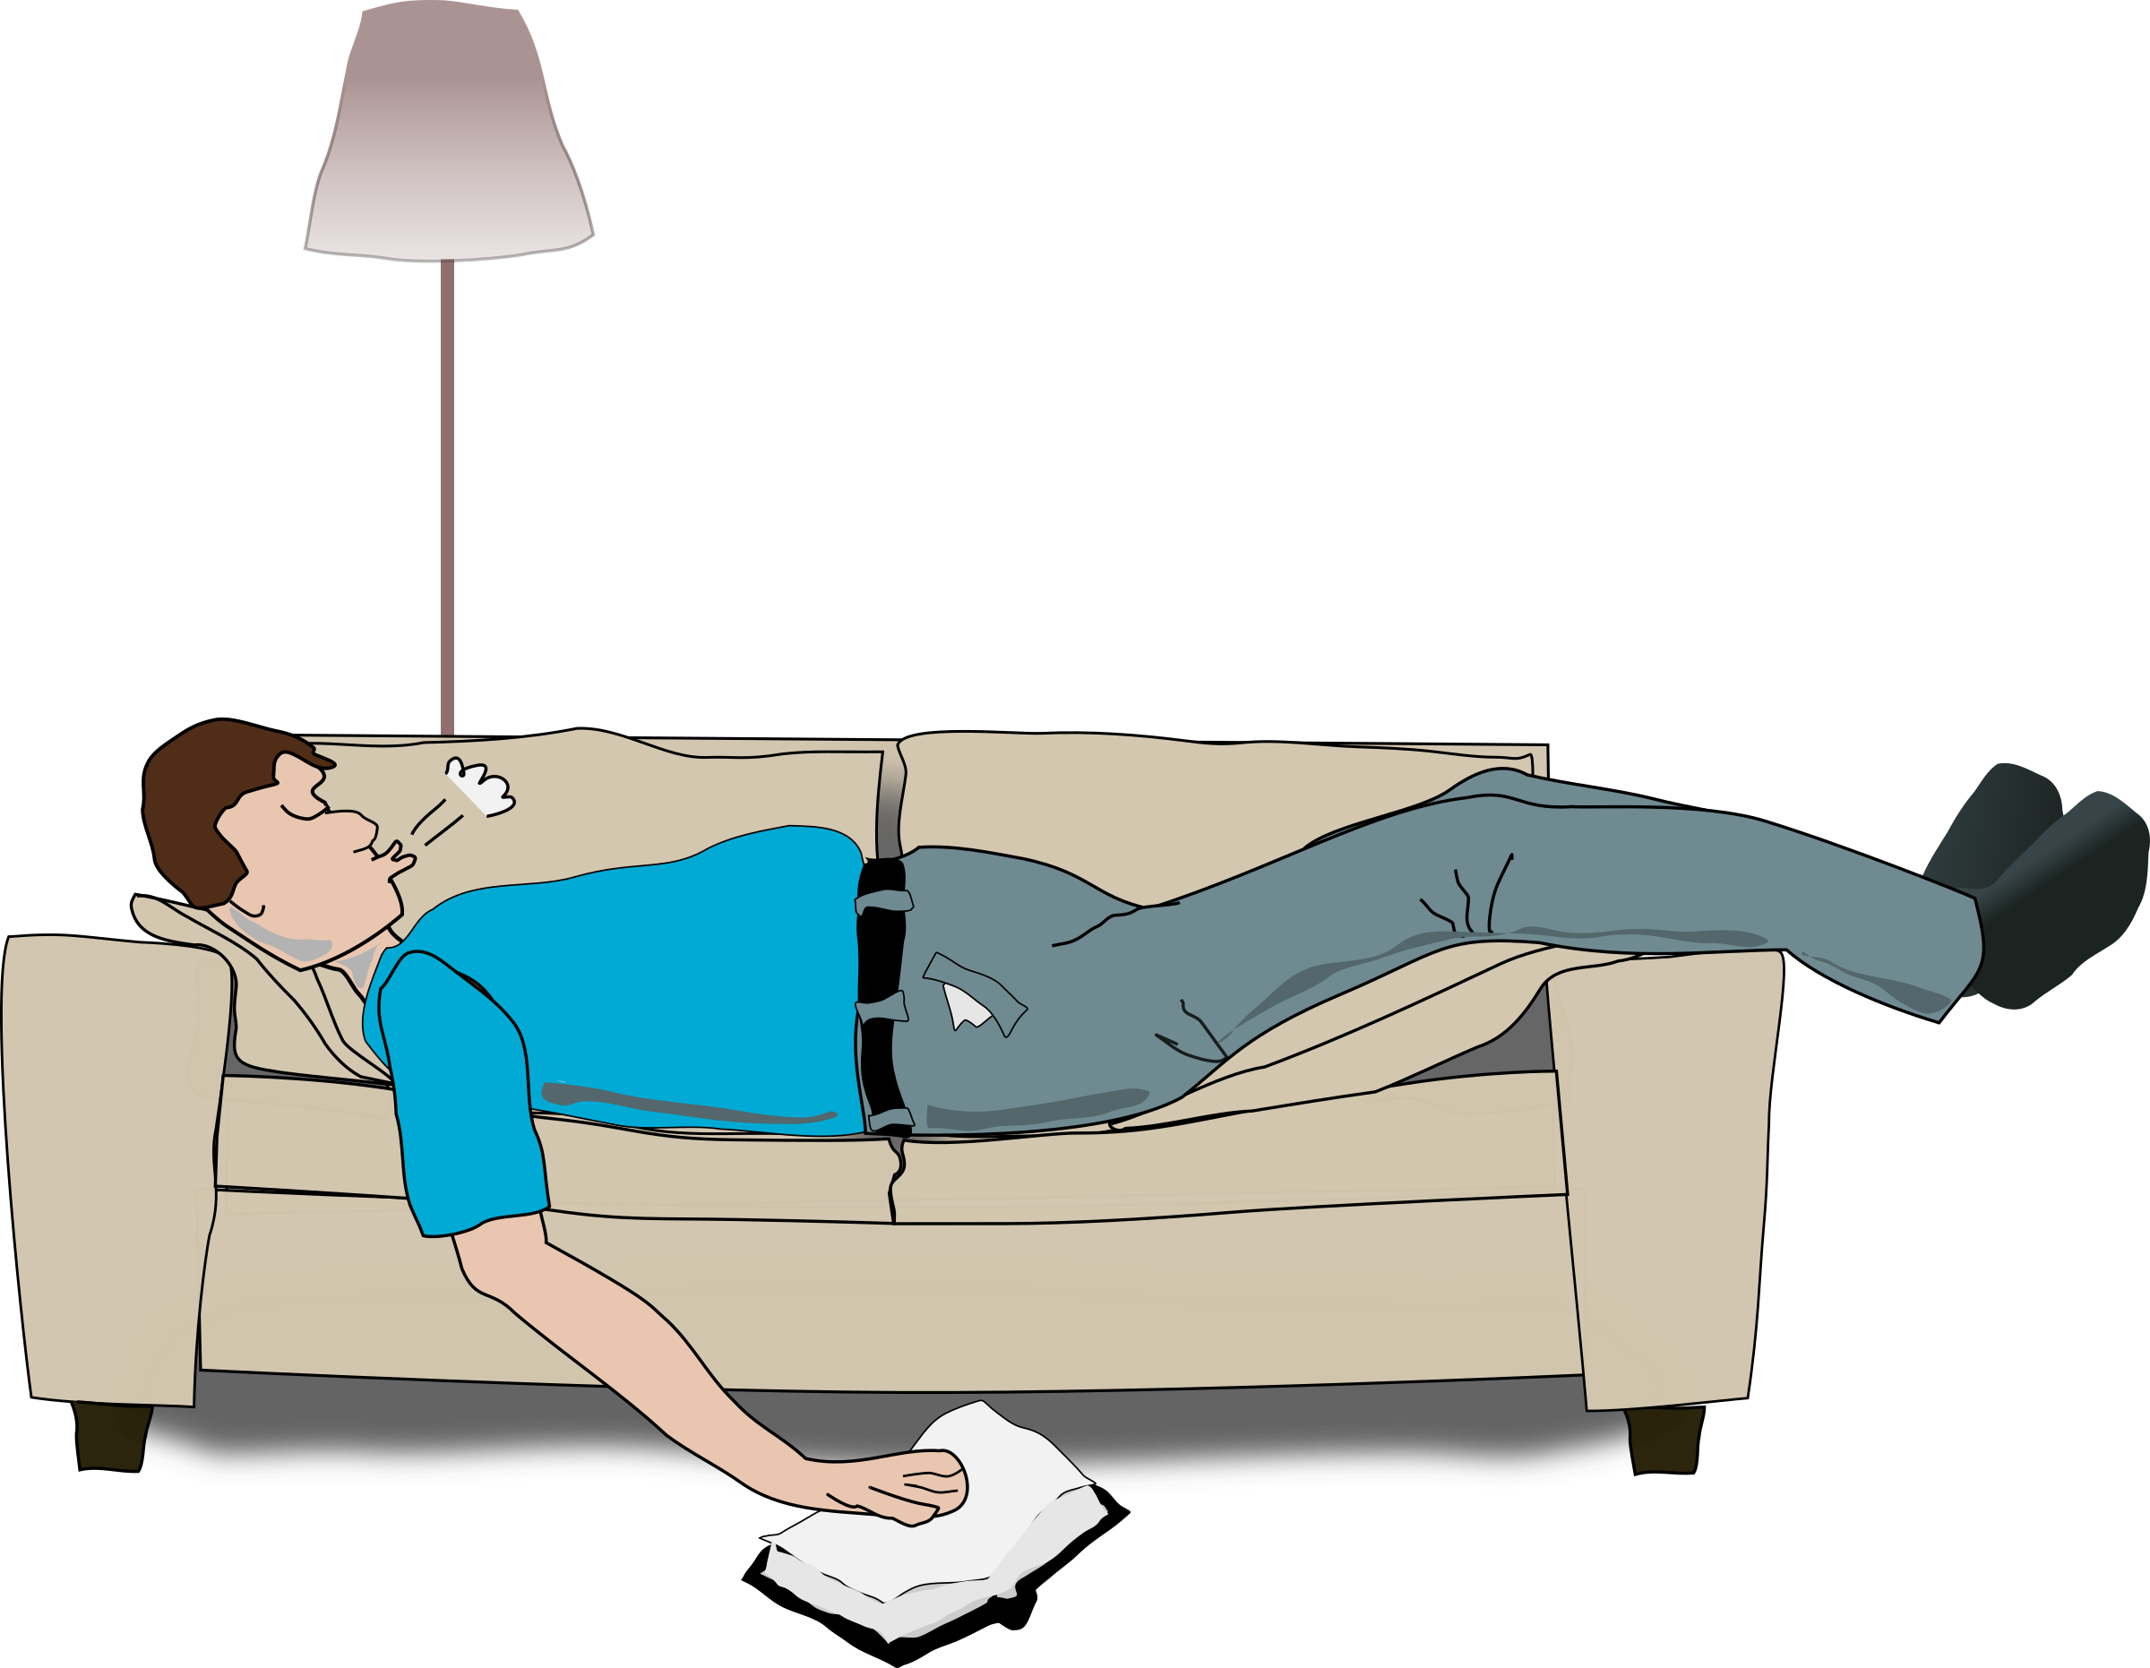



Health

Slide 26
Health
Heart attack
Call ambulance before it happens
Patient with doctor while the attack

Slide 27
How to Connect things?

Slide 28
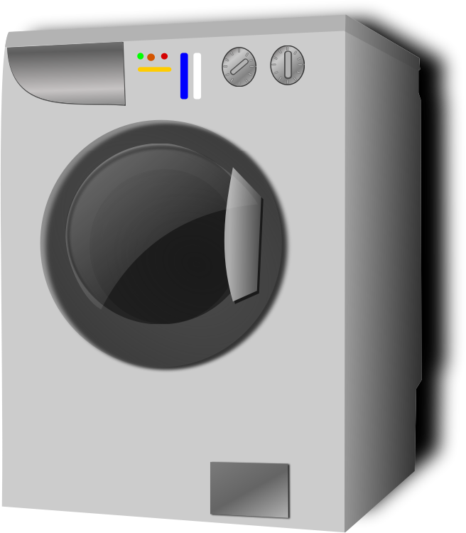
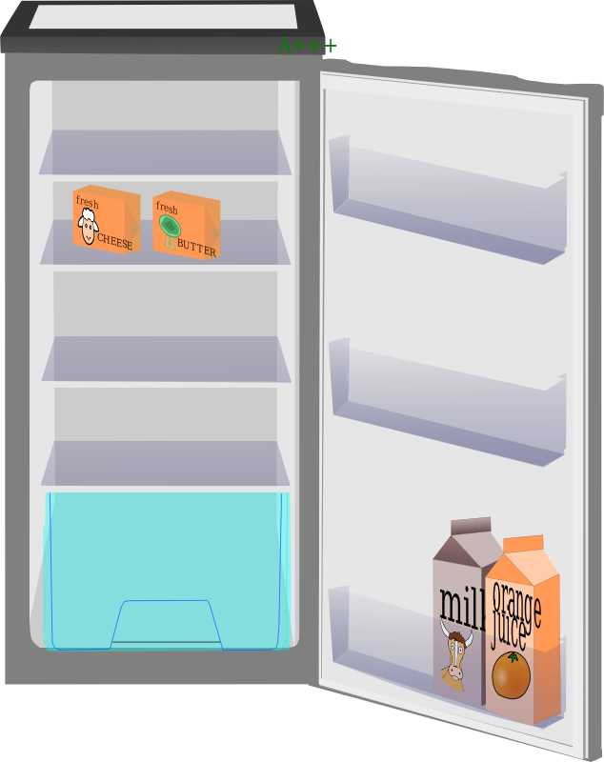
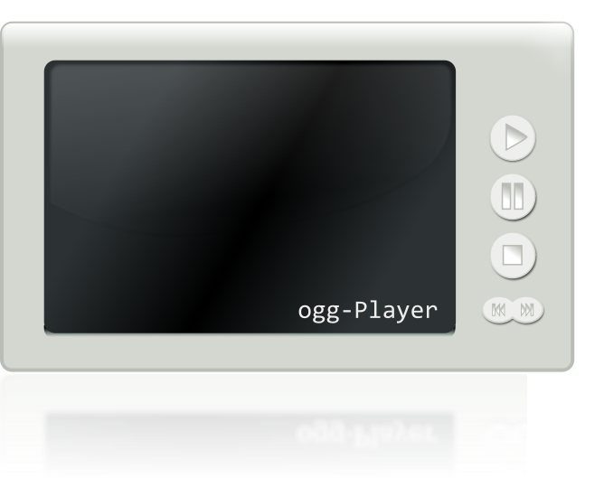
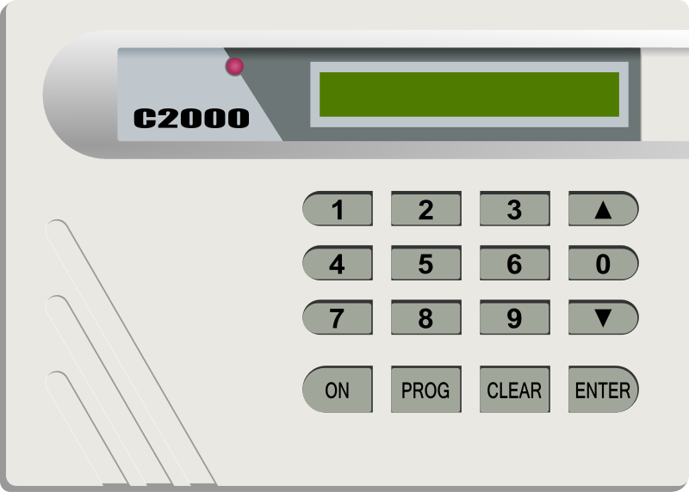
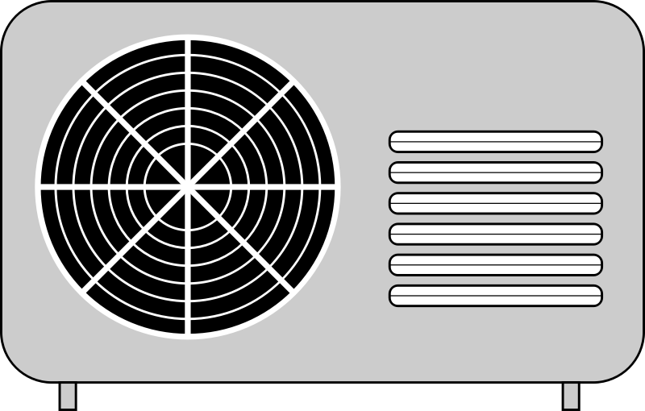
Machine to machine
Protocols
Data access
Compatibility
Brands
Device type
Security
Open or proprietary
Bandwidth

Slide 29
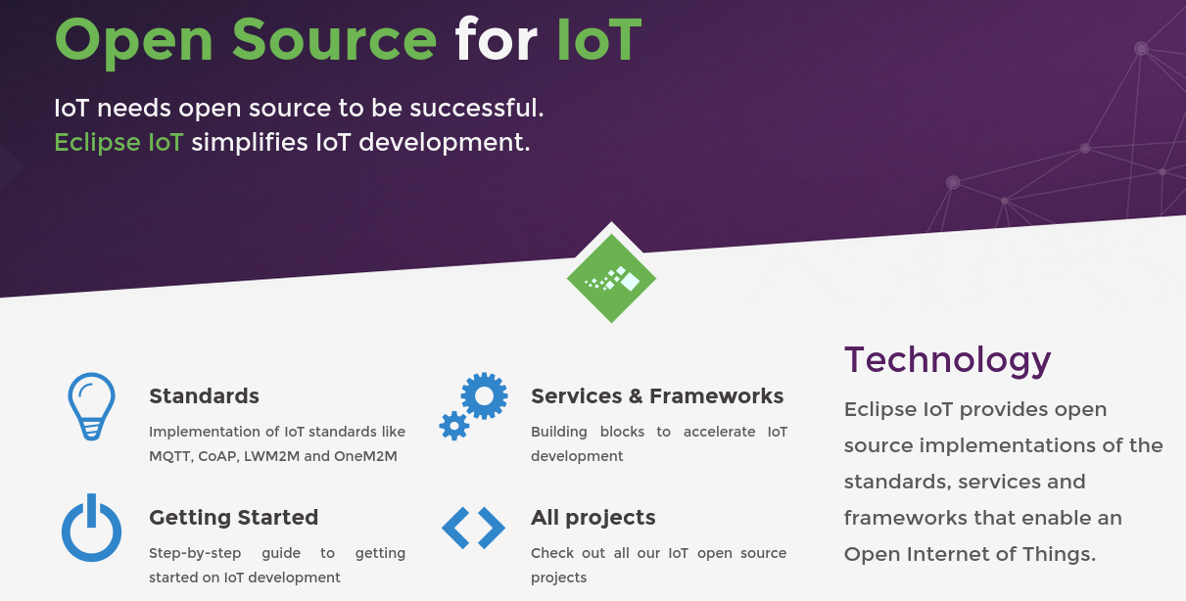
Eclipse http://iot.eclipse.org/

Slide 30
Standards
OMA LightweightM2M
LightweightM2M is principly a device management protocol, but it should be designed to be able to extend to meet the requirements of applications. LightweightM2M is not restricted to device management, it should be able transfer service / application data.
OMA LightweightM2M (LWM2M) is an industry standard for device management of M2M/IoT devices. It heavily relies on CoAP and therefore is optimized for communications over sensor or cellular networks.
OMA LWM2M provides an extensible object model that allows to enable application data exchanges in addition to the core device management features (firmware upgrade, connectivity monitoring, …)

Slide 31
Standards
CoAP
  CoAP (Constrained Application Protocol) is a protocol specialized for use with constrained nodes and networks.
  It implements the REST architectural style, it can be transparently mapped to HTTP. However, CoAP also provides features that go beyond HTTP such as native push notifications and group communication.

Slide 32
Standards
Message Queuing Telemetry Transport (MQTT)
  Protocol designed to connect the physical world devices and networks, with applications and middleware used in IT and Web development.
  Lightweight
  Publish/Subscribe
  Wired/Wireless
  Protocol used by Facebook chat!

Slide 33
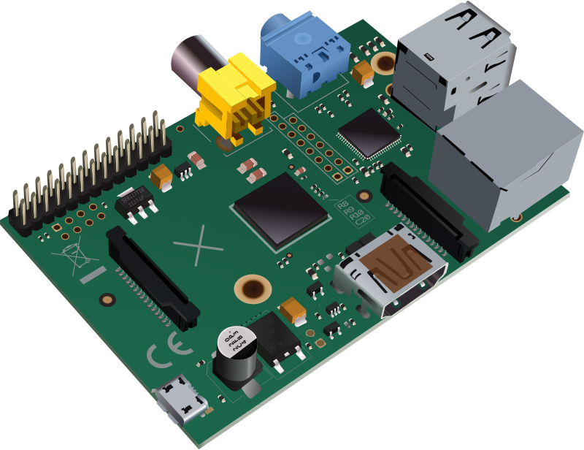
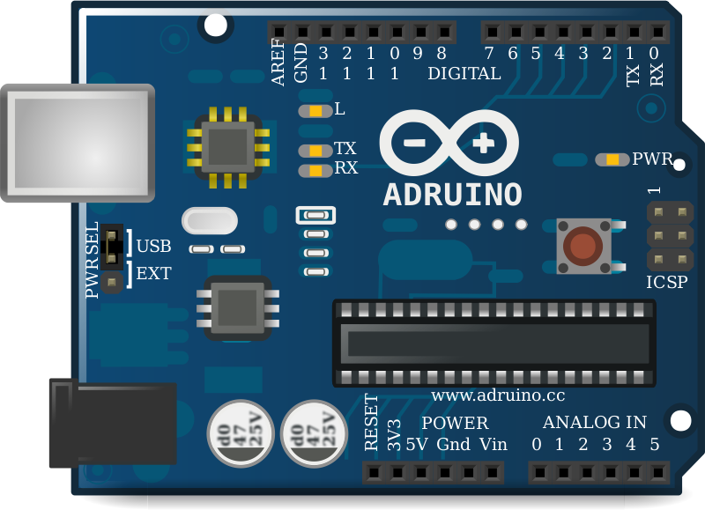
Common hardware
Arduino
Raspberry Pi

Slide 34


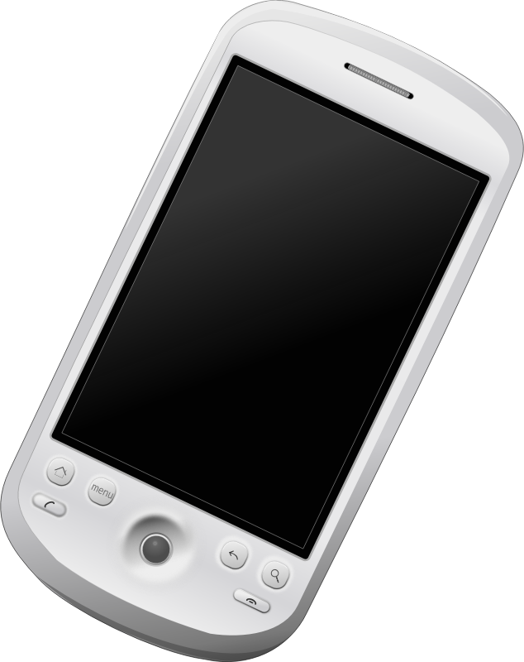
MQTT Implementation
MQTT Server
Publisher
Subscriber

Slide 35
Create Mqtt Server
Mosquitto Server
  Open source
  Can be installed locally
Use a public server
  Adafruit IO

Slide 36
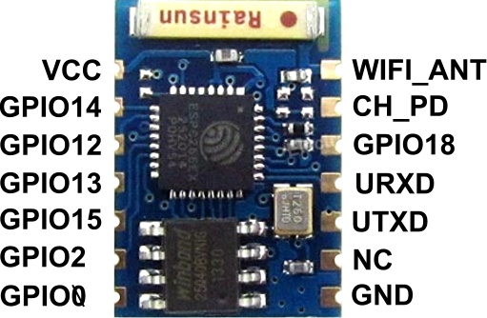
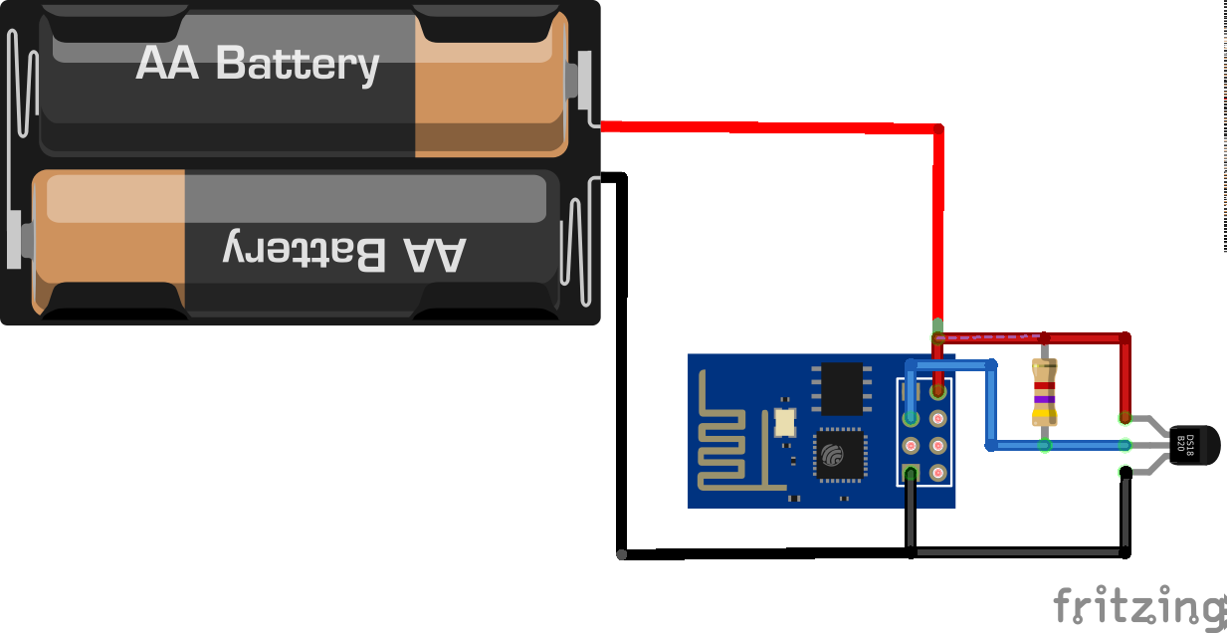
How to get started
Wifi is cheap
Multiple options
ESP8266 < $5

Slide 37
Workshop Goals
Understand simple client/server architecture
Know board ESP8266
  Variants
Install Arduino
Compile project
Connect Wifi
Publish/Subscribe for Mqtt

Slide 38
Register/Create account
https://io.adafruit.com
  Create account

Slide 40
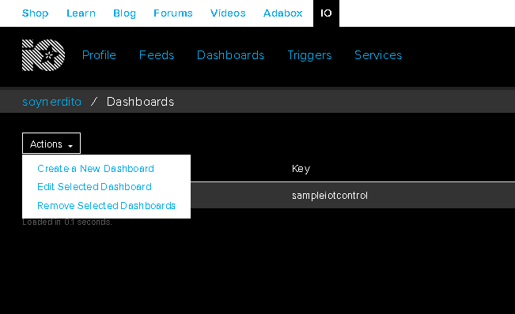
Create a Dashboard

Slide 41
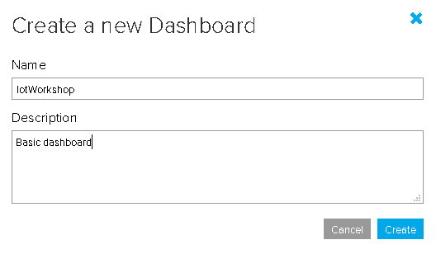
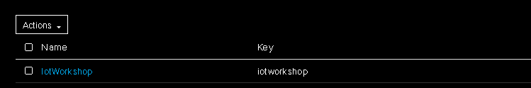
Follow the steps

Slide 42
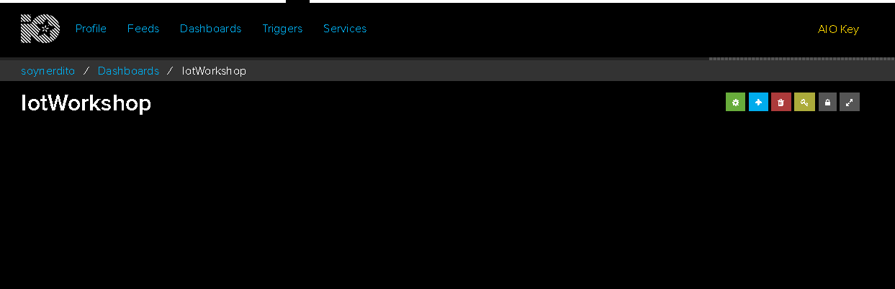
Configure
Create a Feed to connect devices

Slide 43
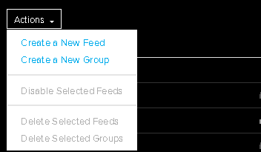
New Feed
A feed is used to represent a value

Slide 44
Mqtt Qos
What is Quality of Service?
The Quality of Service (QoS) level is an agreement between the sender of a message and the receiver of a message that defines the guarantee of delivery for a specific message. There are 3 QoS levels in MQTT:
  At most once (0)
  At least once (1)
  Exactly once (2).
When you talk about QoS in MQTT, you need to consider the two sides of message delivery:
  Message delivery form the publishing client to the broker.
  Message delivery from the broker to the subscribing client.
https://www.hivemq.com/blog/mqtt-essentials-part-6-mqtt-quality-of-service-levels/

Slide 45

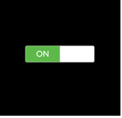
Add controls to Dashboard
Receive control
Publish control

Slide 46
Internet Users by Country
In 2014, nearly 75% (2.1 billion) of all internet users in the world (2.8 billion) live in the top 20 countries.
The remaining 25% (0.7 billion) is distributed among the other 178 countries, each representing less than 1% of total users.

Slide 47
Live demos
Build demo
Making it blink
Notes:
Build a hardware prototype and link it to a network and interact somehow with it.

Slide 48
Wemos D1 mini
ESP8266
Programming with arduino
Led Connected to pin D0

Slide 49
Dotnet new console
using System;
using System.Text;
using System.Threading;
using MQTTnet;
using MQTTnet.Client;
using MQTTnet.Implementations;
namespace mqttConsole
{
class Program
{
static async System.Threading.Tasks.Task Main(string[] args)
{
Console.WriteLine("Hello World!");
// Use TCP connection.
var options = new MqttClientOptionsBuilder()
//.WithTcpServer("broker.hivemq.com", 1883) // Port is optional
//.WithTcpServer("iot.eclipse.org", 1883) // Port is optional
.WithTcpServer("test.mosquitto.org", 1883) // Port is optional
.Build();
// Create a new MQTT client.
var factory = new MqttFactory();
var mqttClient = factory.CreateMqttClient();
mqttClient.ApplicationMessageReceived += (s, e) =>
{
Console.WriteLine("### RECEIVED APPLICATION MESSAGE ###");
Console.WriteLine($"+ Topic = {e.ApplicationMessage.Topic}");
Console.WriteLine($"+ Payload = {Encoding.UTF8.GetString(e.ApplicationMessage.Payload)}");
Console.WriteLine($"+ QoS = {e.ApplicationMessage.QualityOfServiceLevel}");
Console.WriteLine($"+ Retain = {e.ApplicationMessage.Retain}");
Console.WriteLine();
};
mqttClient.Connected += async (s, e) =>
{
Console.WriteLine("### CONNECTED WITH SERVER ###");
// Subscribe to a topic
await mqttClient.SubscribeAsync(new TopicFilterBuilder().WithTopic("outTopic").Build());
Console.WriteLine("### SUBSCRIBED ###");
};
await mqttClient.ConnectAsync(options);
string inputLine = "";
do
{
inputLine = Console.ReadLine();
if (inputLine?.Length > 0)
{
await mqttClient.PublishAsync(
new MqttApplicationMessageBuilder()
.WithTopic("inTopic")
.WithPayload(inputLine)
.Build() );
}
}
while (inputLine?.Length > 0);
}
}
}

Slide 50
Project file
<Project Sdk="Microsoft.NET.Sdk">
<PropertyGroup>
<LangVersion>latest</LangVersion>
<OutputType>Exe</OutputType>
<TargetFramework>netcoreapp2.1</TargetFramework>
</PropertyGroup>
<ItemGroup>
<PackageReference Include="MQTTnet" Version="2.8.4"/>
</ItemGroup>
</Project>

Slide 51
Arduino example
/*
Basic ESP8266 MQTT example
This sketch demonstrates the capabilities of the pubsub library in combination
with the ESP8266 board/library.
It connects to an MQTT server then:
- publishes "hello world" to the topic "outTopic" every two seconds
- subscribes to the topic "inTopic", printing out any messages
it receives. NB - it assumes the received payloads are strings not binary
- If the first character of the topic "inTopic" is an 1, switch ON the ESP Led,
else switch it off
It will reconnect to the server if the connection is lost using a blocking
reconnect function. See the 'mqtt_reconnect_nonblocking' example for how to
achieve the same result without blocking the main loop.
To install the ESP8266 board, (using Arduino 1.6.4+):
- Add the following 3rd party board manager under "File -> Preferences -> Additional Boards Manager URLs":
http://arduino.esp8266.com/stable/package_esp8266com_index.json
- Open the "Tools -> Board -> Board Manager" and click install for the ESP8266"
- Select your ESP8266 in "Tools -> Board"
*/
#include <ESP8266WiFi.h>
#include <PubSubClient.h>
// Update these with values suitable for your network.
const char* ssid = "....";
const char* password = "....";
const char* mqtt_server = "test.mosquitto.org";
WiFiClient espClient;
PubSubClient client(espClient);
long lastMsg = 0;
char msg[50];
int value = 0;
void setup() {
pinMode(BUILTIN_LED, OUTPUT); // Initialize the BUILTIN_LED pin as an output.
pinMode(D0, OUTPUT);
Serial.begin(115200);
setup_wifi();
client.setServer(mqtt_server, 1883);
client.setCallback(callback);
}
void setup_wifi() {
delay(10);
// We start by connecting to a WiFi network
Serial.println();
Serial.print("Connecting to ");
Serial.println(ssid);
WiFi.begin(ssid, password);
while (WiFi.status() != WL_CONNECTED) {
delay(500);
Serial.print(".");
}
Serial.println("");
Serial.println("WiFi connected");
Serial.println("IP address: ");
Serial.println(WiFi.localIP());
}
void callback(char* topic, byte* payload, unsigned int length) {
Serial.print("Message arrived [");
Serial.print(topic);
Serial.print("] ");
for (int i = 0; i < length; i++) {
Serial.print((char)payload[i]);
}
Serial.println();
// Switch on the LED if an 1 was received as first character
if ((char)payload[0] == '1') {
client.publish("outTopic", "Appagando");
digitalWrite(D0, LOW); // Turn the LED on (Note that LOW is the voltage level
// but actually the LED is on; this is because
// it is acive low on the ESP-01)
} else {
digitalWrite(D0, HIGH); // Turn the LED off by making the voltage HIGH
client.publish("outTopic", "Prendiendo");
}
}
void reconnect() {
// Loop until we're reconnected
while (!client.connected()) {
Serial.print("Attempting MQTT connection...");
// Attempt to connect
if (client.connect("ESP8266Client")) {
Serial.println("connected");
// Once connected, publish an announcement...
//client.publish("outTopic", "hello world");
// ... and resubscribe
client.subscribe("inTopic");
} else {
Serial.print("failed, rc=");
Serial.print(client.state());
Serial.println(" try again in 5 seconds");
// Wait 5 seconds before retrying
delay(5000);
}
}
}
void loop() {
if (!client.connected()) {
reconnect();
}
client.loop();
long now = millis();
if (now - lastMsg > 2000) {
lastMsg = now;
++value;
//snprintf (msg, 75, "hello world #%ld", value);
// Serial.print("Publish message: ");
//Serial.println(msg);
//client.publish("outTopic", msg);
}
}

Slide 52
Arduino source wifiManager
#include <ESP8266WiFi.h> //https://github.com/esp8266/Arduino
//needed for library
#include <DNSServer.h>
#include <ESP8266WebServer.h>
#include <WiFiManager.h> //https://github.com/tzapu/WiFiManager
#include <ESP8266WiFi.h>
#include <PubSubClient.h>
//Mqtt stuff
WiFiClient espClient;
PubSubClient client(espClient);
long lastMsg = 0;
char msg[50];
int value = 0;
const char* mqtt_server = "test.mosquitto.org";
//for LED status
#include <Ticker.h>
Ticker ticker;
void tick()
{
//toggle state
int state = digitalRead(BUILTIN_LED); // get the current state of GPIO1 pin
digitalWrite(BUILTIN_LED, !state); // set pin to the opposite state
}
//gets called when WiFiManager enters configuration mode
void configModeCallback (WiFiManager *myWiFiManager) {
Serial.println("Entered config mode");
Serial.println(WiFi.softAPIP());
//if you used auto generated SSID, print it
Serial.println(myWiFiManager->getConfigPortalSSID());
//entered config mode, make led toggle faster
ticker.attach(0.2, tick);
}
void setup() {
// put your setup code here, to run once:
Serial.begin(115200);
//For mqtt stuff
pinMode(D0, OUTPUT);
//set led pin as output
pinMode(BUILTIN_LED, OUTPUT);
// start ticker with 0.5 because we start in AP mode and try to connect
ticker.attach(0.6, tick);
//WiFiManager
//Local intialization. Once its business is done, there is no need to keep it around
WiFiManager wifiManager;
//reset settings - for testing
//wifiManager.resetSettings();
//set callback that gets called when connecting to previous WiFi fails, and enters Access Point mode
wifiManager.setAPCallback(configModeCallback);
//fetches ssid and pass and tries to connect
//if it does not connect it starts an access point with the specified name
//here "AutoConnectAP"
//and goes into a blocking loop awaiting configuration
if (!wifiManager.autoConnect()) {
Serial.println("failed to connect and hit timeout");
//reset and try again, or maybe put it to deep sleep
ESP.reset();
delay(1000);
}
//if you get here you have connected to the WiFi
Serial.println("connected...yeey :)");
ticker.detach();
//keep LED on
digitalWrite(BUILTIN_LED, LOW);
client.setServer(mqtt_server, 1883);
client.setCallback(callback);
}
void callback(char* topic, byte* payload, unsigned int length) {
Serial.print("Message arrived [");
Serial.print(topic);
Serial.print("] ");
for (int i = 0; i < length; i++) {
Serial.print((char)payload[i]);
}
Serial.println();
// Switch on the LED if an 1 was received as first character
if ((char)payload[0] == '1') {
client.publish("outTopic", "Appagando");
digitalWrite(D0, LOW); // Turn the LED on (Note that LOW is the voltage level
// but actually the LED is on; this is because
// it is acive low on the ESP-01)
} else {
digitalWrite(D0, HIGH); // Turn the LED off by making the voltage HIGH
client.publish("outTopic", "Prendiendo");
}
}
void reconnect() {
// Loop until we're reconnected
while (!client.connected()) {
Serial.print("Attempting MQTT connection...");
// Attempt to connect
if (client.connect("ESP8266Client")) {
Serial.println("connected");
// Once connected, publish an announcement...
//client.publish("outTopic", "hello world");
// ... and resubscribe
client.subscribe("inTopic");
} else {
Serial.print("failed, rc=");
Serial.print(client.state());
Serial.println(" try again in 5 seconds");
// Wait 5 seconds before retrying
delay(5000);
}
}
}
void loop() {
if (!client.connected()) {
reconnect();
}
client.loop();
long now = millis();
if (now - lastMsg > 2000) {
lastMsg = now;
++value;
//snprintf (msg, 75, "hello world #%ld", value);
// Serial.print("Publish message: ");
//Serial.println(msg);
//client.publish("outTopic", msg);
}
}

