Slide 1
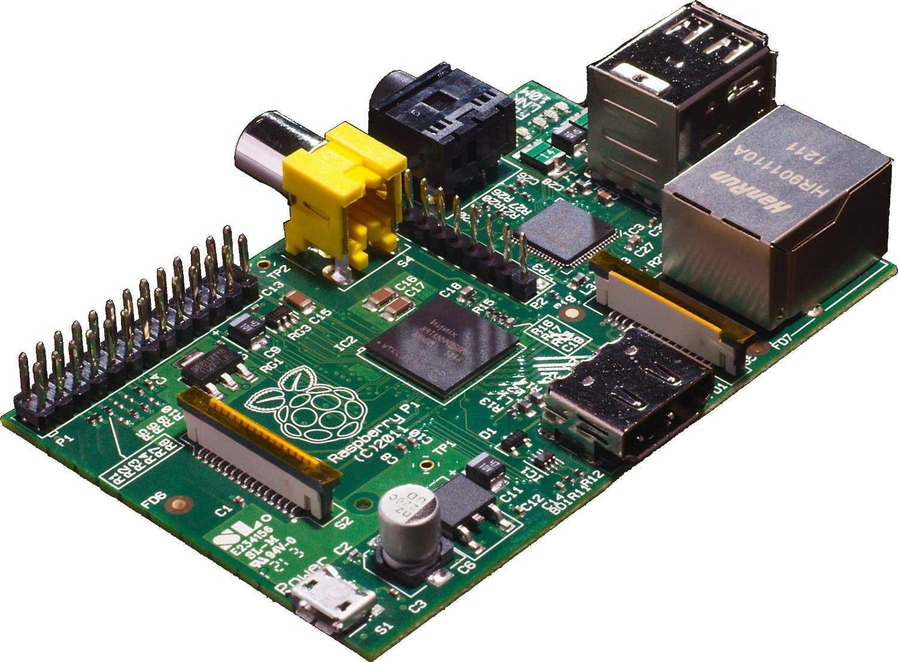


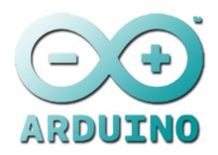
Raspberry Pi .. and then some
By: soynerdito

Slide 2
Glossary
GPIO: General purpose input/output. A pin that can be programmed to do stuff.
GPU: graphics processing unit. The hardware the handles the graphics.
Distro: a specific package (“flavour”) of Linux and associated software.
BGA: ball grid array. A type of surface mount packaging for electronics.
SoC: system on chip. A computer on a single chip.
Brick: to accidentally render a device inert by making changes to software or firmware.
Pxe: preboot execution environment. A way to get a device to boot by via the network.
PoE: power over ethernet. Powering a device via an ethernet cable.
Source: http://www.raspberrypi.org/help/faqs/

Slide 3

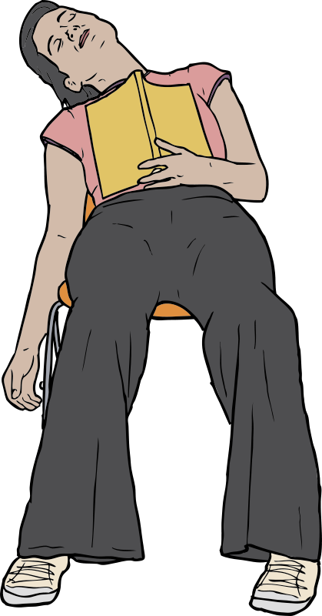
What is the Raspberry Pi?
The Raspberry Pi is a low cost, credit-card sized computer that plugs into a computer monitor or TV, and uses a standard keyboard and mouse. It is a capable little device that enables people of all ages to explore computing, and to learn how to program in languages like Scratch and Python. It’s capable of doing everything you’d expect a desktop computer to do, from browsing the internet and playing high-definition video, to making spreadsheets, word-processing, and playing games.
What’s more, the Raspberry Pi has the ability to interact with the outside world, and has been used in a wide array of digital maker projects, from music machines and parent detectors to weather stations and tweeting birdhouses with infra-red cameras. We want to see the Raspberry Pi being used by kids all over the world to learn to program and understand how computers work.
Source: http://www.raspberrypi.org/help/what-is-a-raspberry-pi/

Slide 4
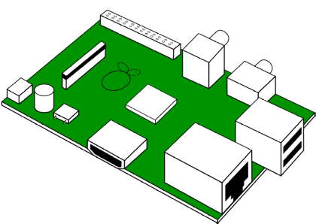
What is the Raspberry Pi?
The Raspberry Pi is a low cost, credit-card sized computer
Capable of everything you’d expect a desktop computer to do.
Plugs into a computer monitor or TV
Uses a standard keyboard and mouse
Raspberry Pi has the ability to interact with the outside world
“We want to see the Raspberry Pi being used by kids all over the world to learn to program and understand how computers work.”
Source: http://www.raspberrypi.org/help/what-is-a-raspberry-pi/

Slide 5
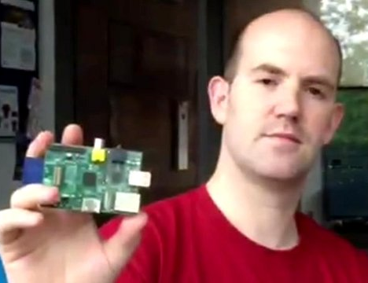
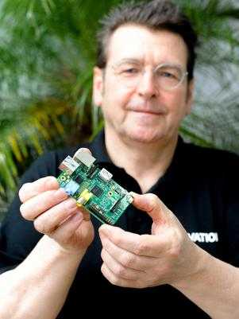
Raspberry Pi Foundation (2009) co-founders among others
Pete Lomas
Eben Upton

Slide 6

Raspberry PI = Arduino ?

Slide 7
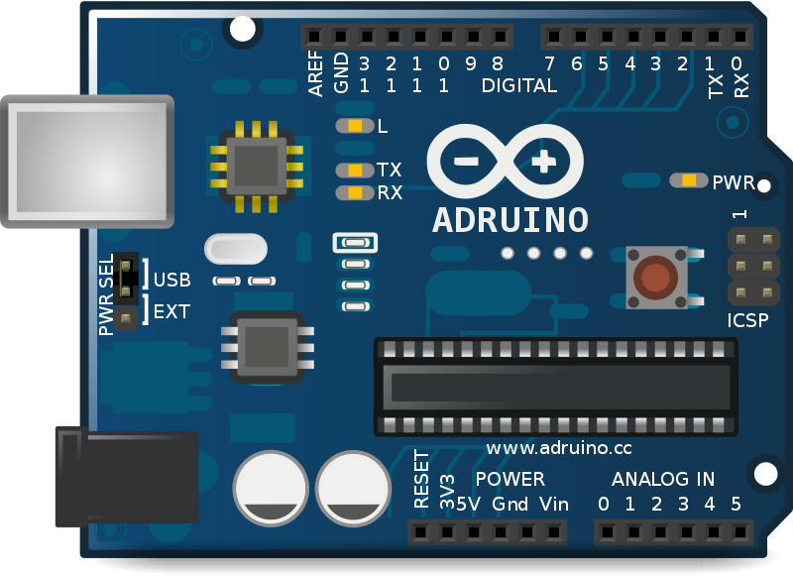
Arduino
Arduino is a single-board microcontroller (wikipedia)
Arduino UNO
Microcontroller
Arduino is more than a board

Slide 8
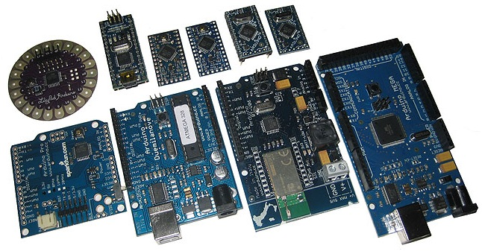
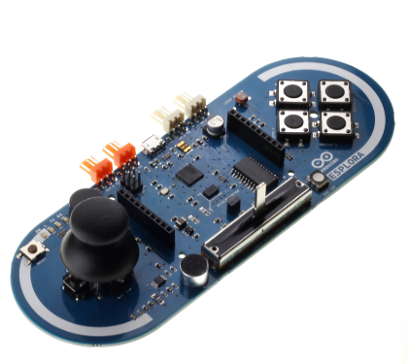
Arduino Family

Slide 9
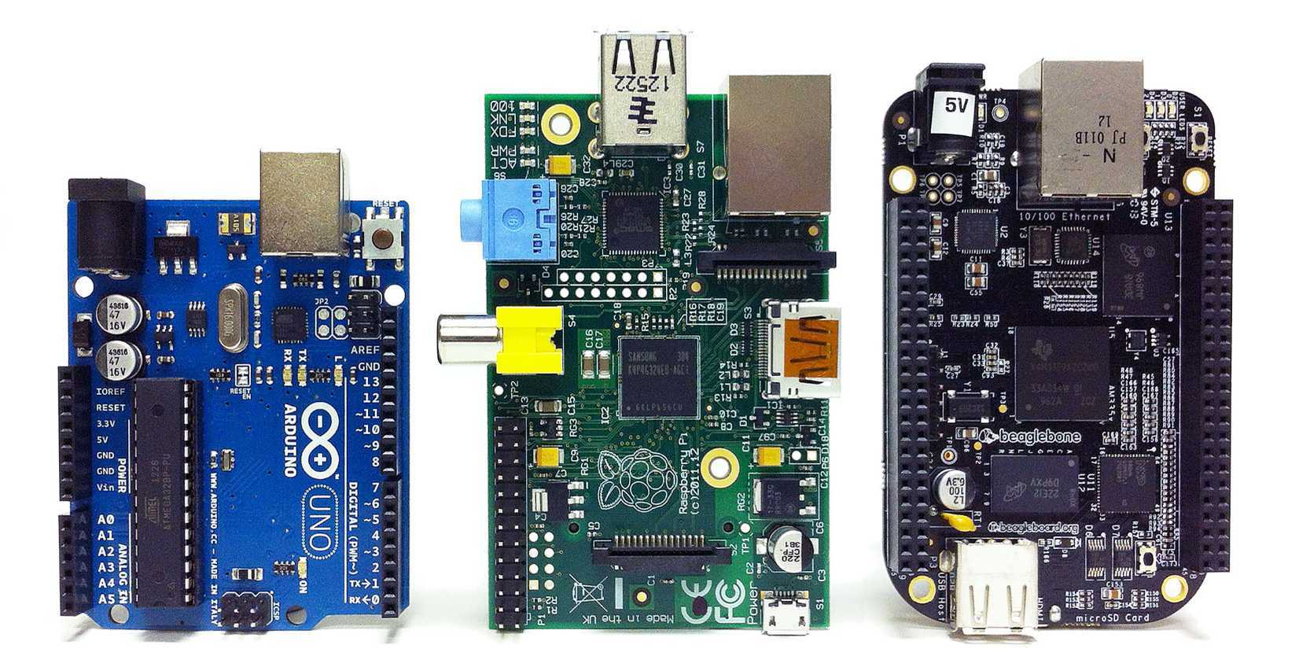


Challengers

Slide 10
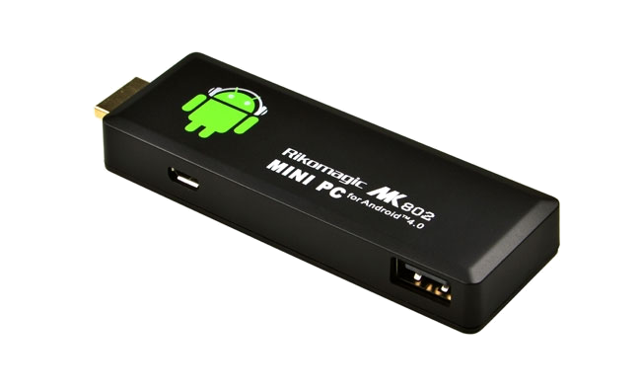
Challengers
Single Board Computers

Slide 11
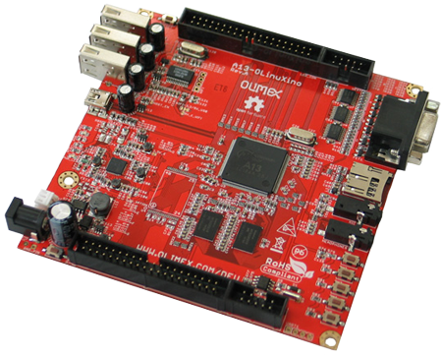
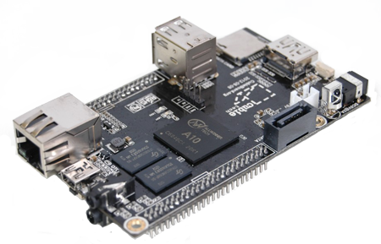
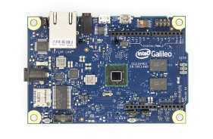
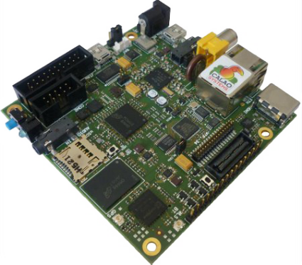
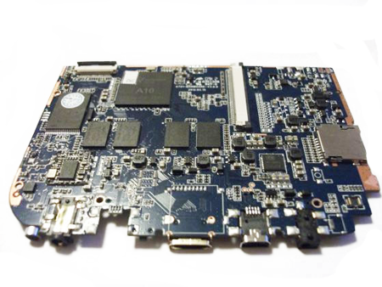
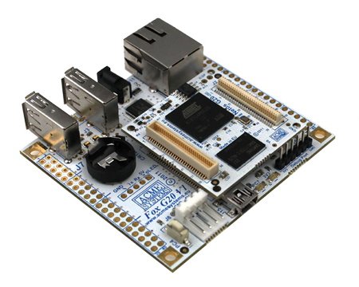
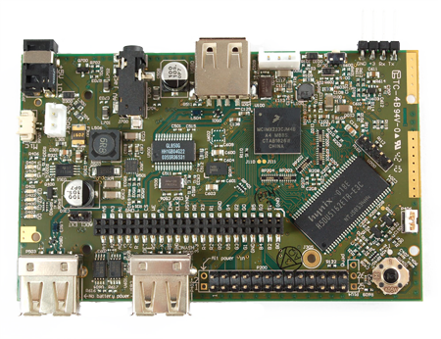
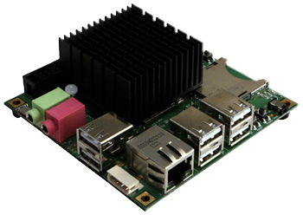
And the list goes on

Slide 12
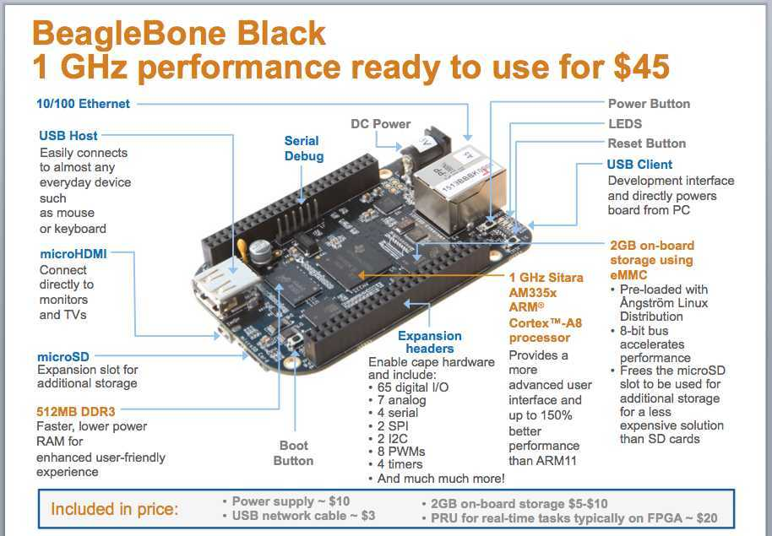

Slide 13
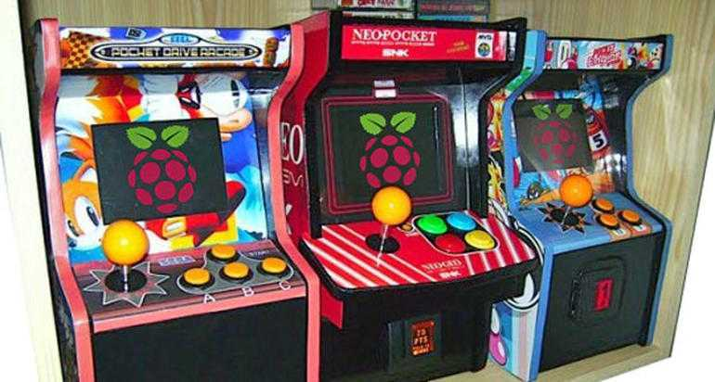


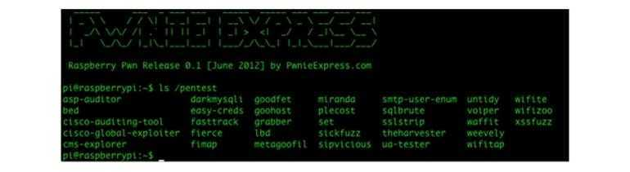

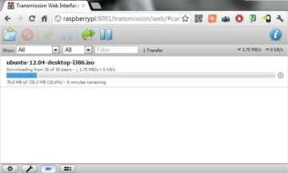
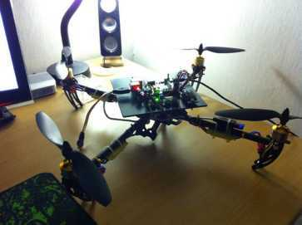
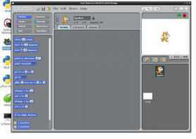
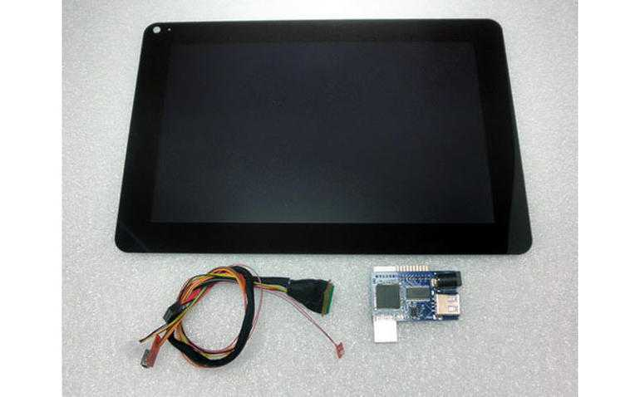
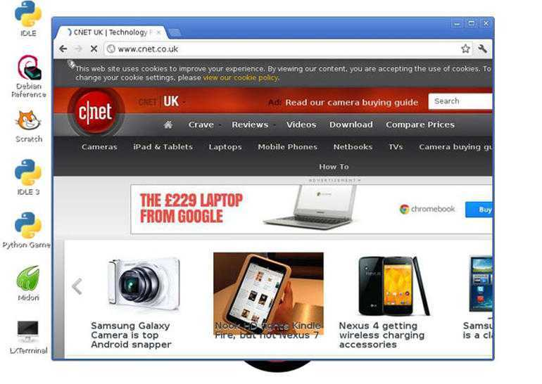
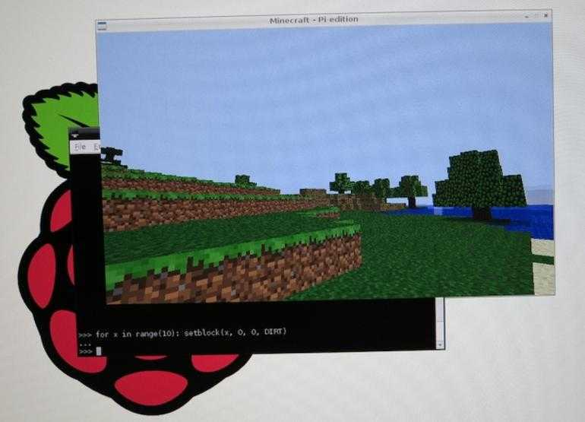
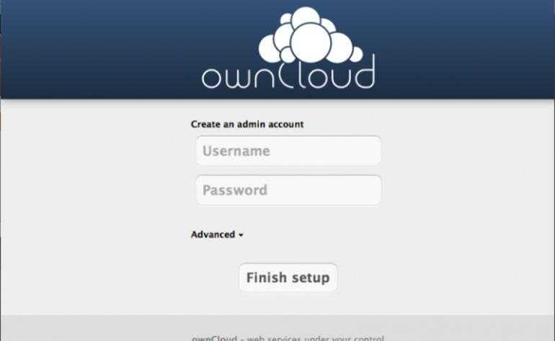
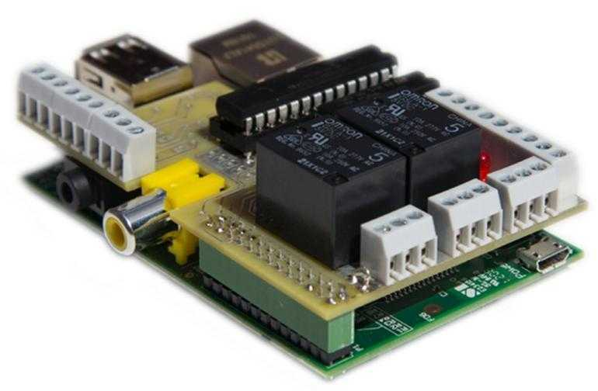

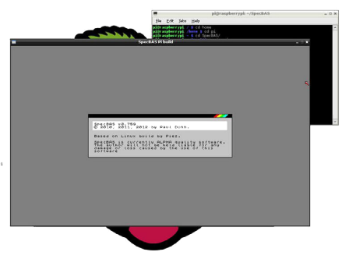
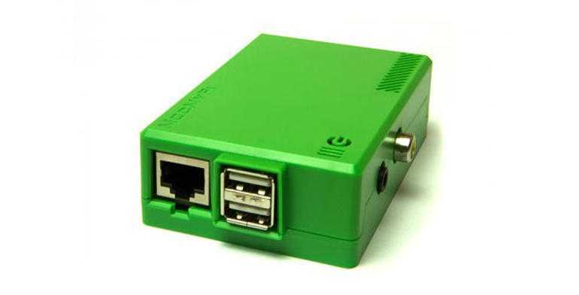

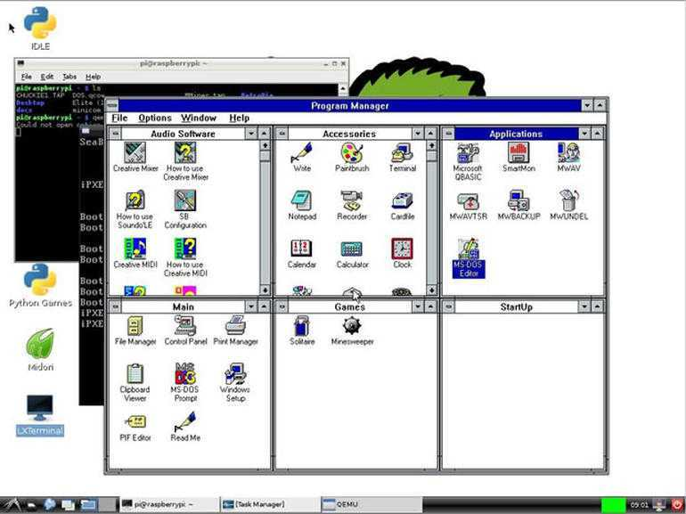
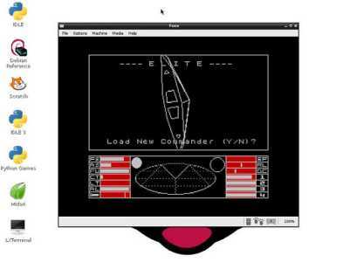

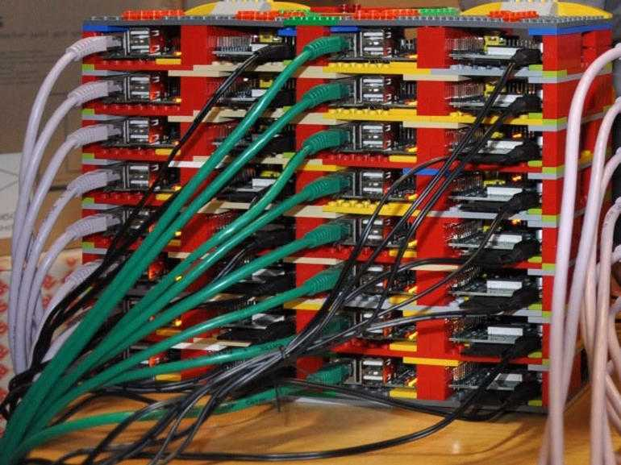

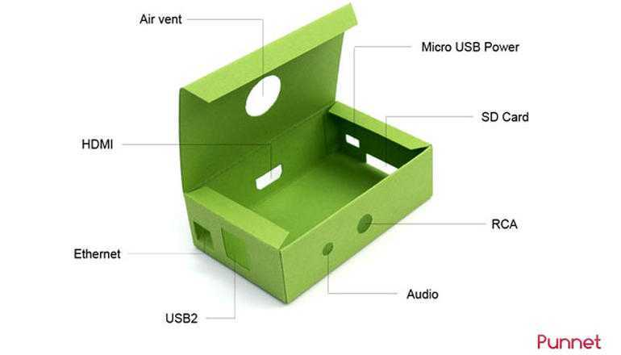
Common projects
http://www.cnet.com/how-to/25-fun-things-to-do-with-a-raspberry-pi/

Slide 14
Robotics
http://www.cnet.com/how-to/25-fun-things-to-do-with-a-raspberry-pi/

Slide 15
Retro Pi
http://www.cnet.com/how-to/25-fun-things-to-do-with-a-raspberry-pi/

Slide 16
10-inch RPi Touchscreen
http://www.cnet.com/how-to/25-fun-things-to-do-with-a-raspberry-pi/

Slide 17
Arcade Pi
http://www.cnet.com/how-to/25-fun-things-to-do-with-a-raspberry-pi/

Slide 18
Beer can keyboard
A keyboard made from beer cans? True enough, the Robofun team hooked up an Arduino board to a Raspberry Pi along with many cans of beer.
http://www.cnet.com/how-to/25-fun-things-to-do-with-a-raspberry-pi/

Slide 19
More Robotics
http://www.cnet.com/how-to/25-fun-things-to-do-with-a-raspberry-pi/

Slide 20
A mini web browser
http://www.cnet.com/how-to/25-fun-things-to-do-with-a-raspberry-pi/

Slide 21
Raspberry Pi Cluster
http://www.cnet.com/how-to/25-fun-things-to-do-with-a-raspberry-pi/

Slide 22
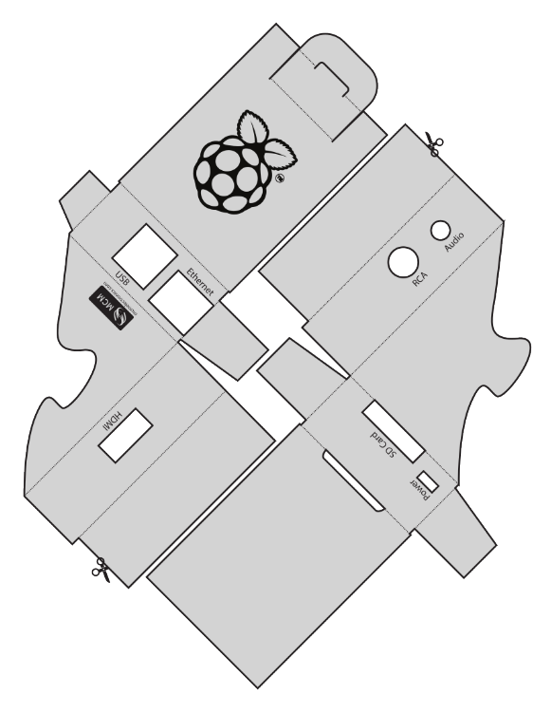
Make your own Pi case
http://www.cnet.com/how-to/25-fun-things-to-do-with-a-raspberry-pi/

Slide 23
Minecraft
http://www.cnet.com/how-to/25-fun-things-to-do-with-a-raspberry-pi/

Slide 24
Mod My Pi
http://www.cnet.com/how-to/25-fun-things-to-do-with-a-raspberry-pi/

Slide 25
Living room PC
http://www.cnet.com/how-to/25-fun-things-to-do-with-a-raspberry-pi/

Slide 26
Home automation
http://www.cnet.com/how-to/25-fun-things-to-do-with-a-raspberry-pi/

Slide 27
Pi Hacker
Being as small as it is, the RPi would make an excellent hacking tool. Regardless of the ethics involved, try out this security penetration testing project.
http://www.cnet.com/how-to/25-fun-things-to-do-with-a-raspberry-pi/

Slide 28
RPi cloud server
http://www.cnet.com/how-to/25-fun-things-to-do-with-a-raspberry-pi/

Slide 29
Windows 3.0 on a Pi
http://www.cnet.com/how-to/25-fun-things-to-do-with-a-raspberry-pi/

Slide 30
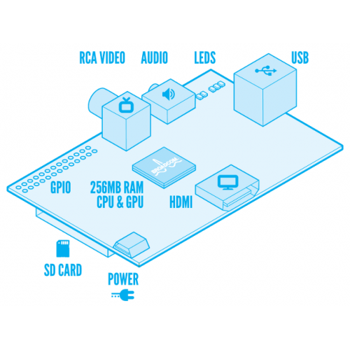
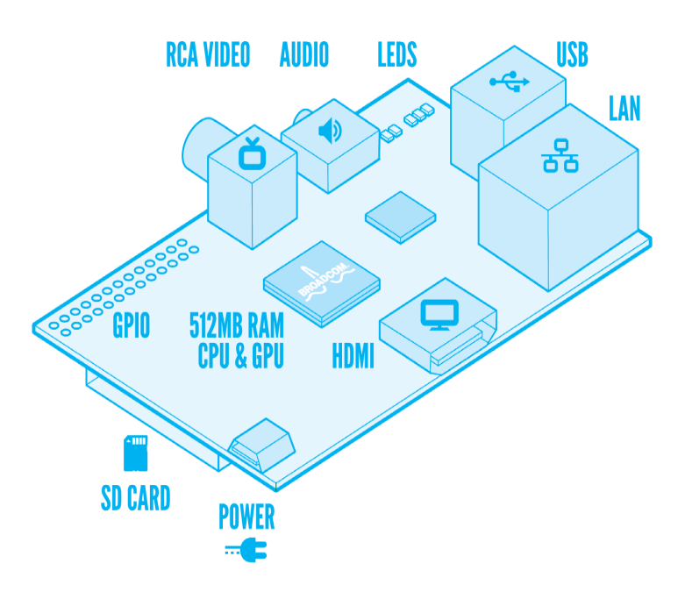

Meet the Enemy
Model A
Model B
1 x USB
256 MB RAM
2x USB
Ethernet
512 MB RAM

Slide 31

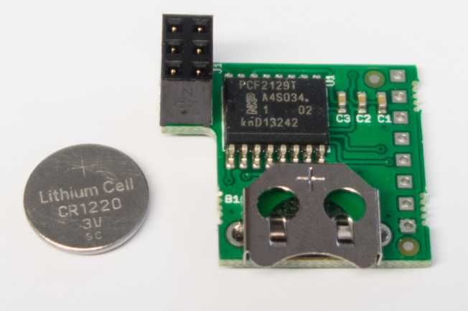
No real time clock?
Raspberry pi has no Real Time Clock
The Pi remember the last time
  fake-hwclock
Unofficial add on
Rasclock – Add on Device

Slide 32

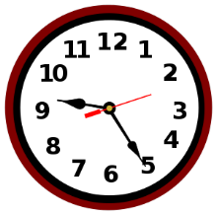


Solution
NTP – Network Time Protocol
Ntpd → NTP Deamon (Service)
/etc/ntpd.conf
server ntp1.npl.co.uk iburst
server 0.dk.pool.ntp.org iburst
server 1.dk.pool.ntp.org iburst
server 2.dk.pool.ntp.org iburst
server 3.dk.pool.ntp.org iburst

Slide 33
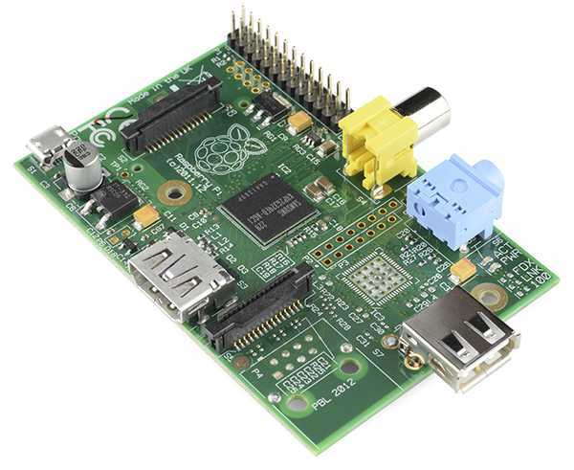
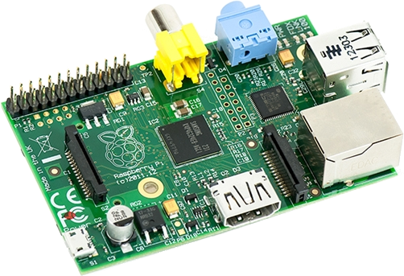
How to identify?
Model B
Model A

Slide 34

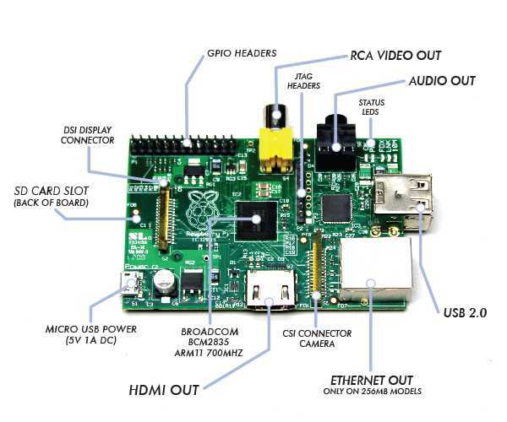
What is what
Only on 512MB Models

Slide 35

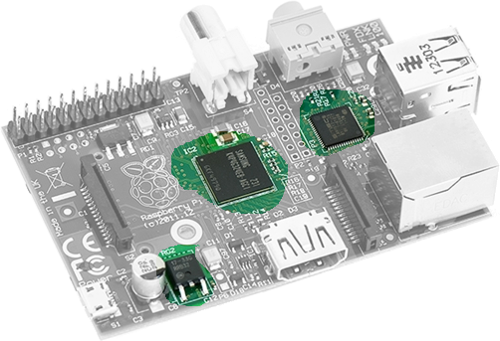
Warm Components
USB host
Ethernet
CPU & GPU
700Mhz
Voltage
Regulator

Slide 36
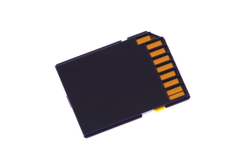
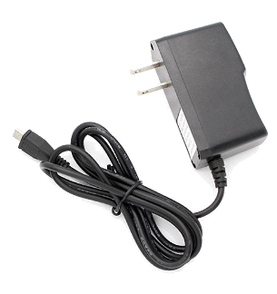
Connecting the PI
Raspberry PI
SDCard Min 4GB
Micro USB Power Supply 5V/1A
Keyboard/Mouse (optional)
USB Wifi (optional)
USB Hub (optional)

Slide 37
Problem with HDMI not visible
/etc/config.conf
Start with uncommenting "hdmi_force_hotplug=1", if that does not work try hdmi_safe=1. Also try to manually set your monitor to HDMI
http://elinux.org/R-Pi_Troubleshooting#No_HDMI_output_at_all

Slide 38

The magic smoke producer
Electronics
Symbol basics
Voltage
Current
Resistance

Slide 39
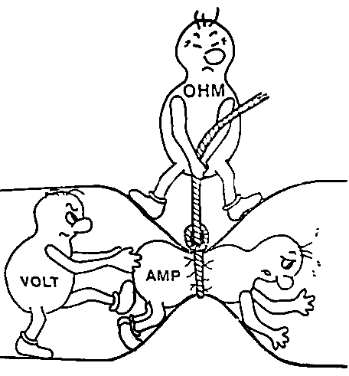
Ohms Law: V = I * R
Voltage = Current x Resistance
I => Current (Amp A)
V => Voltage (Volt V)
R => Resistance (Ohm Ω)

Slide 40
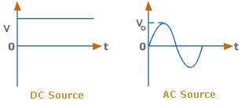
AC DC Voltage

Slide 41
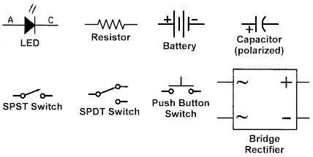
Basic Symbols

Slide 42



Switch
Push button
Toggle Switch

Slide 43

Circuits basic

Slide 44

LED
Light Emitting Diode

Slide 45



Capacitor
Diagram

Slide 46


Resistor

Slide 47



Transistor
Wikipedia says
A transistor is a semiconductor device used to amplify and switch electronic signals and electrical power.
Info: wikipedia pictures: google search

Slide 48
Difference between a Potentiometer and a Rheostat?
The difference between a potentiometer and rheostat is the number of connections, or terminals. A potentiometer has three connections, and rheostat only has two connections. Rheostats are used in such things as light dimmer switches. A potentiometer can be found in a radio volume control knob.
Source: http://www.ask.com/question/difference-between-a-potentiometer-and-a-rheostat

Slide 49


Breadboard
Fast Prototyping circuits
Actual breadboard circuit

Slide 50

Breadboard
Photo
Schematic

Slide 51

Why circuits “burn”?
More current than it can handle
Blah
Blah
Blah
More current than it can handle

Slide 52



Short Circuit?
V = I * R
I = V / R
When R = 0 the value of current is infinite
Infinite Current?!!!!!

Slide 53

NOT a Short Circuit
V = I * R
I = V / R

Slide 54

GPIO

Slide 55
GPIO
Connection of a GPIO to a voltage higher than 3.3V will likely destroy the GPIO block within the SoC
To answer that question I/O ports have two parameters which deal with the output level:
VIL : The maximum low level voltage. (0.8V on the BCM2835)
  0.8V means that if the output is Low it will be <= 0.8V
VIH : The minimum high level voltage. (1.3V on the BCM2835)
  1.3V means that if the output is High it will be >= 1.3V

Slide 56


GPIO

Slide 57
Raspberry Pi Safe Current
What is a safe current?
All the electronics of the pads are designed for 16mA. That is a safe value under which you will not damage the device. Even if you set the drive strength to 2mA and then load it so16mA comes out that will not damage the device. Other than that there is no guaranteed maximum safe current.

Slide 58

Power Pins
The maximum permitted current draw from the 3.3 V pins is 50 mA.
Maximum permitted current draw from the 5 V pin is the USB input current (usually 1 A) minus any current draw from the rest of the board.
Model A: 1000 mA - 500 mA -> max current draw: 500 mA
Model B: 1000 mA - 700 mA -> max current draw: 300 mA
Be very careful with the 5 V pins P1-02 and P1-04, because if you short 5 V to any other P1 pin you may permanently damage your RasPi. Before probing P1, it's a good idea to strip short pieces of insulation off a wire and push them over the 5 V pins so you don't accidentally short them with a probe.
http://elinux.org/RPi_Low-level_peripherals

Slide 59

Wiring a LED

Slide 60


Connection

Slide 61
Installing GPIO Module
$sudo apt-get update
$sudo apt-get install python-dev
$sudo apt-get install python-rpi.gpio

Slide 62
GPIO.setmode(GPIO.BCM)
GPIO.setmode(GPIO.BOARD)
The GPIO.BOARD option specifies that you are referring to the pins by the number of the pin the the plug - i.e the numbers printed on the board (e.g. P1) and in the middle of the diagrams below.
The GPIO.BCM option means that you are referring to the pins by the "Broadcom SOC channel" number, these are the numbers after "GPIO" in the green rectangles around the outside of the below diagrams:
Unfortunately the BCM numbers changed between versions of the Model B, and you'll need to work out which one you have guide here. So it may be safer to use the BOARD numbers if you are going to use more than one pi in a project.
http://raspberrypi.stackexchange.com/questions/12966/what-is-the-difference-between-board-and-bcm-for-gpio-pin-numbering

Slide 63


GPIO Change Rev 1 to Rev 2

Slide 64
Identify Pi Revision
pi@raspberrypi ~ $ cat /proc/cpuinfo
processor : 0
model name : ARMv6-compatible processor rev 7 (v6l)
BogoMIPS : 2.00
Features : swp half thumb fastmult vfp edsp java tls
CPU implementer : 0x41
CPU architecture: 7
CPU variant : 0x0
CPU part : 0xb76
CPU revision : 7
Hardware : BCM2708
Revision : 000e
Serial : 0000000092ca1038
'0002' => 'Model B Revision 1.0',
'0003' => 'Model B Revision 1.0 + Fuses mod and D14 removed',
'0004' => 'Model B Revision 2.0 256MB',
'0005' => 'Model B Revision 2.0 256MB',
'0006' => 'Model B Revision 2.0 256MB',
'0008' => 'Model A 256MB',
'000e' => 'Model B, Revision 2.0, 512MB'
'000f' => 'Model B Revision 2.0 512MB',

Slide 65

Simple IO testing
sudo python
>>> import RPi.GPIO as GPIO
>>> GPIO.setmode(GPIO.BCM)
>>> GPIO.setup(2, GPIO.OUT, initial=GPIO.LOW )
>>> GPIO.output(2, True )
>>> GPIO.output(2, False )
>>> GPIO.output(2, True )
>>> GPIO.output(2, False )
Resistors (typically about 400 ohm)

Slide 66

Button + LED based on quick reaction game
https://github.com/raspberrypilearning/quick-reaction-game

Slide 67
Detect button pressed
#!/usr/bin/env python
from time import sleep
import os
import RPi.GPIO as GPIO
GPIO.setmode(GPIO.BCM)
GPIO.setup(23, GPIO.IN)
GPIO.setup(24, GPIO.IN)
GPIO.setup(25, GPIO.IN)
while True:
if ( GPIO.input(23) == False ):
os.system('mpg321 binary-language-moisture-evaporators.mp3 &')
if ( GPIO.input(24) == False ):
os.system('mpg321 power-converters.mp3 &')
if ( GPIO.input(25)== False ):
os.system('mpg321 vader.mp3 &')
sleep(0.1);

Slide 68
Voltage Status
Status
Pressed
FALSE
Status
Pressed
True
Status
Pressed
FALSE
3.3
Volt
0
Time
Pressed
Released

Slide 69
THE PROBLEM WITH POLLING
This code works, but prints a line for each frame that the button is pressed.
Luckily, the GPIO library has built in a rising-edge and falling-edge function.
A rising-edge is defined by the time the pin changes from low to high, but it only detects the change. Similarly, the falling-edge is the moment the pin changes from high to low.
http://makezine.com/projects/tutorial-raspberry-pi-gpio-pins-and-python/

Slide 70
Voltage Status
Status
Pressed
FALSE
Status
Pressed
True
Status
Pressed
FALSE
3.3
Volt
0
Time
Pressed
Falling Edge
Released
Risings Edge

Slide 71
Edge trigger event
#!/usr/bin/env python
from time import sleep
import os
import RPi.GPIO as GPIO
GPIO.setmode(GPIO.BCM)
GPIO.setup( 2, GPIO.IN)
GPIO.setup(11, GPIO.OUT, initial=GPIO.LOW )
led_on = False
while True:
#GPIO.input( 2 ) == False when pressed
GPIO.wait_for_edge(2, GPIO.FALLING)
led_on = not led_on
GPIO.output( 11, led_on )

Slide 72
Non blocking - callback
#!/usr/bin/env python
from time import sleep
import os
import RPi.GPIO as GPIO
GPIO.setmode(GPIO.BCM)
GPIO.setup( 2, GPIO.IN)
GPIO.setup( 3, GPIO.IN)
GPIO.setup(11, GPIO.OUT, initial=GPIO.LOW )
led_on = False
def postAndroid(channel):
print 'Push called'
#GPIO.RISING
GPIO.add_event_detect(3, GPIO.FALLING, callback=postAndroid, bouncetime=300)
while True:
#GPIO.input( 2 ) == False when pressed
GPIO.wait_for_edge(2, GPIO.FALLING)
led_on = not led_on
GPIO.output( 11, led_on )
Callback

Slide 74

Button with Pull-up resistor

Slide 75

Input 2 buttons
import RPi.GPIO as GPIO
GPIO.setmode(GPIO.BCM)
GPIO.setup(23, GPIO.IN, pull_up_down = GPIO.PUD_DOWN)
GPIO.setup(24, GPIO.IN, pull_up_down = GPIO.PUD_UP)
while True:
if(GPIO.input(23) ==1):
print(“Button 1 pressed”)
if(GPIO.input(24) == 0):
print(“Button 2 pressed”)
GPIO.cleanup()

Slide 76
Input 2 buttons
http://makezine.com/projects/tutorial-raspberry-pi-gpio-pins-and-python/

Slide 77
Input 2 buttons
Events
import RPi.GPIO as GPIO
GPIO.setmode(GPIO.BCM)
GPIO.setup(23, GPIO.IN, pull_up_down = GPIO.PUD_DOWN)
GPIO.setup(24, GPIO.IN, pull_up_down = GPIO.PUD_UP)
def printFunction(channel):
print(“Button 1 pressed!”)
print(“Note how the bouncetime affects the button press”)
GPIO.add_event_detect(23, GPIO.RISING, callback=printFunction, bouncetime=300)
while True:
GPIO.wait_for_edge(24, GPIO.FALLING)
print(“Button 2 Pressed”)
GPIO.wait_for_edge(24, GPIO.RISING)
print(“Button 2 Released”)
GPIO.cleanup()

Slide 78


Relay Board Circuit

Slide 79





Remote Alert
Google's
Cloud Messaging
RemoteAlert
Flask API
Send
Received
Senders
Phone

Slide 80
Non blocking - callback
#!/usr/bin/env python
from time import sleep
import os
import RPi.GPIO as GPIO
from remotealert import RemoteAlert
GPIO.setmode(GPIO.BCM)
GPIO.setup( 2, GPIO.IN)
GPIO.setup( 3, GPIO.IN)
GPIO.setup(11, GPIO.OUT, initial=GPIO.LOW )
led_on = False
ra = RemoteAlert()
dev_id = 'a32b831c-7623-4c43-99cf-b614ff54e902'
def postAndroid(channel):
ra.send( dev_id, 'Message from pi' )
print 'Push called'
#GPIO.RISING
GPIO.add_event_detect(3, GPIO.FALLING, callback=postAndroid, bouncetime=300)
while True:
#GPIO.input( 2 ) == False when pressed
GPIO.wait_for_edge(2, GPIO.FALLING)
led_on = not led_on
GPIO.output( 11, led_on )
#Turn it off to leave it off
GPIO.output( 11, False )
GPIO.cleanup()

Slide 81

Adam Savage's
10 Commandments for Makers
Make something. Anything
Make stuff that improves your life, either mechanically or aesthetically
Don't wait
Use a project to learn a skill
ASK. Ask for help
Share your methods and knowledge and don't make them a secret
Discouragement and failure are intrinsic to the process
Measure carefully
Make things for other people
Use more cooling fluid

