Slide 1


#BadgeLife
Rick Badge
@HackerLab

Slide 2

Welcome
Handle: @soynerdito
Name: Javier
Developer
I write the issues you exploit.

Slide 3

What is #BadgeLife
It’s a long story
https://www.syfy.com/syfywire/luis-from-ant-mans-5-funniest-movie-moments

Slide 4
Origin
One conference (Defcon)
People do their own badges
Other people are crazy searching for

Slide 5
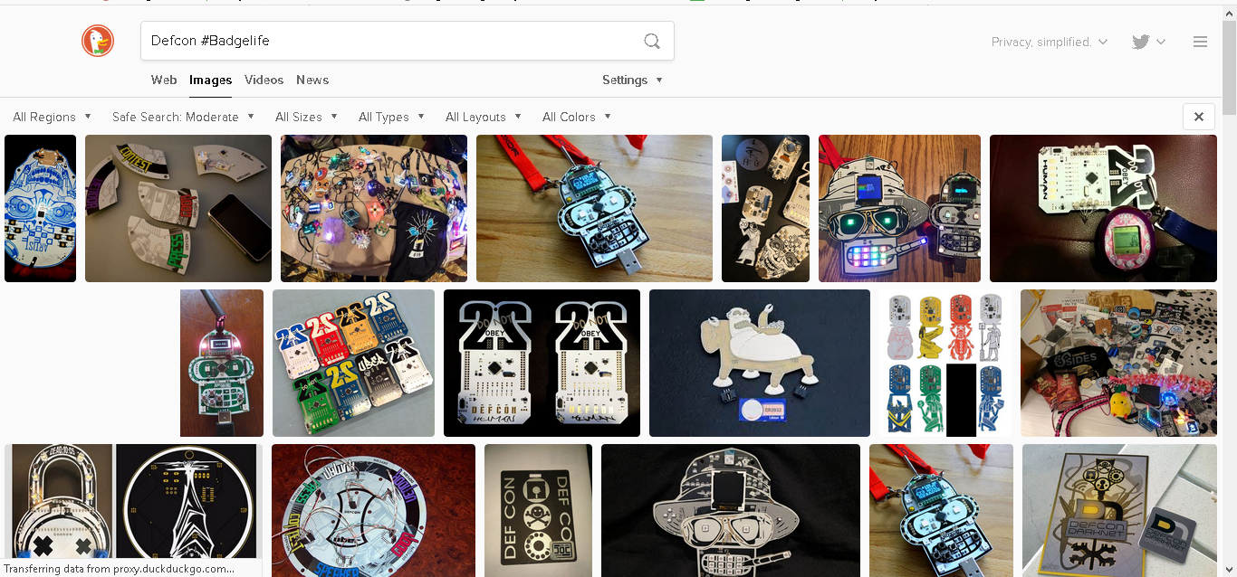
Oh my!

Slide 6
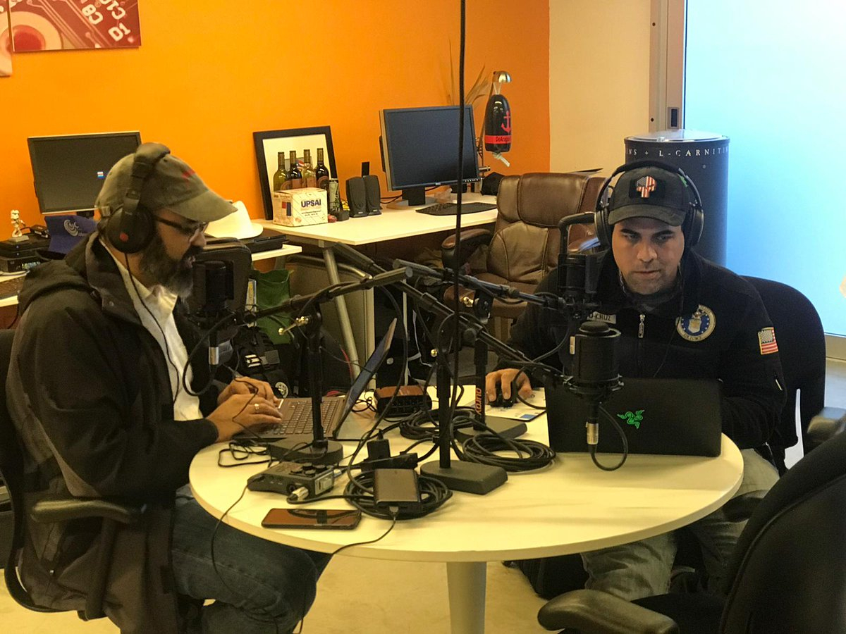
How it all started
One meetup
One conversation
Vamos a hacer un badge para BSides

Slide 7



Slide 8

True that

Slide 9

Scared?

Slide 10
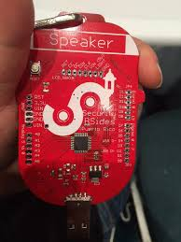
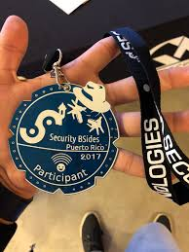
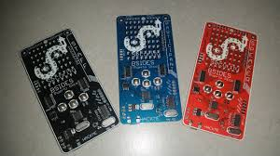
Bsides Badges
BSides2016
BSides2015
BSides2017/18
BSides2015

Slide 11
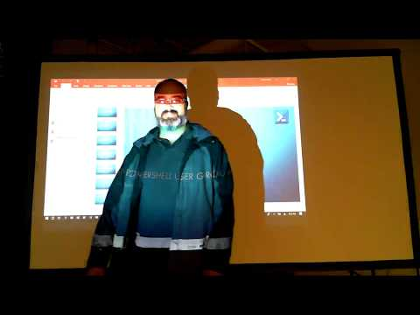
Jose again
Vamos a hacer uno para el Hackerlab!

Slide 12


Y...

Slide 13

Rick Badge
Brain = Attiny13A
Extras:
1 x 74HC164 Shift Register
8 x Leds
8 x 680 ohm resistors
1 x 12.5k resistor
1 x 47uF capacitor

Slide 14




Software
Programming:
  Arduino
Drawing:
  Inkscape
  LibreCAD
  Gimp
PCB Design:
  KiCAd

Slide 15
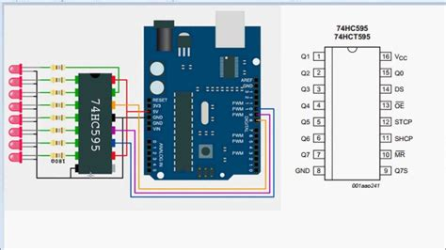
Shift Register

Slide 16
Shift Register

Slide 17


Shift Register
Bit0
Bit1
Bit2
Bit3
Bit4
Bit5
IN
Overflow

Slide 18
Shift Register
?
?
?
?
?
?
Bit0
Bit1
Bit2
Bit3
Bit4
Bit5
IN
Overflow

Slide 19
Shift Register
1
?
?
?
?
?
Bit0
Bit1
Bit2
Bit3
Bit4
Bit5
IN
Overflow

Slide 20
Shift Register
0
1
?
?
?
?
Bit0
Bit1
Bit2
Bit3
Bit4
Bit5
IN
Overflow

Slide 21
Shift Register
0
1
?
?
?
?
Bit0
Bit1
Bit2
Bit3
Bit4
Bit5
IN
Overflow
And that’s a shift register, serial to parallel

Slide 22
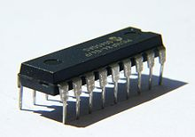
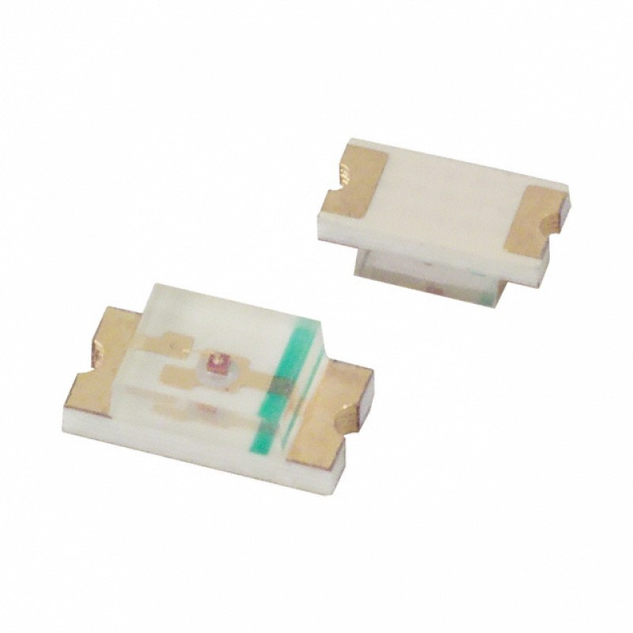
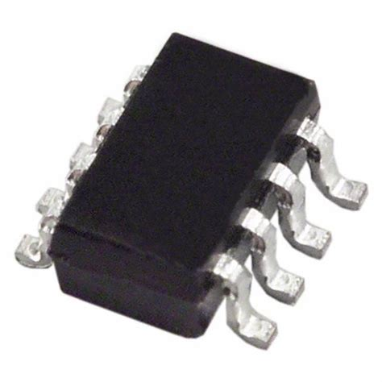
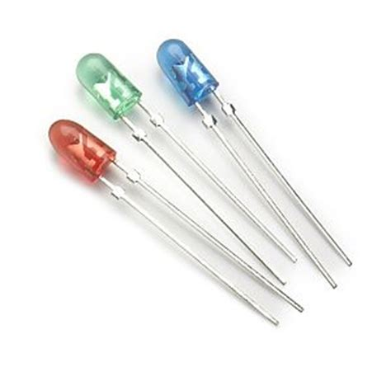
Components
Through Hole
Through Hole
Surface Mount

Slide 23
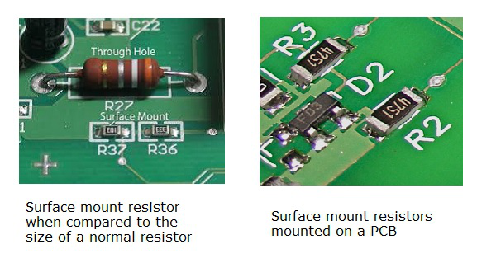

Slide 24
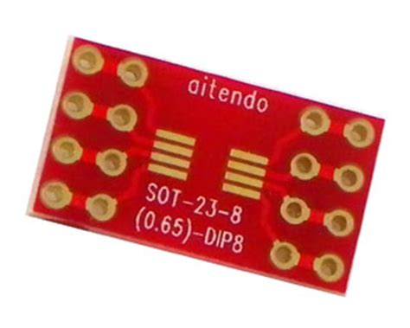
Adapters Surface mount to through hole

Slide 25
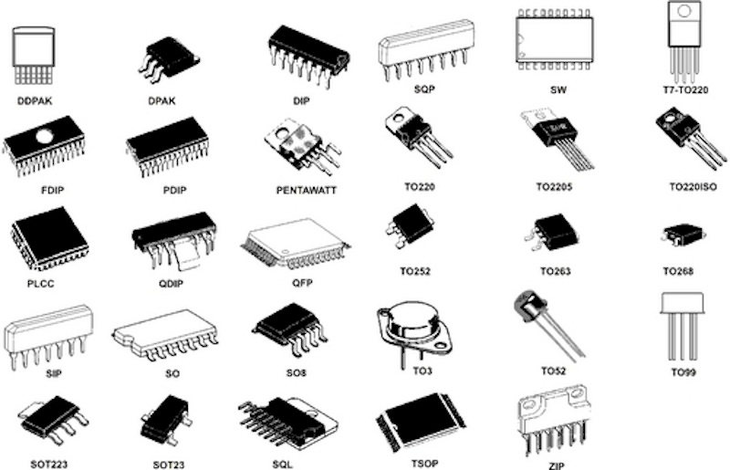
Package Families

Slide 26
Some Surface mount Package sizes
Package type | Size in inches | Size in mm
0201 | 0.024” x 0.012” | 0.6 mm x 0.3 mm
0402 | 0.04” x 0.02” | 1.0 mm x 0.5 mm
0603 | 0.063” x 0.031” | 1.6 mm x 0.8 mm
0805 | 0.08” x 0.05” | 2.0 mm x 1.25 mm
1206 | 0.126” x 0.063” | 3.2 mm x 1.6 mm
1210 | 0.12” x 0.10” | 3.2 mm x 2.6 mm
2020 | 0.20” x 0.20” | 5.08 mm x 5.08 mm

Slide 27
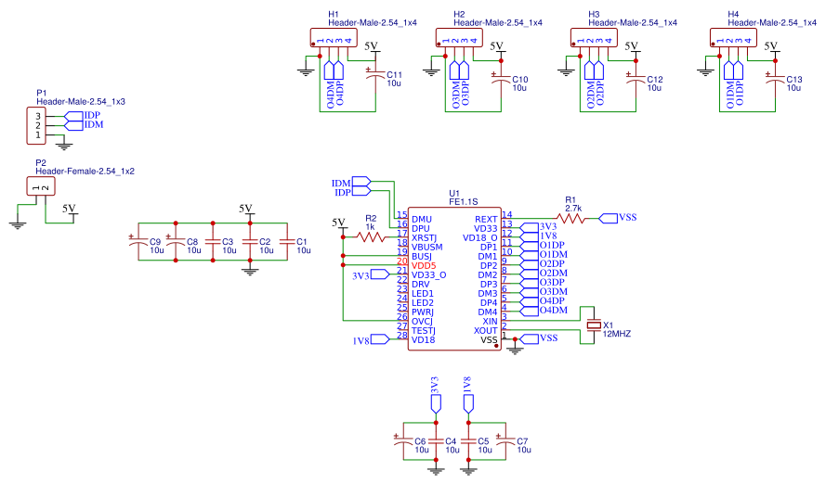

Slide 28
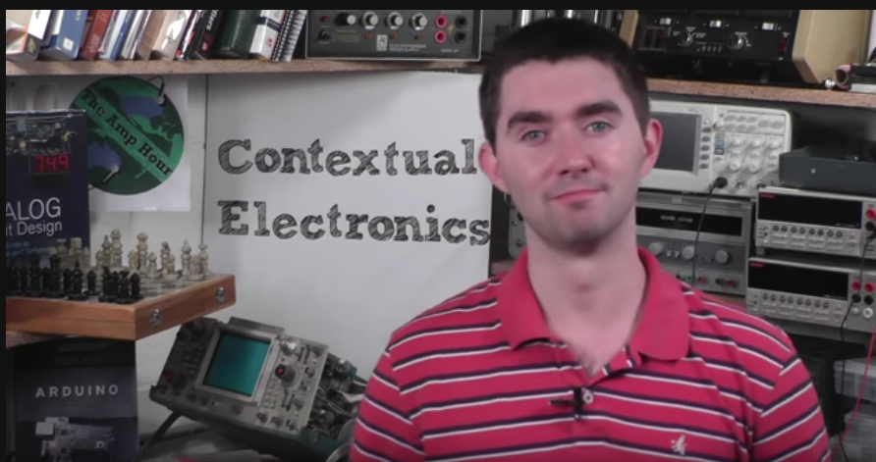
Good Tutorial
Contextual Electronics (Youtube)
https://www.youtube.com/watch?v=iTyi3RvNoB0&list=PLy2022BX6Esr6yxwDzhqYZyuuenJE2s5B

