Slide 1
OGTIP Internship Project
Project Description
Problem Statement : I was given the limited data from a reputed retail website that include relevant information of the consumer behavior through website engagement for multiple product purchase.
As a Data Scientist perform detail EDA on the data and prepare a prediction model which predicts whether a consumer will purchase the product after their visit on the website.
Professor
Minakshi Gautam Data Scientist, Oeson
Presented By
Hamza Soyuer

Slide 2
Detailed Analysis of Consumer Behavior through Website Engagement
Objective: To explore and predict consumer purchase behavior based on website engagement data.

Slide 3
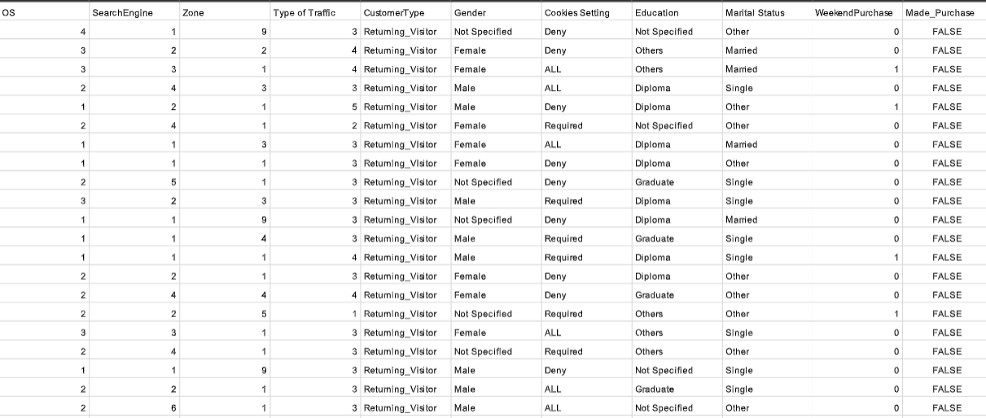
Data Overview
The dataset contains features related to website engagement, user demographics, and purchase decisions. Key features include page visit durations, bounce rates, exit rates, and demographic information.

Slide 4
Data Cleaning Process
Missing values were addressed by applying median imputation for numerical features and mode imputation for categorical features. This ensures a clean dataset for analysis without losing significant information.

Slide 5
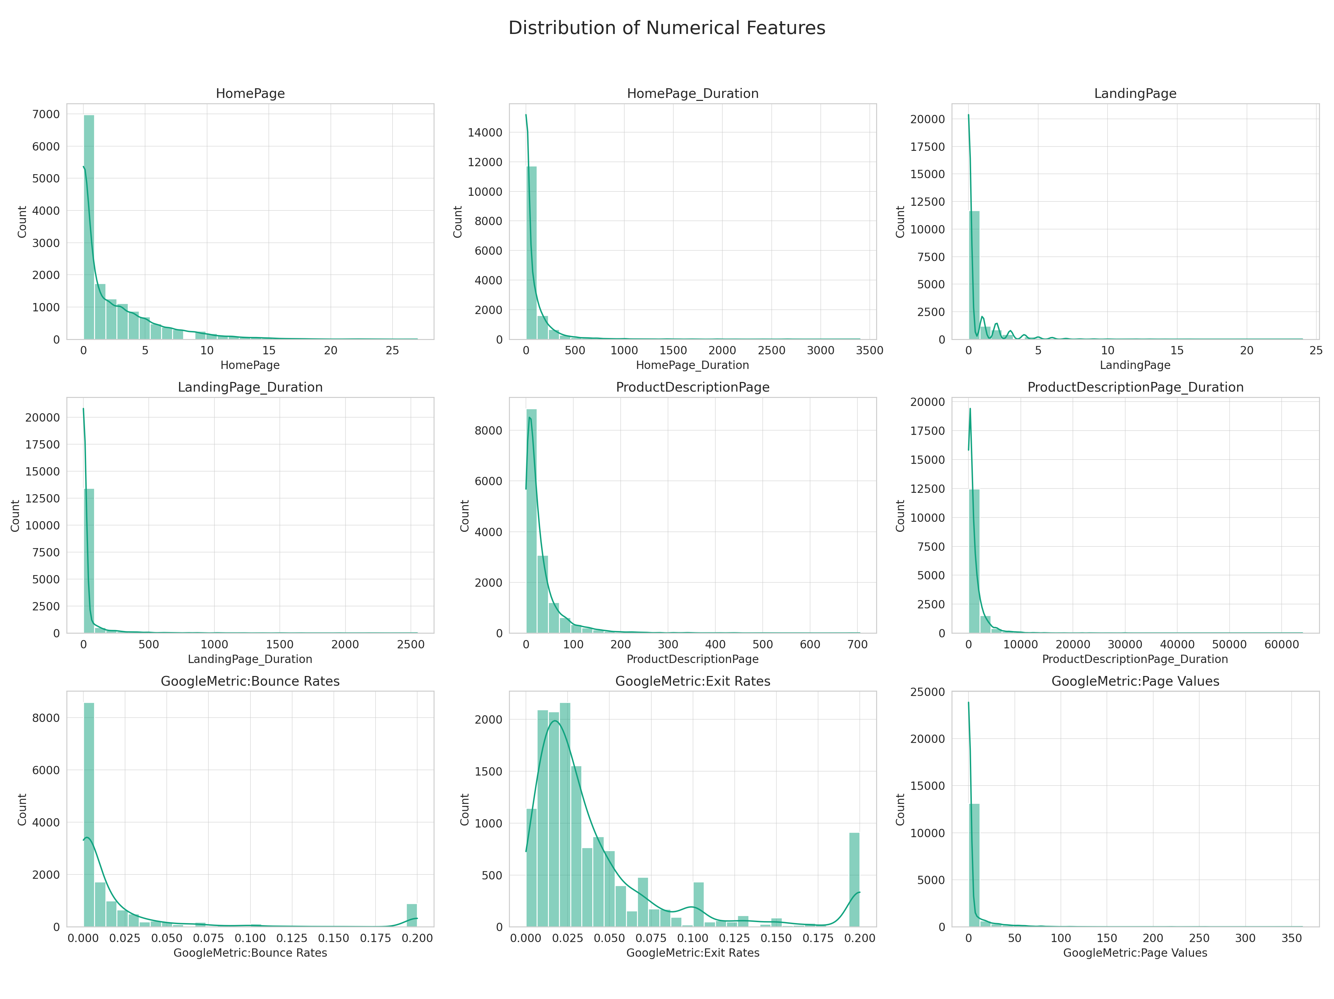
Distribution of Numerical Features

Slide 6

Numerical Features Distribution - Insights
The distributions show varying engagement levels across different pages, with some features showing heavy skewness. This indicates diverse user interactions with the website's content.

Slide 7
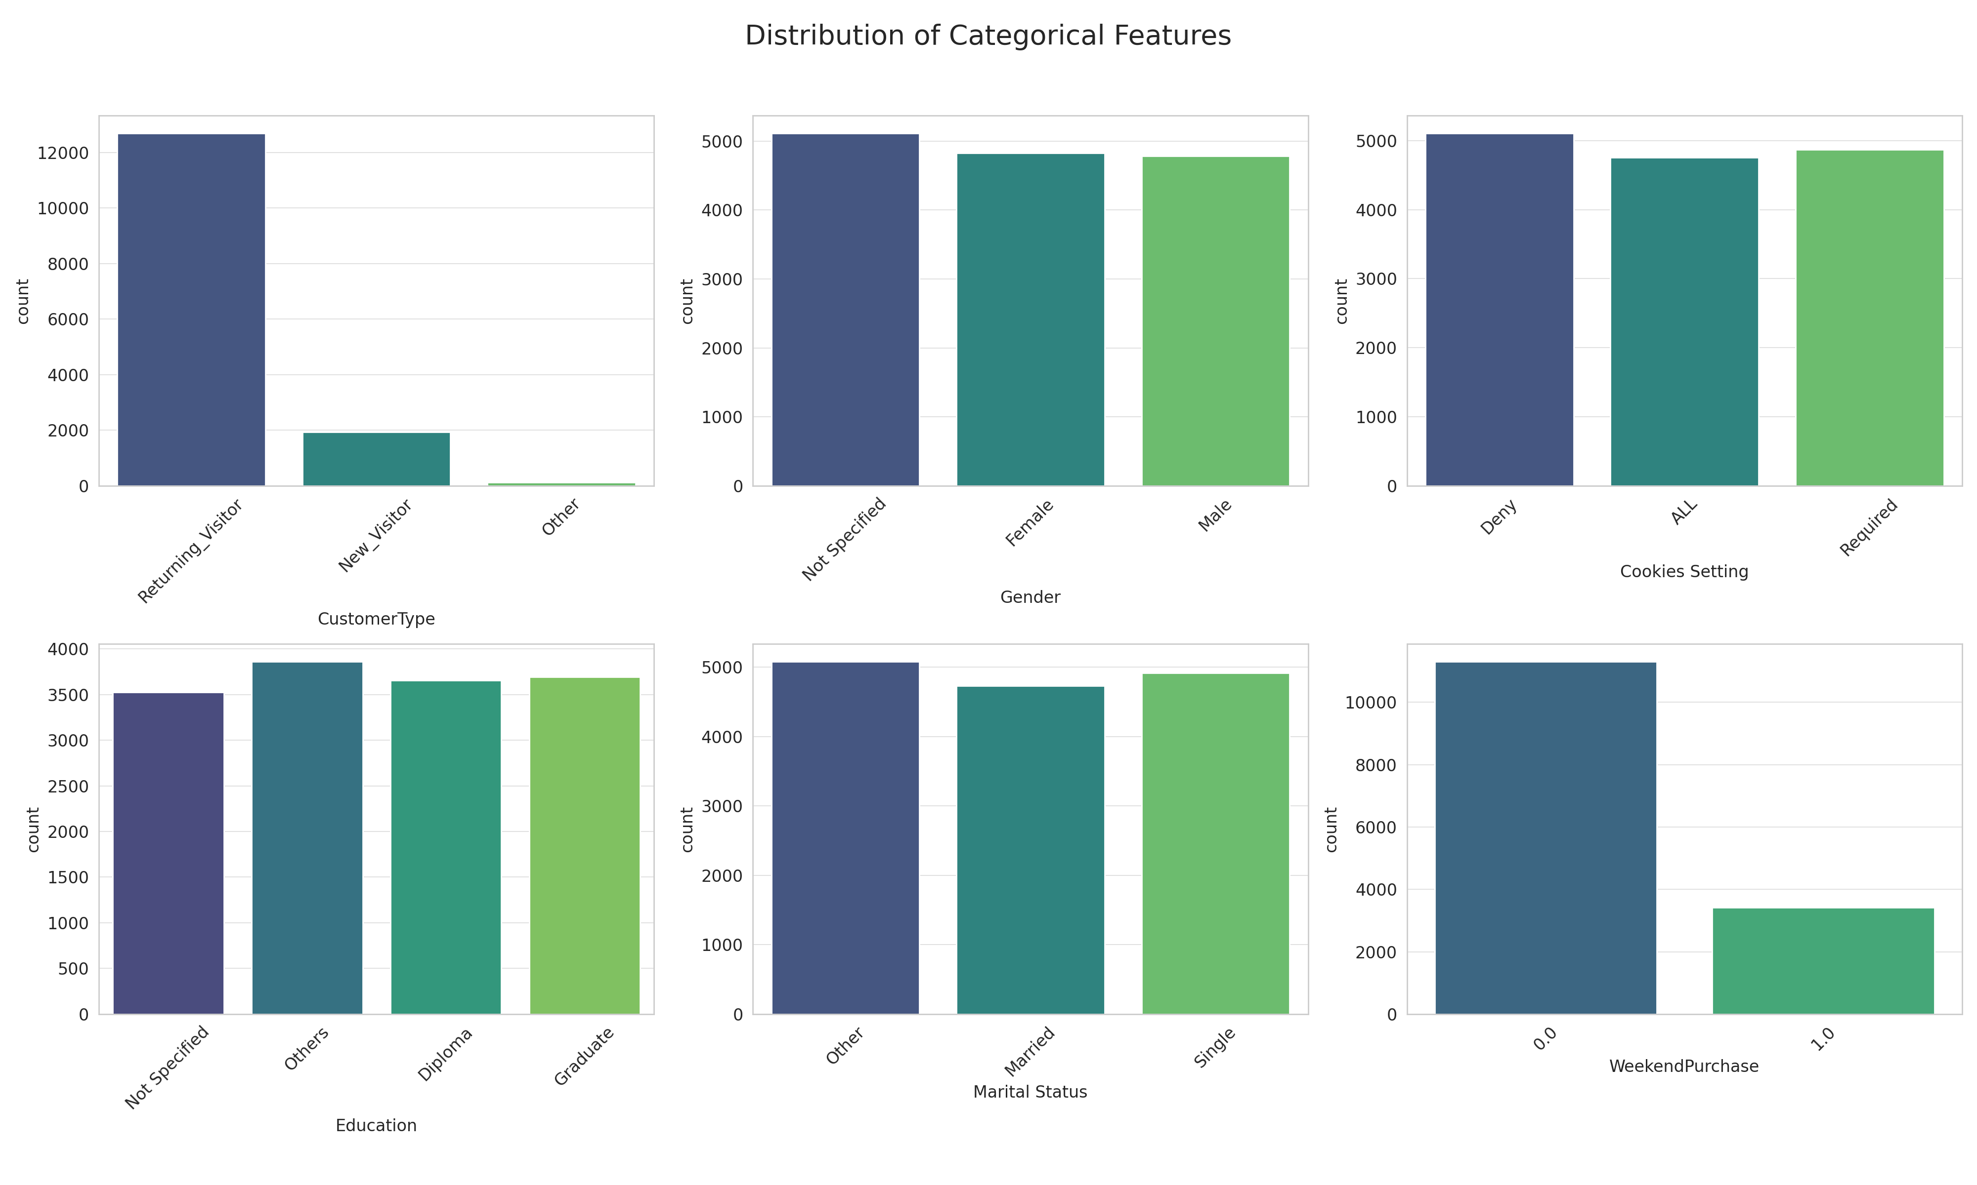
Distribution of Categorical Features

Slide 8
Categorical Features Distribution - Insights
The categorical features reveal insights into user demographics and behavior, such as the predominance of returning visitors and diverse educational backgrounds.

Slide 9
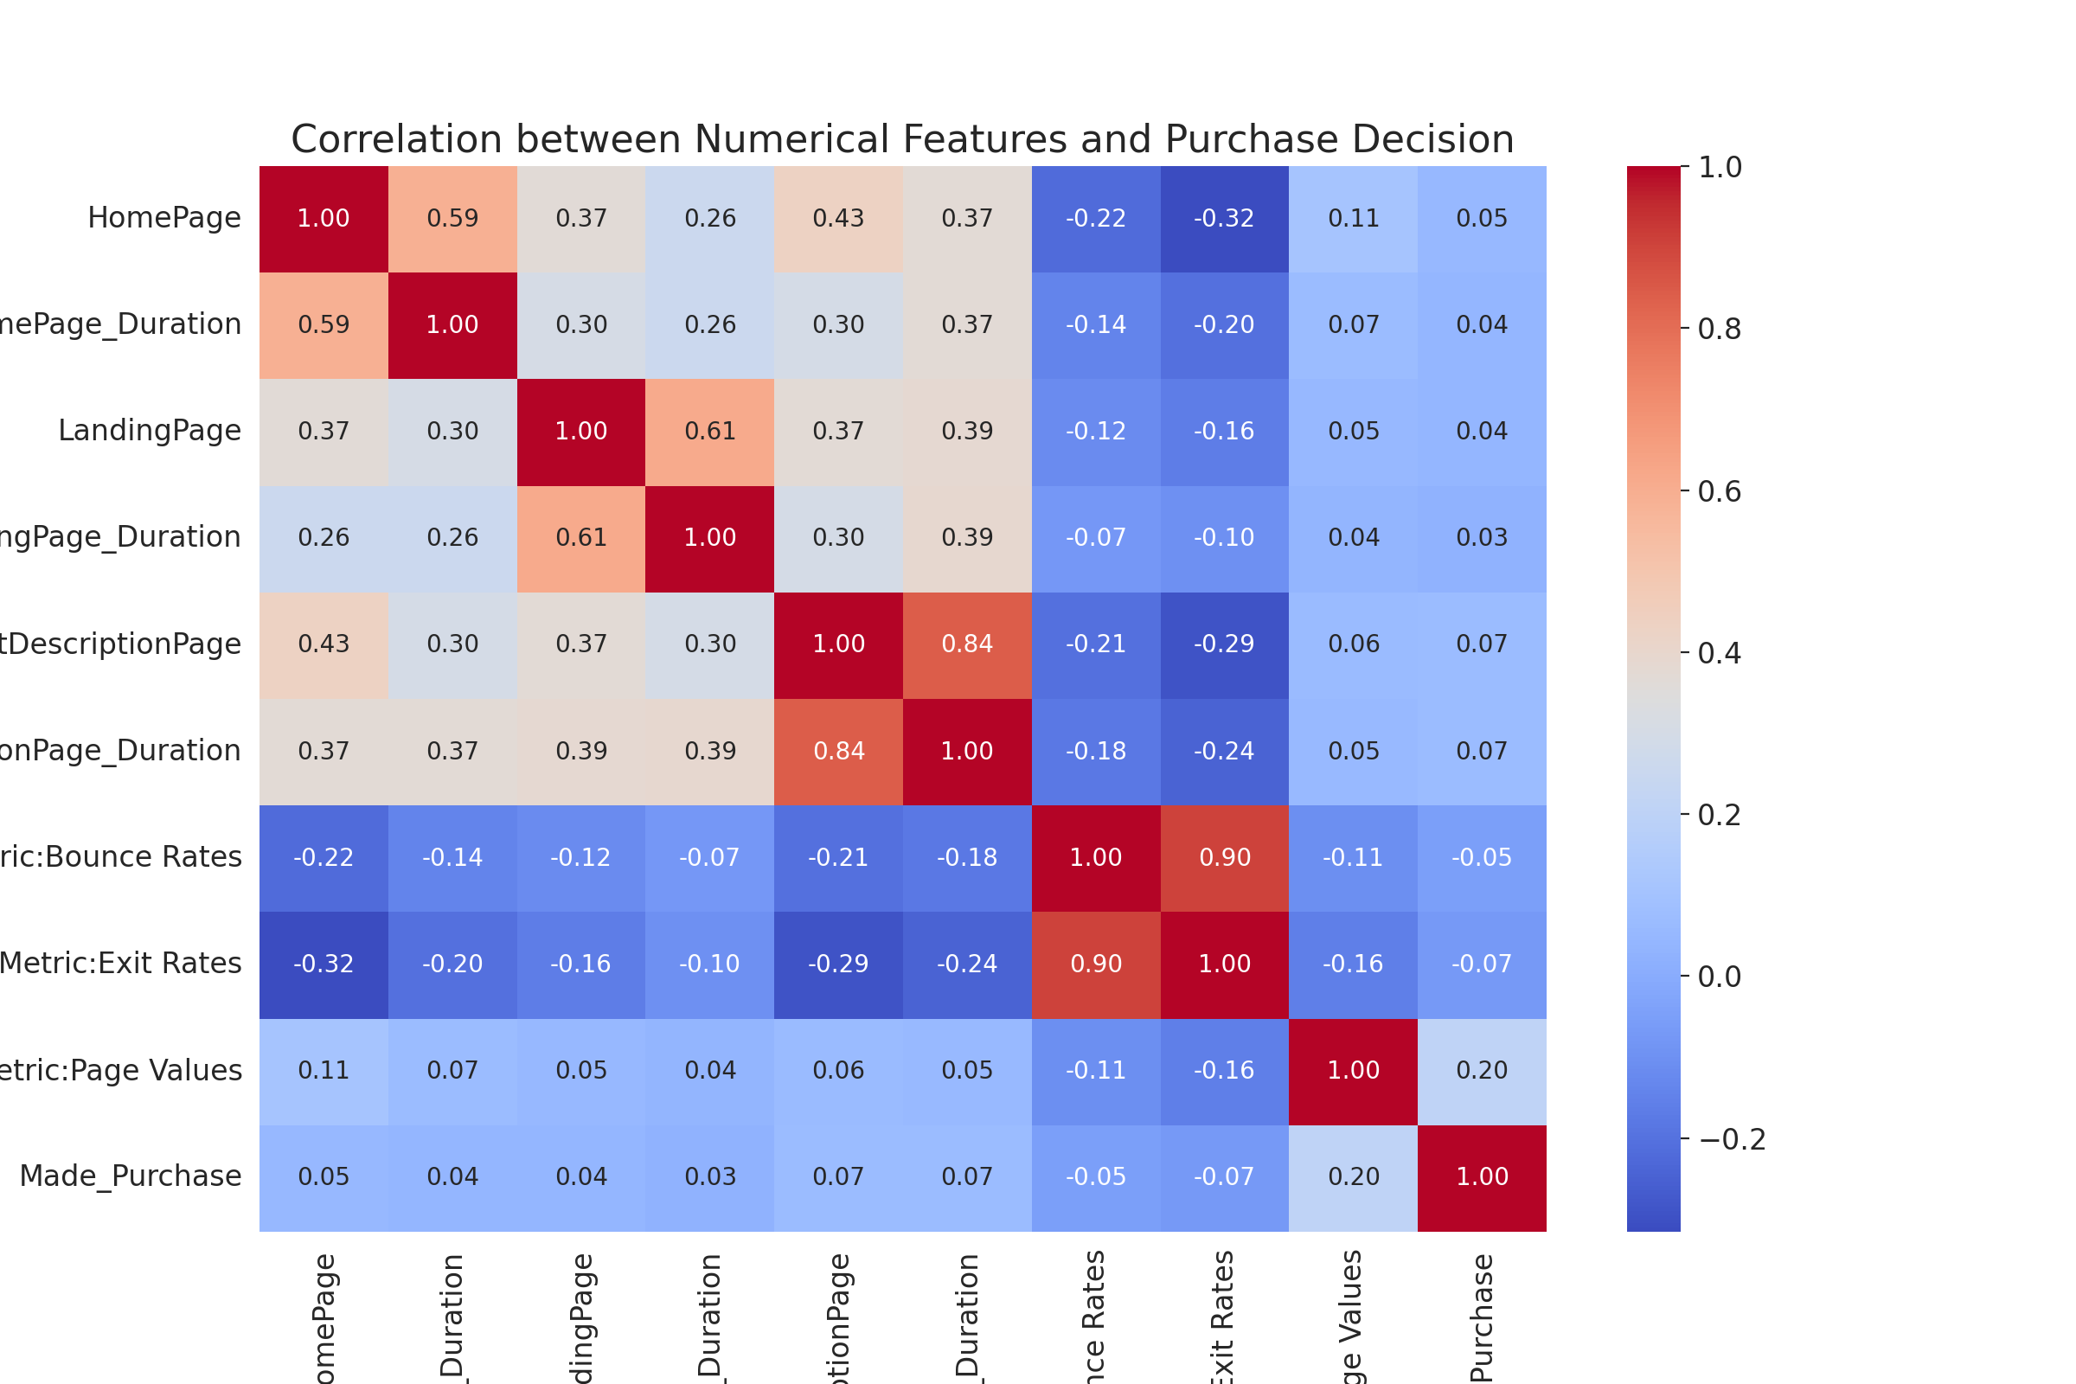
Correlation Analysis

Slide 10
Correlation Analysis - Insights
Correlation analysis highlights the significant positive relationship between page values and purchase decisions, suggesting that pages with higher values are more influential in driving purchases.

Slide 11
Machine Learning Model Summary: Consumer Purchase Prediction
Objective: To predict consumer purchase decisions based on website engagement data using a Logistic Regression model and EDA.

Slide 12
Data Preparation
Feature engineering involved encoding categorical variables and normalizing numerical features. The dataset was split into training and testing sets for model evaluation.

Slide 13
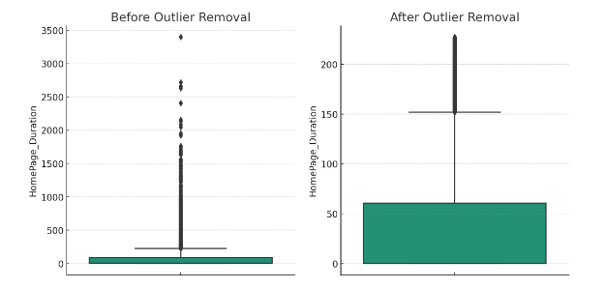
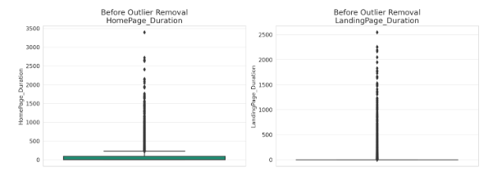
Exploratory Data Analysis (EDA)
Our exploratory data analysis revealed that after outlier removal, user engagement levels on the homepage appear more consistent. This refinement ensures that business strategies are informed by accurate user behavior metrics, leading to better strategic decisions. It's crucial to discern whether outliers are high engagement users or data anomalies to tailor the user experience effectively.

Slide 14
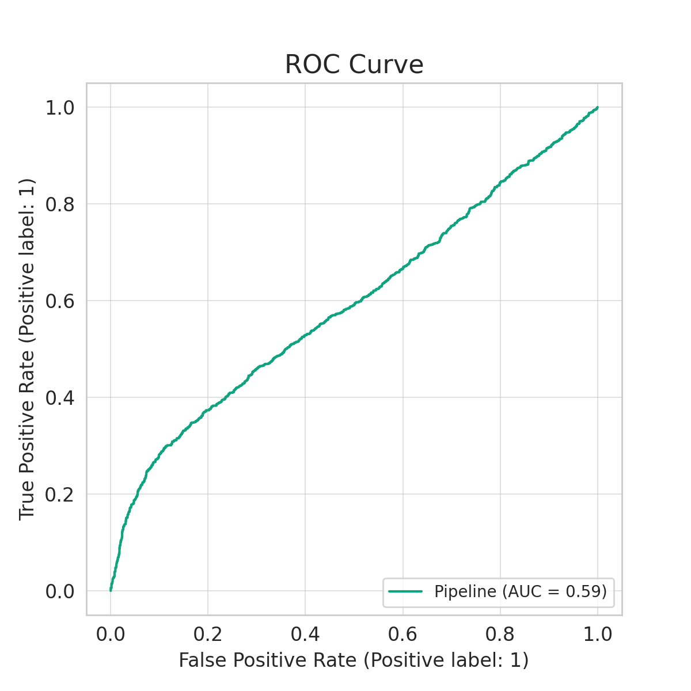
ROC Curve - Model Performance

Slide 15
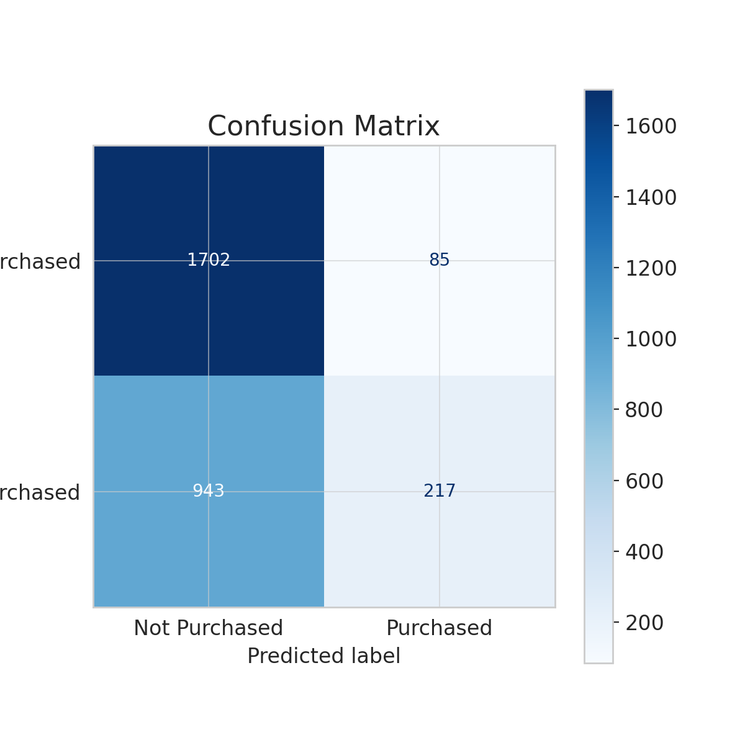
Confusion Matrix - Model Performance

Slide 16
Key Insights and Implications
Key insights include the importance of page value in purchase decisions and the impact of user type (new vs. returning) and day of the week on purchasing behavior. These findings can guide targeted engagement strategies to enhance conversion rates.

Slide 17
Conclusion and Recommendations
The analysis provides a foundation for understanding factors influencing consumer purchases. Recommendations include optimizing high-value pages and tailoring strategies to engage returning visitors and weekday traffic.

