Slide 1
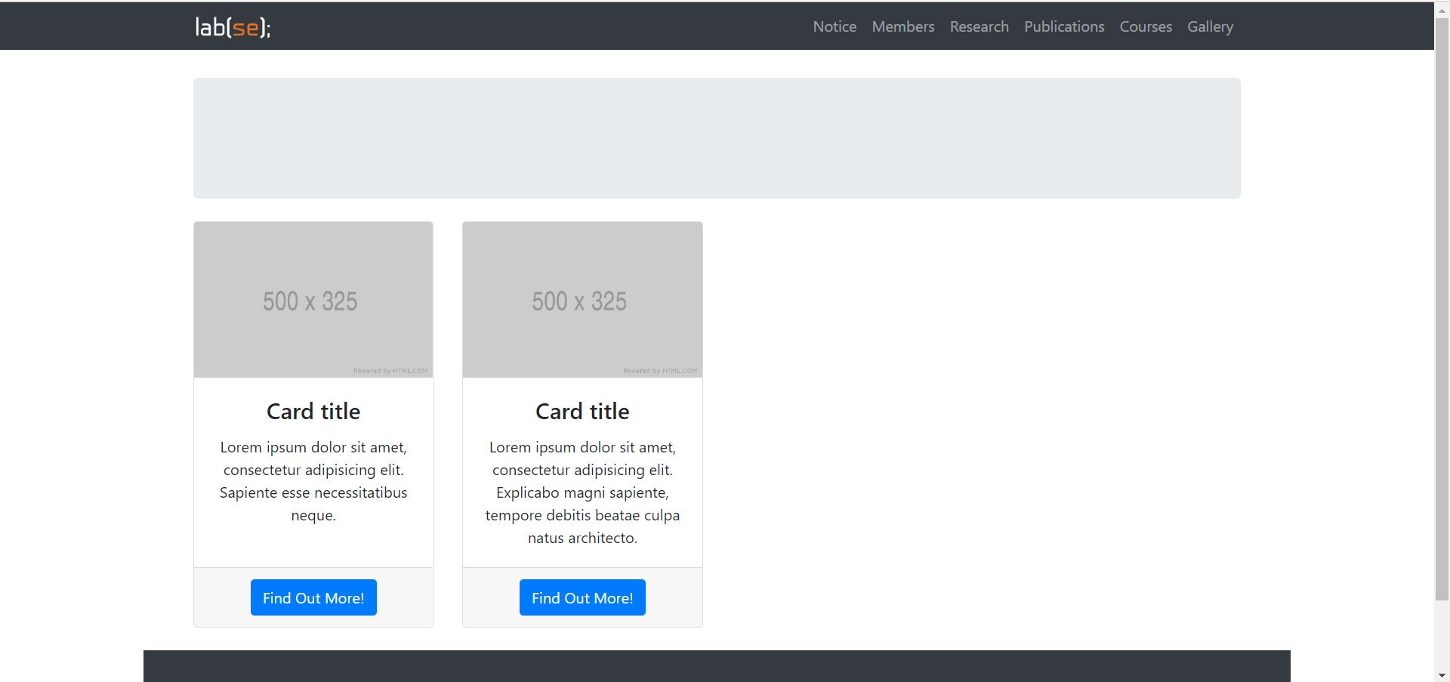

Log in

Slide 2

…
Log in
강가원
COURSE
Alert
2
Team Project
menu1
TA replied your message
-2 hours ago.
menu2
TA replied your message
-3 hours ago.
menu3
menu3
menu2
menu4
menu3
menu5
menu6
Teaching Assist.

Slide 3
…
Log in
강가원
COURSE
Alert
2
Team Project
menu1
TA replied your message
-2 hours ago.
menu2
TA replied your message
-3 hours ago.
menu3
menu3
menu2
menu4
menu3
menu5
menu6
Teaching Assist.

