Slide 1
SAP EWM EXTENDED WAREHOUSE MANAGEMENT TRAINING
AnubhavTrainings.com
www.anubhavtrainings.com

Slide 2

SAP EWM TRAINING
BY:-
Mr. Bijoy
www.anubhavtrainings.com
Notes:
https://unsplash.com/photos/uXB-7la5vqA

Slide 3
SAP EWM TRAINING (Day 11)
AnubhavTrainings.com

Slide 4
Process Code in EWM & Exception Codes
Process code and exception code
Batch selection criteria for Outbound process
Testing of Outbound process with batch selection criteria method
Exception code concept in EWM and Configuration & testing of exception codes

Slide 5
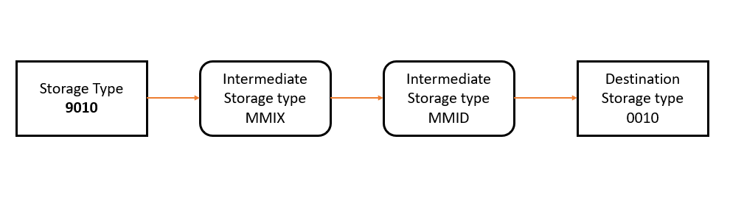
LOSC (Layout Oriented Storage Control)
For specific storage types in the warehouse, it might be necessary to move the goods via an interim storage type, for example an elevator to move from one floor to the other.
The layout-oriented storage control only operates with handling units.
www.anubhavtrainings.com

Slide 6
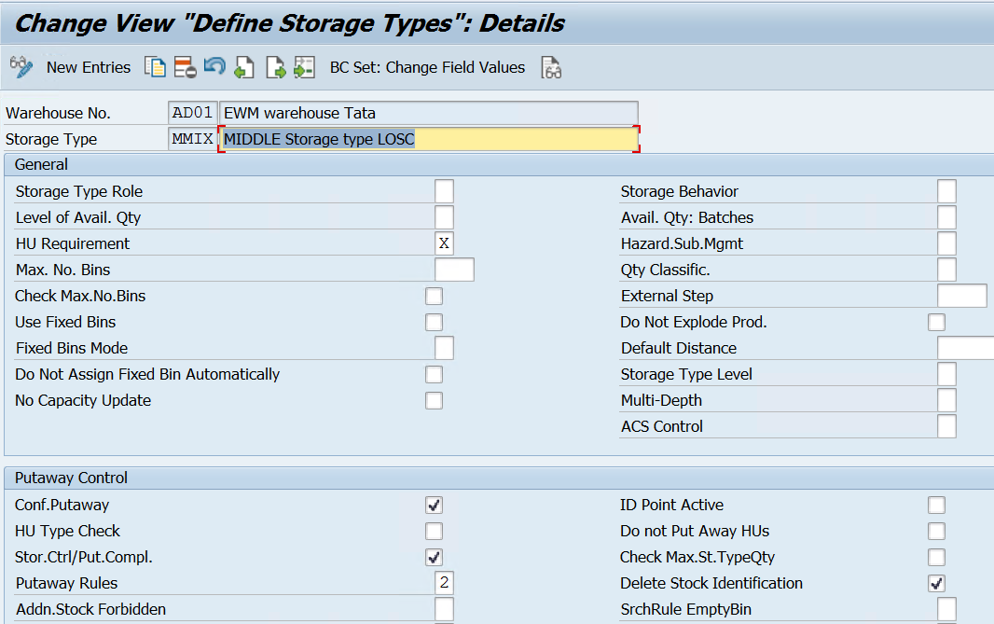
Define Storage types for Intermediate storage types
Create Sections & Bins for the same
www.anubhavtrainings.com

Slide 7
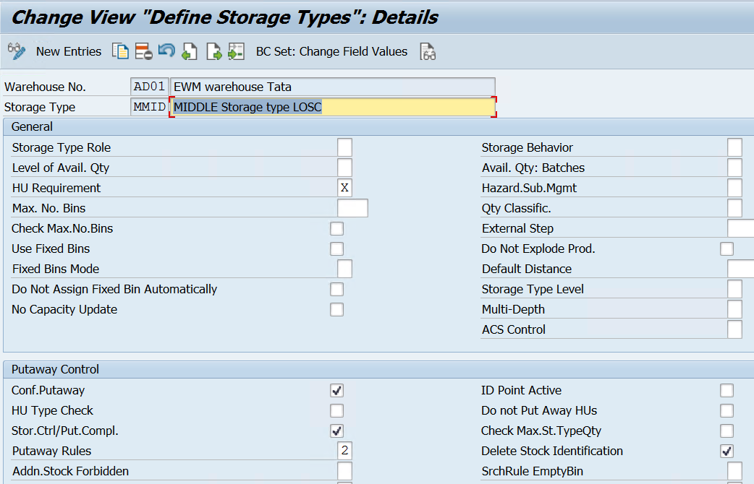
www.anubhavtrainings.com

Slide 8
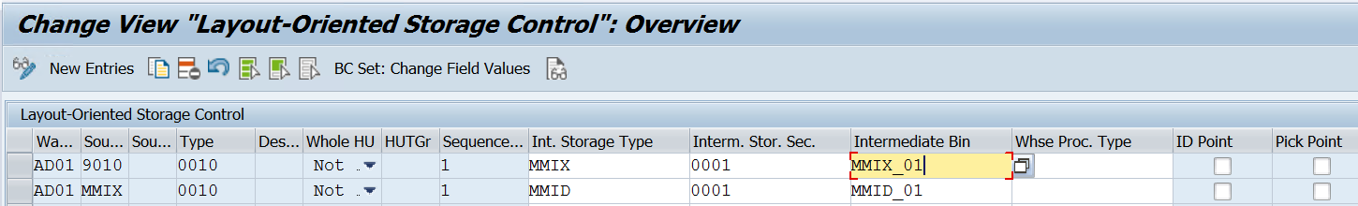
Maintain Storage Section and Create Storage bins.
Define Layout Oriented Storage control
www.anubhavtrainings.com

Slide 9
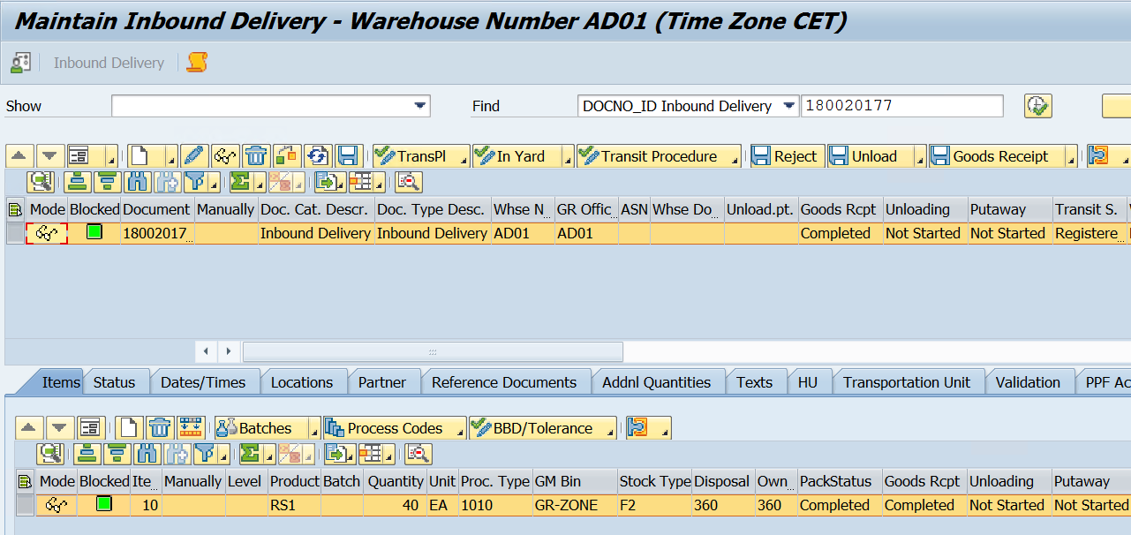
Test Case
1. Inbound delivery distributed to EWM, Do Packing & GR in EWM
www.anubhavtrainings.com

Slide 10
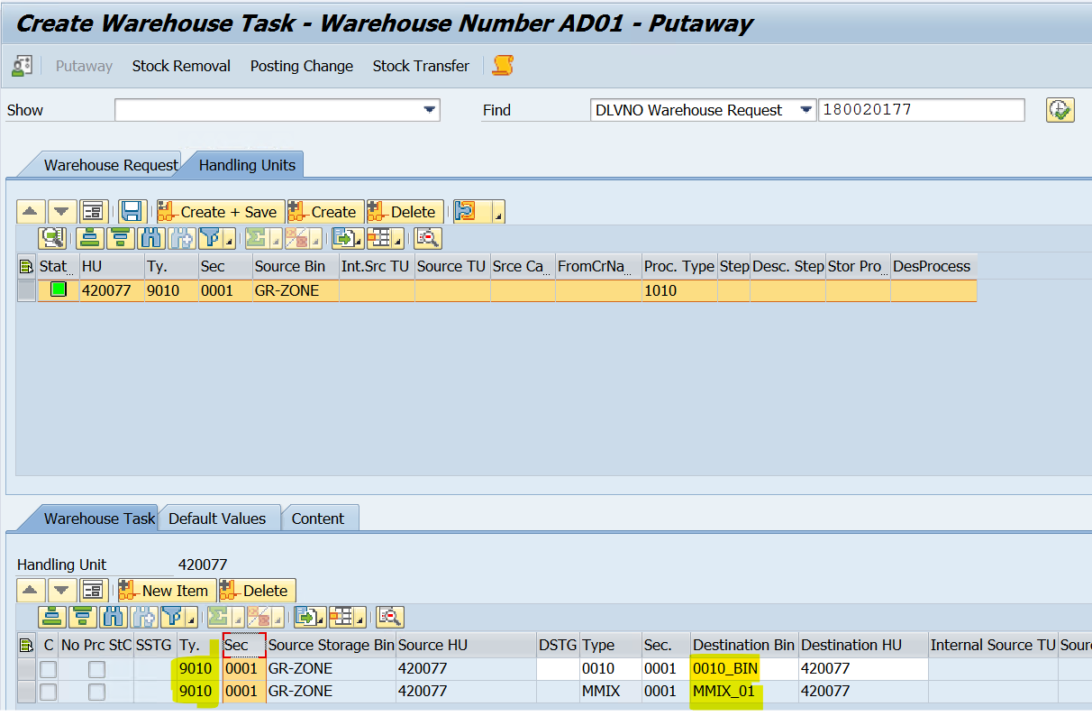
2. Create Warehouse Tasks

Slide 11
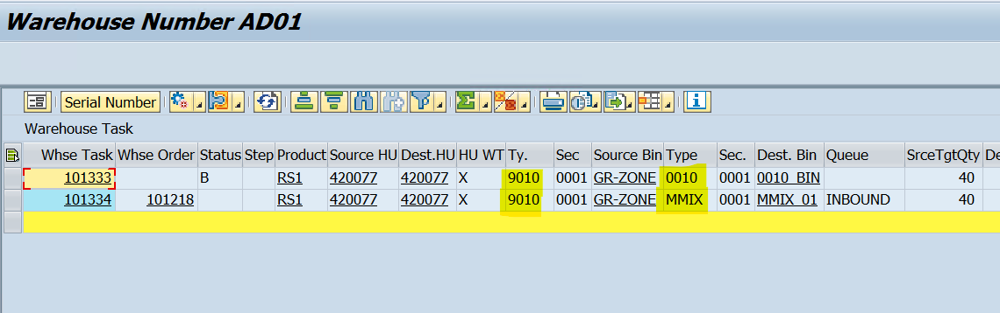
Warehouse Tasks are created –
WT 101329 – From 9010 to 0010 (Destn St type) ….but Status B (Waiting)
WT 101330 – From 9010 to MMIX
Now Confirm the Open WT 101330, Once confirmed another WT would be created for MMIX to MMID

Slide 12
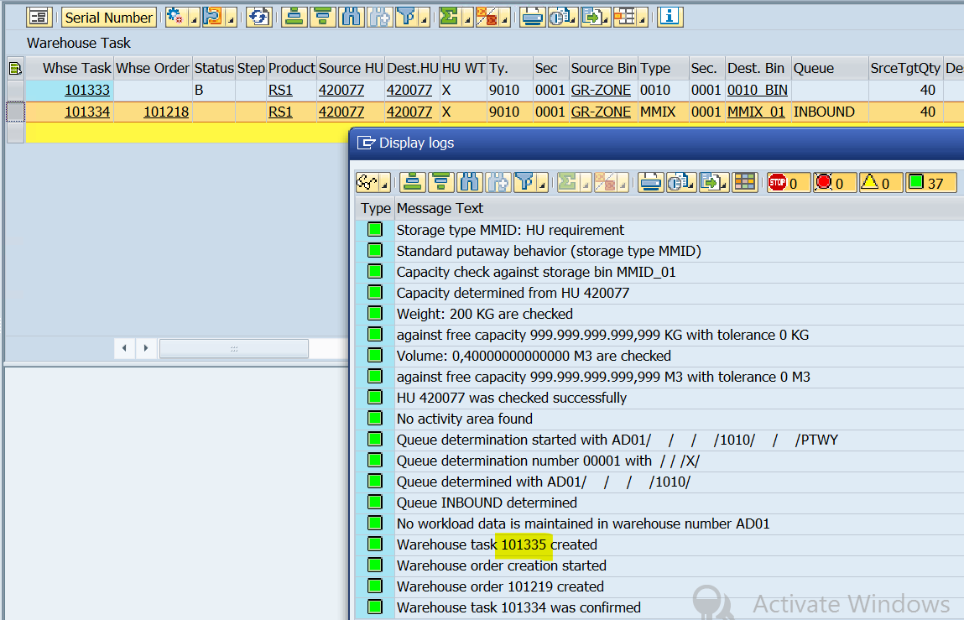

Slide 13
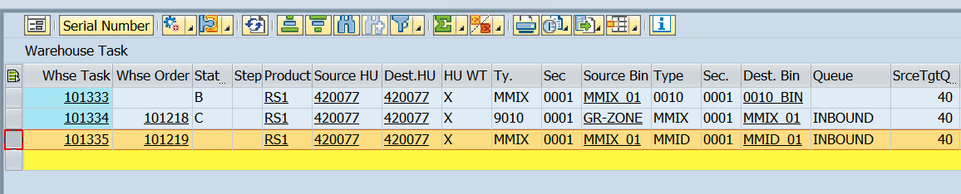
Now confirm the WT 101331 (from MMIX to MMID)
www.anubhavtrainings.com

Slide 14
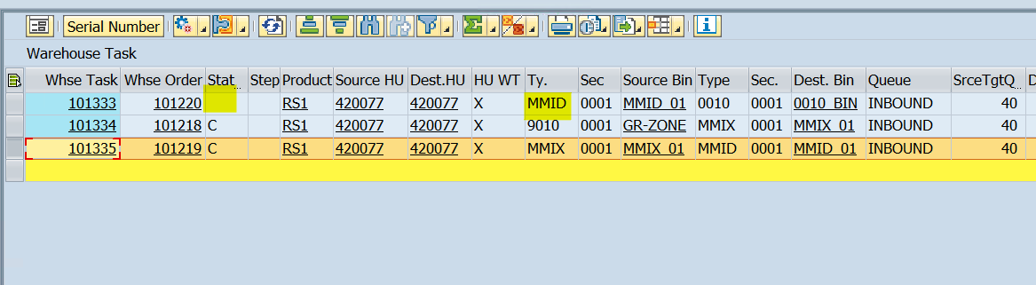
Observe the WT 101329 – Status will get changed to blank & Source details will get updated!
www.anubhavtrainings.com

Slide 15
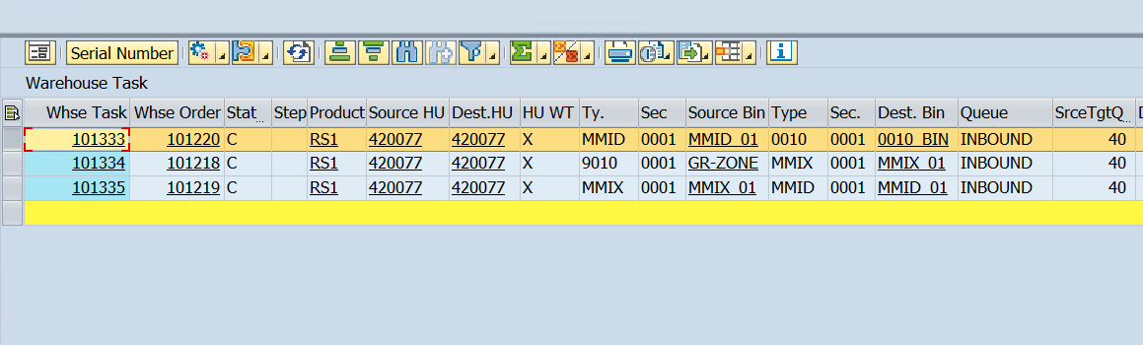
Confirm the WT 101333 to move Product to Final destination bin.
www.anubhavtrainings.com

Slide 16


End of Session 11
www.anubhavtrainings.com

Slide 17

FEEL FREE TO ASK QUESTIONS

Slide 18

Feedback

Slide 19
THANK
YOU

Slide 20

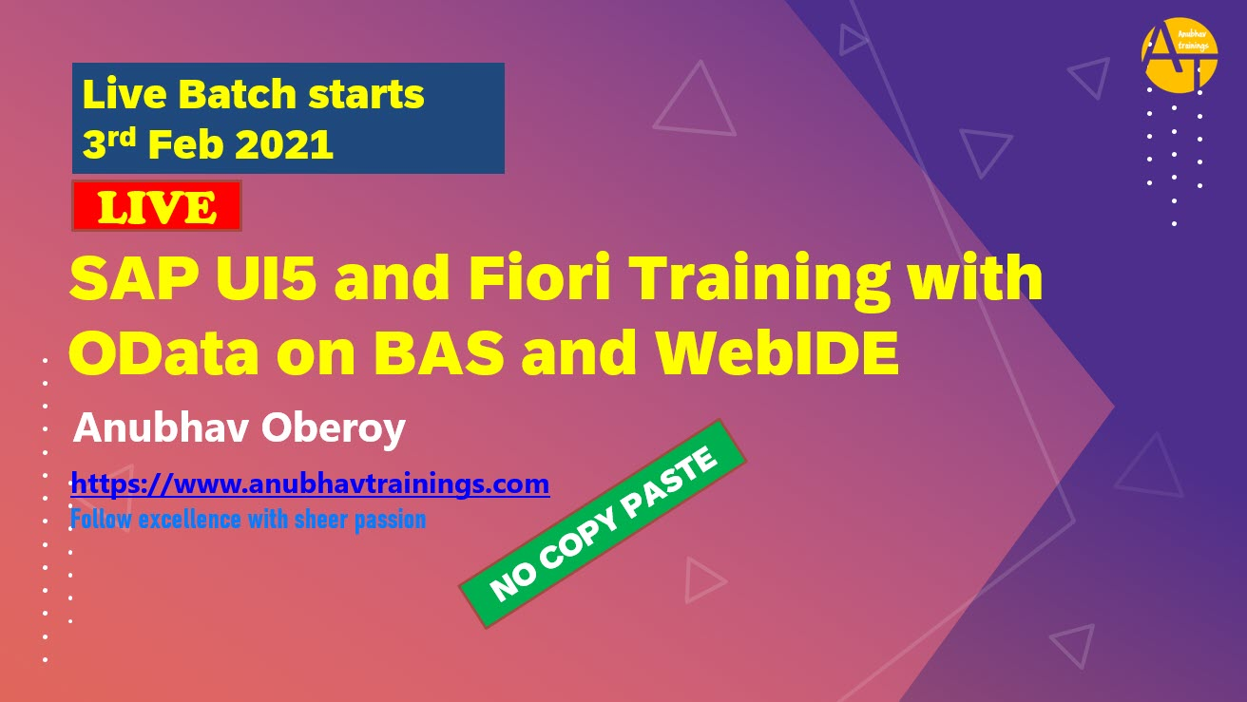

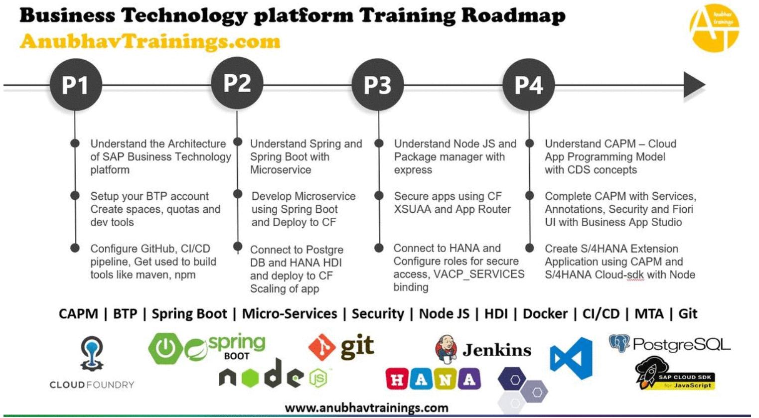
More from AnubhavTrainings.com

Slide 21






We’re committed to empower you to be
#FutureReady
through powerful training solutions.
We build the workforce of the future.
250+
Corporate Clients
30,000+
Learners Trained
25000+
Learners Placed
FREE WEBINARS
Sign up for free webinars with industry experts every fortnight!
Enroll Now!

Slide 22
FREE WEBINARS
Sign up for free webinars with industry experts every fortnight!
Contact us today!
www.anubhavtrainings.com

