Slide 1

Why our app?
Programmer Matching Algorithm: Advanced algorithm for precise skill-based pairing.
Project Showcase: User-friendly interface for displaying past projects.
Real-time Collaboration Tools: In-app communication tools for effective project management.

Slide 2

Monetizing the app:
Subscription Plans: Different tiers (Basic, Pro, Enterprise) with monthly and annual options.
Freelancer Marketplace Fee: Percentage-based fee for successful collaborations.
Advertisement: Non-intrusive ad spaces within the app.

Slide 3
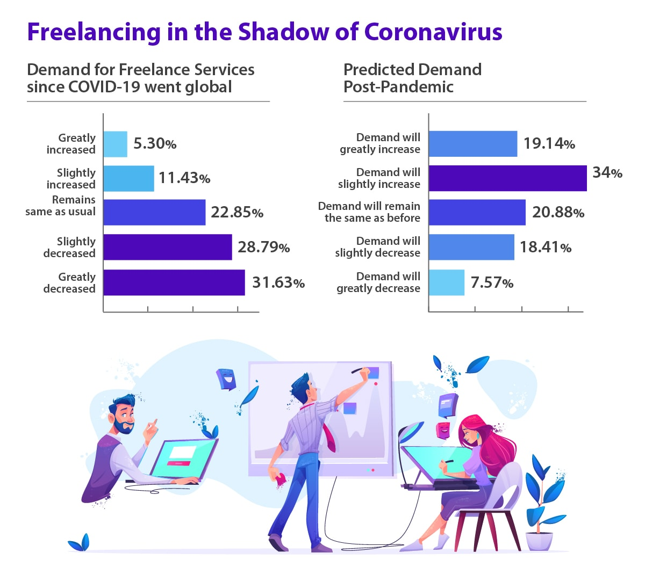
Tapping into a Growing Market
Freelance and Remote Work Trends: Increasing number of tech freelancers and remote workers.
Demand for Specialized Skills: Rising demand for niche skills in software development.
Success Stories: Include testimonials or success stories from beta testing.

Slide 4
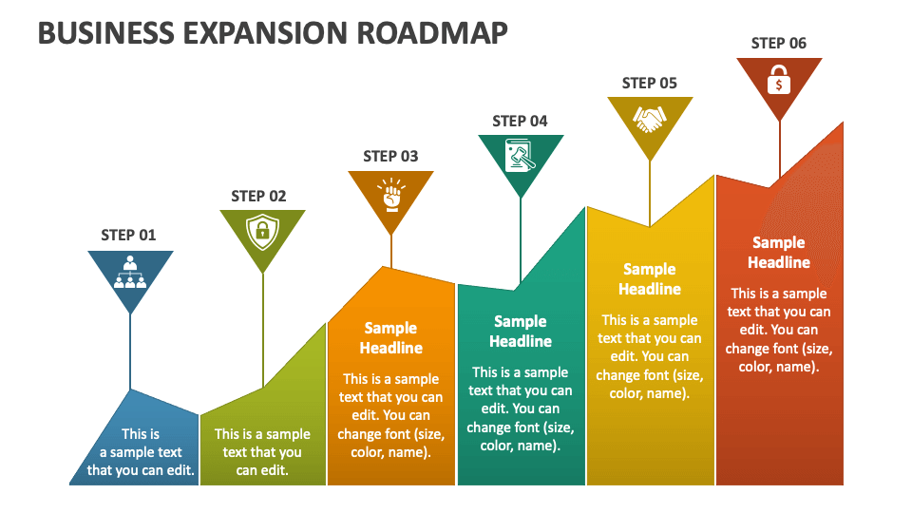
Building Tomorrow's Collaborative Tech Ecosystem
Geographic Expansion: Highlight target regions and expansion strategy.
Feature Enhancements: Plans for continuous improvement based on user feedback.
Community Building: Initiatives such as
events, forums, and partnerships.

Slide 5
Distribution of roles:
Developer 1 – Georgi Atanasov;
Developer 2 – Yordan Mitrev;
QA – Valentin Iliev;
Project Manager – Ivaylo Nichev;
Project Owner – Ester Faris;

