Slide 1
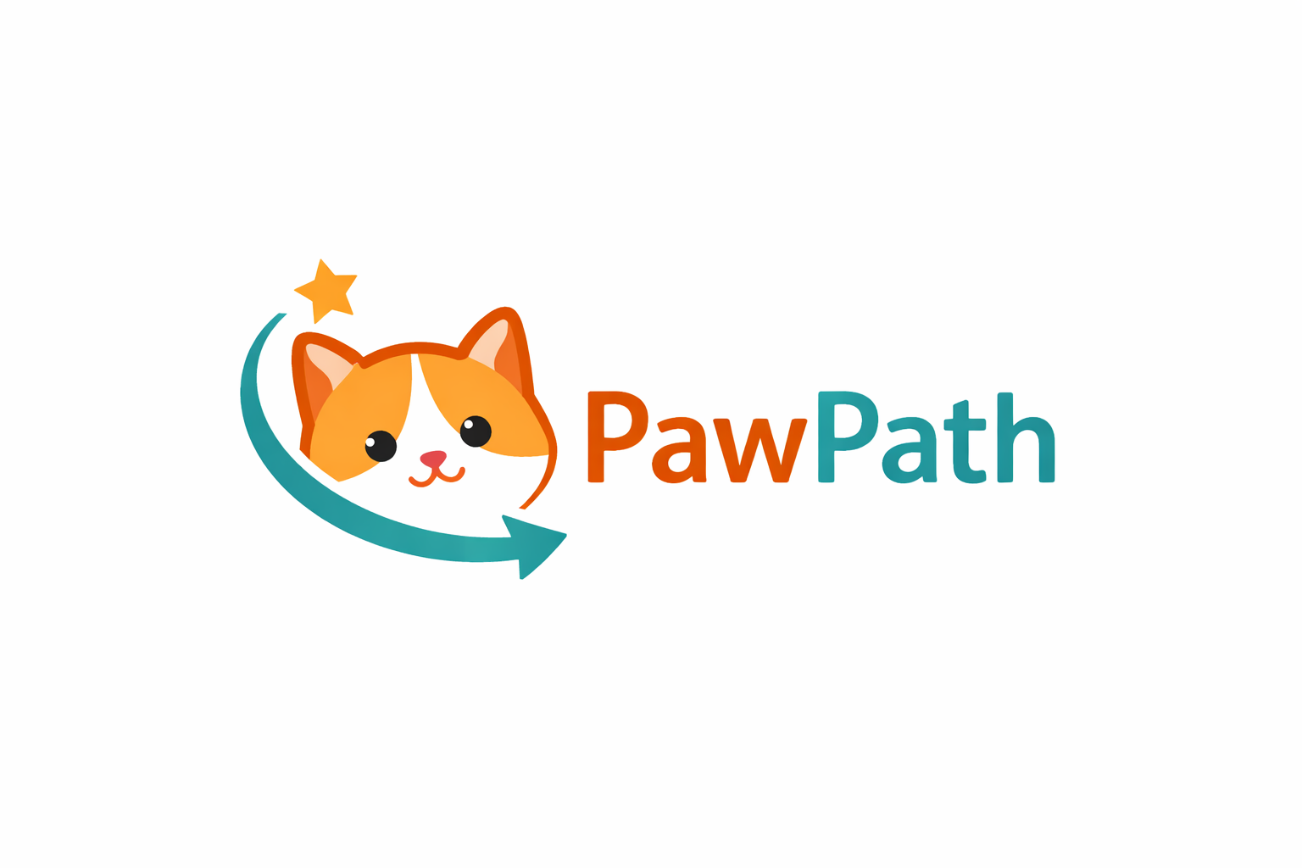
PawPath - Sustainable Business Model
PawPath is a digital platform that connects people in social need with volunteers and institutions through a structured and measurable process.
The platform is free for individuals, while revenue is generated through subscription-based access for institutions such as NGOs, universities, and municipalities.
Our business model is B2B / B2G, focused on long-term partnerships, operational efficiency, and measurable social impact.

Slide 2

Initial Funding Strategy
PawPath’s initial development and early growth will be funded through European Union grant programs supporting social innovation, digital platforms, and community development.
The project aligns strongly with EU priorities in:
digital inclusion
social cohesion
innovation for public good
Key funding sources include:
Horizon Europe
European Social Fund Plus (ESF+)
Erasmus+
Digital Europe Programme
These programs allow PawPath to validate the product before full market monetization.

Slide 3


Revenue Streams
PawPath operates on a subscription-based revenue model focused on institutional users.
Our main revenue streams include:
Subscription plans for NGOs, universities, and municipalities
Service packages with guaranteed response times (SLA)
Enterprise and government-level contracts
Corporate CSR access (long-term)
This model ensures predictable income while keeping the platform free for individuals in need.

Slide 4
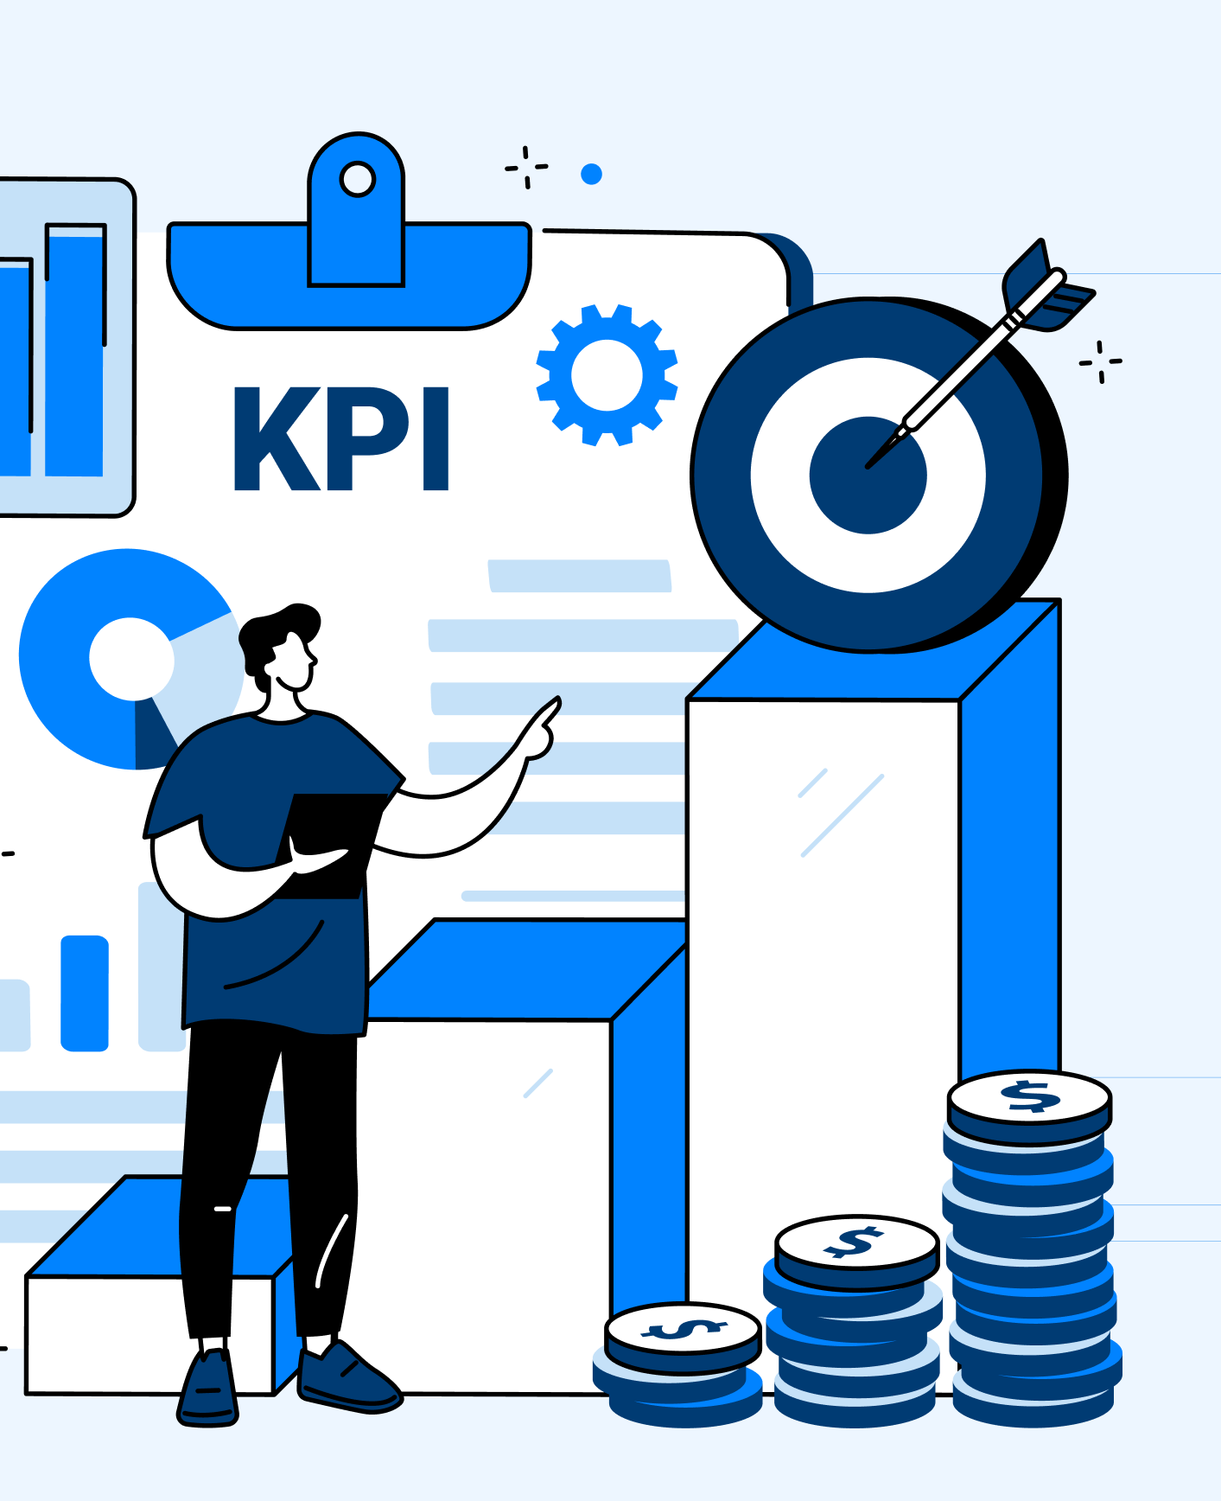
Why Institutions Pay
Institutions do not pay for a social cause -
they pay for operational efficiency and control.
With PawPath, institutions receive:
automated case intake and triage
guaranteed response times (SLA)
measurable social impact through reports and statistics
lower cost per handled case compared to alternatives
PawPath transforms social support from a chaotic process into a manageable service.

Slide 5
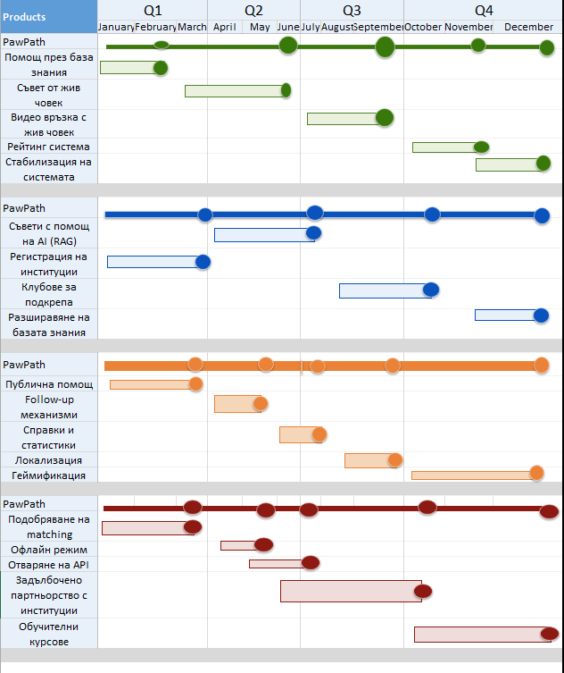
Sustainability & Growth Strategy
PawPath’s business model is designed for long-term sustainability.
Key principles:
individuals in need never pay
revenue comes from institutions with stable capacity
the platform scales through software, not staff growth
accumulated data increases platform value over time
Our goal is to establish PawPath as social support infrastructure, not a one-time initiative.

