Slide 1

Neurotechnology and Neuralink
SEMINAR ON
Submitted by
SP Aryan Biswal
Roll No: 2104052
Regd. No: 2101287310
Seminar in-charge
Asst. Prof. Debashree Manasi Mishra
Dept. of Computer Science and Engineering Data Science
GITA AUTOMOUS COLLEGE, BHUBANESWAR

Slide 2
Outline
Introduction
Neurotechnology
Neuralink
“The Link” – BCIs and their working
Benefits of Neurotechnology - Applications
Neurotechnology: Advantages and Disadvantages
Conclusion

Slide 3
Introduction

Slide 4
Neurotechnology
Neurotechnology is a field that deals with the development and application of technologies that interact with the nervous system.
This can involve devices that are implanted in the brain or nerves, as well as non-invasive devices that can monitor brain activity.
The goals of neurotechnology can be therapeutic, such as helping people with neurological disorders to regain lost function.
Neurotechnology can also be used to augment human capabilities. For example, brain-computer interfaces (BCIs) could allow people to control computers or other devices with their thoughts.

Slide 5
neuralink
Neuralink is a company founded by Elon Musk that's developing a brain-computer interface (BCI) called "the Link". It's a surgically implanted neural-chip implant designed to decode and stimulate brain activity.
Neuralink's implant functions by monitoring and stimulating brain activity with electrical currents. This allows the brain to communicate with external devices.
While still in its early stages, Neuralink's technology has the potential to significantly improve the lives of people with disabilities and even redefine the boundaries of human-computer interaction.

Slide 6
“the link”

Slide 7
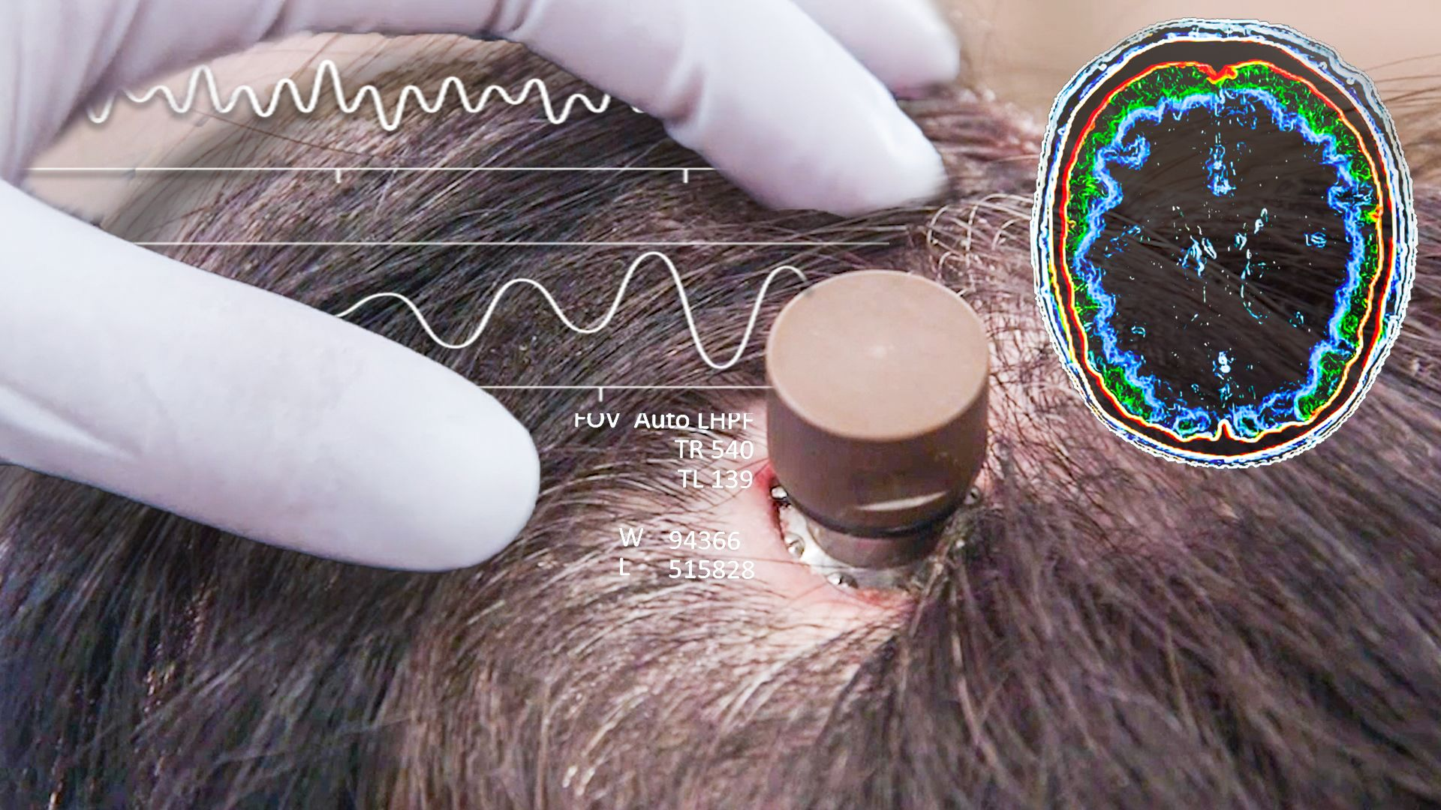
Brain-computer interface
A brain-computer interface (BCI), also sometimes called a brain-machine interface (BMI), is a system that creates a direct communication link between the electrical activity in your brain and an external device.
Non-invasive BCIs: These are the most common type. They use electrodes embedded in a cap or headset placed on the scalp. While convenient, these have weaker signal resolution due to the skull's interference.
Invasive BCIs: These involve surgically implanting electrodes directly into the brain. This offers a clearer signal but is a more complex and risky procedure.

Slide 8
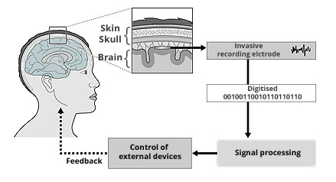
BCI: Working
BCIs work in three main steps: -
Signal Detection: BCIs use sensors to detect electrical signals produced by your brain activity. These sensors can be non-invasive, like a headset you wear, or invasive, where electrodes are implanted directly in the brain through surgery.
Signal Processing: The BCI then interprets these faint electrical signals. By analyzing patterns, the BCI software can decipher what you're trying to do based on your brain activity.
Output Control: Finally, the BCI translates these intentions into commands that control the external device. For instance, if you're thinking about moving your arm, the BCI could send signals to a robotic limb to mimic that movement.

Slide 9
Timeline of neuralink

Slide 10
Early Days (2016-2020)
Founding and Secrecy: Since its foundation Neuralink remained under the radar until 2017, focusing on building its team and core technology.
Focus on Animals: Pre-clinical trials involving pigs and monkeys dominated this period. The aim was to refine the implant, assess biocompatibility, and demonstrate basic functionality like recording brain activity during simple tasks.
Ethical Concerns: These animal tests were controversial. Animal rights groups raised concerns about animal welfare due to reports of infections and deaths.

Slide 11
Building Momentum (2020-2023)
FDA Breakthrough Device Designation (2020): A significant milestone. This designation from the US Food and Drug Administration (FDA) allowed Neuralink to proceed with limited human testing under specific guidelines.
Tech Advancement: Continued refinement of the implant with a focus on minimizing tissue damage during insertion and improving signal quality.
Transparency Efforts: Neuralink began to share more information about its work, including public demonstrations of the technology.

Slide 12
Human Trials Begin (2023-Present)
Human Trials Approved (September 2023): A major step forward. Neuralink received approval to begin human trials targeting individuals with severe spinal cord injuries or ALS.
First Human Implant (January 2024): A historic achievement. Neuralink successfully implanted their BCI device, named Telepathy, in a human volunteer. This initial trial focuses on feasibility, not yet designed to demonstrate safety or effectiveness.
Long-Term Goals: Neuralink's aspirations extend beyond treating neurological conditions. They envision applications in human augmentation and enhanced communication with machines.

Slide 13
benefits of neurotech

Slide 14
Application in Healthcare and lifestyle
Deep Brain Stimulation (DBS): This established therapy uses implanted electrodes to deliver electrical pulses to specific brain regions, alleviating symptoms of Parkinson's disease, essential tremor, and dystonia.
Brain-Computer Interfaces (BCIs): BCIs are still under development, but they hold immense promise for individuals with paralysis or neurological conditions that limit movement.
Improved Assistive Technologies: BCIs can be used to create more sophisticated assistive technologies for people with disabilities.
Video Games and Entertainment: BCI technology is making its way into the gaming industry, allowing players to control characters or interact with virtual environments through brainwaves.

Slide 15
Potential for the Future
Neuroprosthetics with enhanced sensory feedback: Providing a more natural sense of touch and feeling for individuals with prosthetic limbs.
Direct brain-to-brain communication: Imagine telepathic communication or even sharing thoughts and memories directly with others.
Enhanced cognitive function: Neurotechnology might one day help us improve memory, focus, and learning abilities.

Slide 16
Advantages and disadvantages

Slide 17
neurotechnology
advantages
disadvantages
Treatment for Neurological Conditions.
Enhanced Human-Computer Interaction.
Enhanced Prosthetic Control.
Potential for Cognitive Enhancement.
Communication breakthroughs.
Ethical Concerns.
Implant Risks.
Animal Testing.
Unforeseen Consequences.
Weaponization.
Psychological Impact.

Slide 18
conclusion

Slide 19
conclusion
In closing, neurotechnology is a rapidly evolving field with the potential to revolutionize healthcare, communication, and human potential. Neuralink, as a prominent player in this field, has made significant strides in developing brain-computer interfaces.
We've seen how neurotechnology offers exciting advantages, particularly in treating neurological conditions, enhancing human-computer interaction, and potentially even improving cognitive function. However, it's crucial to acknowledge the ethical concerns and safety considerations that need to be addressed as this technology progresses.
By ensuring responsible development and use of neurotechnology, we can unlock its vast potential to improve our lives while navigating the complex challenges it presents.

Slide 20
Thank you!

