Slide 1

Facial Emotion Recognition using Machine Learning
MAJOR PROJECT ON
Submitted by
S P Aryan Biswal
Subhrajit Rout
Rudra Prasad Jena
Guided by
Prof. Lipsarani Jena
Dept. of Computer Science and Engineering Data Science
GITA AUTOMOUS COLLEGE, BHUBANESWAR

Slide 2
Outline
Introduction
What is Facial Emotion Recognition?
Objective
Synopsis of the project
Project Details, Prerequisites
The Process: Processing data, Building and training model, Testing
Project Result and Learnings
Conclusion

Slide 3
Introduction
Facial Emotion Recognition (FER) is a machine learning-based system that identifies human emotions from facial expressions.
The project uses a Convolutional Neural Network (CNN) model built with Keras to classify emotions accurately.
It is trained and tested on the Kaggle Facial Expression Dataset, ensuring a diverse set of facial expressions for better accuracy.
The system integrates computer vision techniques with machine learning, enabling applications in healthcare, security, and human-computer interaction.

Slide 4
Objective
Develop an accurate CNN-based model capable of recognizing facial emotions from static images.
Enhance human-computer interaction by enabling machines to interpret and respond to human emotions.
Improve emotion recognition accuracy by using machine learning techniques and preprocessing methods.
Enable real-world applications such as mental health monitoring, sentiment analysis, and smart surveillance systems.

Slide 5
Synopsis of the Project

Slide 6
Project Details
Name: Facial Emotion Recognition using Machine Learning
Session: 8th Semester, CSE-DS 2025
Under the guidance of: Prof. Lipsarani Jena
Platform: Windows only
Project material: -
Visual Studio Code, Jupyter
Facial Expression Dataset
Python modules such as pandas, numpy, matplotlib, cv2, keras, seaborn

Slide 7
Project Prerequisites
Python (3.12 used)
IDE (Jupyter used)
Numpy (version 1.16.5)
cv2 (openCV) (version 3.4.2)
Keras (version 2.3.1)
Matplotlib (version 3.1.1)
Pandas (version 0.25.1)

Slide 8
The process

Slide 9
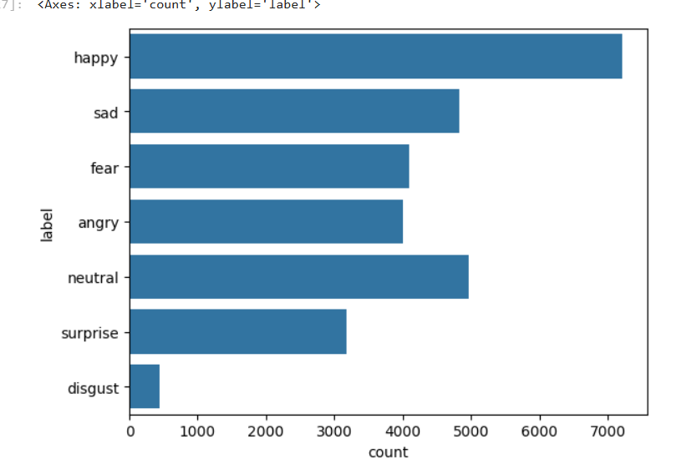
THE dataset
The dataset for this project contains ~36000 images of JPG format.
The dataset contains predefined testing and training data labeled for various emotions.
The emotions are happy, sad, fear, angry, neutral, surprise, disgust.

Slide 10
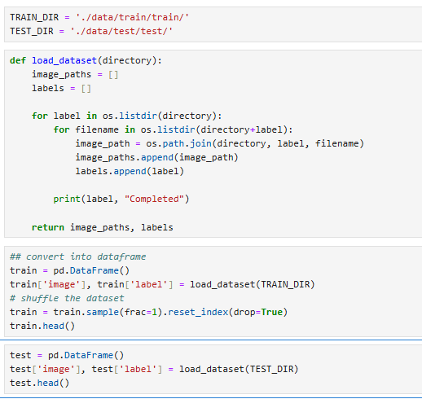
Processing data
The load_dataset() function reads image files from the specified training and testing directories, extracting their file paths and corresponding labels based on folder names.
The image paths and labels are stored in a Pandas Data Frame, making it easier to manipulate and preprocess the data before feeding it into the model.
The training dataset is randomized, ensuring that the model does not learn patterns based on the order of images and improves generalization.
The processed train and test datasets are structured and ready for further preprocessing, such as image resizing, normalization, and augmentation, before being used for model training.

Slide 11
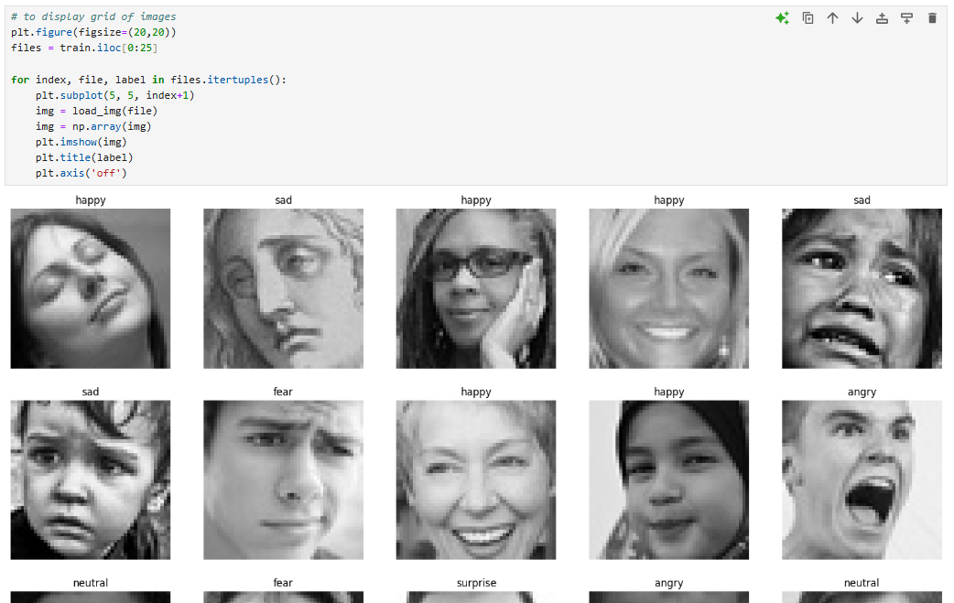
A look at the data
We then create 25 plots in 5×5 shape & display the threshold images of 25 facial expressions.
Each image in the dataset is a 48x48 image focused mainly on frontal face.
The image depicts any one of the seven emotions considered in the dataset.
The images have a single channel 8-bit pixel values ranging from 0 to 255

Slide 12
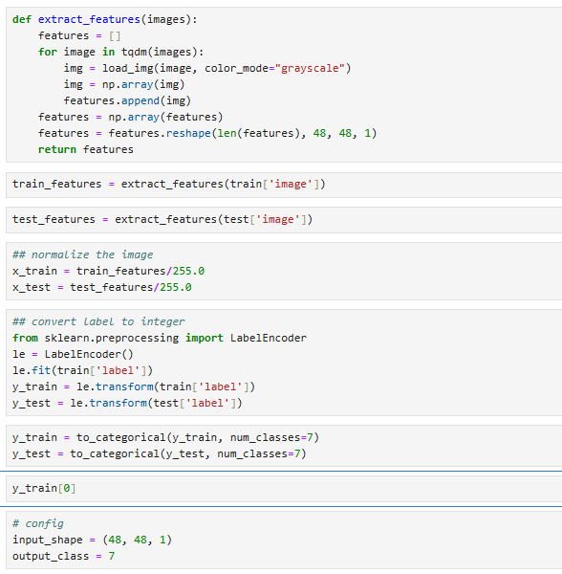
Preparing for the model
Images are reshaped, and normalized by dividing by 255.0 for better model performance.
Emotion labels are converted into numbers using LabelEncoder and transformed into one-hot vectors for classification into 7 categories.

Slide 13
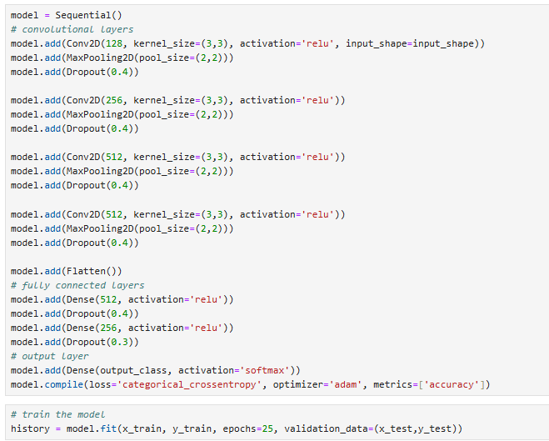
Creating and training The model
A deep Convolutional Neural Network (CNN) is created using multiple Conv2D, MaxPooling2D, Dropout, and Dense layers.
The ReLU activation is used for hidden layers, while the Softmax activation is applied to the output layer for multi-class classification.
The model is compiled using categorical cross-entropy loss and the Adam optimizer. It is trained for 25 epochs with validation data to monitor performance and improve accuracy.

Slide 14
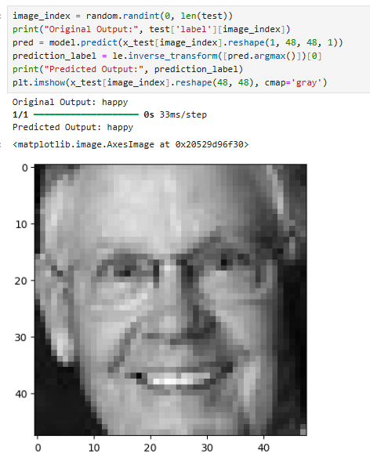
Testing the model
The trained CNN model is tested using the validation dataset to measure its accuracy and effectiveness in recognizing facial emotions. The evaluation helps assess how well the model generalizes to unseen data.

Slide 15
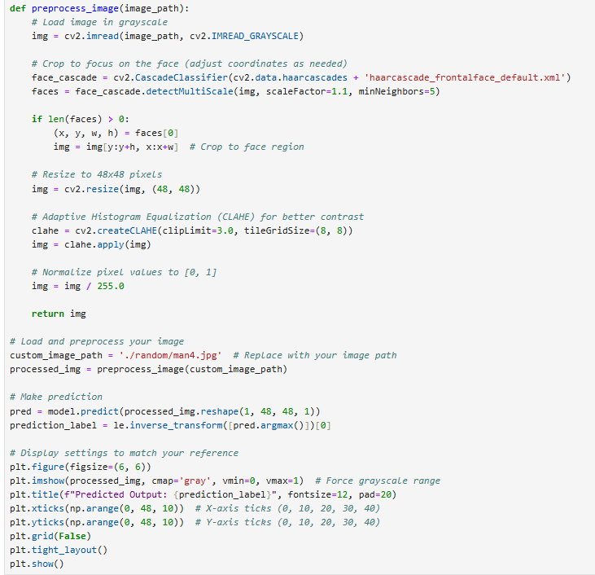
Prediction on External Image
The external image is loaded in grayscale, face detection is applied, and the image is resized to 48x48 pixels for consistency with the model's input requirements.
The preprocessed image is fed into the trained CNN model, which predicts the corresponding emotion label by applying the softmax function and selecting the highest probability class.
The processed image is displayed with the predicted emotion label, ensuring clear interpretation. Grid settings, axis ticks, and color mapping are customized to match the reference display.

Slide 16
Project Result

Slide 17
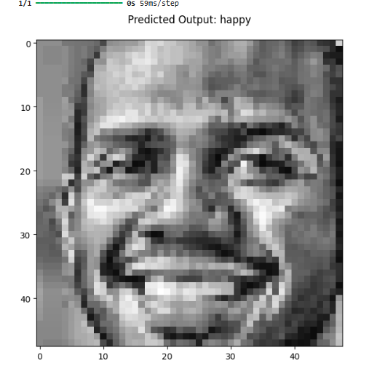
Output of the prediction
The predicted emotion is displayed in the label along with the random image. In this particular instance we have emotion ‘happy’ correctly predicted for the random input image
The input needs to be manually provided to the model by providing the path to the input image.
Image can be of any emotion on facial emotion as long as the image and face are clearly visible

Slide 18
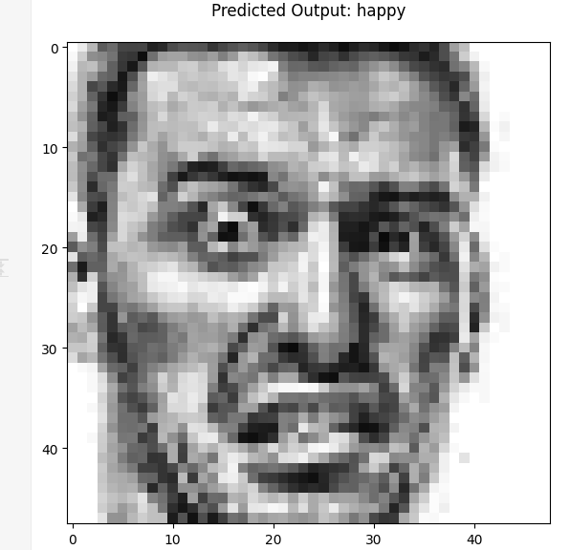
Model evaluation and error
The evaluation was performed on the following matrices:
The validation accuracy is : [0.573]
The training accuracy is : [0.5492]
The validation loss is : [1.1218]
The training loss is : [1.2158]
Although the model is accurate enough it might produce incorrect predictions still. One such example is given here.

Slide 19
Conclusion
The Facial Emotion Recognition Using Machine Learning project successfully demonstrated the capabilities of deep learning in classifying human emotions from facial expressions.
The project followed a structured approach, from data preprocessing and model training to evaluation and deployment, showcasing the practical application of machine learning in computer vision.
Looking ahead, this project opens doors for several future enhancements. Integrating the model with real-time video processing using OpenCV could enable live emotion detection, expanding its applications in fields like psychology, customer feedback analysis, and human-computer interaction.

Slide 20
Thank you!

