Slide 1
Extending the SIMPLE model to choice tasks
Sean Conway

Slide 2
The Model
Scale-Invariant Perceptual Learning Model (SIMPLE)
Predicts memory performance based on temporal distance
Takes ideas from literature on categorization, identification, choice

Slide 3
Temporal distance
Log scaled – Weberian Compression

Slide 4
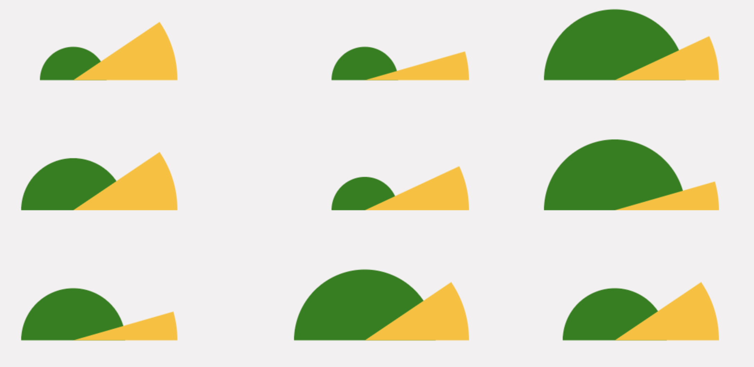
Psychological Distance
Physical dimension values may not correspond to psychological dimension values

Slide 5
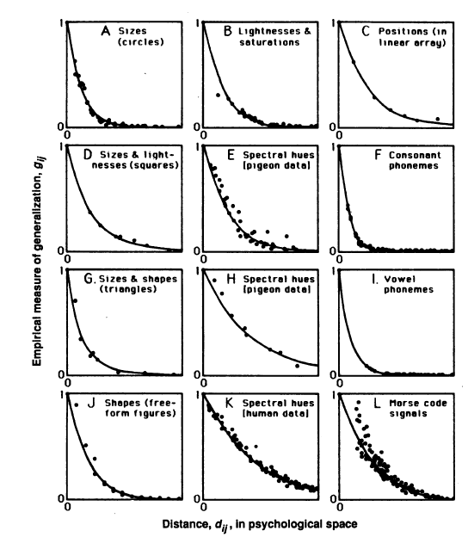
Similarity
Exponentially decreasing function of psychological distance (Shepard, 1987; Nosofsky, 1986)
Shepard (1987 Fig. 1)

Slide 6
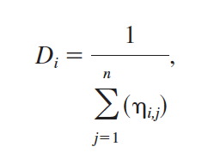
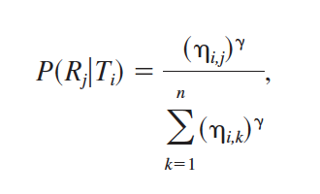
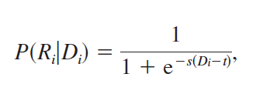
SIMPLE Recall Mechanism
In any given recall position, calculate each item’s similarity to other items.
D – Discriminability
In serial ordering, recall probability is
In free recall, recall probability is

Slide 7
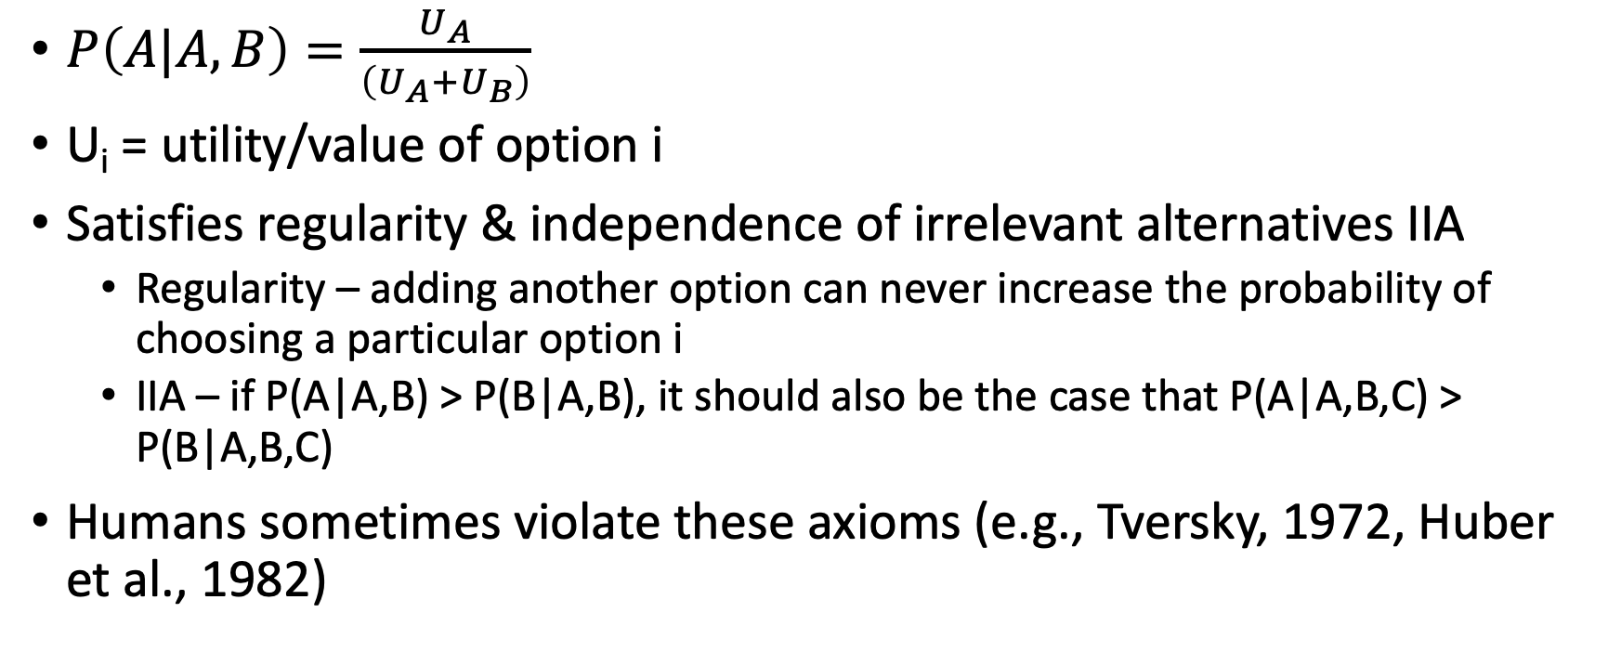
Luce Choice Rule (e.g., Debreu, 1960; Luce, 1963)
$P\left(A|A,B\right)=\frac{U_{A}}{\left(U_{A}+U_{B}\right)}$
U_{i} = utility/value of option i
Satisfies regularity & independence of irrelevant alternatives IIA
Regularity – adding another option can never increase the probability of choosing a particular option i
IIA – if P(A|A,B) > P(B|A,B), it should also be the case that P(A|A,B,C) > P(B|A,B,C)
Humans sometimes violate these axioms (e.g., Tversky, 1972, Huber et al., 1982)

Slide 8
The Proposal
Test SIMPLE’s behavior in 2/3-AFC scenarios
E.g., “which item did you study at position 2?”
Similar to serial order, but with some items removed from the denominator

Slide 9
Progress (so far)
Implemented the model for free recall, serial recall/order
Both closed-form predictions and simulation based on parameter values

Slide 10
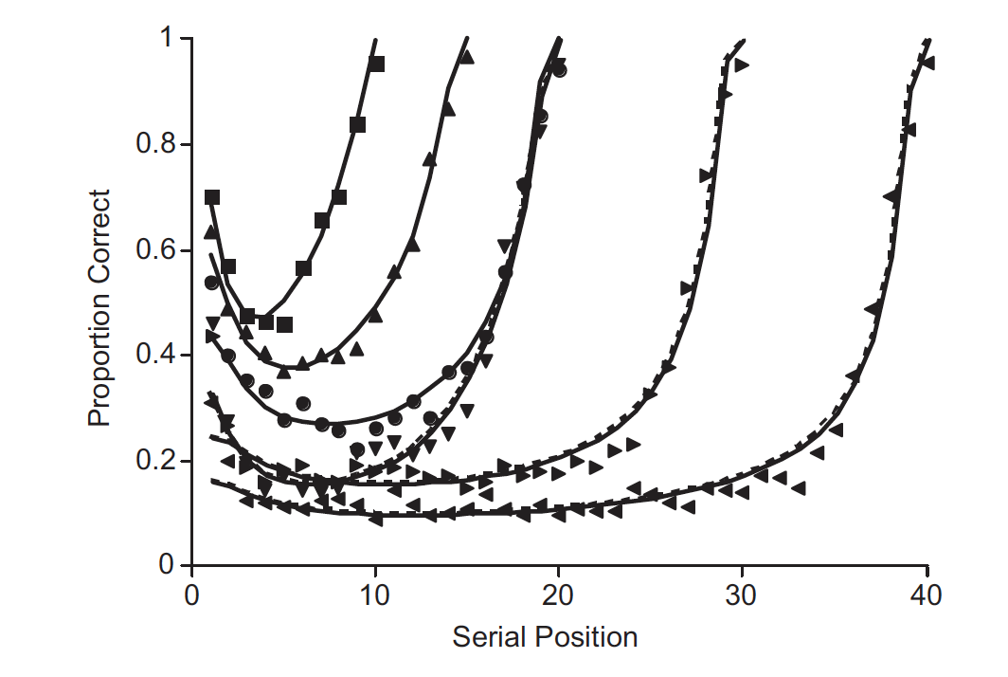
Progress (so far)
Reproduced the Murdock (1962) serial recall curve from Brown et al
Brown et al (2007) Fig. 3

Slide 11
Progress (so far)
Tried (and failed) parameter recovery

Slide 12
To do
Modify it for 2/3 AFC
Consider the types of choice problems to give it
Does it always satisfy regularity/IIA? (I think it will, but not 100% sure)
Try and “break” it?

