Slide 1
Extending the SIMPLE model to forced-choice tasks
Sean Conway

Slide 2
The Model
Scale-Invariant Perceptual Learning Model (SIMPLE)
Predicts memory performance based on temporal distance
Takes ideas from literature on categorization, identification, choice

Slide 3
Temporal distance
Log scaled – Weberian Compression

Slide 4
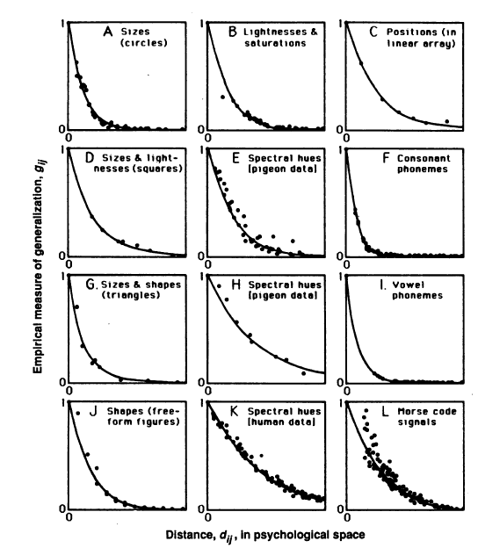
Similarity
Exponentially decreasing function of psychological distance (Shepard, 1987; Nosofsky, 1986)
Shepard (1987 Fig. 1)

Slide 5
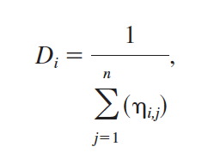
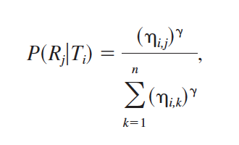
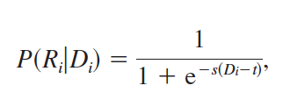
SIMPLE Recall Mechanism
In any given recall position, calculate each item’s similarity to other items.
D – Discriminability
In serial ordering, recall probability is
In free recall, recall probability is

Slide 6
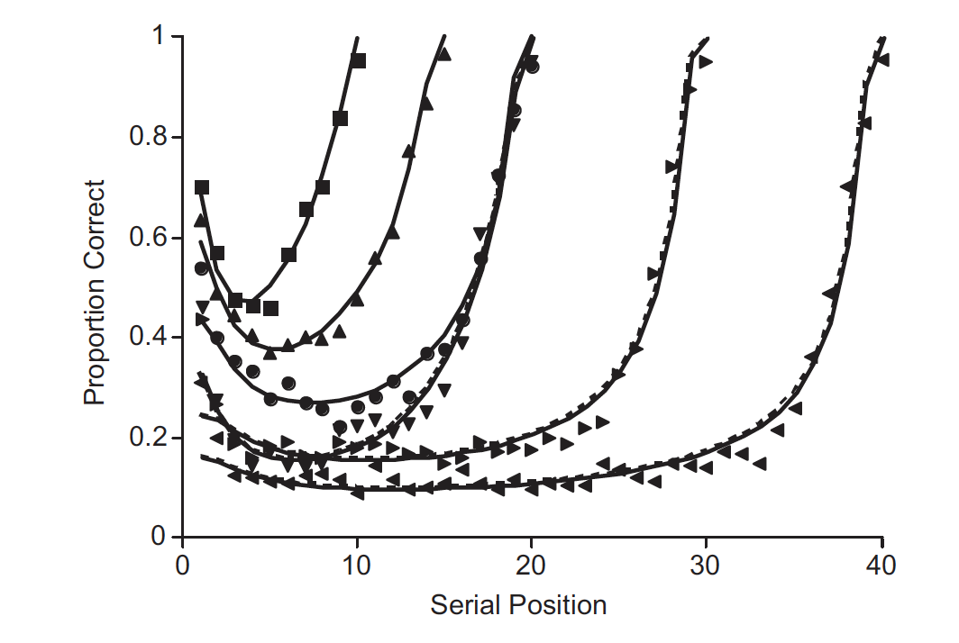
SIMPLE Model
Predicts primacy & recent effects
Brown et al (2007) Fig. 3

Slide 7
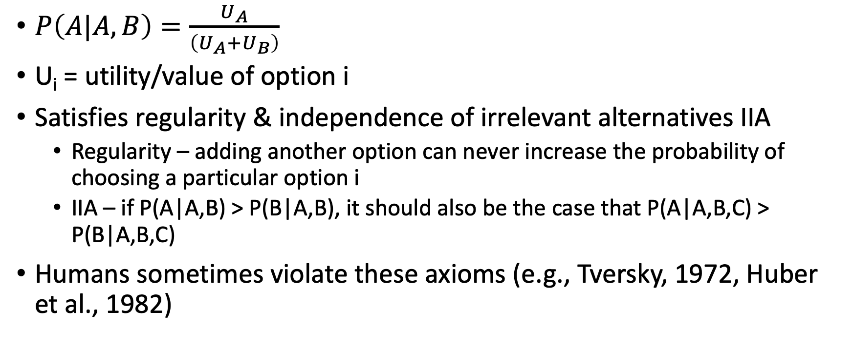
Luce Choice Rule (e.g., Debreu, 1960; Luce, 1963)
$P\left(A|A,B\right)=\frac{U_{A}}{\left(U_{A}+U_{B}\right)}$
U_{i} = utility/value of option i
Satisfies regularity & independence of irrelevant alternatives IIA
Regularity – adding another option can never increase the probability of choosing a particular option i
IIA – if P(A|A,B) > P(B|A,B), it should also be the case that P(A|A,B,C) > P(B|A,B,C)
Humans sometimes violate these axioms (e.g., Tversky, 1972, Huber et al., 1982)

Slide 8
The (Simulated) Choice Task
Participants study a list of stimuli (e.g., words)
A short time passes
Then, they are presented with two stimuli from the list and asked to identify which word was shown in position [X]

Slide 9
Hope

Slide 10
Bear

Slide 11
Coin

Slide 12
Cars

Slide 13
Town

Slide 14
Palm

Slide 15
Tarp

Slide 16
Wane

Slide 17
Lake

Slide 18
Brow

Slide 19
Test
Which of the following items was in position 2?
Bear or Coin?

Slide 20
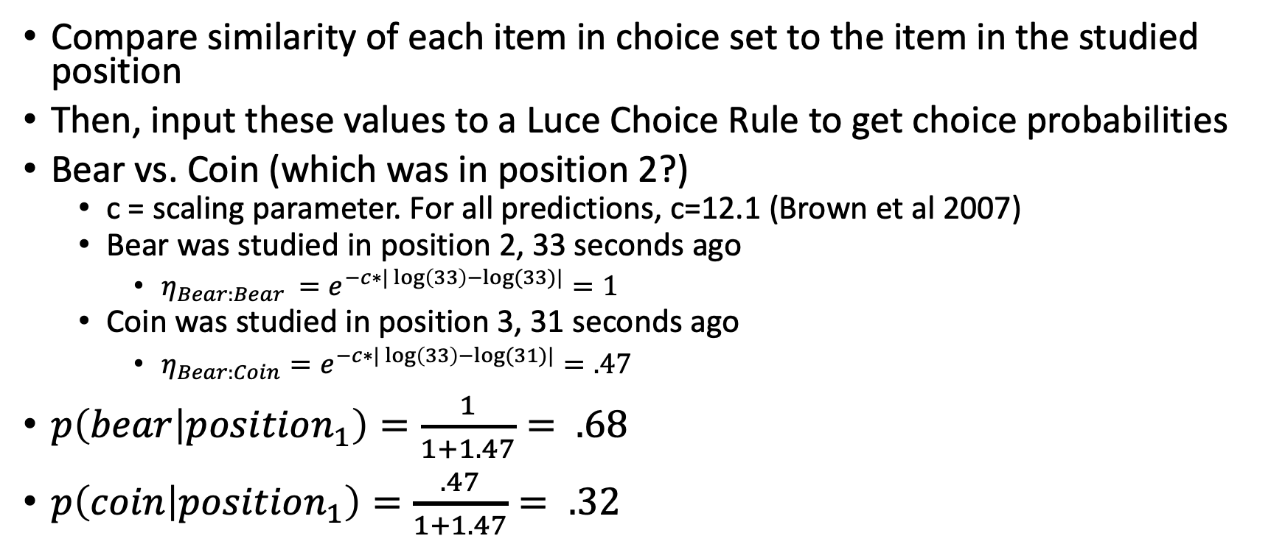
Generating Model Predictions
Compare similarity of each item in choice set to the item in the studied position
Then, input these values to a Luce Choice Rule to get choice probabilities
Bear vs. Coin (which was in position 2?)
c = scaling parameter. For all predictions, c=12.1 (Brown et al 2007)
Bear was studied in position 2, 33 seconds ago
$η_{Bear:Bear }=e^{−c∗|\log\left(33\right)−log⁡(33)|}=1$
Coin was studied in position 3, 31 seconds ago
$η_{Bear:Coin}=e^{−c∗|\log\left(33\right)−log⁡(31)|}=.47$
$p\left(bear | position_{1}\right)=\frac{1}{1+1.47}= .68$
$p\left(coin | position_{1}\right)=\frac{.47}{1+1.47}= .32$

Slide 21
The Stimuli
Murdock et al (1962) stimulus values (as described by Brown et al, 2007)

Slide 22
Some assumptions
Assume that there is one choice prompt per choice set
Assume that this comes about 20 seconds after onset of the last item
Brown et al (2007)
The correct item is always in the choice set

Slide 23
2-Backwards Prompt
Ask participants about the item from the studied position and the item before (except for position 1)

Slide 24
2-Forwards Prompt
Ask participants about the item from the studied position and the item after (except for position 10)

Slide 25
3-Backwards Prompt
Ask participants about the item from the studied position and the item before (except for positions 1 and 2)

Slide 26
3-Forwards Prompt
Ask participants about the item from the studied position and the item after (except for positions 9 & 10)

Slide 27
3-Middle Prompt
Ask participants about each item and its neighbors to either side (except for positions 1 & 10)

Slide 28
Edge Positions

Slide 29
Primacy vs. Recency

Slide 30
Primacy vs. Recency

Slide 31
Conclusions
Model shows primacy and recency effects in 2 & 3 AFC
No evidence for violations of IIA (though I didn’t look very rigorously!)

