Slide 1
Human Computer Interaction
Project Title : Playo ( A Website for booking grounds to play Sports)
Project Team : K SASI KIRAN REDDY (PES1201701584) S P NITHESH KUMAR (PES1201701561)
SAQLAIN PASHA (PES1201701539)
MOHAMMED FAIZAN (PES1201701740)

Slide 2
Outline
CONCEPT VIDEO
NEEDFINDING
LO-FI PROTOTYPING
HI-FI PROTOTYPING

Slide 3

CONCEPT VIDEO

Slide 4

NEEDFINDING

Slide 5
NeedFinding
Problem Statement
Today in India, urbanization is happening at great speed. Many people living in rural areas are moving to cities. So there is huge population density growing in urban areas. With Urbanization people are now finding difficulties to do exercises , play sports in open grounds.
In metro cities, open grounds are very less in number and are mostly private properties due to which people are staying in their homes and becoming lazy. Only professional players and people enrolled in coaching are able to play regularly. In addition to this, people nowadays are finding it difficult in to play with their friends as everyone has different schedules and timings don’t match and also finding people who like the same sport is not easy .

Slide 6
NeedFinding
Proposed Solution:
People who are interested in business and have love towards sports should buy lands or rent them and build courts, grounds for various types of sports.
A startup can come forward to create a website where people can book courts, grounds on a hourly basis.

Slide 7
NeedFinding
Possible Extensions:
A group can book an entire ground / court for playing among themselves .
A player can choose his opponent in the game .

Slide 8
NeedFinding
Advantages of Playo
Business Opportunity is created.
Employment is created for workers who maintain courts and grounds.
People now can play any time they wish.
Searching for grounds is very easy.
Can make friends through playing.
Cheaper than stadiums, professional grounds.
Affordable for many in metropolitan cities.
Through this tax and revenue is collected, which benefits the government.

Slide 9
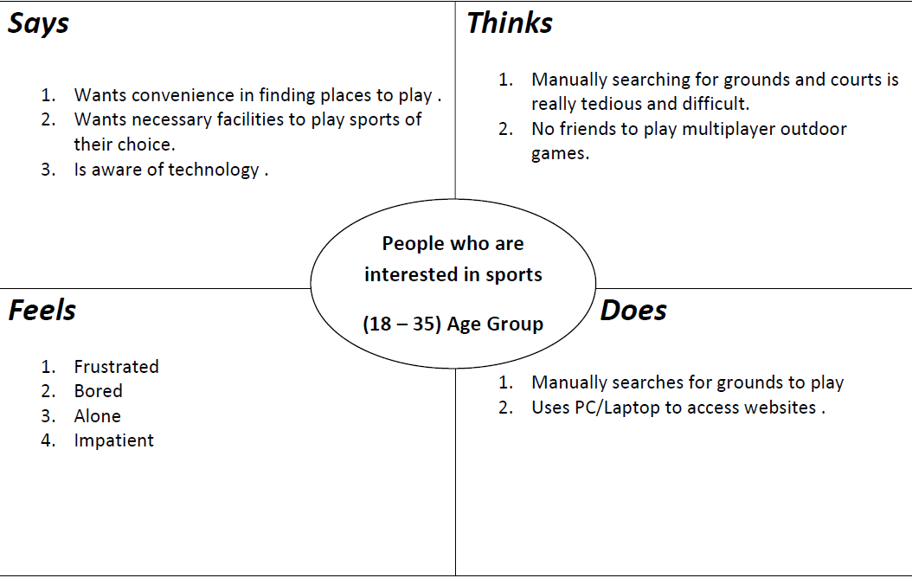
EMPATHY MAP

Slide 10

LO-FI PROTOTYPING

Slide 11
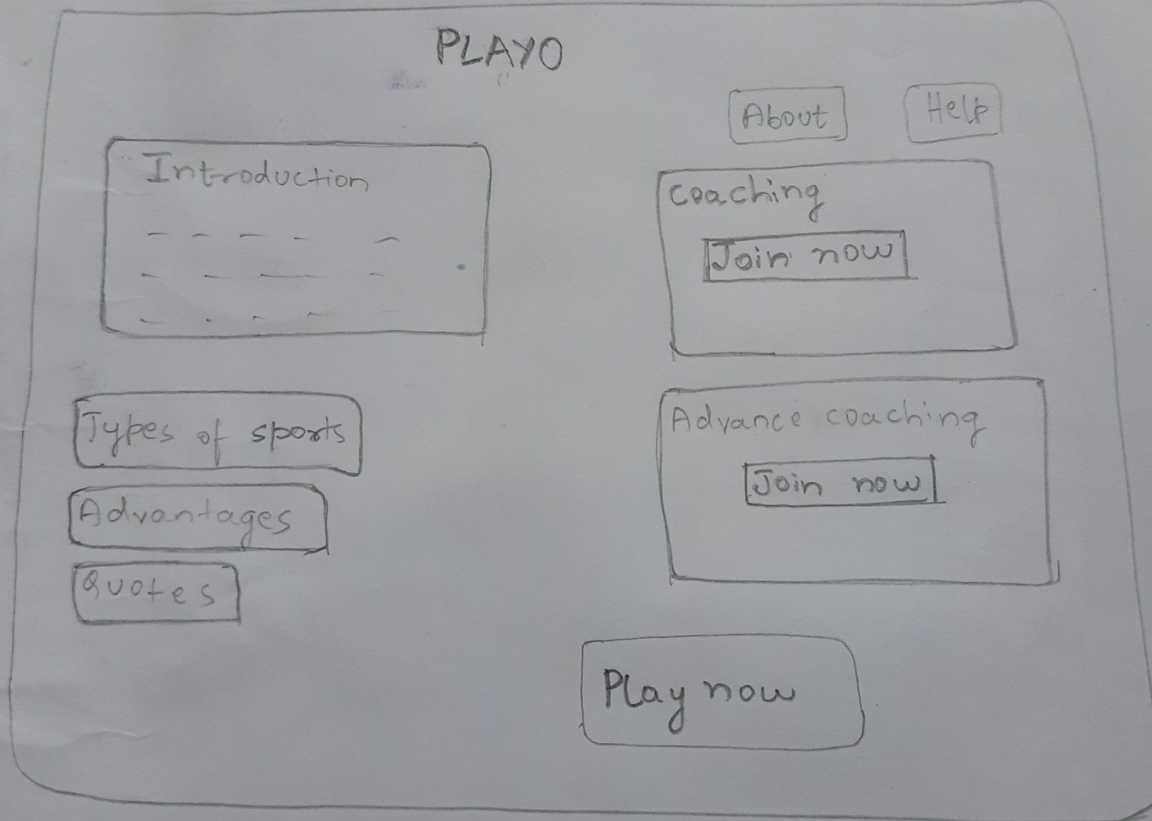
LO-FI PROTOTYPE
Sketches: Web Application
Home Page

Slide 12
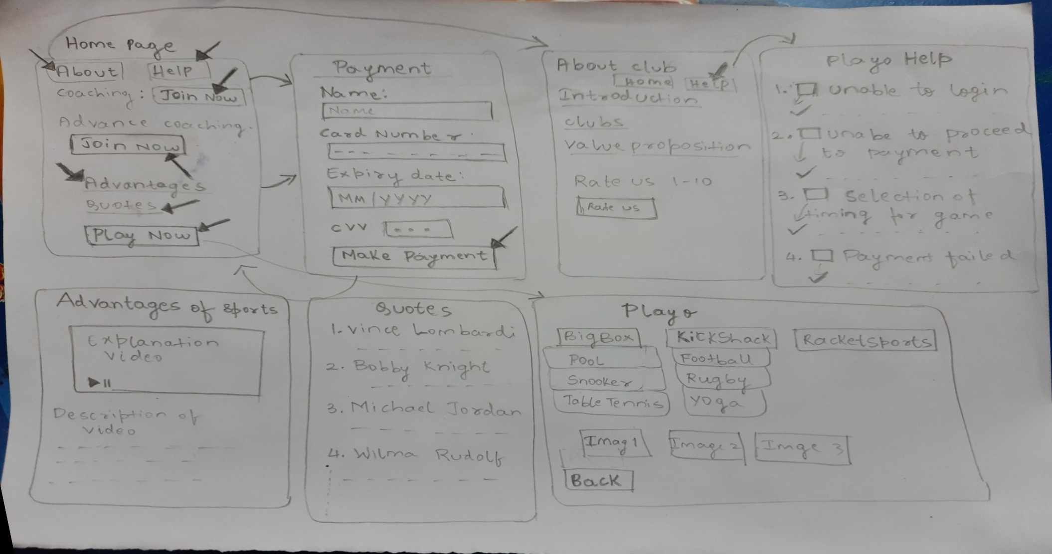
Overall Workflow of our website
LO-FI PROTOTYPE

Slide 13
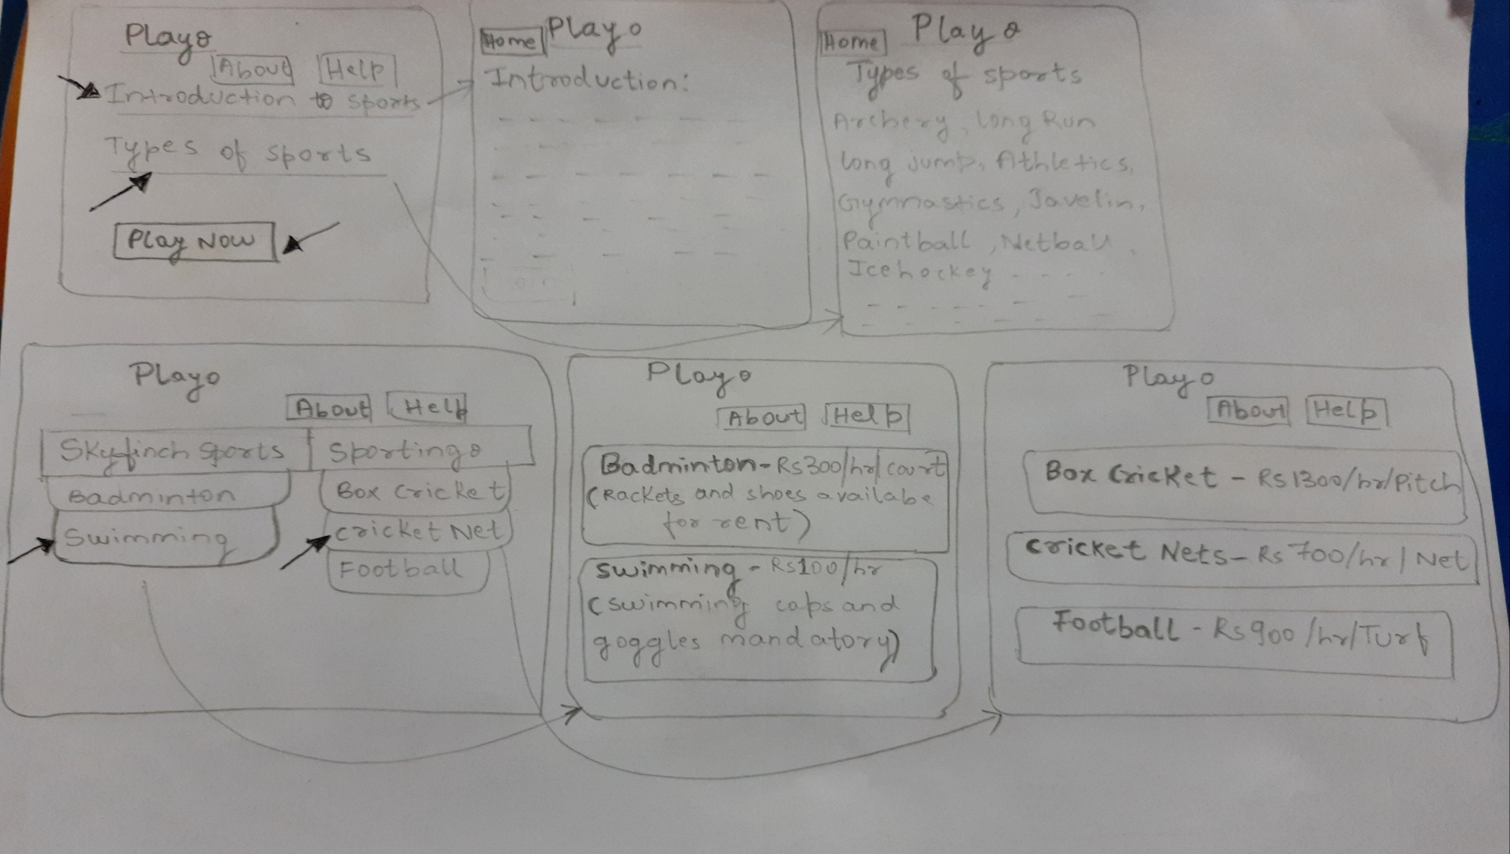
LO-FI PROTOTYPE

Slide 14
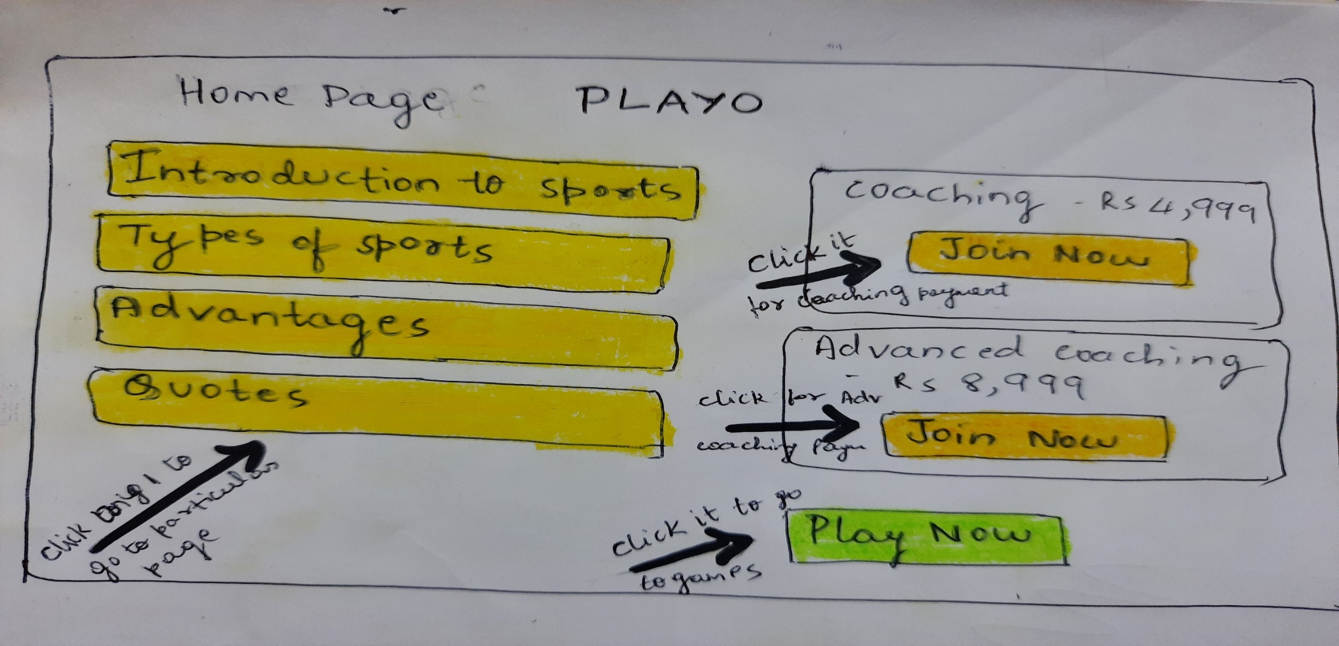
Here we have 3 unique buttons i)One will take to payment page ii)one will take to clubs page iii)Other will take to unique page assigned
LO-FI PROTOTYPE

Slide 15
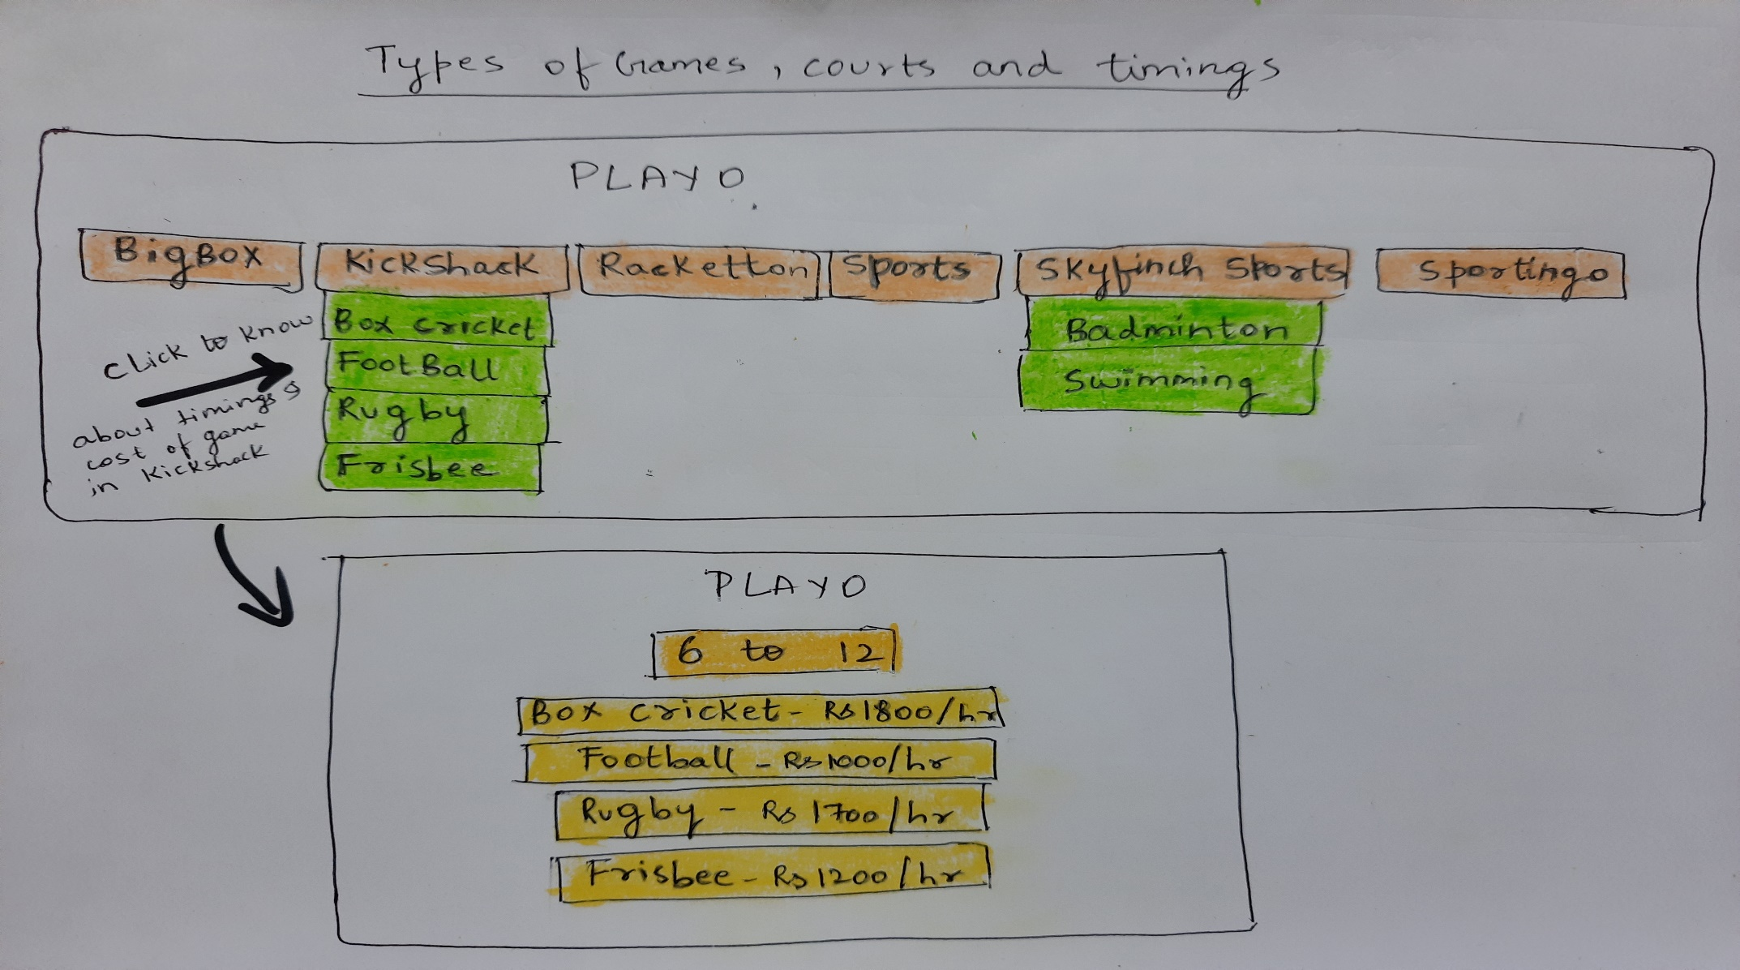
LO-FI PROTOTYPE

Slide 16
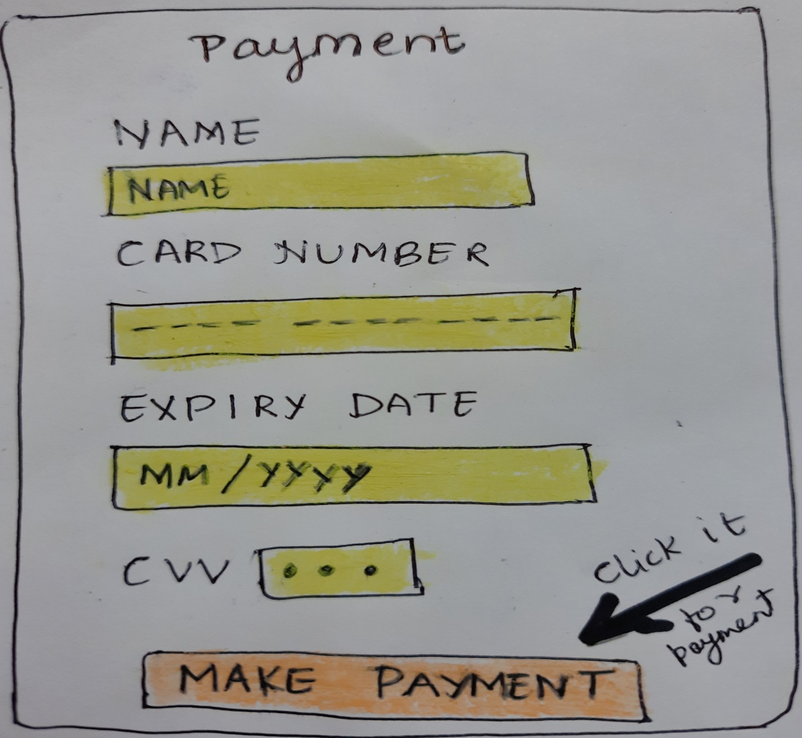
LO-FI PROTOTYPE

Slide 17
Thank You

