Slide 1
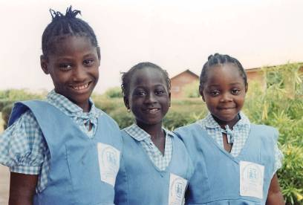
You can help make a difference
World Orphan Week

Slide 2
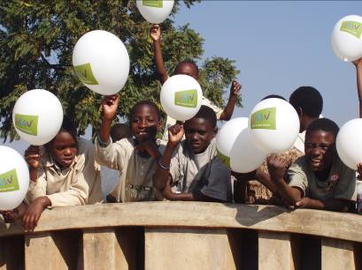
What is ‘WOW’
World Orphan Week
is the time to WOW friends, teachers and family with fun activities whilst raising vital awareness & funds for SOS Children’s Villages

Slide 3
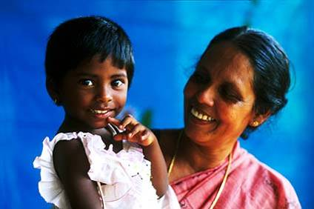
SOS – what we do
a family based approach to long
term care for children who have
been orphaned or abandoned as
a result of poverty, disease, war, famine or natural disaster
children cared for by
SOS mothers in family homes
in unique children’s villages
in 125 countries
SOS is the world’s
largest orphan charity

Slide 4
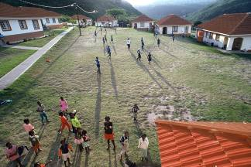
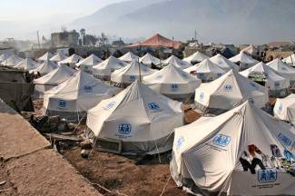
How SOS works:
Each SOS Children’s Village has a nursery school, primary school and medical centre. Many also have secondary schools, vocational centres and social centres
These facilities are open to the wider community and provide outreach support to disadvantaged families, and sometimes emergency relief following natural disasters, such as the Pakistan earthquake

Slide 5
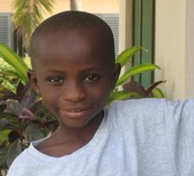
SOS helps children like John:
Last year, John was found abandoned, walking along a road, in rural Ghana. He was 6 years old but looked half his age, as he was extremely malnourished.
John was taken to an SOS Children’s Village where he is now part of a loving family, cared for by his SOS mother and loved by his SOS brothers and sisters.
John has grown in confidence and now attends school. He is a happy boy with a bright future ahead of him.

Slide 6

How you can be part of WOW!
World Orphan Week is a wonderful opportunity to develop international links with our world wide work, gain an insight into other cultures and feel part of the global community.
This can be achieved in a number of ways:
sponsor an SOS Children’s Village & receive annual newsletters
learn how children live in Brazil, South Africa, Ghana, Vietnam
& Belarus using our downloadable educational resources
test your general knowledge with our wikipedia CD
understand the issues facing children in the developing
world by watching child interviews on our WOW DVD

Slide 7
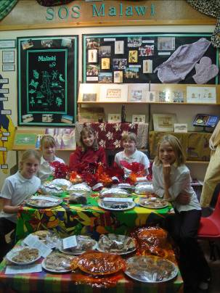
How can you raise vital funds?
There are many fun ways to do this, here are just a few ideas:
Have a non-uniform day
Hold a coffee morning or quiz
Have a themed day, with an international flavour
Do a sponsored spell or penalty shoot
Create artwork and hold an exhibition – encourage parents
to buy yours!

Slide 8
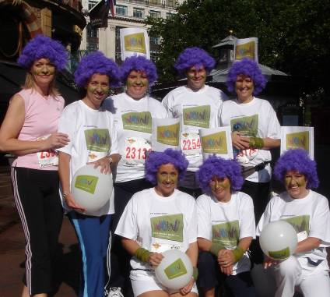
More fundraising ideas…
Involve the whole school in a sponsored virtual challenge:
‘Walk the Wall of China’ by doing circuits of the playground
‘Swim Lake Malawi’ by doing lengths of the local pool
Climb Mount Kilimanjaro by walking up the school steps.
Anything is possible if everyone plays their part!

Slide 9
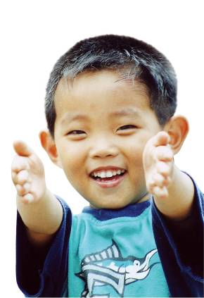
Your Help is Needed!
Whatever you choose to do in
World Orphan Week, your help is
needed and your efforts to raise money and funds are much appreciated.
There are many more orphaned
and abandoned children,
like John, all over the world.
YOU can help give them
a family home, food,
an education and a
brighter future!

Slide 10
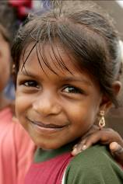
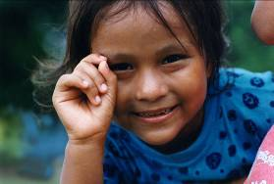
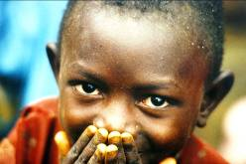
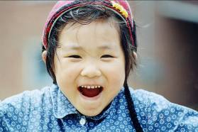
Thank you!

