Slide 1

EGR 222 Software Engineering
Dr. Mikyung Han, Ph.D.
California Baptist University
Introduction

Slide 2


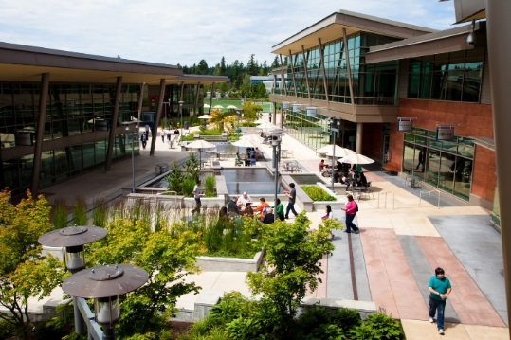

About Myself
Born, Raised in Seoul, Korea till 2005
Worked 4 years at Microsoft Redmond, WA
till 2015
Did MS/PhD at UT Austin, TX till 2011
Professor at CBU
Notes:
Before I start, let me introduce little bit about myself. I was born and raised in Seoul Korea will 2005. I did my undergrad in CS in Korea.
I came to united states at 2005 for my graduate study. During MS/PhD my area of focus was wireless networks and mobile networks.
Now, I am working at Microsoft, I am in the cloud services team doing data analytics and visualization. My area of interest now is business intelligence, distributed systems, and cloud computing. It’s been almost 4 years, it is a great privilege to work there with lots of smart people. I am now seeking to be a faculty at CBU, because I love teaching, I love students. College is exiting time college campus is exiting place. I want to build the kingdom together with students and faculties at CBU living out my life purpose to the full measure, which is to maximize God’s glory in whatever I do.

Slide 3
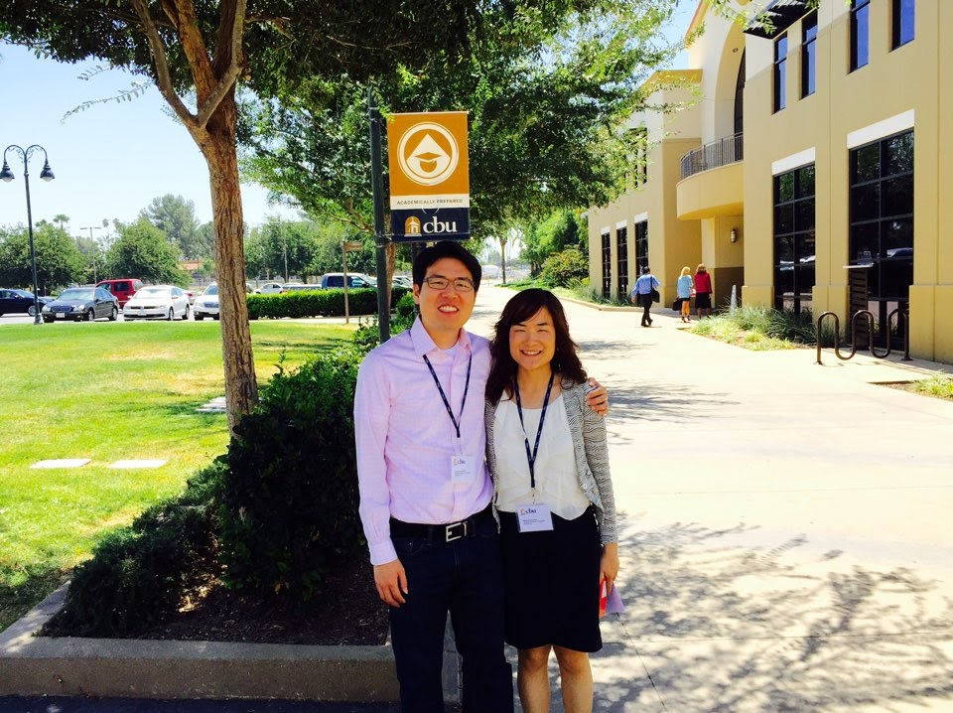
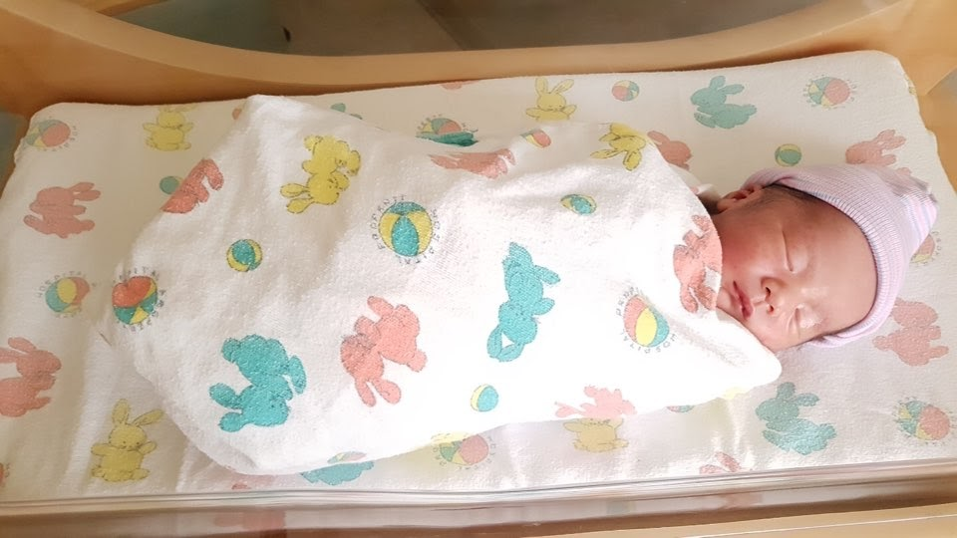

My family
Notes:
Before I start, let me introduce little bit about myself. I was born and raised in Seoul Korea will 2005. I did my undergrad in CS in Korea.
I came to united states at 2005 for my graduate study. During MS/PhD my area of focus was wireless networks and mobile networks.
Now, I am working at Microsoft, I am in the cloud services team doing data analytics and visualization. My area of interest now is business intelligence, distributed systems, and cloud computing. It’s been almost 4 years, it is a great privilege to work there with lots of smart people. I am now seeking to be a faculty at CBU, because I love teaching, I love students. College is exiting time college campus is exiting place. I want to build the kingdom together with students and faculties at CBU living out my life purpose to the full measure, which is to maximize God’s glory in whatever I do.

Slide 4
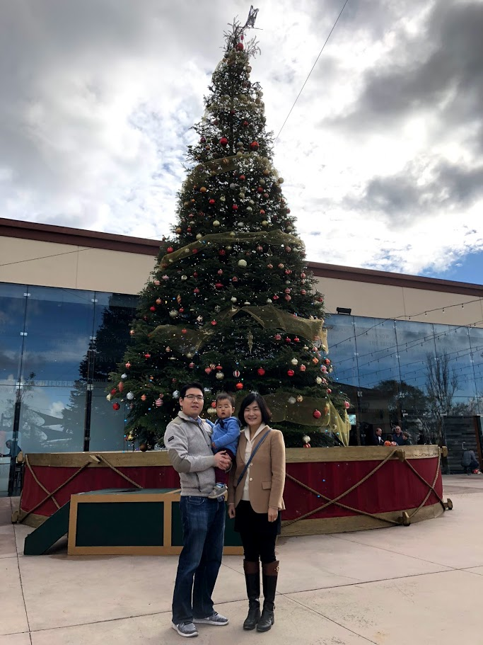
My Faith
Born in a Christian family
Accepted Christ when I was in College
Integrate faith into CS
Member of Saddleback church

Slide 5

Ice-breaker

Slide 6
Your Turn!
Name?
Where are you from (City)?
What is your favorite dessert?
Your academic status (freshmen, sophomore, etc) and major (SE or CS or something else)? Why did you choose?
What do you hope to get out of from this class?

Slide 7
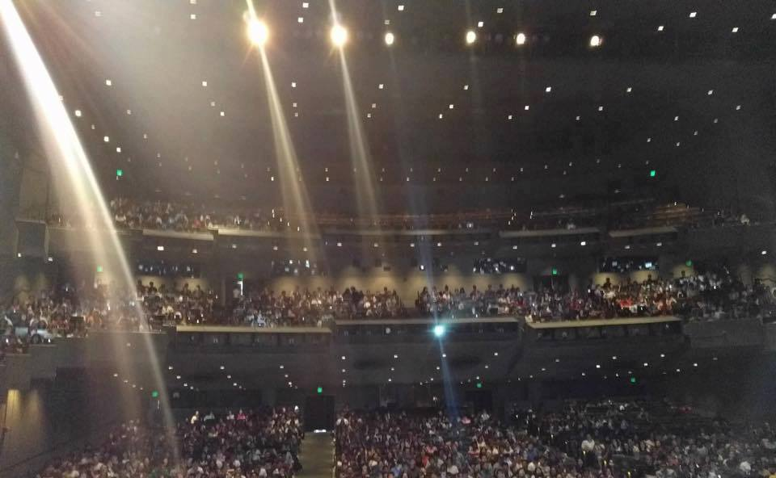
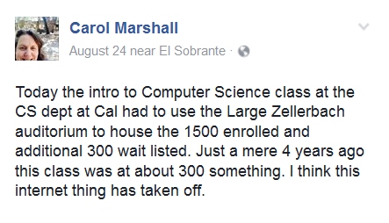
Guess What?
Notes:
UC Berkeley’s Zellerbach auditorium which can house 1984
- 1500 enrolled and additional 300 wait listed. Just a mere 4 years ago this class was at about 300 something

Slide 8
What Does This Mean?

Slide 9
Course Logistics

Slide 10
Before Each Class…
1 minute of Silence and Stillness
With a music
Quite our minds
Refocus our attention to God
God wants to speak to you!

Slide 11
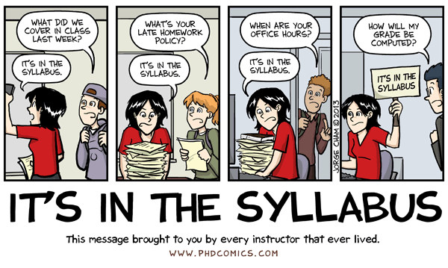
Syllabus Time!

Slide 12

Textbook
Building Java Programs 4th edition by Reges/Stepp
Exercise 0 Upload the proof of textbook
Worth 1% of your final grade
(Physical or electronic version of the book)
You will be using the same book for EGR221 Data Structure

Slide 13
Why buy the textbook?
Aren't books obsolete in the days of the Internet in 2009?
No.
A good book is a well-written, clear, coherent, and comprehensive introduction to the subject material.
The reason to pay is for its writing and editing.
Internet gives only a fractured and partial view of the conceptual material
Yes, Internet is extremely useful in helping you understand a specific error message or looking up Java specs (highly encouraged to use it for this purpose)
Concepts are much more important than low-level programming details!

Slide 14
Why buy the textbook?
Everyone has been burned by overpaying for a bad book.
But this books is EXTREMELY well-written
Will learn much and find them useful far into the future!
Well worth your while to have them on your bookshelf
The same book is use for EGR 221 Data Structures
Cost effective!
You will be actually reading them!

Slide 15
Three Logical Parts
Part 1
Programming Basics Review
Part 2
OOP Principles
Part 3
Overview of SE
80% are recap from EGR 121
With more rigor
20% new things specific to Java
Design and impl. w class and objects
Deep-dive into Java
30,000 foot view
Mini-tour of your future courses in SE/CS
Final project

Slide 16
Tips for Success 1: Be resource-savvy
Come to lecture!
Visit blackboard and check CBU email often!
Utilize ALL of the resources!
Come visit me in Office Hours
Your TA (TBD)
Textbook and Videos!
Slides and Lecture examples
Practice-It!!!!! http://practiceit.cs.washington.edu/practiceit/

Slide 17
Tips for Success 2: Don’t take it personal
If you don’t understand something, it’s a good sign
Having confusion, doubts, questions are super healthy signs that your brain is working and trying to understand
So when you do, don’t be frustrated!
Instead ASK QUESTIONS (especially “WHY?”)
If you have a question, the chances are 10 others in the room will also have the same question!
“The only dumb questions are the ones unspoken”

Slide 18
Tips for Success 3: Keep up with the Assignments
The course material is cumulative and fast-paced
Often times extensions actually work against you because you are loosing time to work on the next more important assignment
Statistically proven
Don’t try to test it yourself
Wisest person learn from others’ experience
Remember: all assignments must be your own work!

Slide 19
How do I know
if the work I did was really mine?

Slide 20

Cheating vs. Collaboration
Gilligan’s Island Rule

Slide 21
Cheating vs. Collaboration
Freedom of Information Rule
Always write the name(s) of who you talk with about your assignments on your assignment
Programming – write as part of comment in the file that has main() method
Other - at the top of the first page

Slide 22
Tips for Success 4: Time management
The most valuable skills to be successful in this class, in your career, in your life!
Q: How many hours to invest outside of the class per class contact hour?
Remember 101?
For 3 unit class, how many hours should you put outside of this class?

Slide 23
Time Management
At least 9 hours per week: Total of 12 hours
I will you 1 hour free!
11 hours per week
Lecture : 1 hour x 2 = 2 hours
PI Exercise : 30 min per question x 4 = 2 hours
Video : 15 min per video x 4 per week = 1 hour
Textbook/PPT : 30-45 min per class = 1 hour 30 min
HW : 4 - 5 hours
I will give you weekend!
Excluding lecture, excluding weekend, 1 hour 15 min each day

Slide 24

….If Things are Taking Longer than it should
Don’t take it personal
Take it as a signal to seek out community
Q: Can you learn a language by yourself?
Find a buddy
Find a community

Slide 25
Tutoring Session
TBD
4-5 handsome and awesome tutor lined up
Will be held least 3-4 times a week
Extra credit opportunity

Slide 26
Textbook Reading Club
Based on student evaluation
Need 6-8 self-motivated students as facilitator
Commitment : 45 min weekly or bi-weekly
As a facilitator, all you have to do is show up and read textbook together based on Syllabus schedule
Keep it short and sharp
No need to finish all reading
No need to discuss or answer each others question
Do NOT do any other assignments or activities
JUST R.E.A.D
Send Dr. Han an email by 1/10 EOD
Extra credit given to the facilitators and the regular participants

Slide 27
Form Your Own Study Group
Encourage reading textbook and lecture notes
Work on the assignments together
Study for exams together
Extra credit given to all participants
Need to provide me a meeting log: Include time, place, and people participated, and what you did
Regularity recommended: weekly
Because assignments are weekly!

Slide 28

Shhh….

Slide 29
Secrets To Beautiful Programming
I will be revealing these secrets throughout the semester
Stay tuned!
Secret #1: Knowing lecture is limited
Secret #2: Knowing it doesn’t happen overnight
Secret #3: Knowing the time
Secret #4 ….

Slide 30
Lecture is Limited
1:20+ ratio is not the best for learning esp. true for programming
Many ways to write code that does the same thing
Lecture can only cover a limited set!
I kept the slides comprehensive
Slides are longer than what I can cover during lecture
I will be skipping slides and focus on key concepts only
Hidden slides : because it is a recap from EGR121 C++

Slide 31
Good news: Lecture is Limited
Even if you don’t like the lecture
It is only < 20% of your learning experience
2 hours vs 9 hours!
“I wasted 1 hour today, therefore it’s a bad day and I am going to waste the other 23 hours!”
Still false and foolish whether the initial waste was because of you or somebody else!

Slide 32
Your Part is So Much More!
Whether that’s a good news or bad news it is your choice!
Yes, be ACTIVELY ENGAGED during lecture
Take notes, packet and work sheets exercises
But even more important components than lecture is
Video, HW, Practice-It, Tutoring session, Group study
Textbook, textbook, textbook!
Learn to think like a software engineer
Thinking critically about designs and implementation given the requirement within given time limit
can only come from
be actively engaged both inside and outside of class!

Slide 33

During class, please interrupt and ask questions!
Classes are your time to learn, not my time to talk!
Let’s do this together!

Slide 34
When you have questions outside of class
Below strategy is to protect everyone’s time and ensure you have the best quality resource available when you need
You may have technical questions
Programming questions
Non-programming questions : IDE or Github, etc
You may have non-technical questions
Classroom related, attendance, CHANCE, due date, etc
Career advice
Lecture content clarification
Homework spec clarification
Grade

Slide 35
When you have technical questions…
Attend tutoring sessions! (BB → Tutoring Session Info)
Refrain from sending an email during tutoring session!
Attend in person instead or 1:1 appointment with TA or tutors
Programming questions
Tutoring session or 1:1 help (IN-PERSON!)
Syntax error, algorithm questions, debugging help, etc
Refrain from sending programming questions via email
Other non-programming questions
Tutoring session or 1:1 in-person help or send email to TA
Git failed, IntelliJ some menu is disabled, etc
May send email to ChristopherT.Nugent@calbaptist.edu

Slide 36
When you have non-technical questions
Classroom issues
Excused absence, lecture content clarification, asking for CHANCE, career advice, etc
Ask the instructor (office hour, email, talk after class)
Ask the instructor!
How/where/when to submit your work, etc, ALL NECESSARY INFO is in BB!
Before asking, plz READ the instruction provided! ☺

Slide 37
Office Hours
During my office hours, can ask ANY questions ☺
My office : TEGR 332
TBD in BB and will be posted in my office
Favor to ask: Send me an email prior to visit as the hours may change from time to time

Slide 38

Grading Policy
Refer to grading policy document (BB -> Syllabus)

Slide 39
Extra Credit
Devotional Essay
Study Group/Tutoring Session
Textbook Reading Club
CSDS Seminar
Github Learning Lab
More!

Slide 40

Reminder: HW0 is Out
Setting up your environment
Github
IntellJ
Due by next class
No programming required ☺

Slide 41
Reminder
Sign and submit “AGREEMENT FORM” before you leave
HW0 due Monday
Watch Video 1 and Code Along 1 due Monday
Read Textbook
Find your reading buddy by Wednesday
Volunteer needed textbook reading facilitator
(Commitment: 1 hour per week)
Exercise 0 (Proof of Textbook) is due next Monday

Slide 42
Sign-up for Github and Github Student Pack
Go to Github.com and sign up with your CBU email
This creates just your regular github account
Go to https://education.github.com/pack and request your student developer pack
This will give you unlimited free private repo
If you do not get the approval within a day or two, then go to https://github.com/contact and fill out the form to expedite the approval

Slide 43
Sign-up for Practice-It
Practice-It
a web application to help you practice solving Java programming problems online.
Used by UW CSE intro Java courses
Go to https://practiceit.cs.washington.edu/
Create Account
MUST select “California Baptist.University”
Put your account info HERE
Due by EOD TODAY!

