Slide 1
AWS Cloud 9
EGR 223 – SE Approach to HCI

Slide 2
AWS Cloud 9 Sign Up
https://aws.amazon.com/free/
https://aws.amazon.com/cloud9

Slide 3

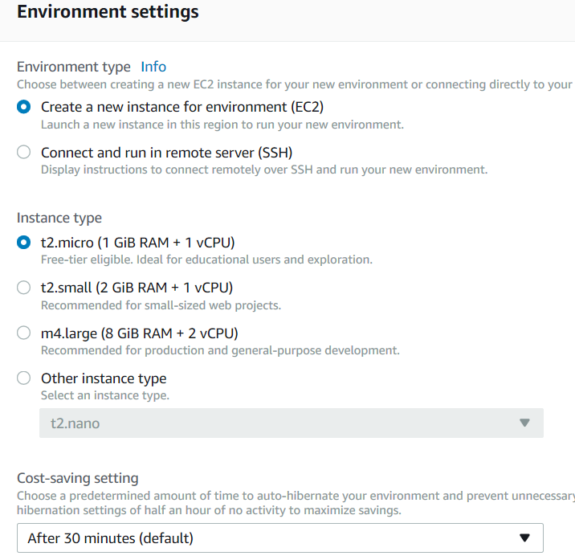

Slide 4
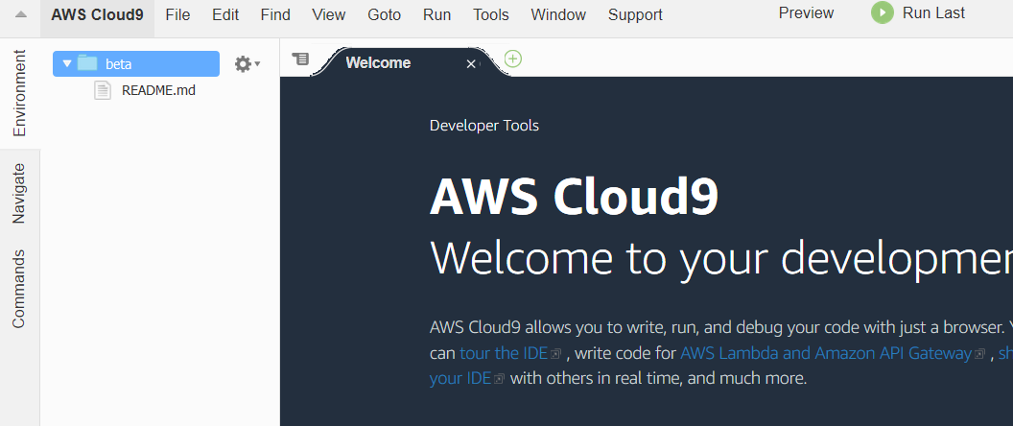

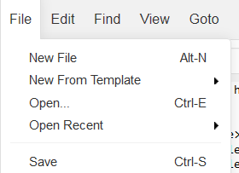
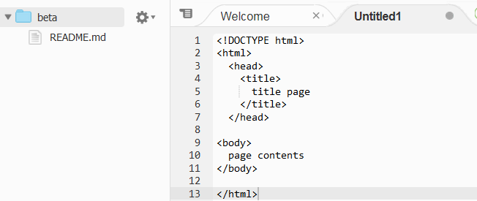
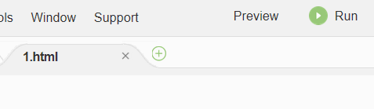
CTRL-S

Slide 5
Structure of HTML Page
<!DOCTYPE html>
<html>
<head>
<title>
title page
</title>
</head>
<body>
page contents
</body>
</html>
an HTML page is saved into a file ending with extension .html
DOCTYPE tag tells browser to interpret our page's code as HTML5, the latest/greatest version of the language

