Slide 1
Irony
“It wasn’t all that long ago that archeologists discovered skeletons inside the stone walls surrounding the city. The bodies of American soldiers captured after a raid in 1803. The authorities quickly said that the men were already dead when walled up, but Gamache wondered. After all, why put bodies into a wall unless it was a grotesque punishment , or to conceal a crime? Since Québec was built on bones and irony, the invading soldiers had become part of the city defenses. Bury Your Dead; p. 83-84

Slide 2
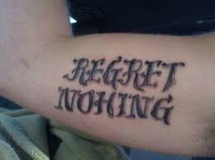
Irony - the use of words to convey a meaning that is opposite its literal meaning - a state of affairs or an event that seems deliberately contrary to what one expects.

Slide 3
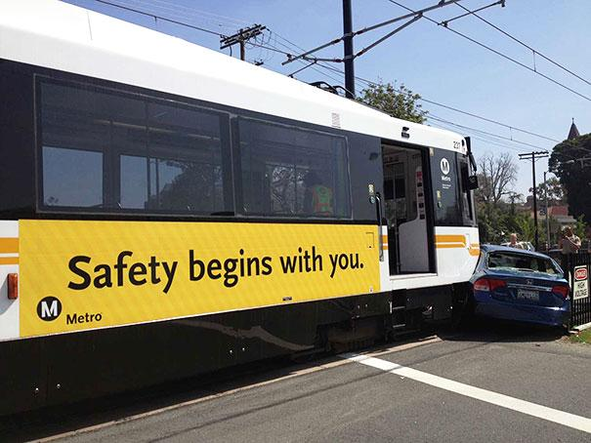

Slide 4
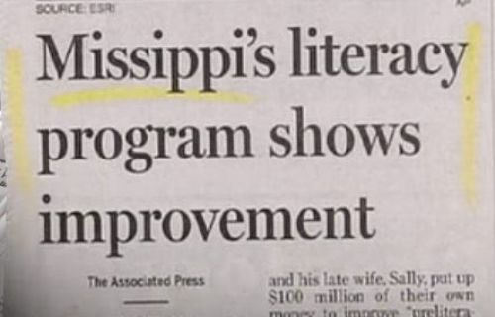

Slide 5
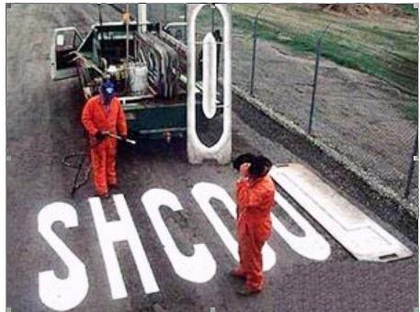

Slide 6
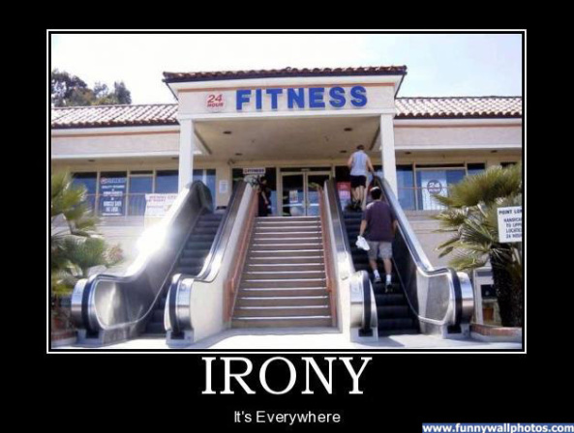

Slide 7
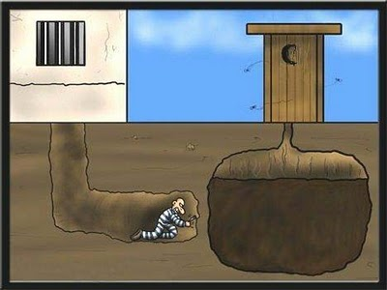

Slide 8
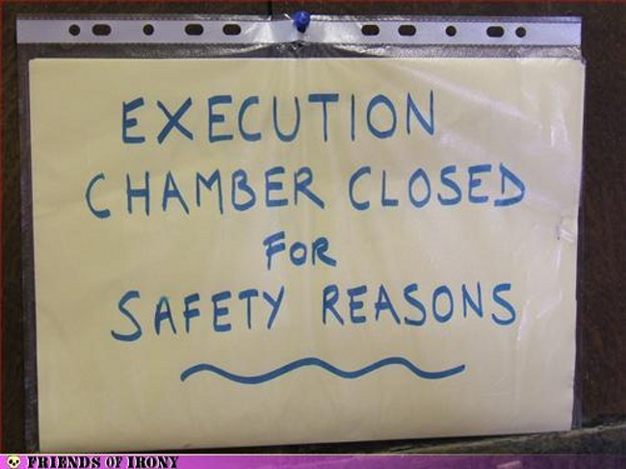

Slide 9
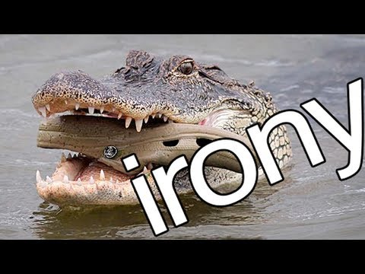

Slide 10
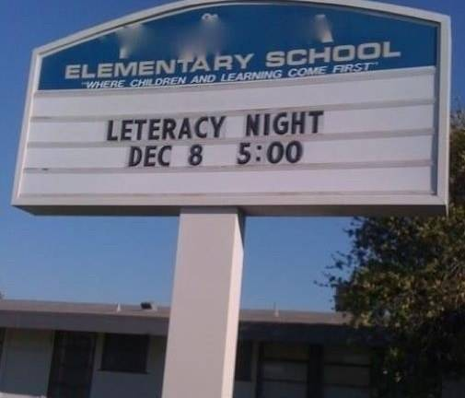

Slide 11
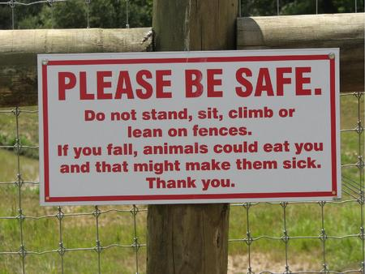

Slide 12
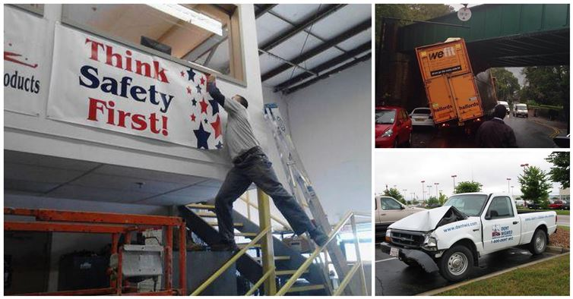

Slide 13
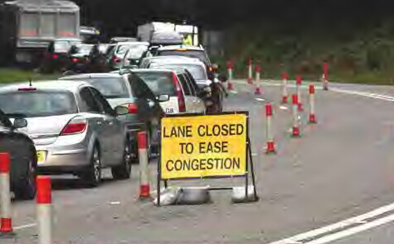

Slide 14
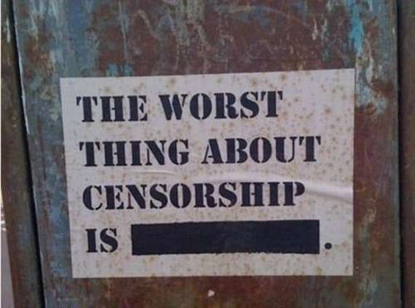

Slide 15
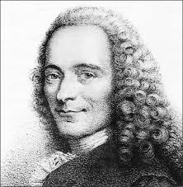
“It is forbidden to kill; therefore all murderers are punished unless they kill in large numbers and to the sound of trumpets.” ― Voltaire

