Slide 1

Understanding Literature

Slide 2


Dual purpose
To entertain
To educate

Slide 3


Entertainment aspect may be obvious
Ideas or values almost always presented in indirect or ‘symbolic’ forms.

Slide 4
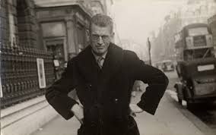
Authors not always fully aware or interested in the ‘message’ of their work.
Samuel Beckett: “It’s bad enough having to write these books without talking about them too.”

Slide 5
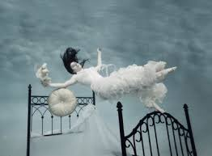
Relation of authors to their works like that of dreamers to dreams.

Slide 6

Dreams convey meaning to the dreamer in puzzling and symbolic ‘safe’ ways
(unclear, ambiguous, concealed).

Slide 7

The intelligent and attentive reader may be better able to understand a text than the person who wrote it.

Slide 8

Authors occupy certain positions within the structure and hierarchies of their societies.

Slide 9

After all, where do we get the word “authority”?

Slide 10

Ideas and values implicit in literature influenced by
History
Culture
Circumstances
Systems of belief
Dominant powers

Slide 11

Understanding literature depends on a solid knowledge and understanding of
History
Language
Culture

Slide 12

Literary texts operate through indirect allusion, understatement, implication…. The truth is often ‘veiled.’

Slide 13
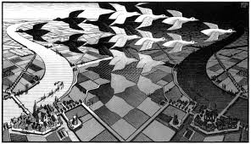
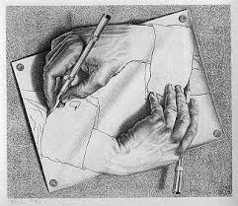
Literary texts often distinguished by intricacies and subtleties of levels of meaning.

Slide 14
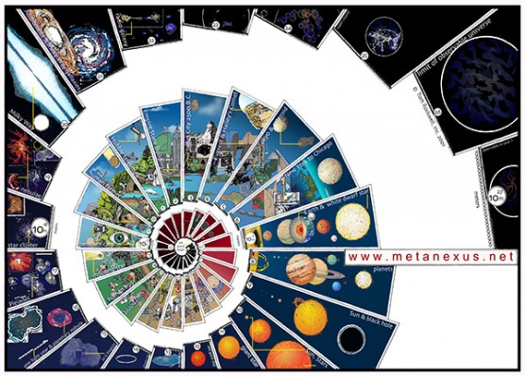
There may be indirect references and invisible chains of associations between sets of images, concepts and ideas…

Slide 15

Becoming a good reader is a lifelong pursuit.

Slide 16
Power point inspired by: http://mockingbird.creighton.edu/english/fajardo/teaching/Miscellan/understand.htm

