Slide 1
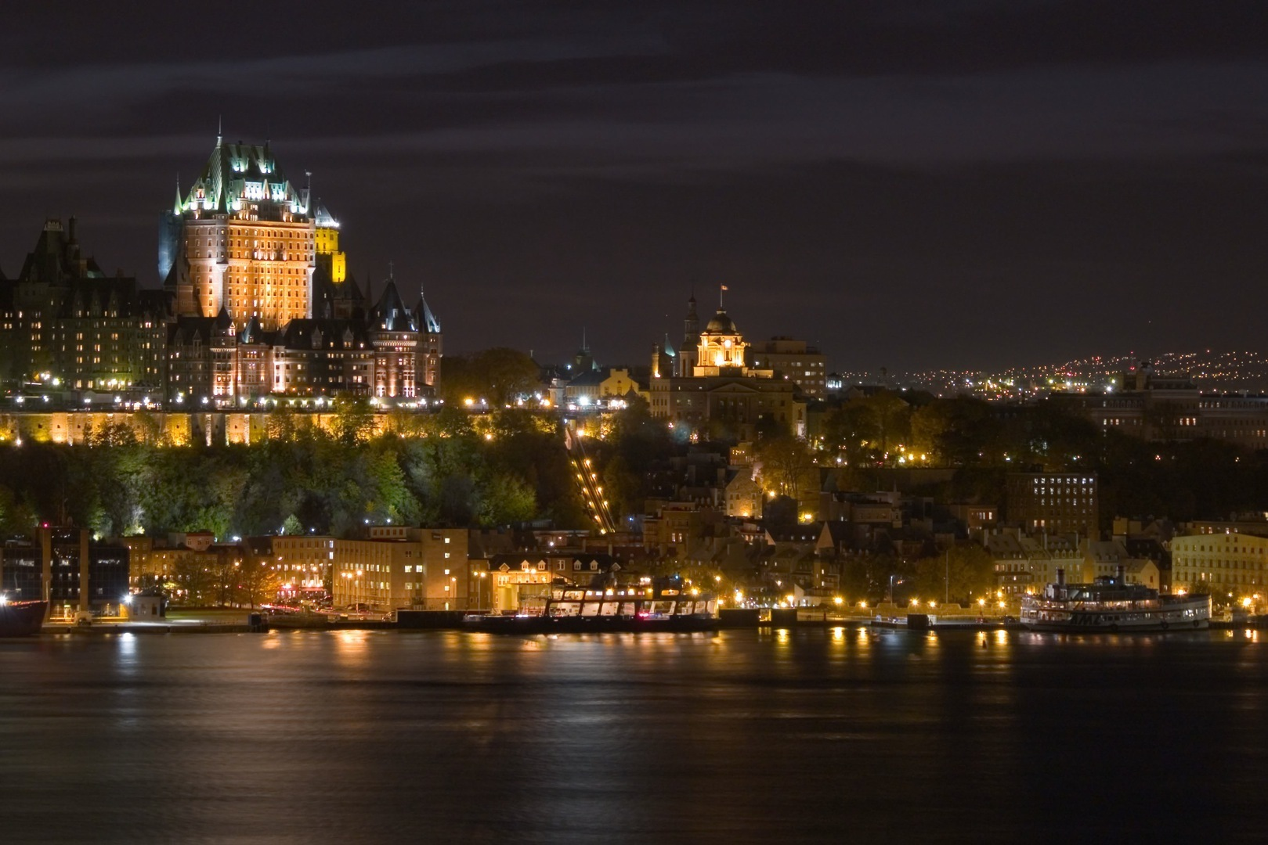
Old Québec City

Slide 2
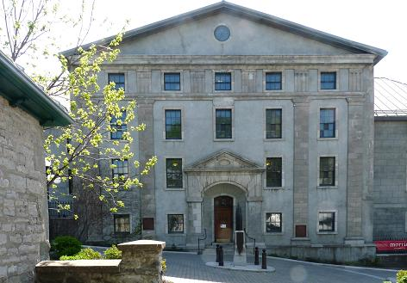
Literary and Historical Society of Québec

Slide 3
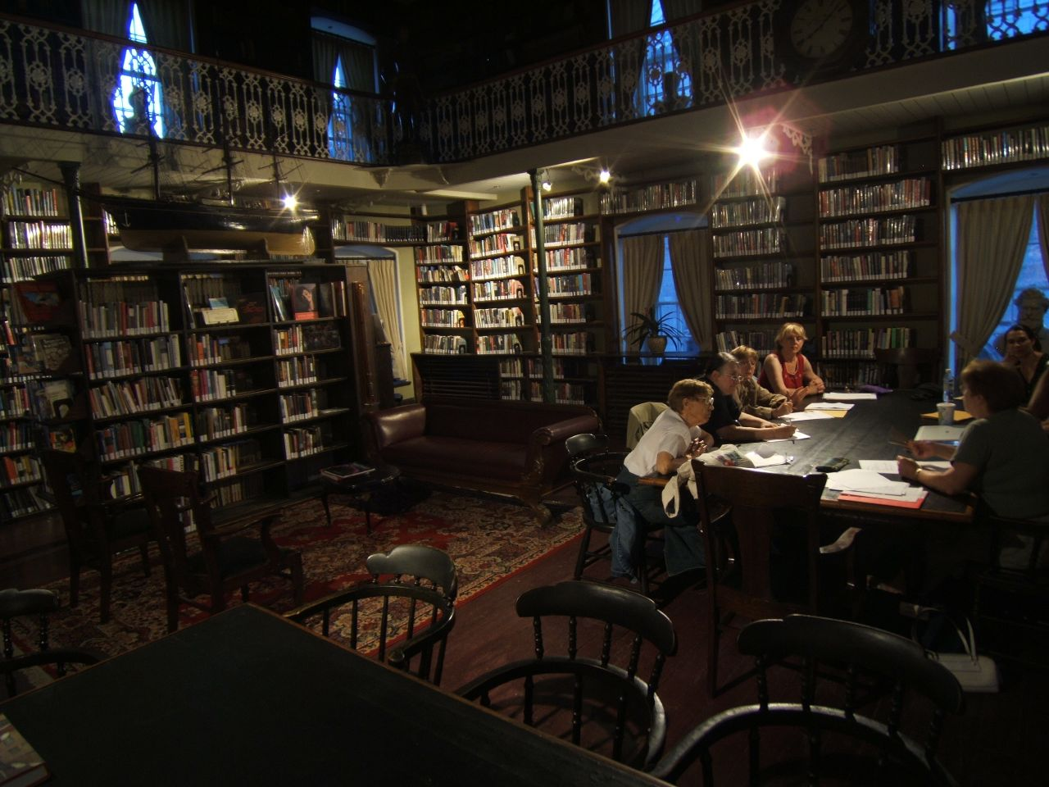

Slide 4
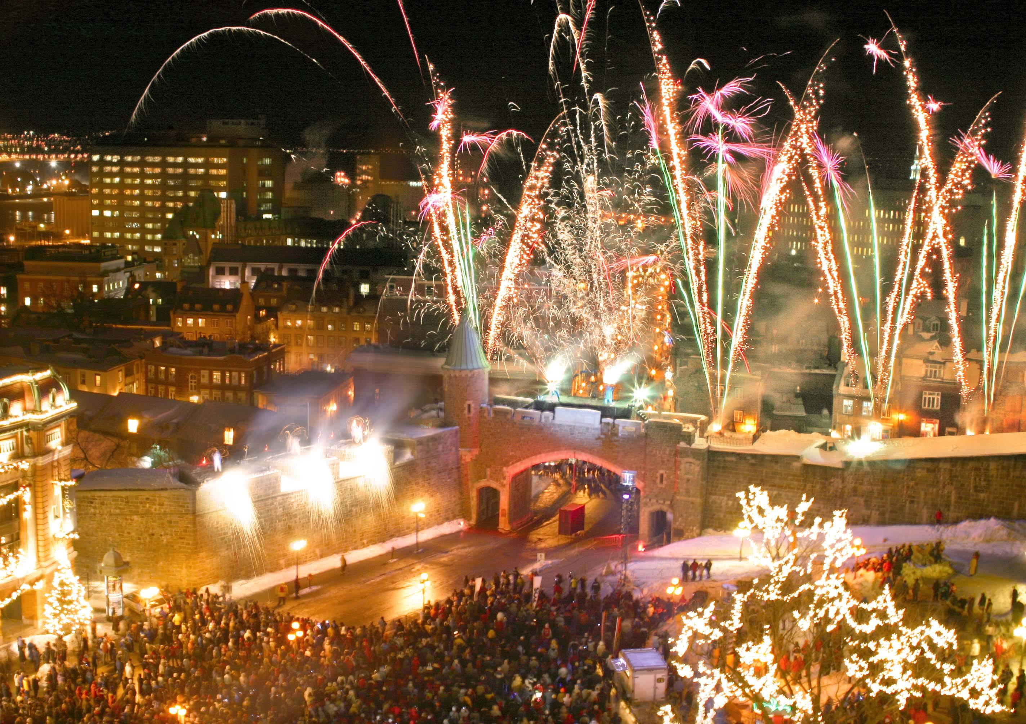
Opening Ceremony of Winter Carnaval

Slide 5
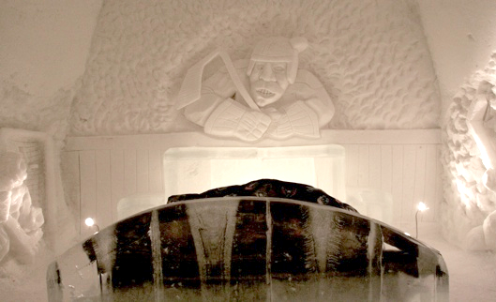
The Ice Hotel in Quebec

Slide 6
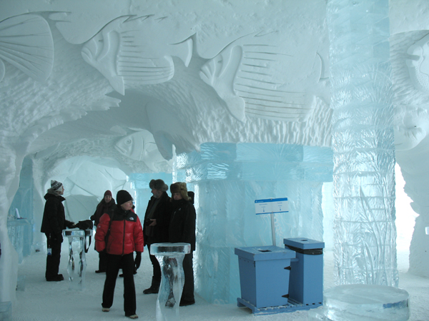
Inside the Ice Hotel

Slide 7
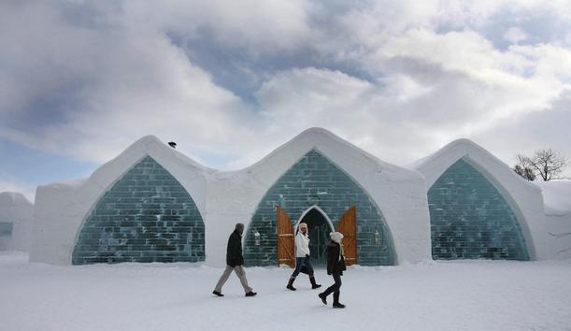
Ice Hotel

Slide 8
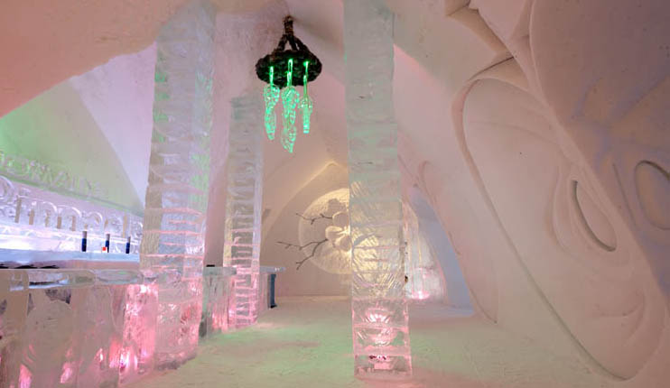

Slide 9
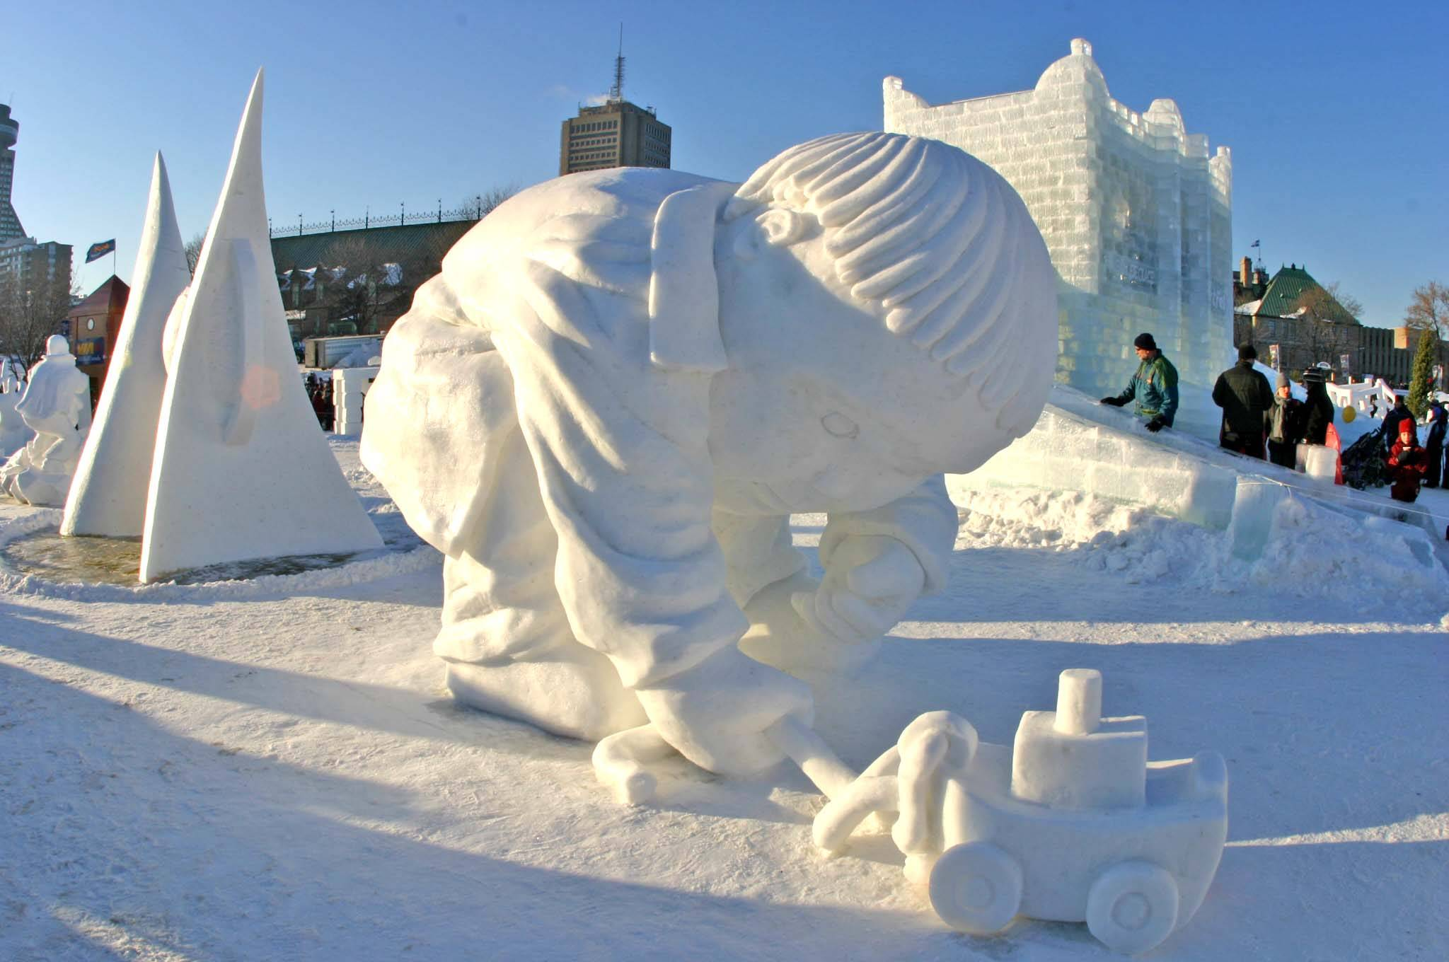
Snow sculpture

Slide 10
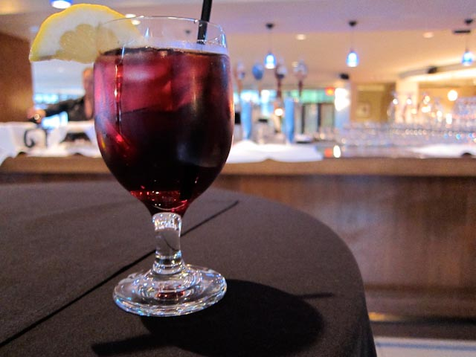
Caribou – red wine or port (75%) and hard liquor (whiskey, brandy or rum) 25%

Slide 11
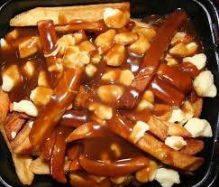
Poutine – “a heart attack in a bowl” – French fries, cheese curds and gravy

Slide 12
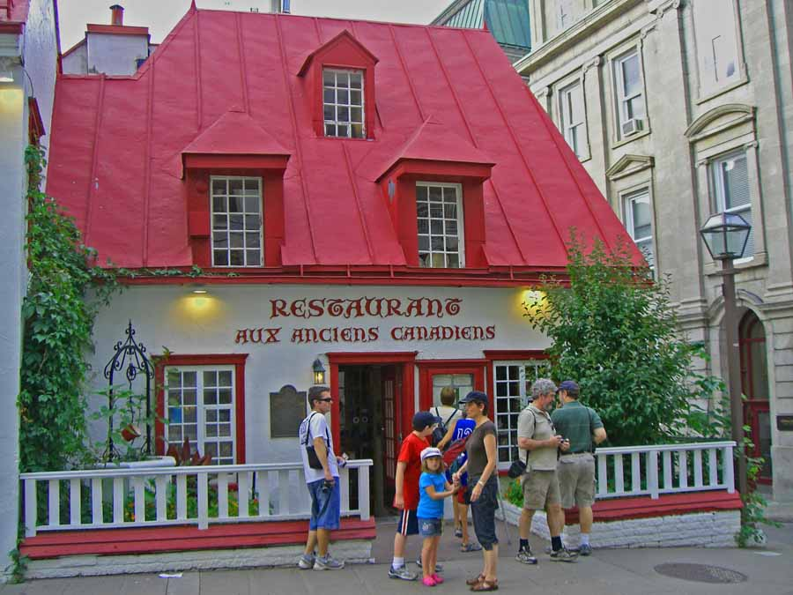
One of the places Gamache and Emile go to eat

Slide 13
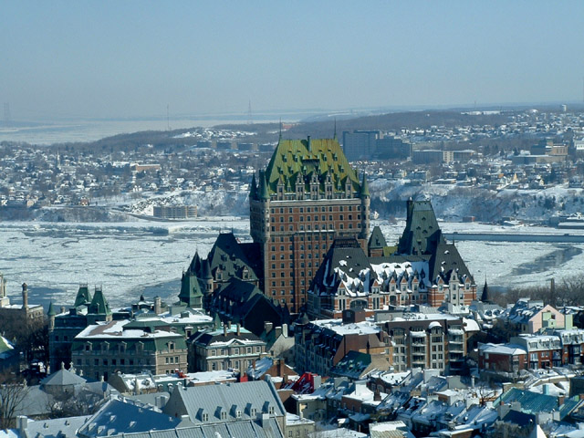
Chateau Frontenac

Slide 14
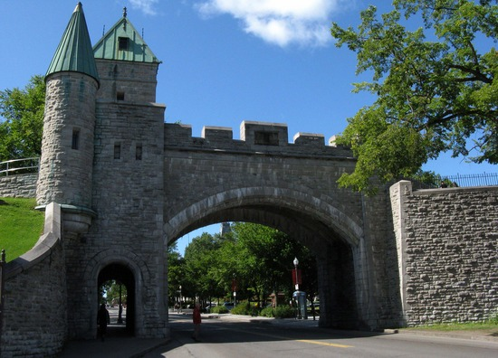
The Walled City of Quebec

Slide 15
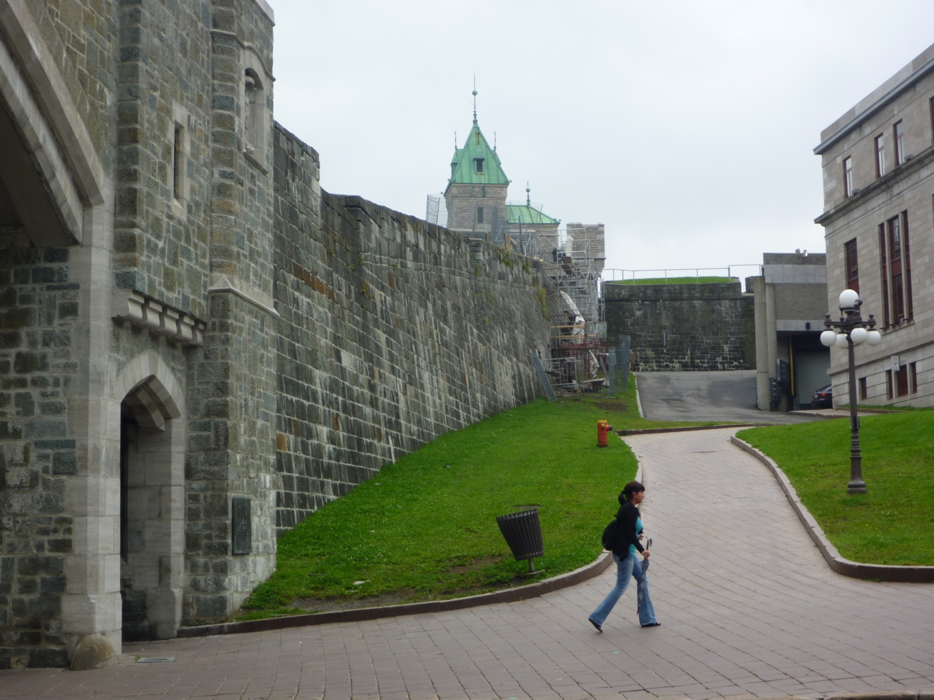

Slide 16
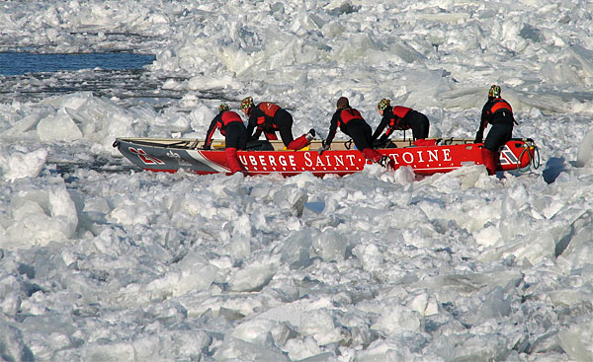
Ice Canoe Race

Slide 17
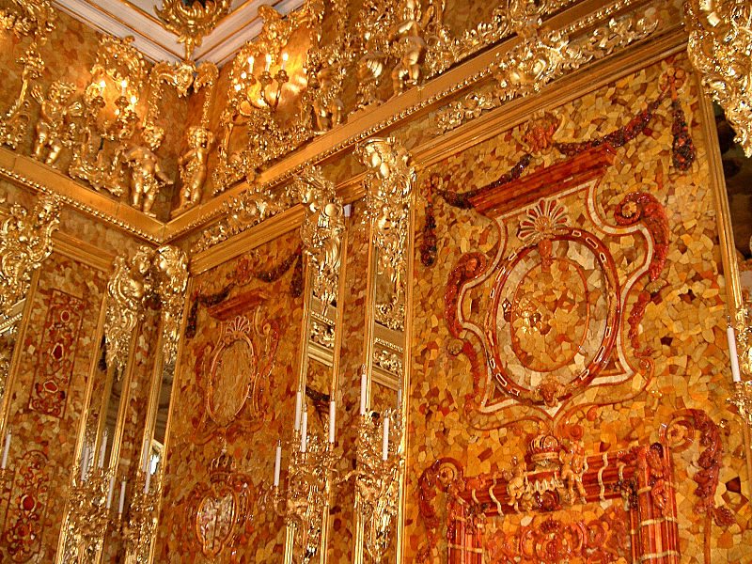
Panels of the Amber Room commissioned in 1701 by Frederick of Prussia

Slide 18
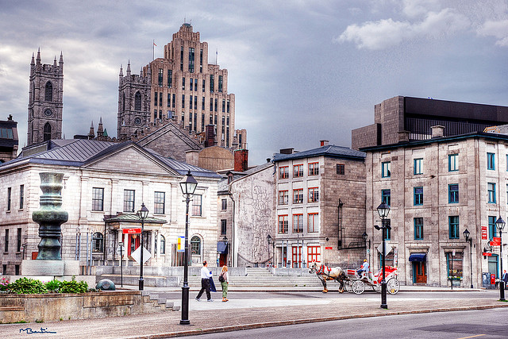
Place d’Youville

Slide 19
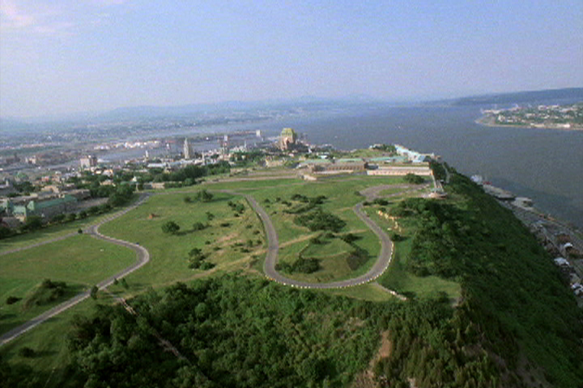
Plains of Abraham

Slide 20
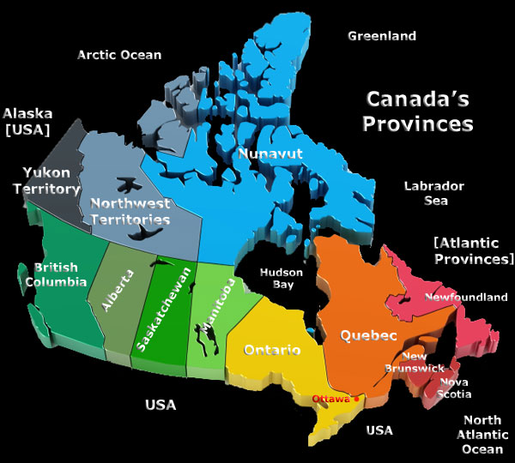
Canada’s Provinces and Territories

Slide 21
