Slide 1

Russian History 1917-1940
By: Colin Morris

Slide 2
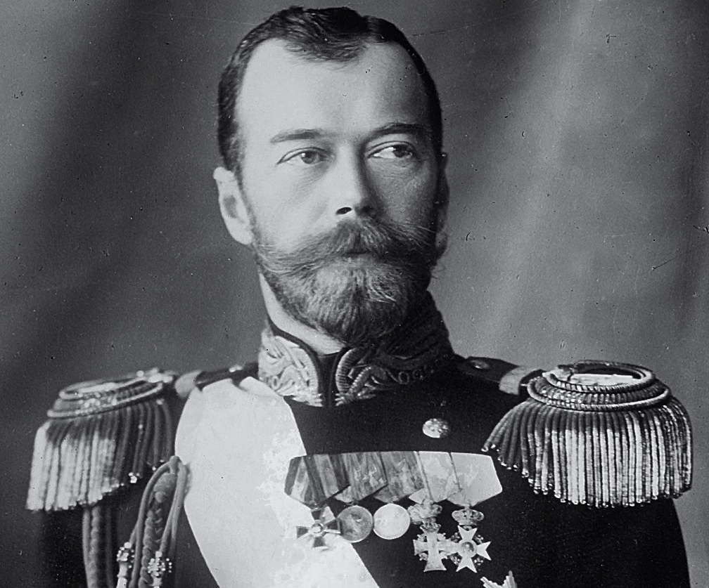
Tsar Nicholas 1894 -1917

Slide 3
Tsar Nicholas
Very unpopular among Russians during the early 20th century because he often made poor decisions or resorted to violence
Bloody Sunday (1905)
Stolypin's Necktie (1905-1911)
Controversy of Rasputin (1906-1917)
Controversy of World War I (1915)
Declared himself commander of military and left the duties of Tsar to his wife (and Rasputin)

Slide 4
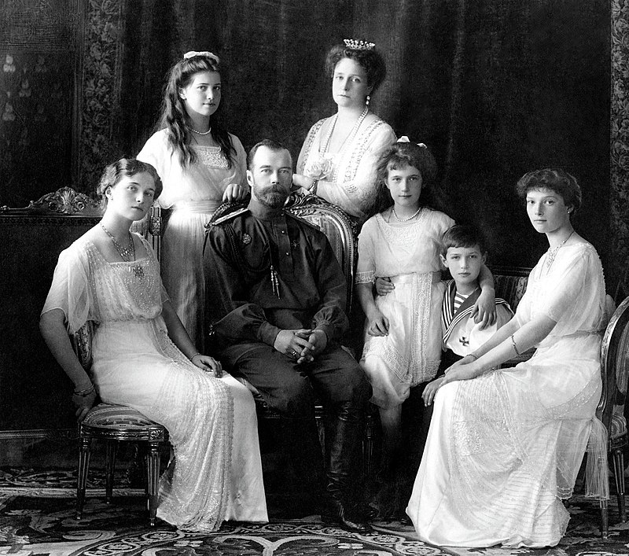
Romanov Family
Execution of family occurred on July 16th, 1918

Slide 5
Bolsheviks and Mensheviks
Bolsheviks (“majority”)
Led by Lenin
More radical
Mensheviks (“minority”)
Worried that Lenin would become a dictator
Less radical

Slide 6
Russian Revolution (1917 - 1923)
Started March 8th, 1917 (known as March Revolution)
Ultimately forced the Tsar to abdicate the throne, ending 300 years of Romanov family rule
Duma (provisional government) and Local Soviets had dual power after abdication
Lenin comes back from exile and was very critical of the new Provisional Government
Lenin promised peace, land, and bread (food) and called for rule by the Local Soviets and getting rid of the Provisional Government
Lenin starting gaining popularity, but Prime Minister of Provisional Government threw him to exile once again

Slide 7
Russian Revolution (1917 - 1923)
Kornilov, the newly appointed Supreme Commander-in-Chief decided to try a military coup d'état
The coup fell apart, but Bolsheviks took this opportunity to obtain power
Bolsheviks took control of key buildings and Lenin is back
Lenin took control and established his cabinet (Sovnarkom)
Social Revolutionaries won election soon after cabinet is established
Lenin claimed that the election was unfair and that the election was counter-revolutionary
Became more of a dictatorship as he repressed and killed people who were not loyal to him or the Bolsheviks
Capital Petrograd is moved to Moscow because of the encroaching Germans

Slide 8
Russian Civil War(1917 - 1923)
Red Army
Fighting for Bolsheviks
Led by Lenin
White Army
Fighting for monarchism, social democracy, and capitalism
Militant Socialists
Many groups that fought against both the Red and White Armies

Slide 9
Russian Civil War(1917 - 1923)
Bolshevik Red Army begins Red Terror, where secret police would kill suspected traitors
Bolsheviks murder the Romanov family
Lenin and Trotsky's Red Army win in the end
USSR established in 1922
Stalin gained power and became leader of Soviet Union after Lenin’s death

Slide 10
Soviet Union and Stalin Era (1922-1991)
Five Year Plans
First Five-Year Plan (1928-1932)
Focused on moving Russia from agricultural economy to industrial economy
Second Five-Year Plan(1933-1937)
Continued plans of first but the collectivization of farms is esatblished
This meant that individual farms would be state-controlled (Sovkhoz) and collectively-controlled (Kolkhoz)
This led to massive famines and social turmoil

Slide 11
Soviet Union and Stalin Era (1922-1991)
Stalin Constitution (1936-1977)
Cemented Stalin’s power before the Great Purge
It did address many concerns and problems of the constitution prior
Great Purge (1936-1938)
Stalin’s plan to repress minorities and opposition
Kulaks (wealthy farmers) who in Lenin and Stalin’s view are in direct competition with the Proletariat (working class)
Many Kulaks were killed, and it is estimated that’s Stalin's actions are responsible for 680,000-1,200,000 deaths

