Slide 1
Customer Churn Analysis | Stage 2
• Data Preparation and Clustering Analysis
• Preprocessed dataset, train/test split, encoding and scaling
• Elbow method, K-Means, cluster visualisation and insights

Slide 2
Stage 2 Objectives
• Prepare reliable data for analysis and modelling
• Handle missing data and categorical variables
• Create training and testing sets
• Apply appropriate scaling
• Identify distinct customer segments with clustering

Slide 3
Dataset and Data Quality
• 7,043 records and 10 columns
• No missing values in the supplied fields
• 1,869 churn cases and 5,174 non-churn cases
• 302 exact duplicate rows identified
• No customer ID was supplied, so duplicates were retained and documented as a limitation

Slide 4
Data Preparation Pipeline
• Categorical variables were one-hot encoded
• Numerical variables were standardised with StandardScaler
• 80% training and 20% testing split
• Split was stratified using the Churn target
• Preprocessing was fitted on training data before transforming test data
• Saved preprocessing pipeline supports reproducibility

Slide 5
Training and Testing Sets
• Training set: 5,634 records
• Testing set: 1,409 records
• Stratification preserves the churn class distribution
• Training data is used for fitting
• Testing data remains separate for later validation

Slide 6
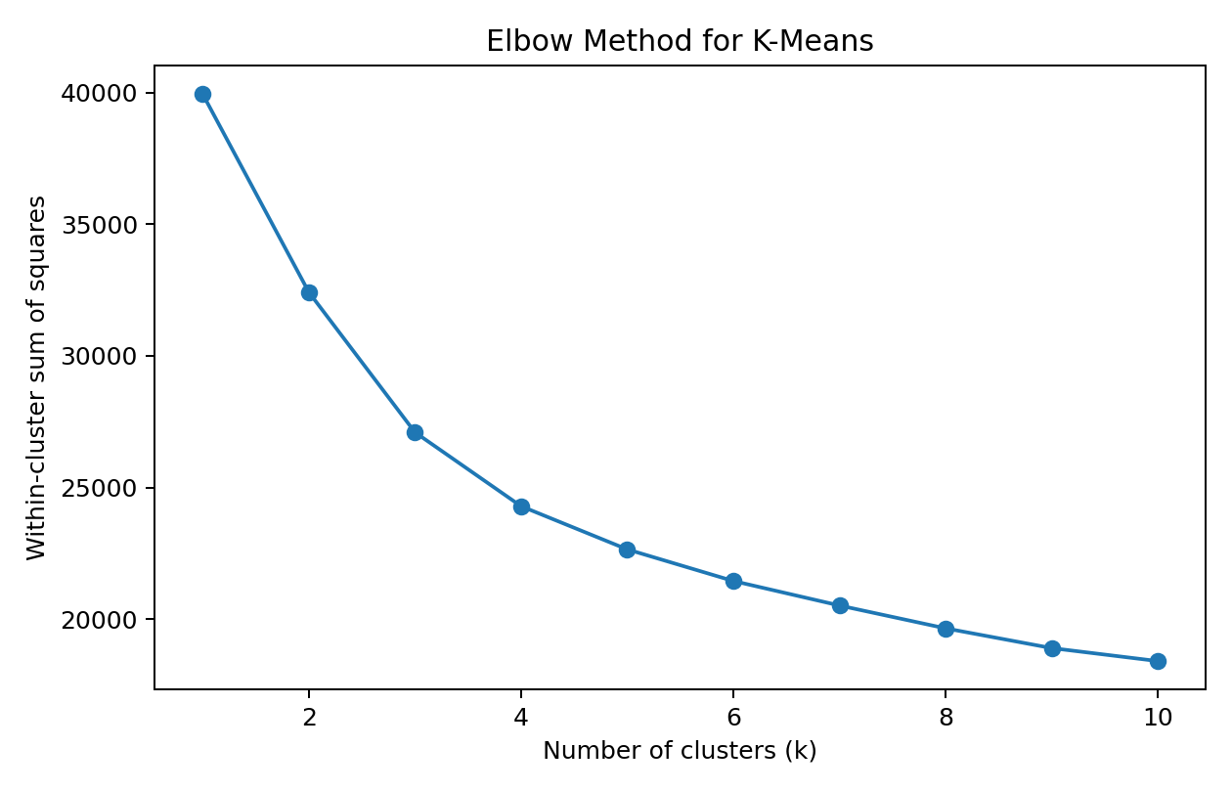
Elbow Method
• Compared K-Means solutions across multiple k values
• Used within-cluster sum of squares
• The practical elbow supported k = 4
• Four clusters were selected for Stage 2

Slide 7
K-Means Clustering
• K-Means trained with k = 4
• Used scaled numerical and one-hot encoded categorical features
• Churn was excluded from model fitting because clustering is unsupervised
• Random state = 42 and n_init = 20 for reproducibility
• Trained model and preprocessing objects were saved

Slide 8
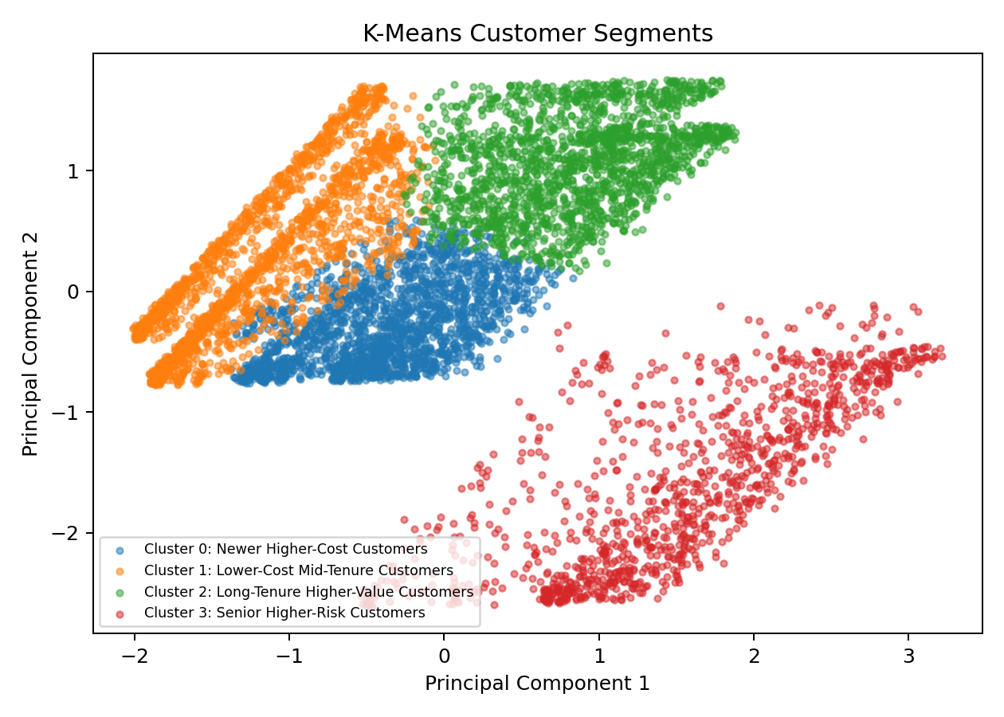
Cluster Visualisation
• PCA was used only to display the segments in two dimensions
• Four customer groups were profiled
• Profiles include tenure, monthly charges, senior citizen rate and observed churn
• Churn was used after clustering for interpretation, not to create the clusters

Slide 9
Customer Segment Labels
• Cluster 0: Newer Higher-Cost Customers
• Cluster 1: Lower-Cost Mid-Tenure Customers
• Cluster 2: Long-Tenure Higher-Value Customers
• Cluster 3: Senior Higher-Risk Customers
• Labels are descriptive, not causal conclusions

Slide 10
Key Findings
• Customer groups differ in tenure, monthly charges and observed churn
• Some segments show higher observed churn and may warrant closer retention analysis
• Long-tenure groups provide a useful comparison with newer groups
• Segments can support later predictive modelling and retention planning

Slide 11
Stage 2 Deliverables Checklist
• ✓ Preprocessed dataset
• ✓ Training and testing sets
• ✓ Scaling and encoding documentation
• ✓ Elbow method and selected cluster count
• ✓ Trained K-Means model
• ✓ Clustered data and profiles
• ✓ Cluster visualisation, labels and interpretation

Slide 12
Next Phase
• Use prepared data for supervised churn predictive modelling
• Evaluate models using held-out testing data
• Compare model performance
• Combine predictive results with customer segments
• Develop evidence-based retention recommendations

Slide 13
Thank You
• Customer Churn Analysis | Stage 2
• Data Preparation and Clustering
• Jira is used to track project progress and next actions

