Slide 1





PROJECT NAME
Team : Sumit Pawar Guide: Mr.Aditya Dhambale
(sumitp2608@gmail.com)
Disclaimer: The content is curated for educational purposes only.
Notes:
Slides: Prepare a short slide deck (10-12 slides) summarizing the project objectives, methodology, and key results.

Slide 2
OUTLINE
Problem Statement
Live Demo of the Project
Conclusion

Slide 3
Problem Statement
The bike sales and resale market in India is influenced by various factors such as brand popularity, engine capacity, and seasonal trends. However, buyers and sellers often lack clear insights into which brands retain their value, which months yield higher resale prices, and how engine specifications affect resale value. This lack of data-driven decision-making can lead to suboptimal pricing strategies and missed opportunities for both consumers and dealers.

Slide 4
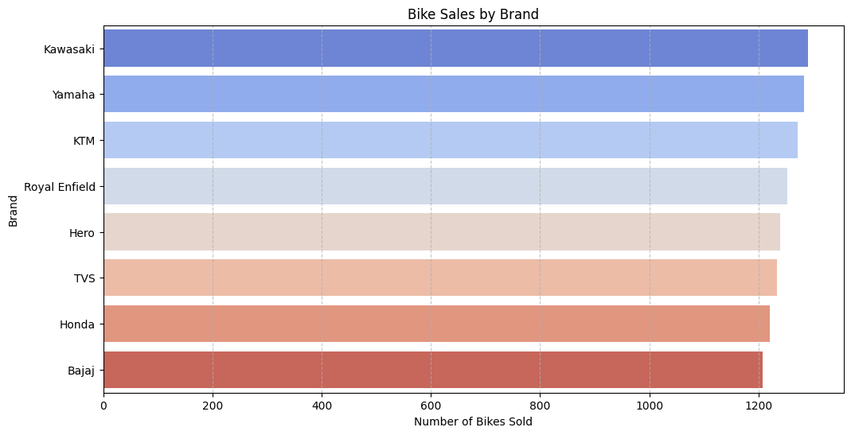
Live Demo of Project
This bar chart represents Bike Sales by Brand. The horizontal bars indicate the number of bikes sold for each brand, with Bajaj having the highest sales, followed by Honda, TVS, Hero, and Royal Enfield. The colors range from warm (high sales) to cool (low sales), making it easier to identify top-selling and less popular brands.

Slide 5
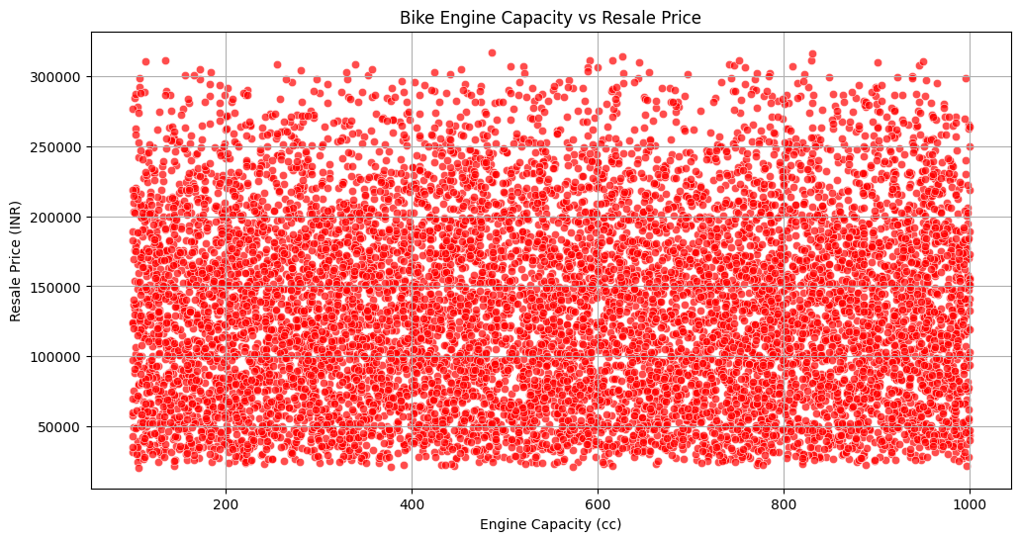
Live Demo of Project
This bar chart represents Bike Sales by Brand. The horizontal bars indicate the number of bikes sold for each brand, with Bajaj having the highest sales, followed by Honda, TVS, Hero, and Royal Enfield. The colors range from warm (high sales) to cool (low sales), making it easier to identify top-selling and less popular brands.

Slide 6

Live Demo of Project
This bar chart displays the Sales Distribution by Brand, showing the number of bikes sold for different brands. Bajaj has the highest sales, followed by Honda, TVS, and Hero, while Kawasaki has the lowest. The color gradient helps visualize the sales trend, with warmer colors representing higher sales and cooler colors representing lower sales.

Slide 7
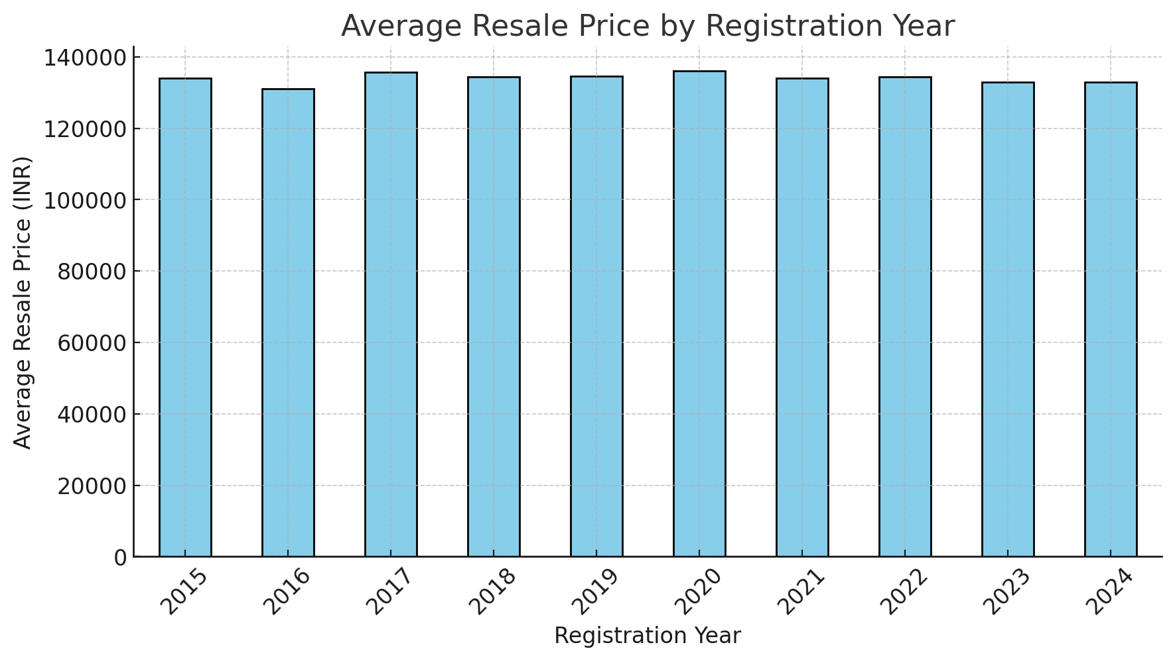
Live Demo of Project
This bar chart data on bike sales and resale prices. The bar chart shows stable average resale prices (around 130,000–140,000 INR) over the years. The scatter plot illustrates resale prices across different engine capacities, showing a wide distribution. The text highlights brand-wise sales, with Bajaj leading, followed by Honda, TVS, Hero, and Royal Enfield. Warmer colors indicate higher sales, while cooler colors represent lower sales. These visuals offer insights into market trends, resale values, and brand popularity.

Slide 8
Conclusion
This project analyzes bike sales trends, resale prices, and engine capacities in the Indian market. Bajaj leads in sales, followed by Honda, TVS, Hero, and Royal Enfield. Resale prices remain stable over the years, while engine capacity shows no direct correlation with resale value. Seasonal trends can help buyers and sellers make informed decisions. These insights provide a data-driven approach to understanding market dynamics, benefiting manufacturers, dealers, and consumers.

Slide 9
Github Link

Slide 10
Thank you!
Notes:
thank you very much for joining this PPT, keep learning.
10

