Slide 1
CURALENS Domain Name : Health Care Technology Problem Statement : Simplifying Medical Lab Reports Team ID : KGH216 Team Name : TECH TITANS
See Your Health Clearly with AI

Slide 2
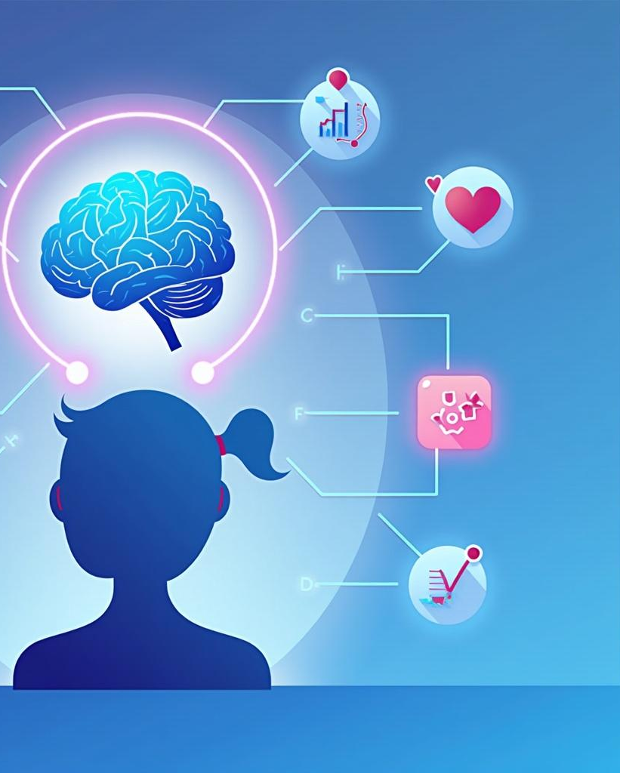
Problem Statement
1 .What problem are you solving?
Many patients cannot understand laboratory reports because they contain complex medical terms and values.
2.Who is affected?
Patients and junior healthcare professionals who need quick interpretation of lab results.
3.Why is this problem important?
Misunderstanding reports can cause anxiety, confusion, and incorrect health decisions..

Slide 3

Proposed Solution
CURALENS is an AI-powered system that reads laboratory reports, analyzes the test values, and explains the results in simple language.
What makes it unique?
It uses OCR and AI to automatically interpret lab reports and provide easy-to-understand health insights.
How it solves the problem?
It helps users quickly understand their medical results, reduces confusion, and improves health awareness.

Slide 4
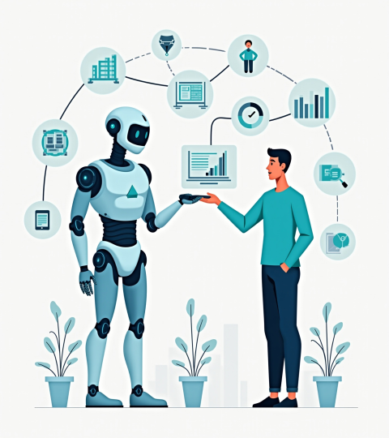
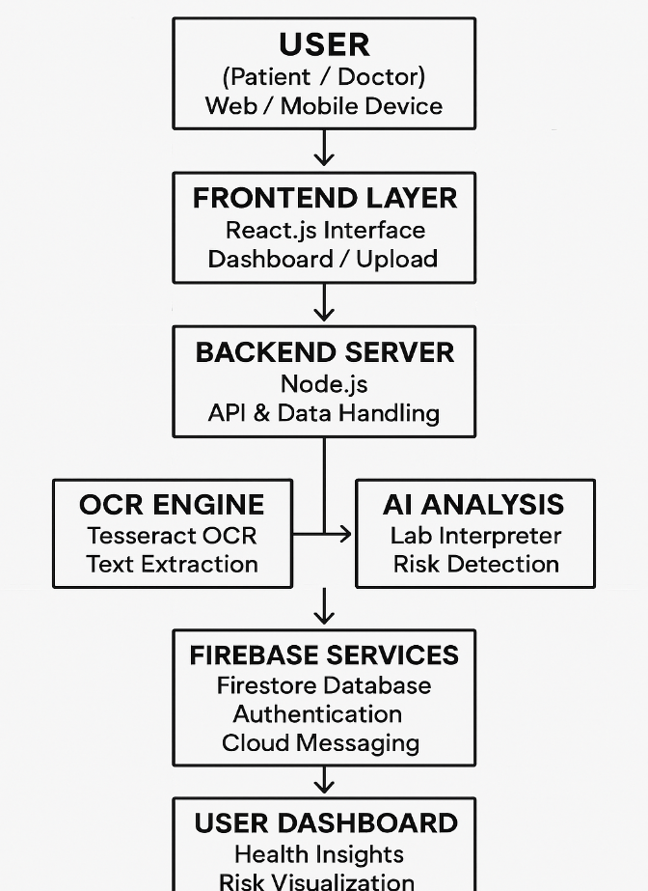
SYSTEM ARCHITECTURE :

Slide 5
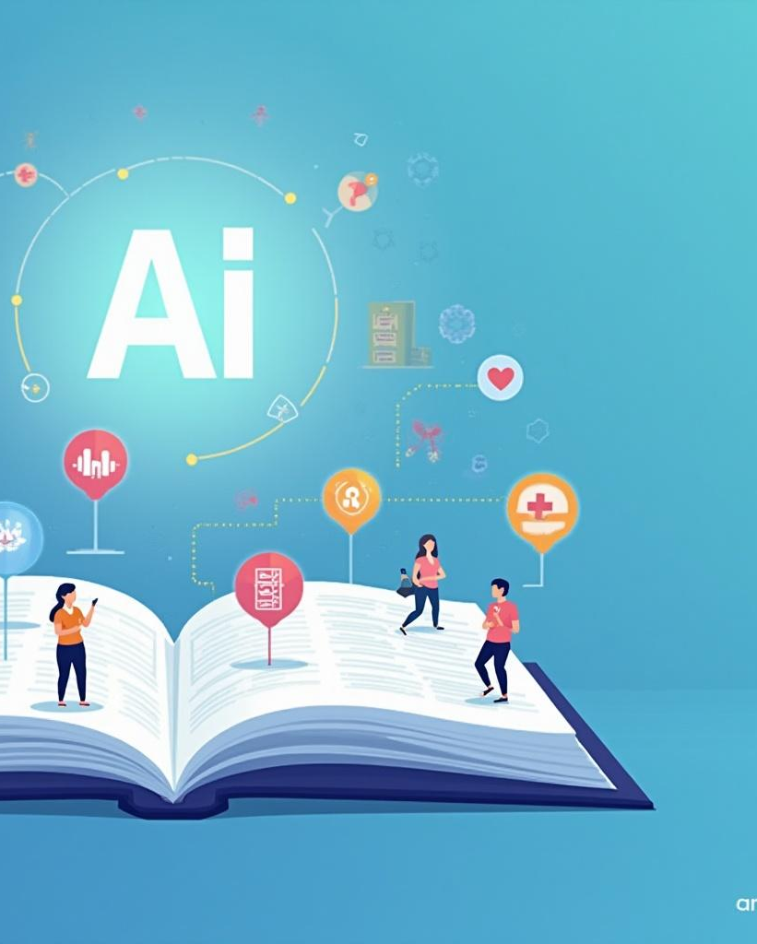
SYSTEM FLOW / WORKFLOW
The system works in the following steps:
User Input: User logs in and uploads a laboratory report (PDF or image).
Processing: OCR extracts the text → System detects lab test values → AI analyzes the values and compares them with reference ranges.
Output / Result : The system shows simplified explanations, risk levels, and health insights on the dashboard.

Slide 6

USER INTERACTION / ACTORS
Users (Patients):Upload lab reports, view AI analysis, and ask questions through the AI assistant.
Junior Healthcare Professionals:Use the system to quickly interpret laboratory results.
Devices:Users access the system through computers or mobile devices.
External Systems:Firebase services manage authentication, database storage, and notifications.Presentation Structure

Slide 7
DATA / COMPONENT DESIGN
Database Structure:
Data is stored in Firebase Firestore with collections like Users, Reports, and LabResults.
Data Flow:
User uploads report → OCR extracts text → System detects test values → AI analyzes results → Data stored in database → Results shown on dashboard.
Module Interactions:
Frontend sends report to backend → OCR processes the report → AI engine analyzes values → Results are saved and displayed to the user.

Slide 8
THANK YOU

