Slide 1



CP2
KREATIVE GENESIS 2026
PROBLEM STATEMENT TITLE
Domain Name : Health Care Technology Problem Statement : Simplifying Medical Lab Reports Team ID : KGH216 Team Name : TECH TITANS

Slide 2

CP2
Problem Overview
Brief description of the problem :
Many patients find it difficult to understand laboratory test reports because they contain complex medical terms and numerical values. This often leads to confusion and anxiety about their health condition.
Target users or beneficiaries :
Patients, individuals without medical knowledge, and junior healthcare professionals who need quick and simple interpretation of lab reports.

Slide 3
CP2
Solution Overview
Short Explanation:
CURALENS is an AI-assisted laboratory report interpretation system that helps doctors quickly analyze lab reports and generate simplified explanations for patients. The system processes laboratory reports, extracts medical values, and provides insights based on verified medical datasets.
Key Features:
Automatic lab report reading using OCR
AI-assisted analysis of lab values
Doctor verification of medical insights
Structured medical datasets for accurate analysis
Clear explanations that doctors can share with patients

Slide 4
CP2
Prototype Overview
The current prototype of CURALENS demonstrates the basic workflow of the system for analyzing laboratory reports with doctor-supported verification.
Application Interface:
The prototype includes the main UI screens such as the dashboard, report upload page, and AI analysis page where users can upload reports and view interpreted results.
System Modules Implemented:
Report upload module OCR module to extract text from lab reports AI analysis module to compare values with medical datasets Dashboard to display results and insights Medical Dataset
Integration:
The system uses structured medical datasets for lab test reference ranges, which can be reviewed and verified by doctors to ensure accuracy

Slide 5
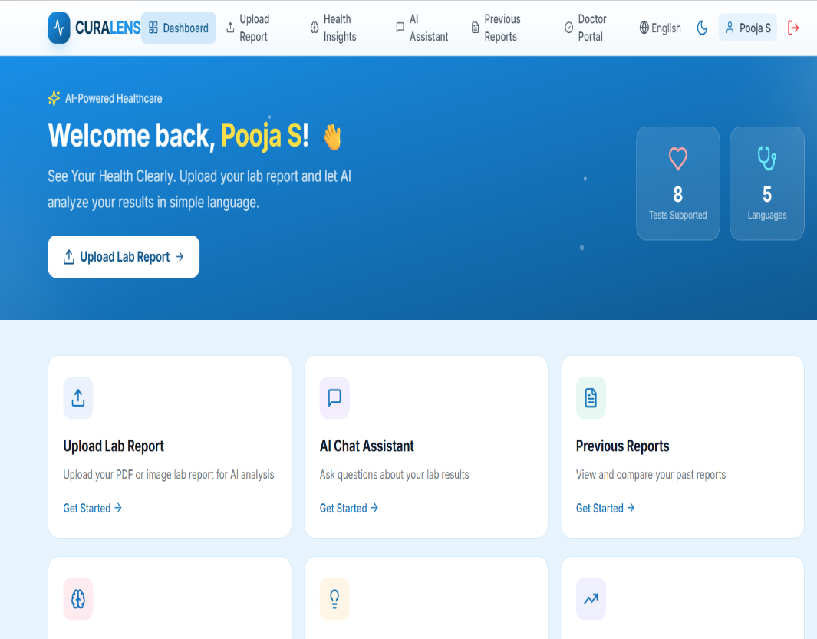
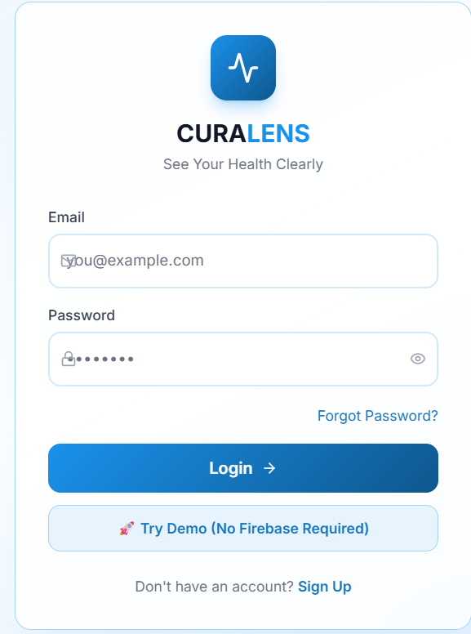
CP2
Prototype Demonstration
The current prototype of CURALENS shows the progress of the system in analyzing laboratory reports.
Screenshots of the Application:
The prototype includes UI screens such as the dashboard, report upload page, and analysis page where users can view interpreted results.
Working Modules:
Report upload module
OCR text extraction module
AI analysis module
Dashboard for displaying results
Interaction Between Components:
User uploads a report → OCR extracts lab values → AI compares values with medical datasets → results are displayed on the dashboard and reviewed by doctors.

Slide 6
CP2
System Workflow
The system works in the following steps:
User Input:
User logs in and uploads a laboratory report (PDF or image).
Processing:
OCR extracts the text → System detects lab test values → AI analyzes the values and compares them with reference ranges.
Output / Result:
The system shows simplified explanations, risk levels, and health insights on the dashboard.

Slide 7
CP2
Progress So Far
Since the first checkpoint presentation, we have started implementing the CURALENS application.
UI Development:
The user interface design has been developed, including the login page and main application dashboard.
Authentication Setup:
A basic login system has been implemented to allow users to securely access the application.
Application Interface:
The main application page has been created where users can interact with the system and access features such as report upload and analysis.
Initial Module Setup:
The foundation for integrating modules like OCR processing and AI analysis has been prepared for further development.

Slide 8
CP2
Next Steps
Before the final checkpoint, the following tasks need to be completed:
Feature Implementation:
Implement core features such as lab report upload, OCR text extraction, AI analysis, and health insights generation.
Integration Improvement:
Integrate all modules including the frontend, backend, OCR engine, and database for smooth system operation.
Testing and Optimization:
Test the system for accuracy and performance, and optimize the application for better reliability and user experience.

