Slide 1



KREATIVE GENESIS 2026
CP3
PROBLEM STATEMENT TITLE
Domain Name : Health Care Technology Problem Statement : Simplifying Medical Lab Reports Team ID : KGH216 Team Name : TECH TITANS

Slide 2

CP3
Problem Overview
Brief description of the problem :
Many patients find it difficult to understand laboratory test reports because they contain complex medical terms and numerical values. This often leads to confusion and anxiety about their health condition.
Target users or beneficiaries :
Patients, individuals without medical knowledge, and junior healthcare professionals who need quick and simple interpretation of lab reports.

Slide 3
CP3
Solution Overview
Short Explanation:
CURALENS is an AI-assisted laboratory report interpretation system that helps doctors quickly analyze lab reports and generate simplified explanations for patients. The system processes laboratory reports, extracts medical values, and provides insights based on verified medical datasets.
Key Features:
Automatic lab report reading using OCR
AI-assisted analysis of lab values
Doctor verification of medical insights
Structured medical datasets for accurate analysis
Clear explanations that doctors can share with patients

Slide 4
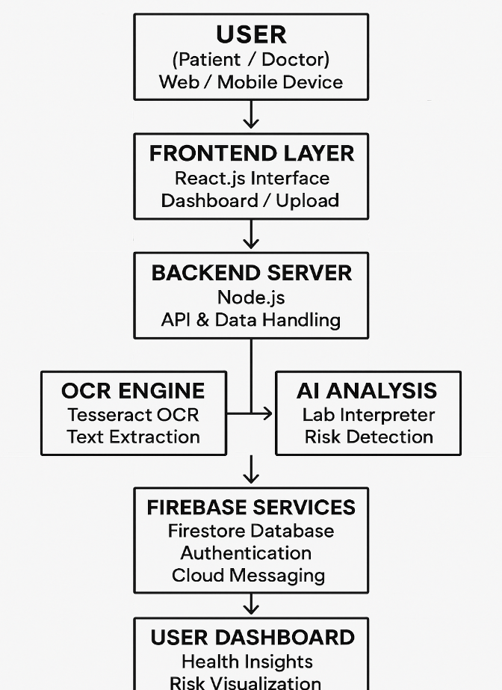
CP3
System Architecture :

Slide 5
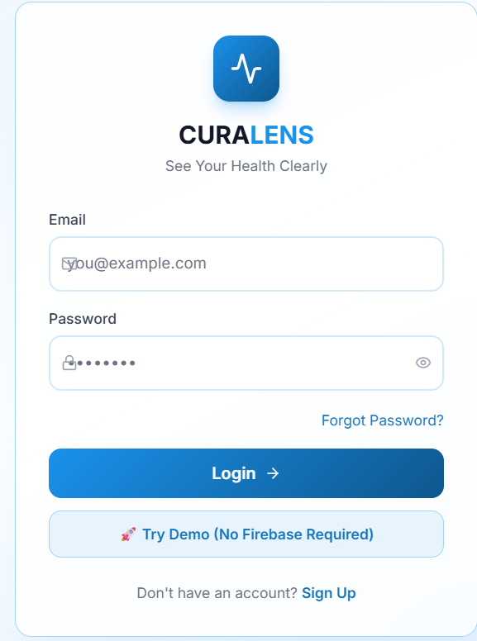
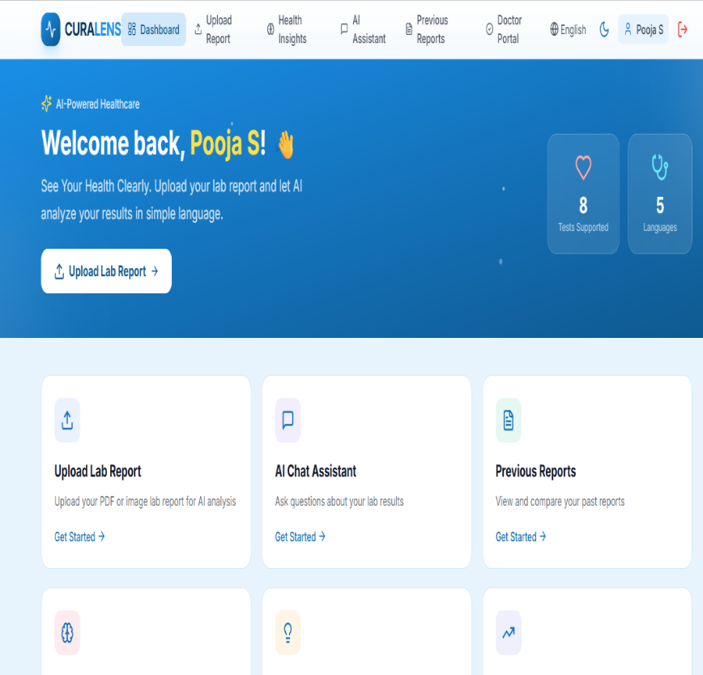
Prototype Demonstration
The current prototype of CURALENS shows the progress of the system in analyzing laboratory reports.
Screenshots of the Application:
The prototype includes UI screens such as the dashboard, report upload page, and analysis page where users can view interpreted results.
Working Modules:
Report upload module
OCR text extraction module
AI analysis module
Dashboard for displaying results
Interaction Between Components:
User uploads a report → OCR extracts lab values → AI compares values with medical datasets → results are displayed on the dashboard and reviewed by doctors.

Slide 6
CP3
System Workflow
The system works in the following steps:
User Input:
User logs in and uploads a laboratory report (PDF or image).
Processing:
OCR extracts the text → System detects lab test values → AI analyzes the values and compares them with reference ranges.
Output / Result:
The system shows simplified explanations, risk levels, and health insights on the dashboard.
Explain the current working flow of the prototype.
Example:
Input → Processing → Output

Slide 7
Progress So Far
Since the first checkpoint presentation, we have started implementing the CURALENS application.
UI Development:
Designed the user interface including the login page and main dashboard.
Authentication Setup:
Implemented a basic login system for secure user access.
Application Interface:
Created the main page where users can upload and analyze lab reports.
Initial Module Setup:
Prepared the base for OCR processing and AI analysis integration.
Feature Planning:
Planned core features such as report upload, OCR text extraction, AI analysis, and health insight generation.
Integration Preparation:
Started preparing integration between frontend, backend, OCR engine, and database.
Testing Plan:
Initial testing and optimization steps have been planned to improve system accuracy and performance.
CP3

Slide 8

Key Achievements
Feature Implementation
AI-based laboratory report analysis module developed
secure login and application dashboard implemented
Medical dataset-based report interpretation system created
Accuracy & Reliability
System designed to analyse actual medical dataset values instead of giving generic AI predictions
Reduces incorrect interpretations that may occur in general AI responses
Provides more precise and structured analysis of lab report values
Doctor-Supported Validation
Results can be verified and validated by medical professionals
Designed as a doctor-assisted AI system, not a fully automated prediction tool
System Capability
Helps users understand complex laboratory reports easily
Improves reliability of health report interpretation compared to general AI tools

Slide 9
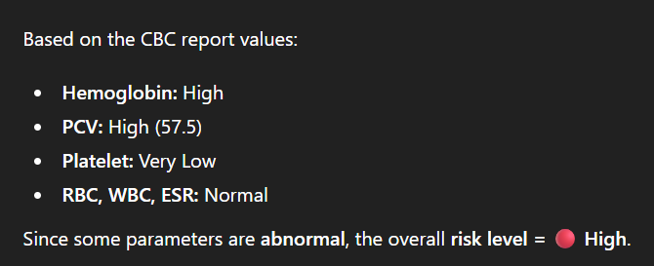
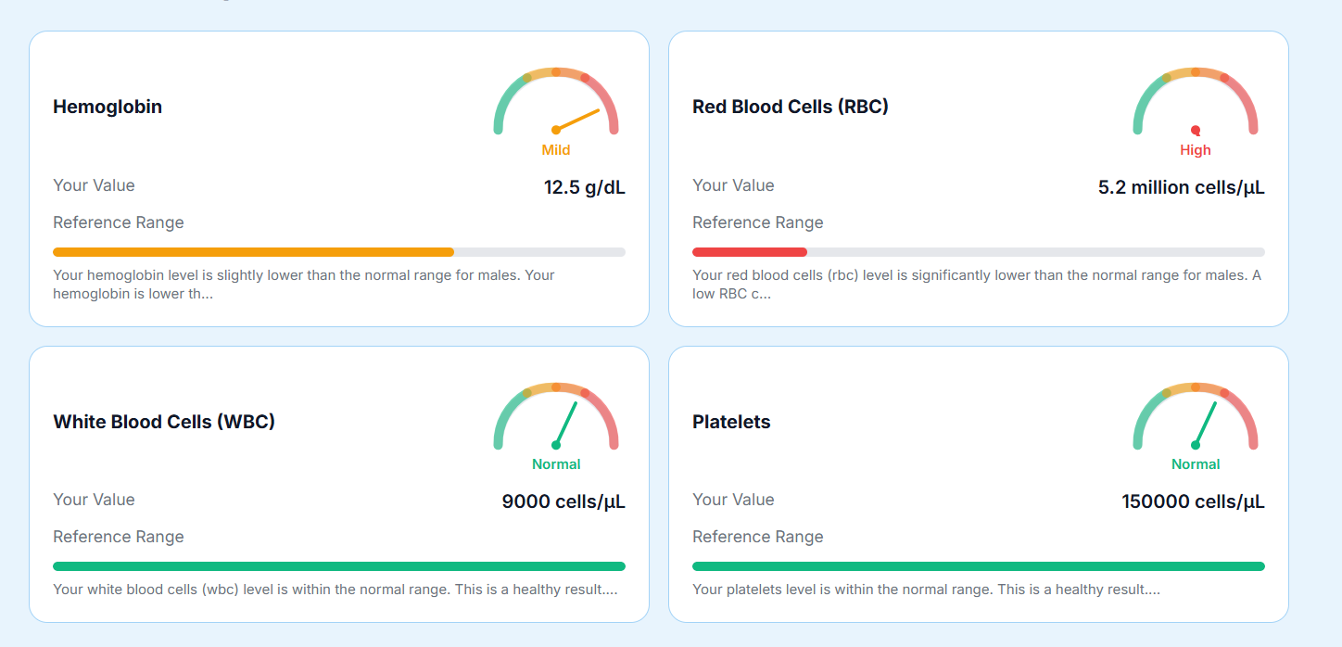

Slide 10

Thank you

