Slide 1



sales
View in Power BI
Last data refresh:
8/16/2023 5:02:03 PM UTC
Downloaded at:
8/16/2023 5:02:55 PM UTC

Slide 2
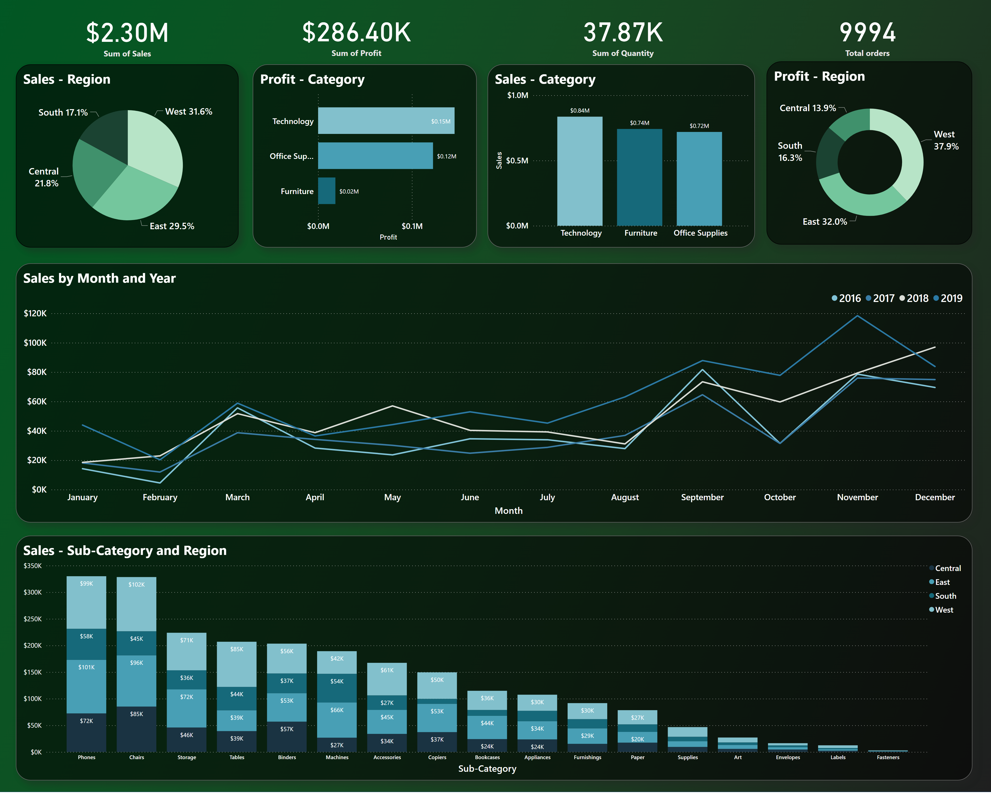
1
Notes:
Sales - Region
No alt text provided
Sales - Category
No alt text provided
Sales - Sub-Category and Region
No alt text provided
Profit - Category
No alt text provided
Profit - Region
No alt text provided
card
No alt text provided
card
No alt text provided
card
No alt text provided
Sales by Month and Year
No alt text provided
card
No alt text provided

Slide 3
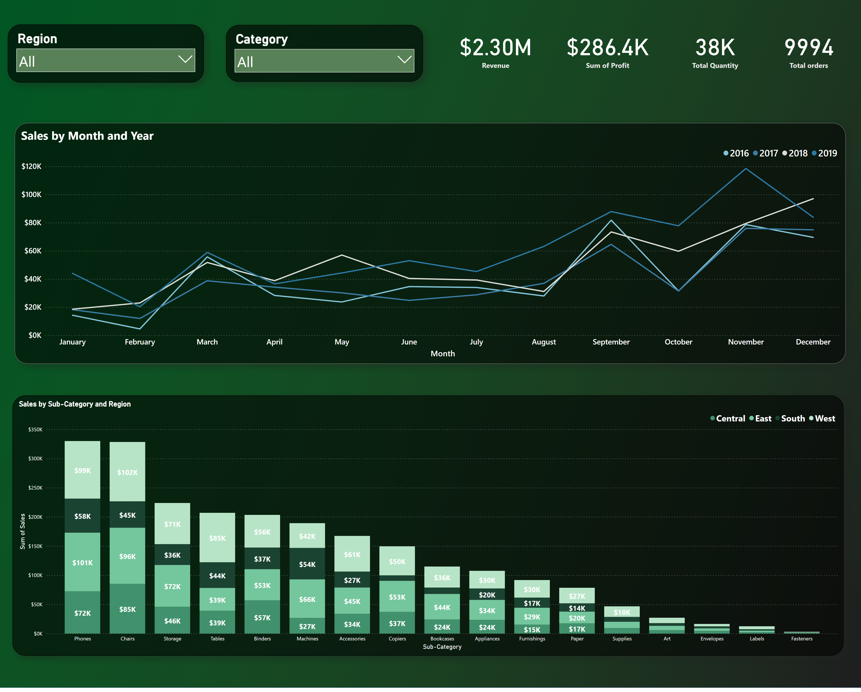
2
Notes:
Sales by Sub-Category and Region
No alt text provided
card
No alt text provided
card
No alt text provided
card
No alt text provided
card
No alt text provided
slicer
No alt text provided
slicer
No alt text provided
Sales by Month and Year
No alt text provided

